Slide 1
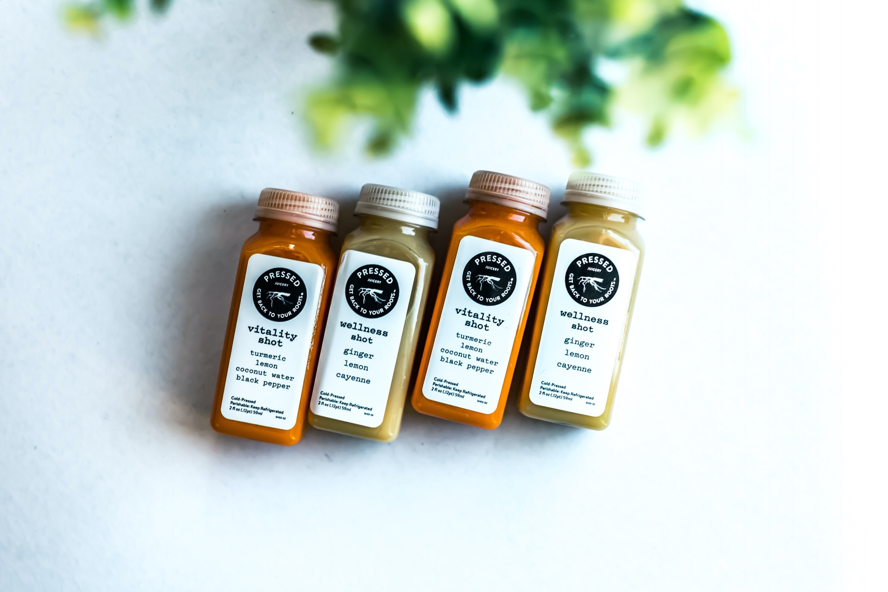
Cross-Lingual Zero Shot Transfer
Jayveersinh Raj | Makar Shevchenko | Nikolay Pavlenko

Slide 2
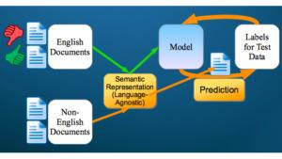
Cross-Lingual NLP is
Focus on developing models capable of processing data in multiple languages
Extremely relevant in globalised and interconnected business environment
Applications: machine translation, cross-lingual information retrieval, sentiment analysis, named entity recognition
Challenges: language diversity, lack of parallel data, idiomatic expressions, differing word orders
Notes:
focus on developing models capable of processing data in multiple languages
extremely relevant in globalised and interconnected business environment
useful in machine translation, cross-lingual information retrieval, sentiment analysis, named entity recognition
many challenges: language diversity, lack of parallel data, idiomatic expressions, differing word orders

Slide 3
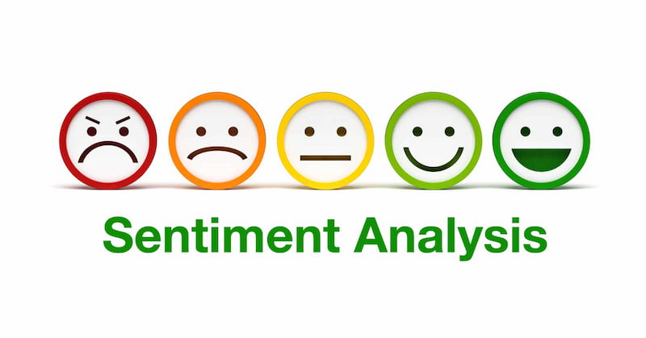
The problem that we solve is
Sentiment analysis - usage of computational methods to extract emotional data from text
Toxicity analysis - branch of sentiment analysis, identification of harmful content in text data
Relevant in social media, online community management, content moderation

Slide 4
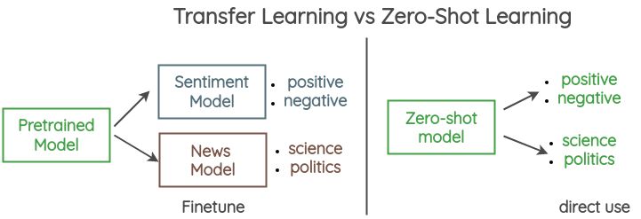
We make one more model because
Accomplishing zero-shot learning - a specific type of transfer learning
Zero-shot learning allows the model to accomplish a task with text in a language it was not trained on
It does that while using alignment of the vector space common to all languages
Significant improvement over transfer learning: no training dataset augmentations and no fine tuning is required for multi-language performance

Slide 5
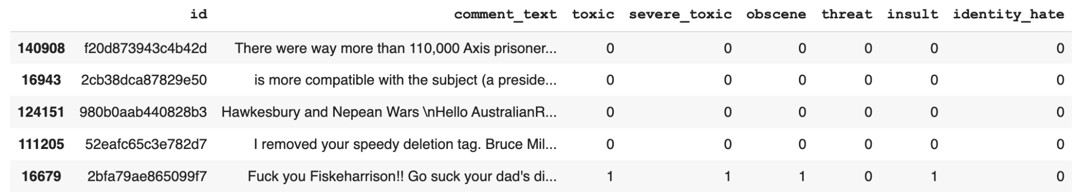
We found Jigsaw dataset with English toxic comments
We use it for training
150k samples
6 not mutually-exclusive categories of toxicity
Imbalanced: 10% toxic vs 90% non-toxic
50% of samples are shorter than 37 tokens

Slide 6
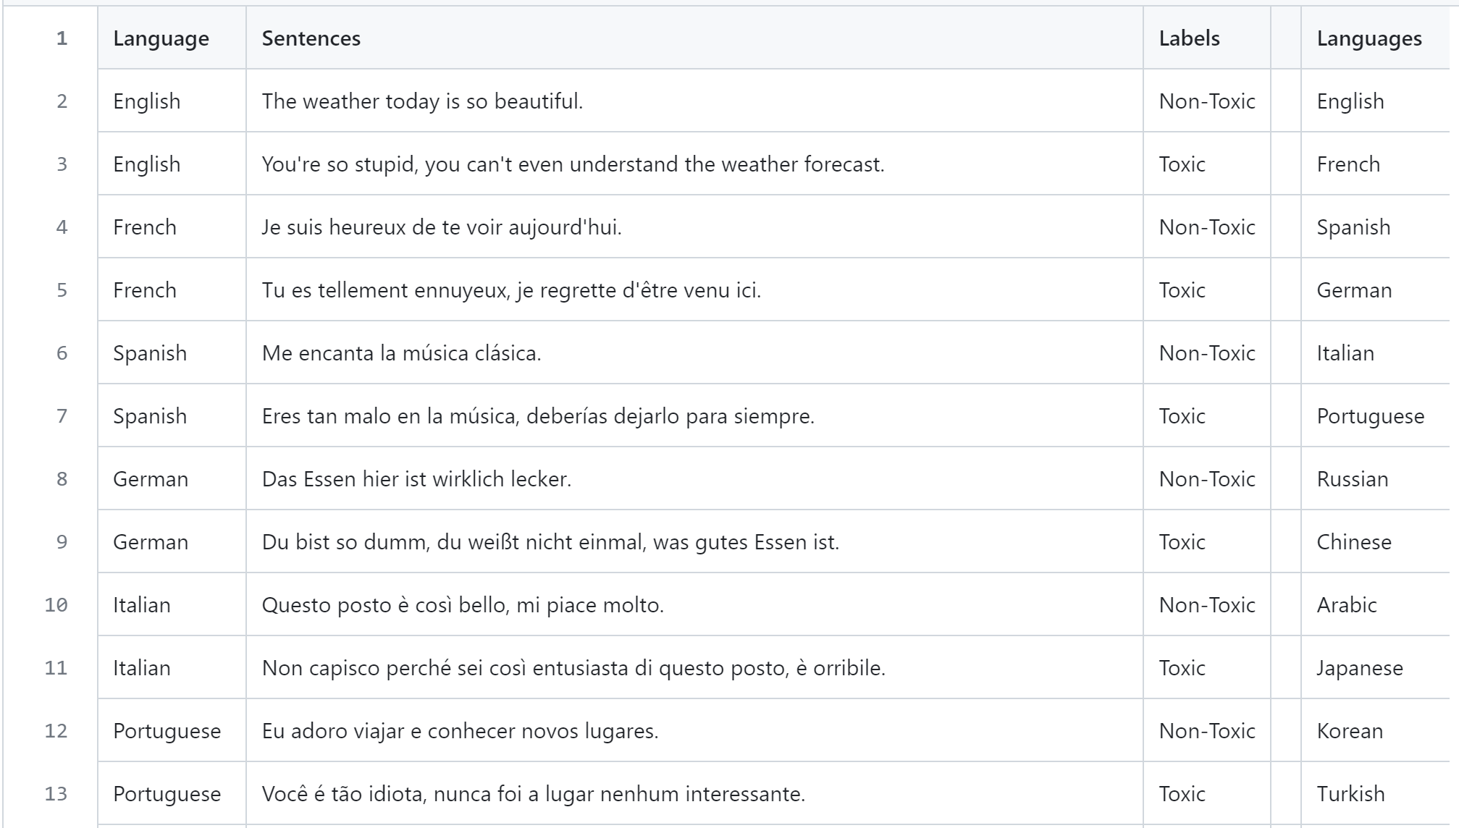
And collected our own multilingual dataset
We use it for testing
50 toxic + 50 non-toxic
50 languages
Different language families
Notes:
50 toxic and 50 non-toxic comments were composed and labeled
we have used languages from different families: e.g. German, Italian, Chinese, Arabic

Slide 7
We united the toxicity labels to dense the data
Problem: model cannot learn small toxicity categories
identity_hate category is 0.93% of the dataset
threat - 0.3%
Solution: make super-class “toxic”

Slide 8
We applied transformers to extract text embeddings
Transformers are state-of-the-art (SOTA) in NLP
Intuition: latent space contain sentiment
We use multilingual versions trained on 100+ languages
BERT-based:
XLM-RoBERTa - multilingual version of RoBERTa, gave SOTA results in NLP
DistilBERT - 40% smaller and 60% faster version of BERT preserving 95% of performance, baseline
We did sum and min-max downsampling for DistilBERT embeddings

Slide 9
We tried Naive Bayes, Decision Tree and NN to classify
Classifiers output a binary value: whether the given embedding of a text is toxic or not
Pipelines:
DistilBERT + Decision Tree
DistilBERT + Gaussian Naive Bayes
DistilBERT + Neural Network
XLM-RoBERTa + NN out of the box

Slide 10
Implementation was done with Python 3.10
Libraries used:
transformers - for embedding models
sklearn, pytorch - for classifiers
Notebooks and data is available in our GitHub repo
Adapted for GPU

Slide 11
We utilized Google Colab GPU
Training took
3 hours for pipeline with XLM-RoBERTa
5 minutes for pipelines for DistilBERT

Slide 12
We got the following metrics
On English test set:
0.96 F1 score using XLM-RoBERTa pipeline
0.59 accuracy using DistilBERT + NN
0.55 accuracy using DistilBERT + Gaussian Naive Bayes
0.54 accuracy using DistilBERT + Decision Tree
On multilingual dataset:
0.75 Top-1 accuracy using XLM-RoBERTa pipeline
0.5 accuracy using DistilBERT pipelines

Slide 13
XLM-R got such results because
Non-toxic sentences
100% accuracy - our model generalizes well
Toxic sentences
50% → they were not toxic enough, but were subjective to the human annotator.
Proof of claim: GPT4 translated them, they weren’t severe, but refused to generate toxic sentences
Conclusion: GPT4 after generating said they were toxic, which is contradictory to itself, hence, our model is better in detecting abuse/toxicity/severity.

Slide 14
We deployed the model with StreamLit
To make the model universal we used ONNX
To make better inference we used NVIDIA GPU, MX250.
We used TensorRT since it is designed to optimize and accelerate the inference of deep learning models, primarily for deployment on NVIDIA GPUs.

Slide 15
What we learnt?
Robust, and application driven modelling
Making more generalized, and universal model for real life applications.
Making cross lingual models, and providing solutions for real life existing problems, like in this case dealing with multi-lingual data, and aligning vector space for robust Natural Language Inference (NLI).
Converting a language specific model to universal.

Slide 16
Problems we faced, and how we tackled them
Training the model
Given the size of the dataset, we were not sure if we could train it on colab. It took us some days to theoretically figure out, and by increasing the epochs. Also, prototyping different models made it difficult.
Deployment
The model is trained in pytorch, and hence it should be made made universal. We used ONNX (Open Neural Network Exchange), the idea is to provide interoperability between different deep learning frameworks and streamline the path from research to production.

Slide 17
Why are we also focused on deployment?
An application specific model that has a real life use case is useless if it is not deployed especially if it’s your company’s project. It is also a good way to learn, and/or hone the most important skill in Machine learning, i.e. deployment.

Slide 18
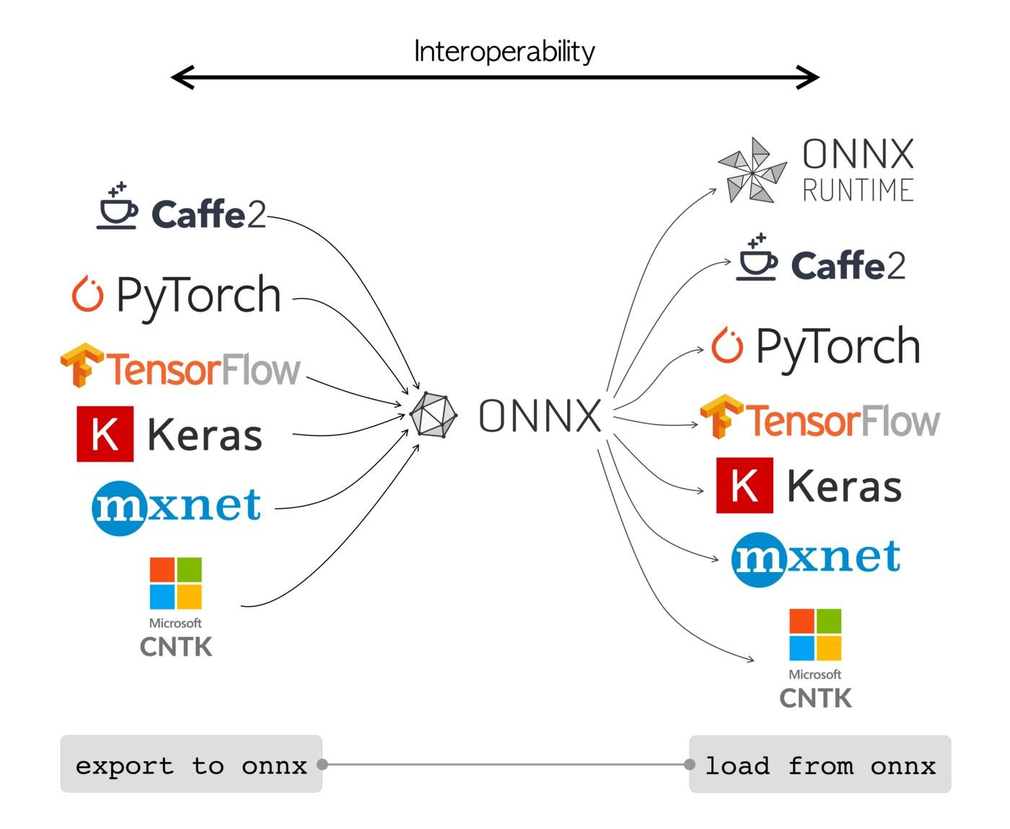

Slide 19
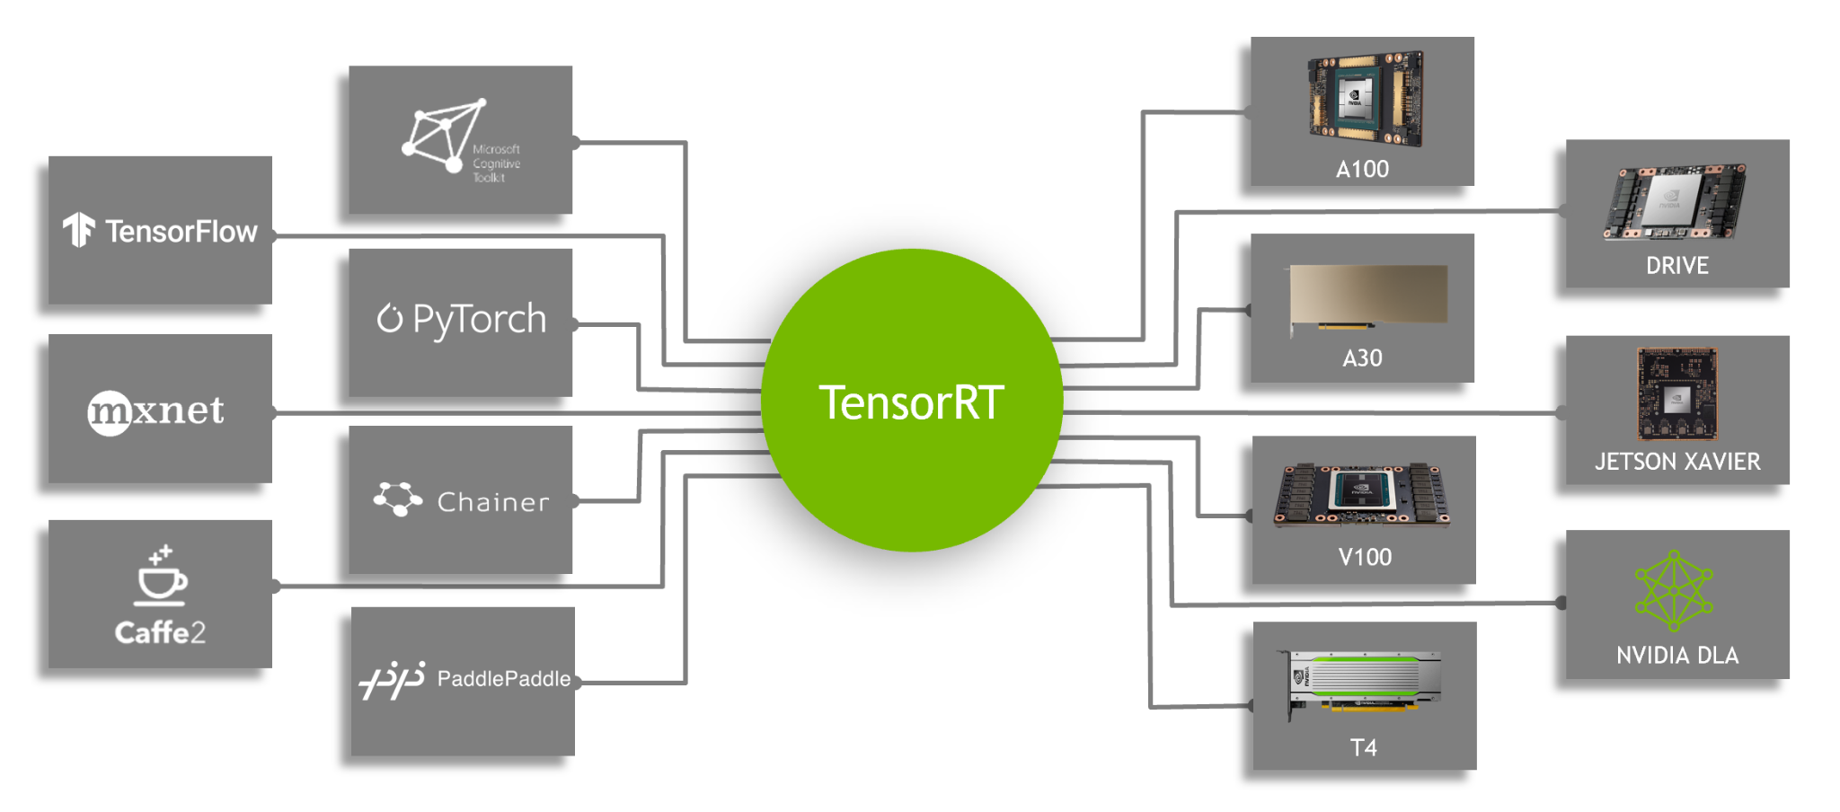
It is advised to consider converting the model to ONNX then using TensorRT

Slide 20
Classifier works on languages that it has never seen - Zero-Shot!
The current however already performs good when the language is written in the same script which in most cases it is.

Slide 21
Conclusion
Our work is production ready for industrial use, we might want to consider extending our current dataset to deal with the flaws, and add a transcription, and/or speech layer to make it more robust, and powerful.
And yes it works for any arbitrary language, if your language is low resource, and no model in the world performs on it, no worries, here is a work that I am citing that could be useful, and yes can be done on a single GPU: LINK

Slide 22
Tech stack used

Slide 23
We have a demo for you!
Give us your prompts:
Example toxic: “This is dirty to think about, you must be a retard”
Example toxic: “Об этом грязно думать, ты, должно быть, дебил”
Example non-toxic: “I do not like Makar”
Example non-toxic: “Мне не нравится макар”

Slide 24
References
http://gerard.demelo.org/papers/adversarial-self-learning.jpg
https://blog.reputationx.com/hs-fs/hubfs
https://amitness.com/images/zero-shot-vs-transfer.png
No one check references. But you are here, so look at that cool GIF on the background.

