Slide 1
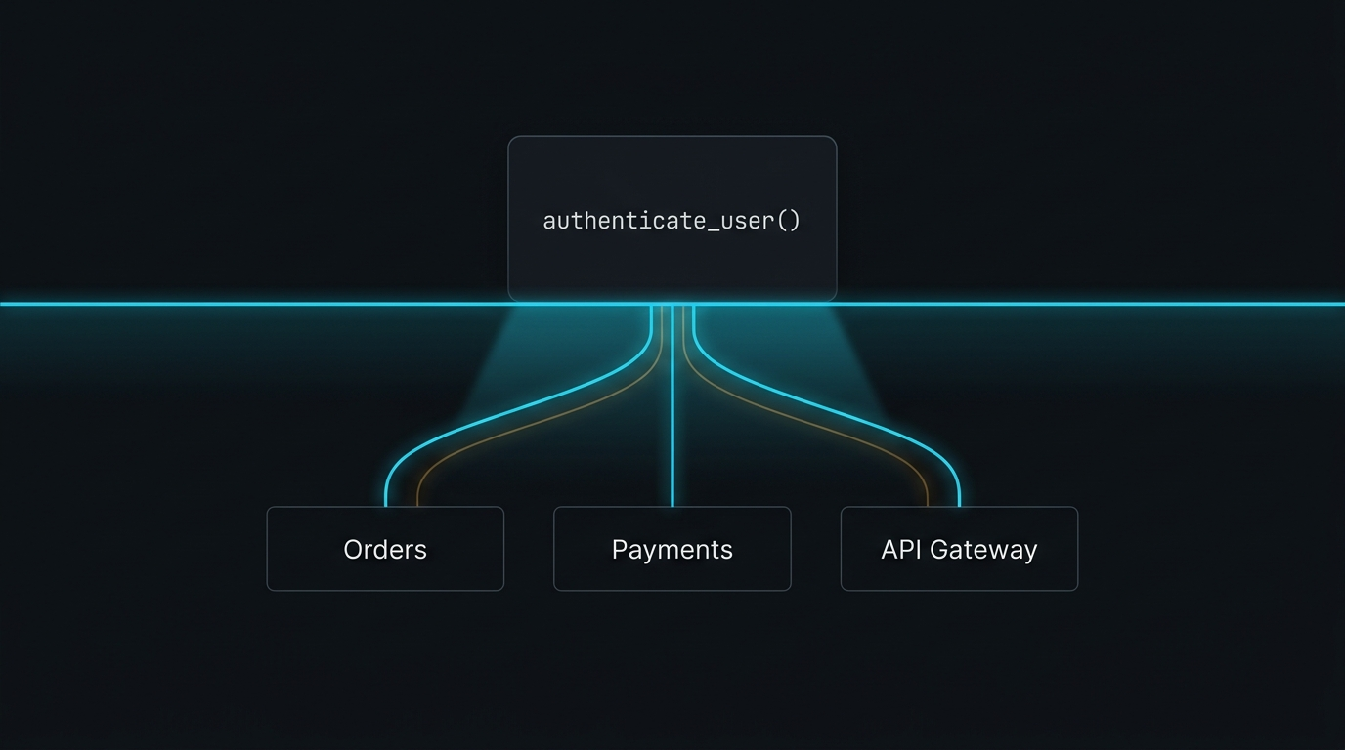
IBM BOB 2.0 × IBM WATSONX.AI × DEVELOPER WORKFLOW INTELLIGENCE
X-Ray
See the impact before you change the code.
Never merge code in the dark again.
Notes:
A developer changes one function. The tests pass. The pull request is approved. And then production breaks somewhere they never knew was connected.
We built X-Ray to answer one question before that merge happens: what will this change affect?

Slide 2
THE DEVELOPER DILEMMA
The Code Changed Here. The Bug Appeared There.
A single line refactor in authentication silently ripples across downstream services.
01 // THE LOCAL REFACTOR
auth_service.py
02 // THE UNSEEN BLAST RADIUS
Hidden Dependency Ripple
• Orders Service — Direct caller - expects v1 token parameter
• Payments Service — Indirect caller via Order checkout flow
• Background Worker — Async job processing relies on session context
• Notifications Engine — Transitive dependency on auth status
class AuthService:
# Updating token verification contract
- def authenticate(self, user):
+ def authenticate(self, user, token_v2):
...
✓ Unit tests passed for auth_service.py
✓ Linter passed with 0 errors
✓ Pull Request reviewed & merged
💥 PRODUCTION OUTAGE IN PAYMENTS
The hidden problem: Developers cannot see the full dependency chain before making the change.
Notes:
Here is the moment every developer has lived through: a single line change in a service that seems completely safe.
The tests passed. The linter passed. But 15 minutes after deployment, payment processing failed because an indirect caller wasn't updated.

Slide 3
“What happens if I change this?”
How 30 million developers try to answer this question today:
01
SEARCH
Grep across files
02
TRACE
Read import chains
03
GUESS
Mentally follow callers
04
TEST
Run existing tests
05
HOPE
Hope nothing broke
X-Ray turns “HOPE” into VISIBILITY.
Notes:
This is the question every engineer asks before clicking merge. And today, our workflow ends in one thing: hope.
Hope that tests catch it. Hope that the code reviewer noticed it. X-Ray turns that hope into concrete visibility.

Slide 4
MEET X-RAY
A Software Change Impact Analyzer
Bridging deterministic code graph intelligence with IBM watsonx cognitive reasoning.
01 // SEE
Scan the Codebase
Extract complete AST graph: files, classes, functions, and import/call edges in milliseconds.
02 // TRACE
Calculate Dependencies
Execute bi-directional multi-hop BFS to trace direct callers and downstream ripple effects.
03 // ACT
Explain, Test & Verify
IBM watsonx.ai Granite synthesizes architectural risks and generates runnable regression test suites.
AST Analysis
Parses Python AST syntax trees without executing runtime code.
Blast Radius
Traces multi-hop callers, callees, and affected test suites.
Git Diff Intelligence
Maps unified git diff line changes to exact AST symbols.
AI Safety Layer
watsonx Granite synthesizes risk areas & 1-click pytest suites.
“X-Ray doesn't replace developers. It gives them visibility before they make decisions.”
Notes:
X-Ray is built on three simple principles: See, Trace, and Act. It doesn't attempt to replace developers with autonomous code writers.
It acts as an architectural radar, giving developers total visibility before they commit.

Slide 5
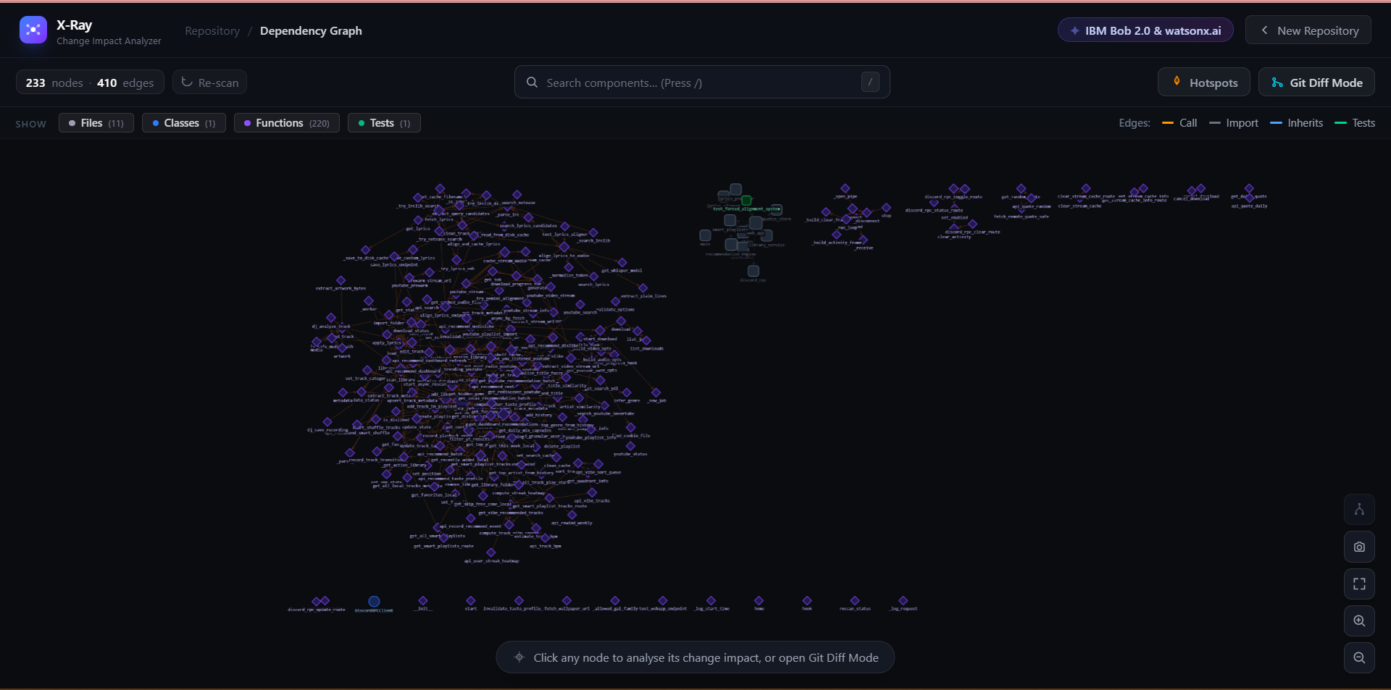
PRODUCT WOW #1
One Repository. One Living X-Ray.
Architecture discovered automatically from the codebase — 0 manual documentation.
DISCOVERED IN DEMO REPO
① 233 Nodes & 410 Edges
Files, classes, functions, and tests parsed into an interactive Cytoscape graph in <300ms.
② Multi-Hop Dependencies
Call, import, inheritance, and test coverage edges mapped automatically across modules.
③ Git Churn Heatmap
Historical git commit frequency overlaid as a thermal layer to spot code hotspots.
“We don't ask the developer to manually map the architecture. X-Ray builds it from the repository.”
Notes:
We don't ask the developer to manually map the architecture. X-Ray builds it directly from the repository.
Here you see 233 nodes and 410 edges discovered automatically in our sample Python repo.

Slide 6
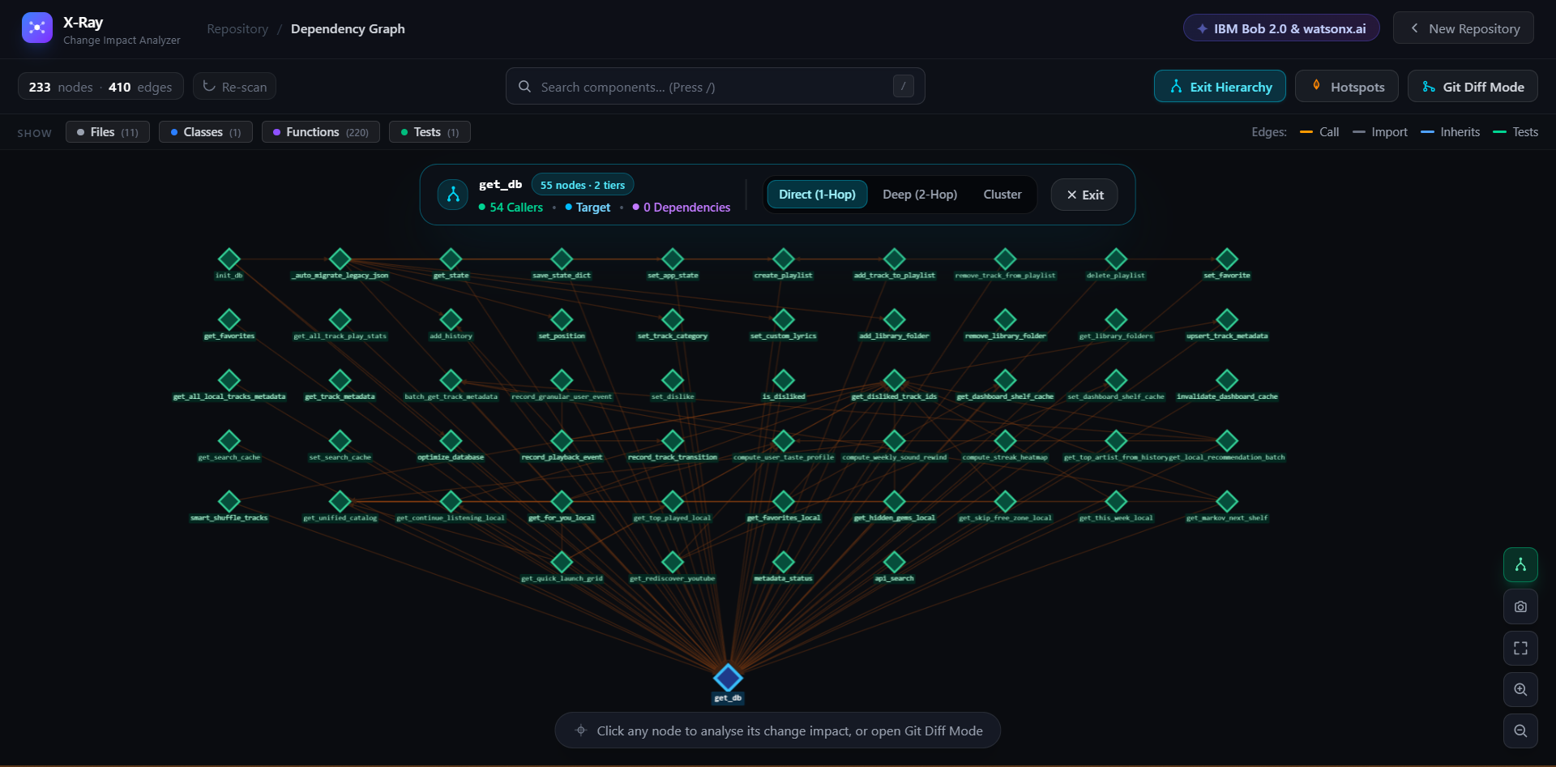
PRODUCT WOW #2
From Hairball → Architecture
The graph isn't the product. Understanding the graph is.
BEFORE // THE HAIRBALL
Raw Force-Directed Chaos
Graphs with 200+ nodes quickly become visual hairballs. Developers cannot isolate what calls what in a tangled cluster.
✦ 54 Callers. One Click. Structured.
●
╱ ╲ │ ╱ ╲
╱╲ ╲│╱ ╱╲
╱ ╲╱ ╲ ╲ ╱
[ Tangled Clusters ]
Notes:
A 250-node graph is visually overwhelming. But with X-Ray's 1-Click Hierarchy Tree, developers instantly isolate a target component.
Here, get_db is centered as the hero node, and all 54 callers fan out upward in golden-ratio tiered rows.

Slide 7
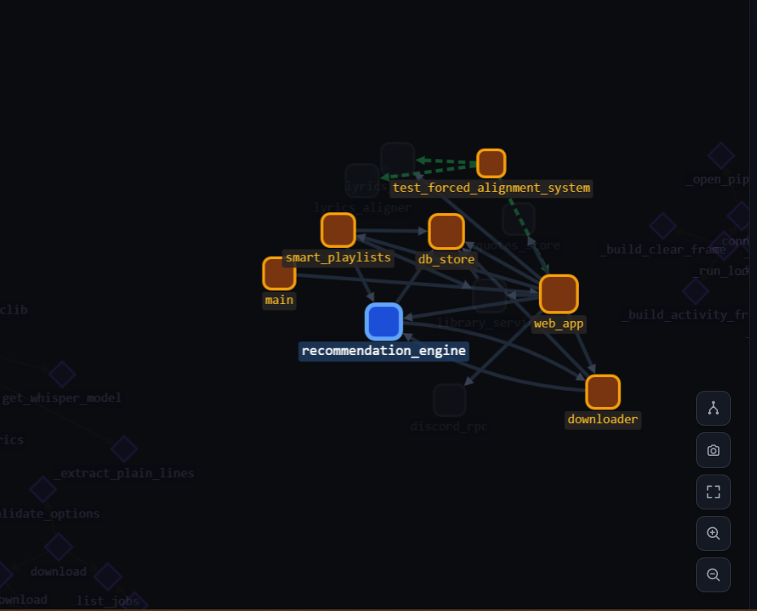
PULL REQUEST PRE-FLIGHT
Don't Ask “What Exists?” Ask “What Will Break?”
Real-time blast radius calculation on unified Git pull request diffs.
PR IMPACT PIPELINE
↓ Git Unified Diff
Parses modified hunks from git diff or PR.
↓ Changed AST Symbol
Resolves lines to exact function `recommendation_engine`.
↓ Direct Callers
5 downstream components directly call modified symbol.
↓ Transitive Blast Radius
Multi-hop dependencies traced across files.
↓ Verification Command
Generates targeted test command: pytest tests/
Pre-Merge Blast Radius Active
Notes:
X-Ray isn't a passive code viewer. When a developer creates a PR, X-Ray parses the unified git diff, identifies the exact modified AST symbols, and lights up the downstream blast radius.
It outputs the exact targeted pytest command so developers don't have to wait 20 minutes for a full CI suite.

Slide 8
SCENARIO SIMULATION
Simulate the Change Before Making It
What-if blast radius forecasting powered by IBM watsonx.ai Granite.
TARGET COMPONENT: authenticate_user() in auth/service.py
WHAT IF: “Refactoring authentication contract to enforce OAuth2 JWT verification”
DIRECT IMPACT
5 Services
web_app, main, smart_playlists, db_store, downloader
TRANSITIVE REACH
14 Endpoints
Second-hop downstream consumers across 4 files
TEST COVERAGE
38% Covered
1 test suite covers 2 of 5 callers. 3 callers untested!
RISK AREAS
HIGH RISK
🔴 Payments 🟠 Orders 🟡 Background Workers
✦ IBM WATSONX.AI GRANITE 13B // GROUNDED RISK REASONING
“Payments indirectly depends on the current authentication session through OrderService. Modifying token verification without updating session expiration will cause checkout drops in mobile clients. Recommend adding backward-compatible token headers before migrating.”
Notes:
Developers can type any planned refactoring into X-Ray. Watsonx Granite reads the grounded AST callers and explains the hidden architectural consequences before a single line of code is committed.

Slide 9
TECHNICAL ARCHITECTURE
Two Engines. One Safety Layer.
Deterministic analysis finds the evidence. Granite explains and verifies it.
CODEBASE REPOSITORY / GIT DIFF INPUT
ENGINE 1 // DETERMINISTIC ANALYSIS
• Python AST Syntax Parser — Extracts function, class, and import symbols with 0% AI hallucination.
• NetworkX DiGraph Core — Stores directed multi-hop graph with degree & centrality weighting.
• Bi-Directional BFS Traversal — Calculates exact caller/callee blast radius in milliseconds.
• Git Churn History Miner — Parses commit histories to identify code volatility hotspots.
ENGINE 2 // IBM WATSONX.AI GRANITE
• IBM Cloud watsonx.ai API — Enterprise API integration using ibm-watsonx-ai SDK.
• ibm/granite-13b-chat-v2 — High-throughput foundational enterprise code & chat model.
• Grounded AST Prompts — Zero hallucination: injects actual callers, callees & diff hunks.
• AST Synthesis Fallback — Graceful static synthesis ensures 100% uptime even if offline.
X-RAY INSIGHT: Deterministic Blast Radius + Granite Risk Explanation + 1-Click Test Suites
Deterministic analysis finds the evidence. Granite explains the evidence and helps developers act on it.
Notes:
We don't ask an LLM to guess the dependency graph. Our deterministic engine maps the exact mathematical truth with zero hallucination.
Then, IBM watsonx Granite interprets the evidence and helps developers act on it.

Slide 10
THE KILLER FEATURE // IBM BOB 2.0
X-Ray Doesn't Stop at “Warning.”
From detecting untested dependencies to auto-generating executable pytest suites in 1 click.
01 // THE PROBLEM DETECTED
⚠️ Untested Dependencies
3 downstream components depend on the modified code but have 0% test coverage.
02 // 1-CLICK TEST GENERATOR (IBM BOB 2.0 & GRANITE)
# test_recommendation_engine.py - Generated by IBM watsonx Granite
import pytest
from unittest.mock import patch, MagicMock
@pytest.fixture
def mock_dependencies():
with patch('db_store.get_connection') as m_db:
yield {'db': m_db}
def test_recommendation_happy_path(mock_dependencies):
# Happy path assertion on target contract...
def test_invalid_token_exception():
with pytest.raises(AuthenticationError): ...
Traditional Tools Stop Here:
• Linters show a warning and walk away.
• Developers must manually spend 45 minutes writing fixtures, mocks, and assert boilerplate.
• Result: Tests never get written.
✓ Fixtures ✓ Mocks (@patch) ✓ Happy Path ✓ Edge Cases ✓ Exceptions
[ Copy Pytest Code ] [ Download .py ] [ Run: pytest tests/ -v ]
Notes:
Most developer tools only tell you what is broken and walk away. X-Ray goes a step further: it auto-generates the complete, runnable pytest suite using IBM Bob 2.0 and Watsonx Granite.
Detect -> Explain -> Generate -> Verify.

Slide 11
BUSINESS VALUE
One Workflow. Four Problems Removed.
Concrete, observable workflow acceleration across the development lifecycle.
01 // DEPENDENCY TRACING
BEFORE X-RAY:
Manually grep & trace imports across dozens of files
WITH X-RAY:
Automatically map complete AST impact graph in milliseconds
02 // BLAST RADIUS
BEFORE X-RAY:
Guess affected files and hope nothing broke
WITH X-RAY:
See exact direct and transitive multi-hop ripple effects
03 // TEST VERIFICATION
BEFORE X-RAY:
Run entire bloated mono-repo test suite
WITH X-RAY:
Identify and execute targeted test suites for modified paths
04 // REGRESSION PREVENTION
BEFORE X-RAY:
Discover silent outages after code hits production
WITH X-RAY:
Review and fix risks before code is ever merged
DEVELOPER OUTCOME
Dramatically less manual investigation time.
ENGINEERING OUTCOME
Significantly reduced regression risk.
BUSINESS OUTCOME
Safer, faster, and more predictable software delivery.
Notes:
X-Ray delivers concrete engineering value: developers spend less time investigating dependencies, code reviews become faster, and production releases become predictable.

Slide 12
COMPETITIVE POSITIONING
Where X-Ray Fits
A factual positioning matrix across the modern developer toolchain.
CAPABILITY | LINTERS (SonarQube) | CODE SEARCH | GENERIC AI (Copilot) | X-RAY
Repository Search | — | ✓ (Text-based) | ✓ | ✓ (AST-indexed)
Structured Dependency Graph | Limited | Limited | Not deterministic | ✓ (Full AST graph)
Multi-Hop Blast Radius | — | — | Not deterministic | ✓ (Deterministic BFS)
Git Diff → Impact | Limited | — | Context dependent | ✓ (Symbol-level)
1-Click Hierarchy Isolation | — | — | — | ✓ (Structured Tree)
Grounded AI Explanation | — | — | Generic | ✓ (IBM Granite 13B)
1-Click AI Test Generation | — | — | Generic templates | ✓ (Grounded in AST)
X-Ray combines repository structure, change analysis and grounded AI into one developer workflow.
Notes:
Linters check syntax. Code search finds text. Generic AI writes code. X-Ray is the first tool that combines repository structure, Git diff analysis, and grounded AI into a unified safety layer.

Slide 13
THE FUTURE ROADMAP
From Analyzer → Developer Safety Network
Continuous software impact intelligence across the entire development lifecycle.
TODAY: Python Repositories ──► NEXT: GitHub PR Bot ──► NEXT: IDE X-Ray ──► NEXT: Multi-Language
PR GUARDIAN
Continuous CI/CD Gatekeeper
Automatically comments visual blast radius diagrams directly on GitHub and GitLab pull requests. Blocks merges if high-risk paths lack test coverage.
✦ PLANNED EXTENSION
IDE X-RAY
Real-Time In-Editor Radar
VS Code & JetBrains extension that highlights downstream caller impact live in the gutter while developers write code.
✦ PLANNED EXTENSION
MULTI-LANGUAGE
Polyglot AST Support
Extending the deterministic AST graph engine from Python to TypeScript/JavaScript, Go, and Java enterprise microservices.
✦ PLANNED EXTENSION
Notes:
Our vision is to make X-Ray a ubiquitous safety net across the entire software development lifecycle—from the developer's IDE to the GitHub pull request gatekeeper.

Slide 14
Software changes every day.
Understanding their impact shouldn't be a guessing game.
X-Ray
See the impact before you change the code.
IBM Bob 2.0 × watsonx.ai × Granite • GitHub • Live Demo • Team X-Ray
Notes:
Software changes every day. Understanding their impact shouldn't be a guessing game.
X-Ray: See the impact before you change the code. Thank you.

