Slide 1



Analyzing Agriculture Productivity Across Indian States

Slide 2

Learning Objectives
To examine agriculture productivity trends across states.
To identify factors influencing productivity.
To propose actionable recommendations for improvement.
GOAL
Source :
www.freepik.com/

Slide 3
Tools and Technology used
Power BI:
Interactive dashboards.
Mapping and trend visualization.
Version Control:
GitHub for tracking project progress and code collaboration.
GitHub link > https://github.com/Jayvishwakarma809/FinalProjectEdunet
PowerPoint:
For delivering insights and sharing results.

Slide 4
Methodology
Create an interactive Power BI dashboard to share findings with stakeholders, allowing them to filter by state, crop, or year.
Collect information on crop yields, annual rainfall, pesticides, and fertilizer usage.
Use charts, graphs, and tables in our Power BI dashboards to explore productivity trends over time.
Enable state-wise or crop-wise filtering for better improvement.

Slide 5
Problem Statement:
Analyzing what are the average of rainfall, area, fertilizer, and pesticides are needed to different states for producing maximum crops.
What is the average of production in different states by rainfall and crop year to analyze which are top five states that are producing the most.
How to decrease the use of fertilizers in different states and see which states are using more fertilizer without improving their crop production.

Slide 6
Solution:
We designed an interactive dashboard named Overview to determine the average uses of fertilizer, pesticides with the average of rainfall and area covered by the crops by comparing production and yield by different states.
To determine the top five productive states, we designed dashboard named Crop Production by analyzing average of production by crop-year and in different states.
To reduce the uses of fertilizers we add table in our dashboard which gives sum of all things for different states then we use Pie chart feature to analyze top five states which uses most fertilizers.

Slide 7
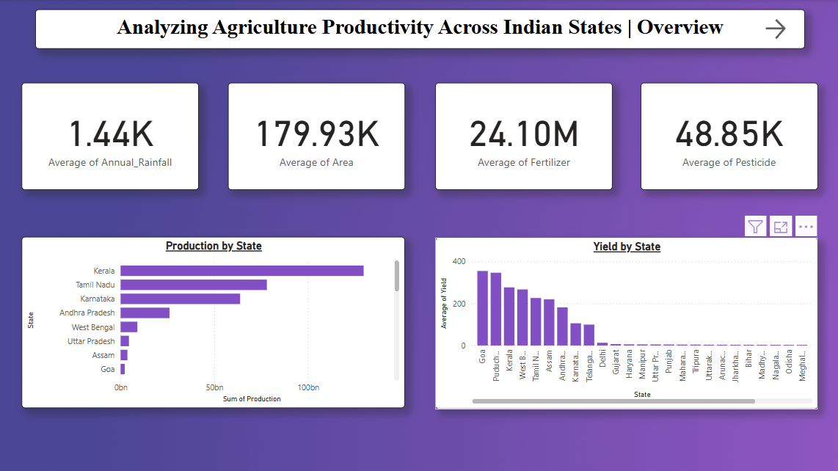
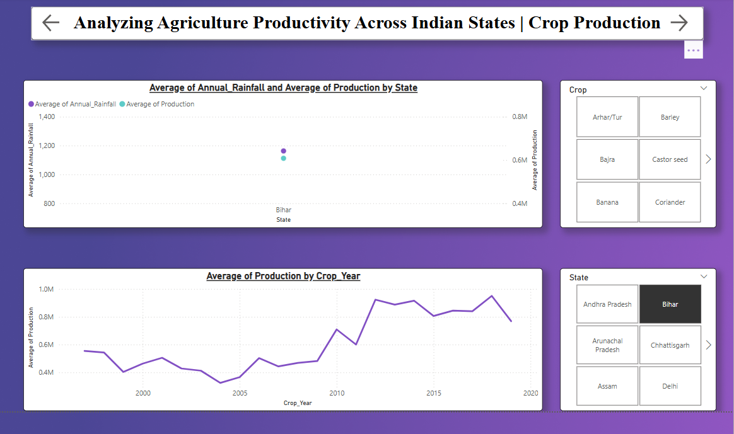
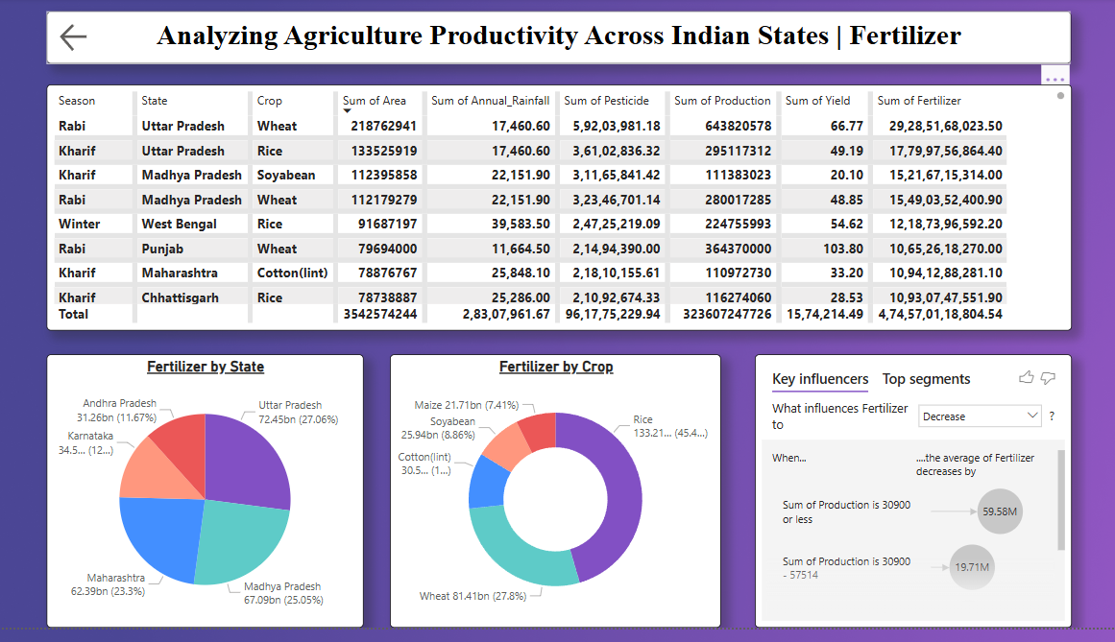
Screenshot of Output:
These are the outputs of our project in first image we get to see the overview of our project.
In second image we analyzes the crop production by crop year and average annual rainfall.
And in the last image we determines which states are uses more fertilizer and what influences fertilizer to decrease in different states.
My GitHub repository link ->> https://github.com/Jayvishwakarma809/FinalProjectEdunet

Slide 8
Conclusion:
In conclusion we analyzed that Kerala produces most with using less fertilizer and area as compare to some other states and Goa has the best yield but it produces less because of less area and less annual rainfall.
We also analyzed which are the top five states that uses fertilizers but did not give the results as compare to other states.
In last I like to say that using Power BI tool for designing dashboards can really improve the businesses because in this project we analyzed to many things in very simple and efficient way so to improve the production by state we should use this tool.
Thank You!

