Slide 1
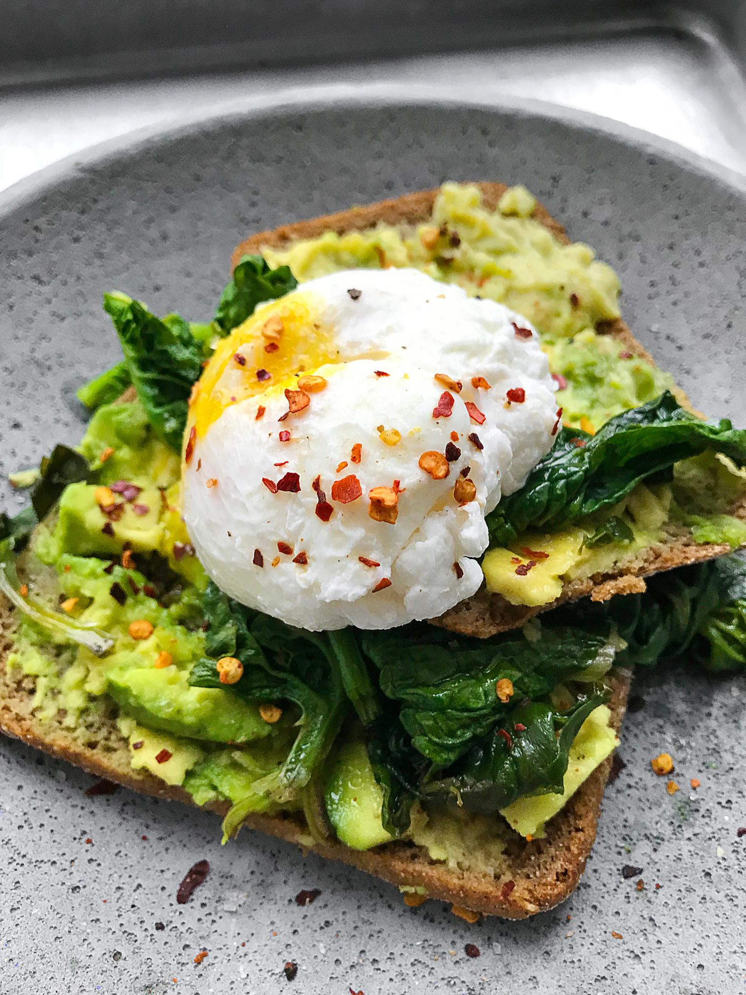



Zomato
Restaurant Data Analysis
By
Jaywantrao G. Salunkhe

Slide 2

Problem Statement
Suggestions of the Countries where Zomato can open newer Restaurants.
Suggestions of the cities in suggested countries.
Analyze the quality regarding ratings for restaurants that are already present in the countries.
Analyze the expenditure on food.
Analyze the competitors.
Analyze the cuisines that need to be focuse.
Analyze the trends of the Online deliveries and table bookings.
Analyze the rates of the cuisines.

Slide 3
Data Overview
Raw Data having 20 attributes.
Modified Data having 24 attributes.
Description: Contains restaurant information like name, location, cuisine, pricing, and ratings.
Country Description having 6 attributes.
Description: Provides country details such as code, name, currency, and symbol.
Data Cleaning and Preprocessing:
Adjustments made to restaurant names, locality, and date formats.
Handling missing or inconsistent values.
Incorporating country information using lookup functions.
Identification and removal of special characters.
Updating average cost for two and cuisines based on specific criteria.
Conditional formatting to highlight underserved markets for potential restaurant openings.

Slide 4

Analysis – Opening New Restaurants
Analyzing countries with less competition.
Cities and states for opening new restaurants.
Rating in suggested countries.
Expenditure on food in suggested countries.
Competitor.
Cuisines.
Online booking / Table Deliveries.
Correlation between rates of cuisines and ratings.

Slide 5
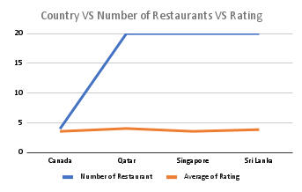
Analysis
New Restaurant Locations:
Selection of countries has been done on two basis
Less Competition
The ratings are average in suggested countries – this has been taken into consideration as this shows that the customers are not satisfied with the restaurants present there

Slide 6
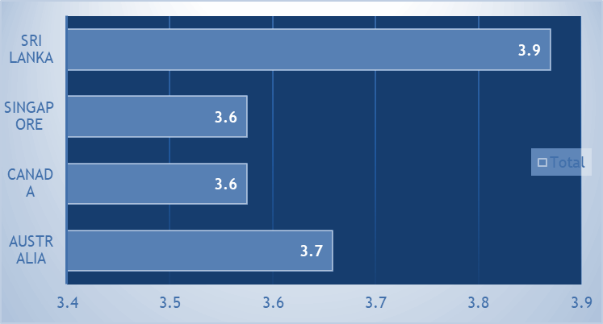
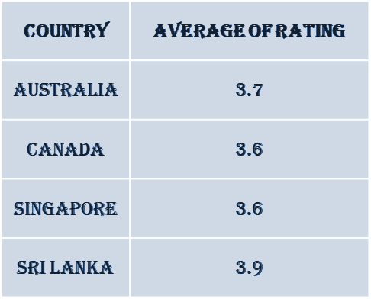
Analysis
States and Cities for New Restaurants:
Australia - Mayfield, Montville, Paynesville
Canada - Consort
Singapore - Singapore
Sri Lanka - Colombo
Average Rating of Restaurants in Suggested Countries:
The ratings in the selected countries are in the range of 3.6 to 3.9. It shows that the customer are not fully satisfied their with the restaurant
Hence we have the best chances to grow if we will provide them the good quality of food and service

Slide 7
Analysis
Competitor Analysis:
Restaurants name – Biggest competitor
1918 Bistro & Grill
Bridge Road Brewer
Lake House restaurants
Simply Strawberries by jagro
Al’frank Cookies
Restaurants – Low Ratings
Poets Café
Pier 70
Elite Indian Restaurant
Queen’s cafe

Slide 8
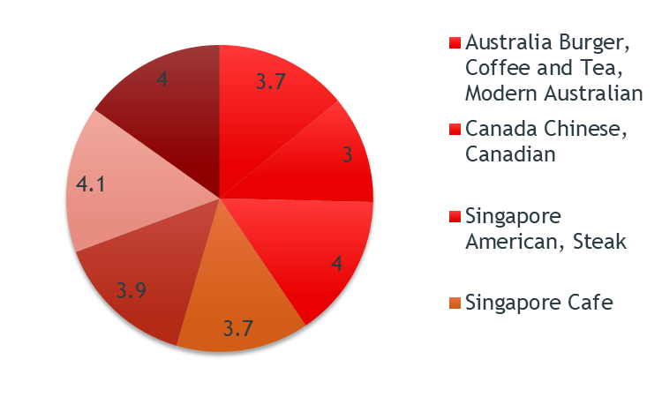
Analysis
Cuisine Recommendations:
These are the highest rated cuisines in all the four suggested countries.
Top preferred cuisines is seafood in all the 4 countries.
Cuisines with highest rating
Burger
Pizza
Sea Food
Australian
American

Slide 9
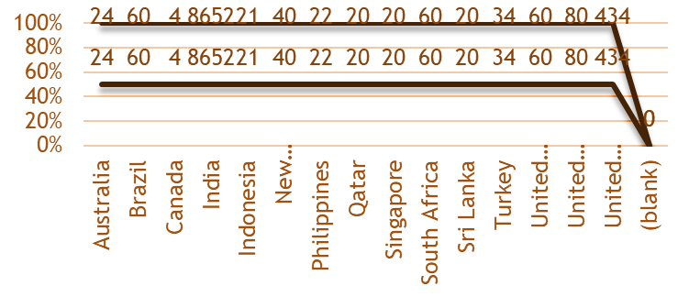
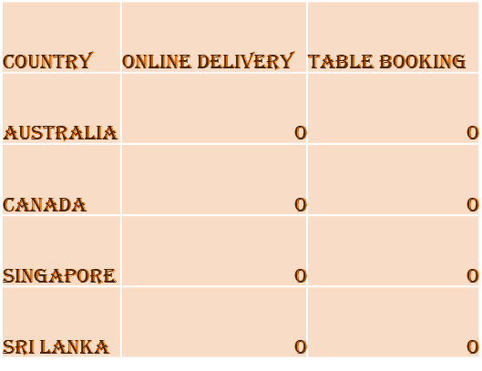
Analysis
Online Delivery and Table Booking:
Selected four counties doesn’t provide onlineDelivery and table booking options to their customers
We should go for table booking and online delivery. As none of the restaurants are providing this facility. This can be monopoly for our business and a greatest advantage to survive in that countries.

Slide 10
Methodology
Used Microsoft Excel for data analysis, cleaning, preprocessing, and visualization.
Leveraged Excel functions and tools such as Pivot Tables, Conditional Formatting, Lookup Functions, and Statistical Functions.
Steps included data cleaning, preprocessing, enrichment, and enhancement.
Analyzed data using pivot tables and conducted correlation analysis.
Visualized data with charts and graphs, utilizing conditional formatting for strategic insights.

Slide 11
Methodology
Enrichment and Enhancement :
Enriched modified data with country information using lookup functions.
Calculated new metrics and conducted correlation analysis.
Data Analysis and Visualization:
Created pivot tables for summarizing data.
Visualized data with charts and graphs.
Utilized conditional formatting for strategic insights.

Slide 12
Strategic Recommendations
New Restaurant Locations:
Recommendation: Open restaurants in Australia, Canada, Singapore, and Sri Lanka.
Justification: These countries show low competition and promising ratings.
Cuisine Selection:
Recommendation: Offer a diverse range of cuisines including Pizza, Mediterranean, Australian, Italian, Chinese, Bakery, Seafood, American, Continental, Desserts, and Beverages.
Justification: Diverse menu options correlate with higher customer satisfaction.
Online Delivery and Table Booking:
Recommendation: Implement online delivery and table booking services.
Justification: Current data suggests a demand for these services.

Slide 13
Strategic Recommendations
Competitor Analysis:
Recommendation: Learn from biggest competitors and address issues highlighted by low-rated restaurants.
Justification: Understanding competitors' strategies can inform improvements.
Culinary Pricing Strategy:
Recommendation: Adjust prices based on cuisine preferences and customer feedback.
Justification: Price adjustments can optimize profitability while maintaining satisfaction.
Financial Control:
Recommendation: Monitor food expenditure closely for financial sustainability.
Justification: Understanding expenditure levels ensures financial health.
Marketing and Promotion:
Recommendation: Invest in targeted marketing campaigns.
Justification: Effective marketing drives foot traffic and increases restaurant visibility.

Slide 14
Conclusion
The analysis reveals valuable insights into restaurant data, guiding strategic decisions for expansion and improvement. Key findings include:
Identification of countries with low competition and high potential for new restaurant ventures.
Understanding customer preferences and the impact of factors like cuisine, price range, and services on ratings.
Recommendations for targeted culinary offerings, service enhancements, and pricing strategies to enhance customer satisfaction and competitiveness.
Visualizations provide clear insights into market trends, competitor analysis, and financial expenditure.
This analysis underscores the importance of data-driven decision-making in the restaurant industry, enabling businesses to optimize performance and meet evolving consumer demands effectively.

Slide 15
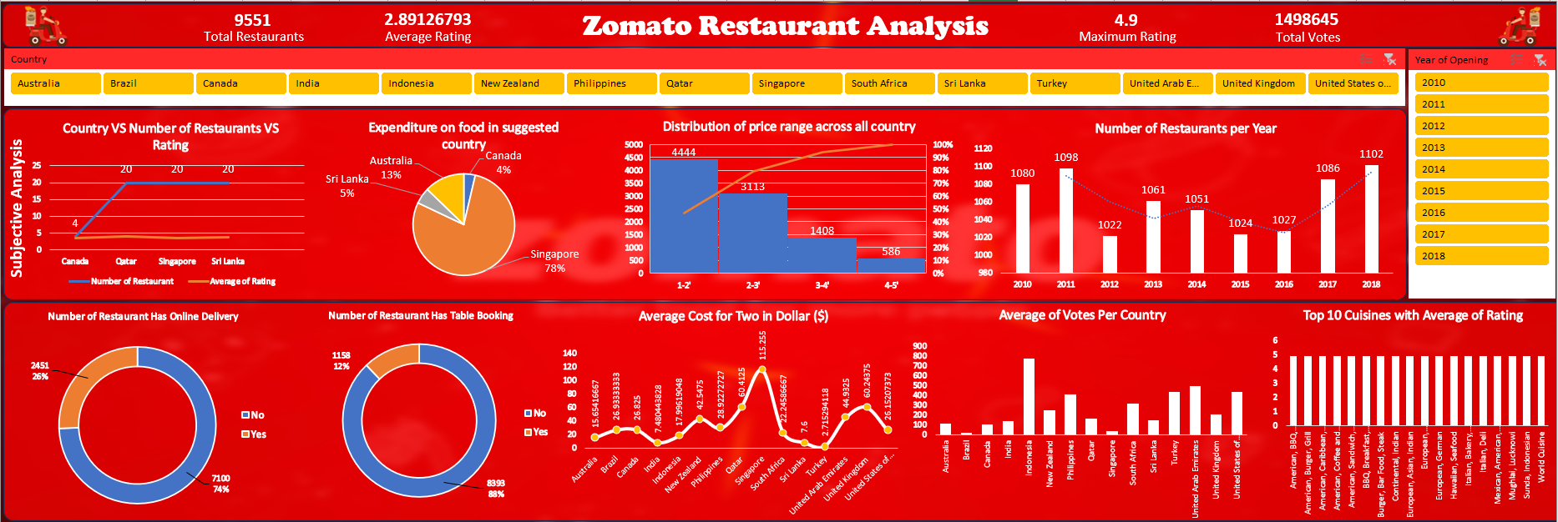
Dashboard and Visualizations

Slide 16
Acknowledgements
We would like to express our gratitude to “Rishabh Varma” for their valuable guidance throughout Excel Model.

Slide 17
References
Dataset: Provide by “Newton School”
Other Resources: PNG from “Google”

Slide 18
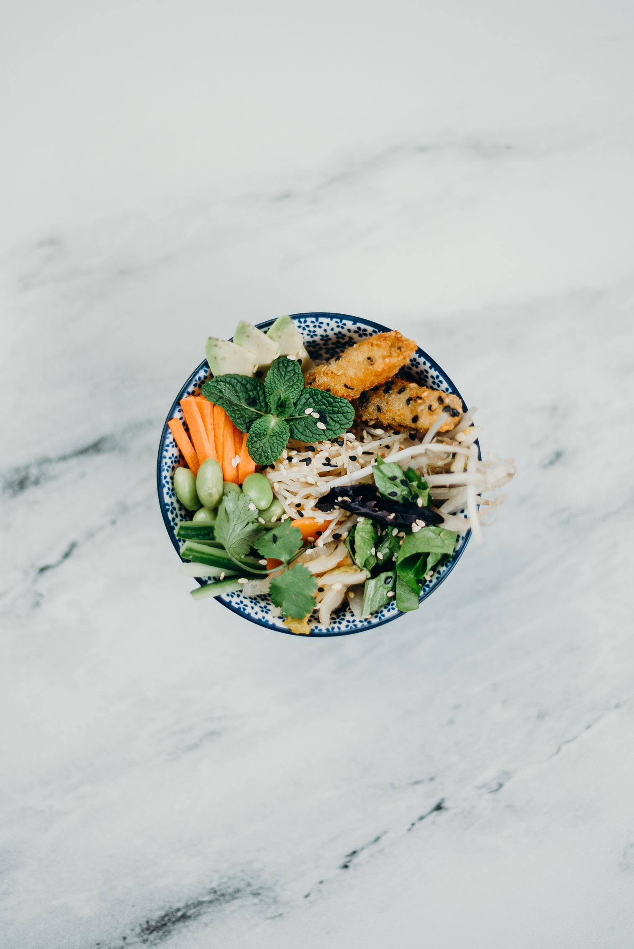
Thanks You

