Slide 1
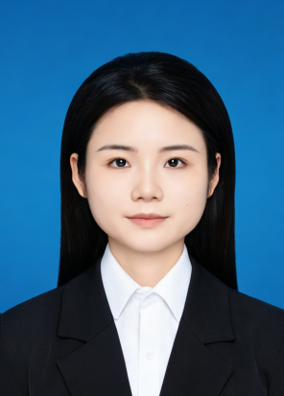
基本信息
毕业于中国地质大学（武汉）计算机学院，获得地学信息工程工学博士学位，现任职于武汉科技大学计算机科学与技术学院。在2024年1月到2025年7月荣获国家留学基金委奖学金在De Montfort University杨圣祥教授课题组进行联合培养。近年来一直致力于人工智能以及智能计算领域及其应用的研究。在IEEE Transactions on Evolutionary Computation、Swarm and Evolutionary Computation、Expert Systems with Applications以及Applied Soft Computing等期刊发表论文。
Bao Qian graduated from the School of Computer Science at China University of Geosciences (Wuhan) with a Doctor of Engineering degree in Geoscience Information Engineering. She is currently employed at the School of Computer Science and Technology, Wuhan University of Science and Technology. From January 2024 to July 2025, I was awarded a scholarship by the China Scholarship Council and conducted joint training in the research group of Professor Yang Shengxiang at De Montfort University. In recent years, I have been committed to the research in the fields of artificial intelligence and intelligent computing and their applications. In IEEE Transactions on Evolutionary Computation, Swarm and Evolutionary Computation, Expert Systems with Published papers in journals such as Applications and Applied Soft Computing.
包芊
职称：讲师
研究方向：人工智能，智能计算，多目标优化等
电子邮箱:qianbao@wust.edu.cn

