Slide 1


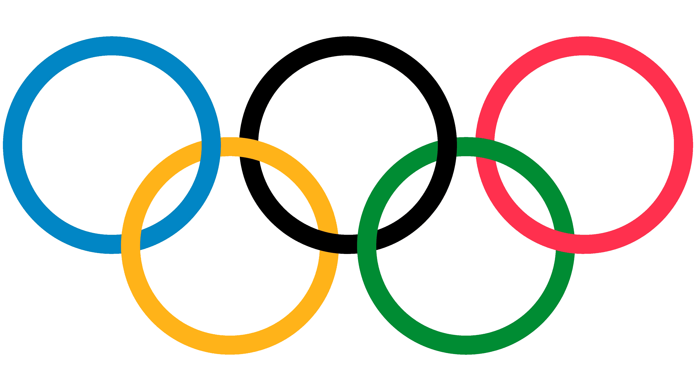
120 Years of Olympic History
By : Mitchell Hatchett
Andrew Giannettino
Tetyana Spielmann
Jaylen Whittaker
David Scott

Slide 2
Introduction
This dataset contains historical information on the modern Olympic Games, covering all the Games from Athens 1896 to Rio 2016. The dataset consists of 271,000 records, with each row representing an individual athlete participating in a specific Olympic event. The data was sourced from the www.sports-reference.com website. The significance of this dataset is heightened as the USA is gearing up to host the next Olympic Games in 2028.
The main questions we are answering in the presentation are :
Athletes that won most medals
How does athlete height affect performance
Relationship between different sports and ages throughout Olympic history

Slide 3
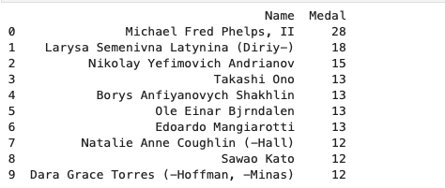
Athletes that won the most medals
In this question we wanted to figure out which athletes won the most medals.

Slide 4
Curiosity!!
As you can tell from the last slide out of those ten athletes only 3 of them were females. With seeing that it made ask two more questions.
Why out of those ten athletes are 3 of them only women?
Male vs Female who has more total medals?

Slide 5
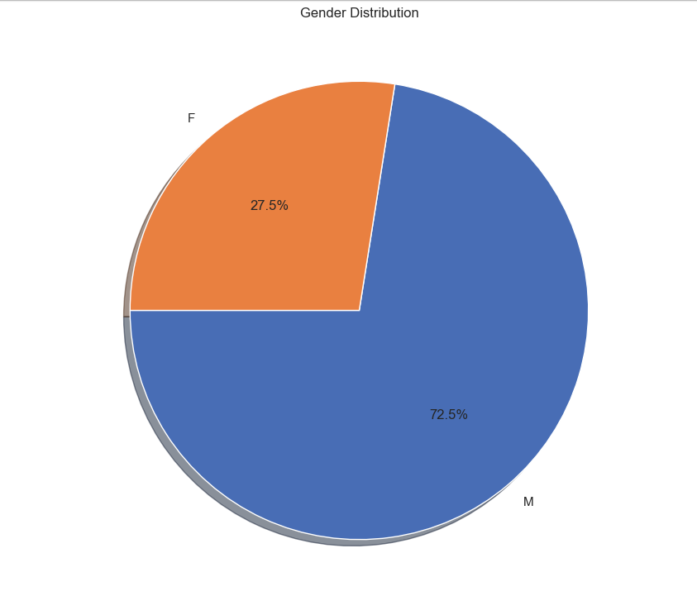

Why out of those ten athletes are 3 of them only women?
The answer to this question simply put there are about 2 and a half times more males than females participating in the Olympics.

Slide 6

Male Vs Female Total Medals
Based of the information in the last slide you can already guess that males will probably have more total medals than females.
From the image above you can tell males have almost 3 times more medals than females.

Slide 7
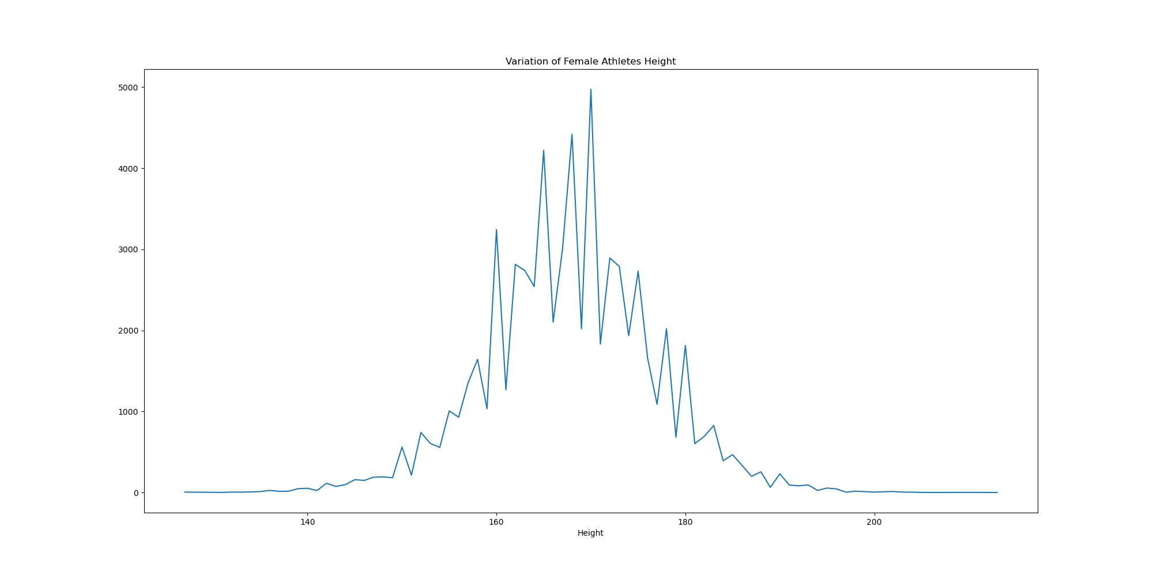
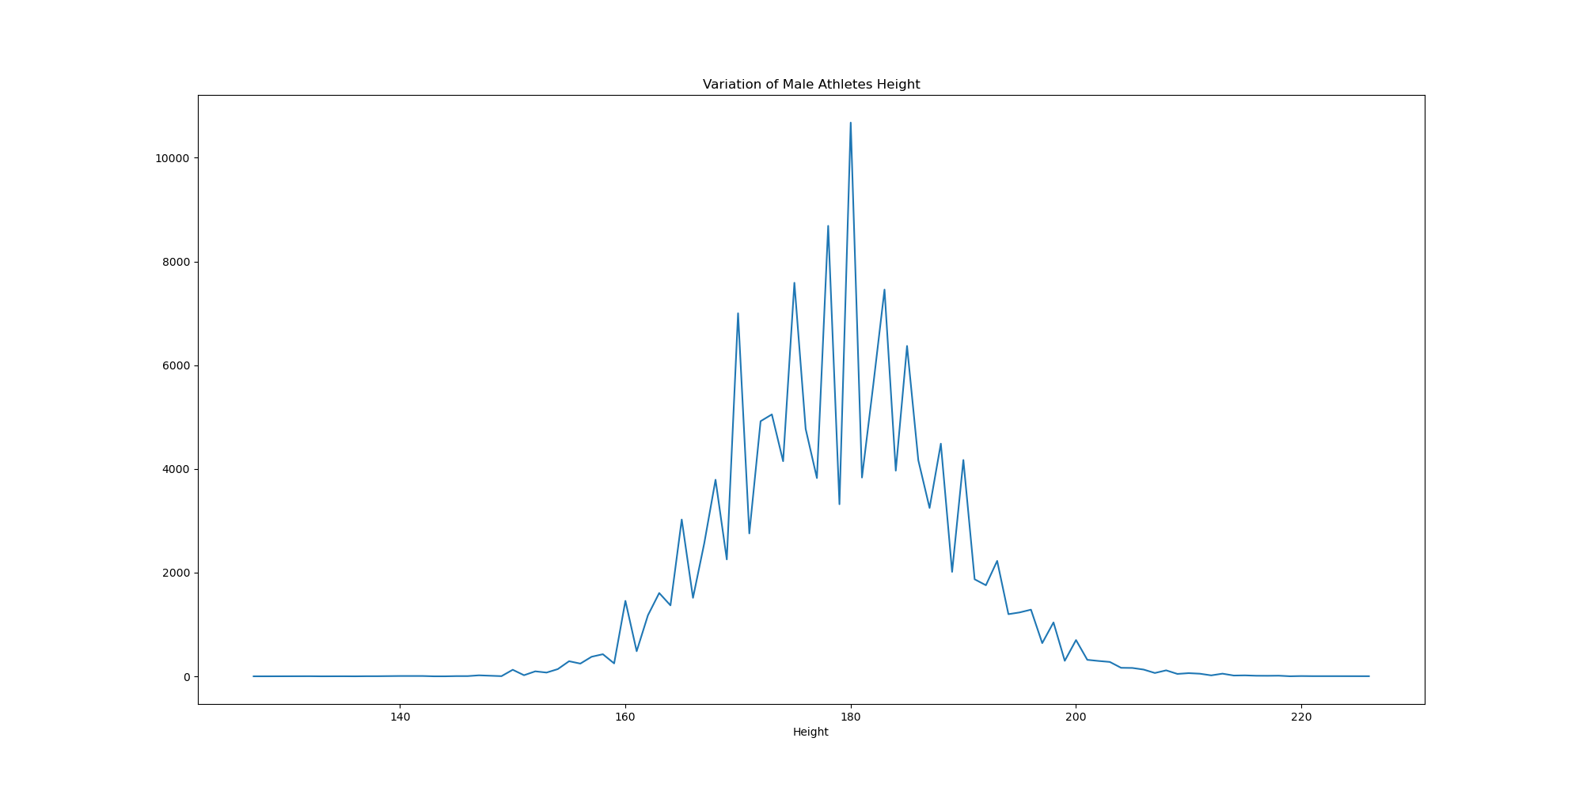
How Does Athlete Height affect performance
Median Height
Males: 180cm
Females: 170cm
Overall: 175cm
The Median height follows an upward trend when we limit it to medal winners

Slide 8
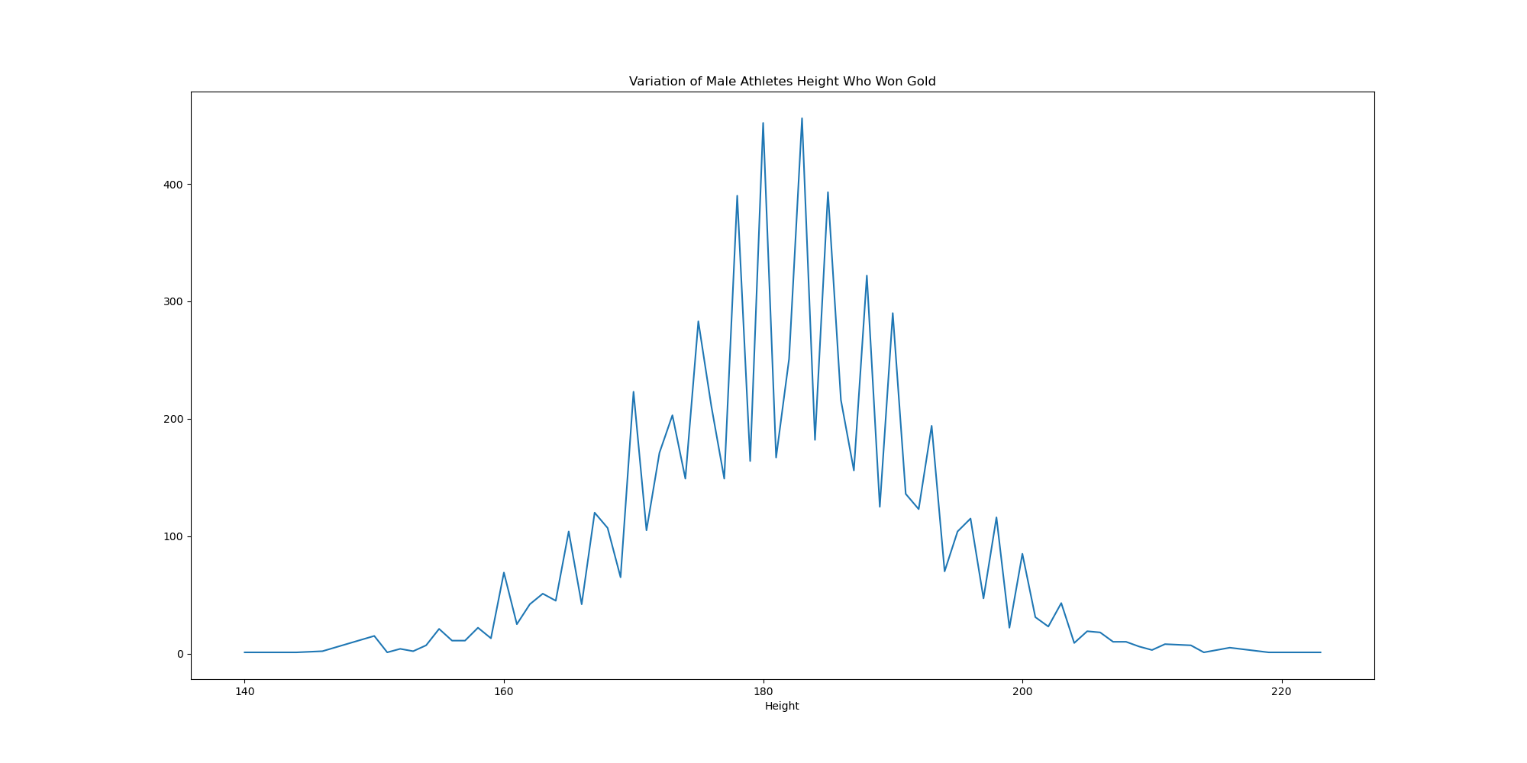
Gold Medal winner Heights

Slide 9
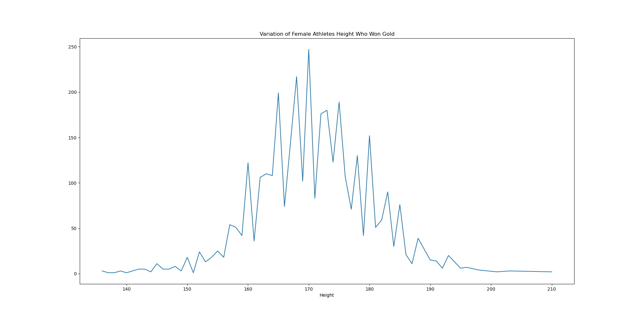
Gold medal winner heights

Slide 10
Athlete Height comparison
For males the trend is more apparent and we can see it follows this trend for silver and bronze winners as well
For females it is more subtle but is still present
Bronze and silver winners tend to have less and less winners over the median height compared to that of the gold winners
While height seems to have an effect of what medal an athlete may win I want to take a deeper look and see if it holds true when comparing countries winnings and height.

Slide 11
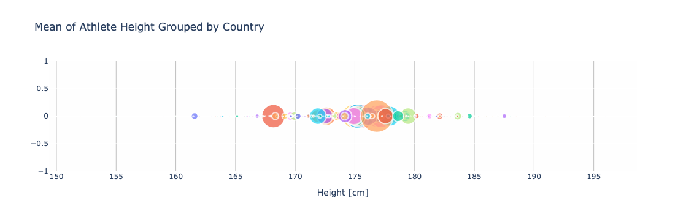
Countries Height
US Mean Height: 178.62 cm
URS Mean Height: 175.1cm
Germany Mean Height: 177.21cm
France Mean Height: 178.20cm
Italy Mean Height: 175.22cm
Sweden Mean Height: 177.91cm
Canada Mean Height: 174.93cm
Australia Mean Height: 176.85cm
Russia Mean Height: 178.84cm
Based on the top 10 most winning countries we can see that their overall athlete mean heights are all over the median of 175 cm except for Canada.

Slide 12
Height Conclusion
Based upon the data that was analyzed I believe that the taller an athlete is the better the chance of that athlete winning a medal.
This seems to be a bigger factor than even number of athletes since based upon my graphs we can see even countries with high numbers of participants don’t make the top 10 when it comes to winning such as Japan and Mexico.

Slide 13
Olympians World wide
Top 10 Countries of People participate in the Olympics
United States: 3,105
Germany: 1,211
Soviet Union: 1,204
France: 1,039
Great Britain: 1,036
People's Republic of China: 899
Italy: 885
Russian Federation: 779
Sweden: 740
Japan: 690

Slide 14
Olympians World wide
Top 10 countries Gold medals:
United States: 1229
Soviet Union: 473
Germany: 384
People's Republic of China: 384
Great Britain: 325
France: 312
Italy: 299
Russian Federation: 290
Sweden: 233
Japan: 229

Slide 15
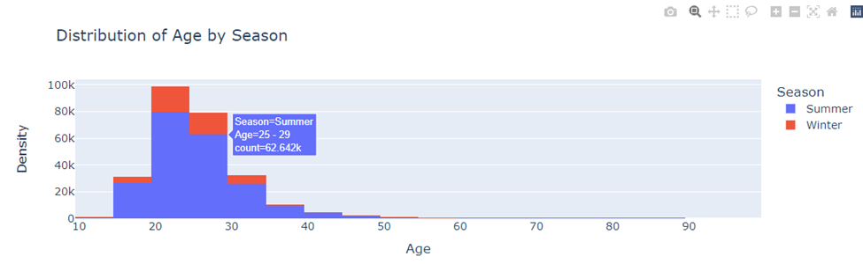
Olympians are probably older and younger than you think

Slide 16
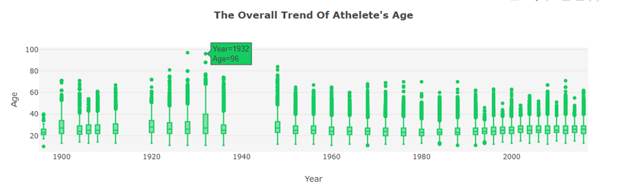
According to the International Olympic Committee, "there is no specific age limit for taking part in the Olympic Games."

Slide 17
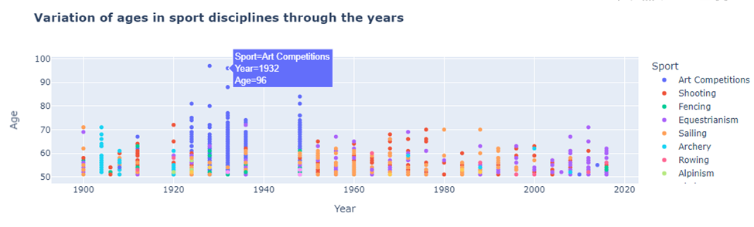
top 10 most popular olympic sports around the world:
GYMANSTICs, Swimming, Athletics (Track & Field), Weightlifting, Basketball

Slide 18
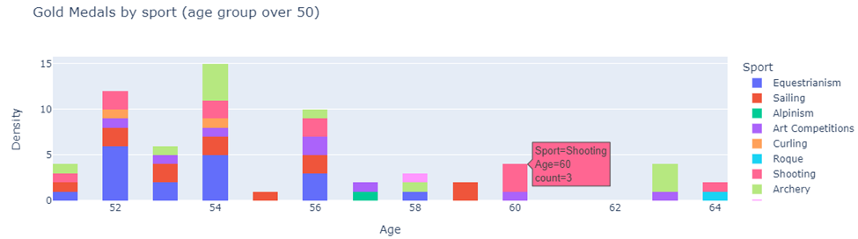
Oscar Swahn became the oldest Olympic gold medallist when, at 64 years 258 days old, his team won the men's 100 m running deer (single shot) shooting event at his home Games in Stockholm, Sweden, in 1912.

Slide 19
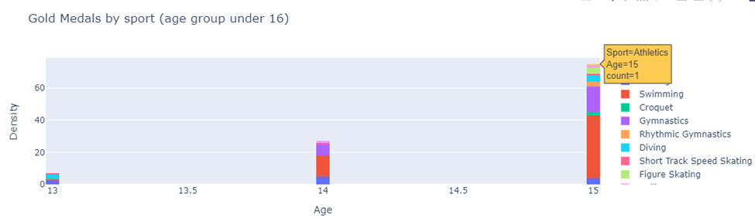
Marjorie Gestring was just 13 and 268 days old when she made history for the United States after capturing the gold medal in the 3-meter springboard diving competition in the 1936 Berlin Olympic Games

Slide 20
In conclusion, our analysis enables us to trace the evolution of sports popularity over Olympic history, providing insights into age trends across different years. The majority of athletes fell within the 20-40 age range throughout Olympic history. However, in the early 1900s, there was a higher proportion of older performers compared to the 2000s, reflecting the frequency of art and sculpting competitions, shooting, sailing, and horse dressage back then. In contrast, today's most popular Olympic sports include gymnastics, basketball, swimming, and track and field.

