Slide 1

Laboratory Management System
Enhancing Efficiency in Laboratory Operations

Slide 2
GROUP 1
Advanced Database Management Systems- DAMG 7275
Spring 2024
ADEDAMOLA ADESOYE 002707831
EMMANUEL CHIBUA 002799484
JAY SHUKLA 002619454
JONAH IGWEH 002742495
GUNJIT ARORA 002679282

Slide 3
Agenda
Business Problem Addressed by Database Design
Designing Process
Conceptual modeling
ER Diagrams
Entities And Attributes
Applications
Business Rules
Relationships/Associations
Views
Executive Summary
Summary

Slide 4
Executive Summary
Our main goal:
Design a resilient and scalable laboratory database management system
How did we gather requirements?
What did this information help with?
What tools did we use?

Slide 5
Business Problem Addressed by DB Design
Challenges During COVID-19
Identified Gap
Increase in demand for testing services exposed the limitations of the current laboratory management system
Late lab findings caused delays in diagnosis and worsened health for many people
The impact of this inefficiency has revealed to lab owners the importance of a resilient and scalable laboratory management database system.

Slide 6
Design Process
Requirement Gathering
The first phase entailed a thorough procedure of acquiring requirements. We researched the lab method using several online sites. Understanding the flow was crucial for us. We understood which entities were engaged and how they interacted. We analyzed web news and conducted interviews to determine user problem points.
Vision
Our objective was to improve laboratory operations through effective data tracking. The long-term vision involves implementing artificial intelligence for predictive analysis, creating a forward-thinking and adaptive system.

Slide 7
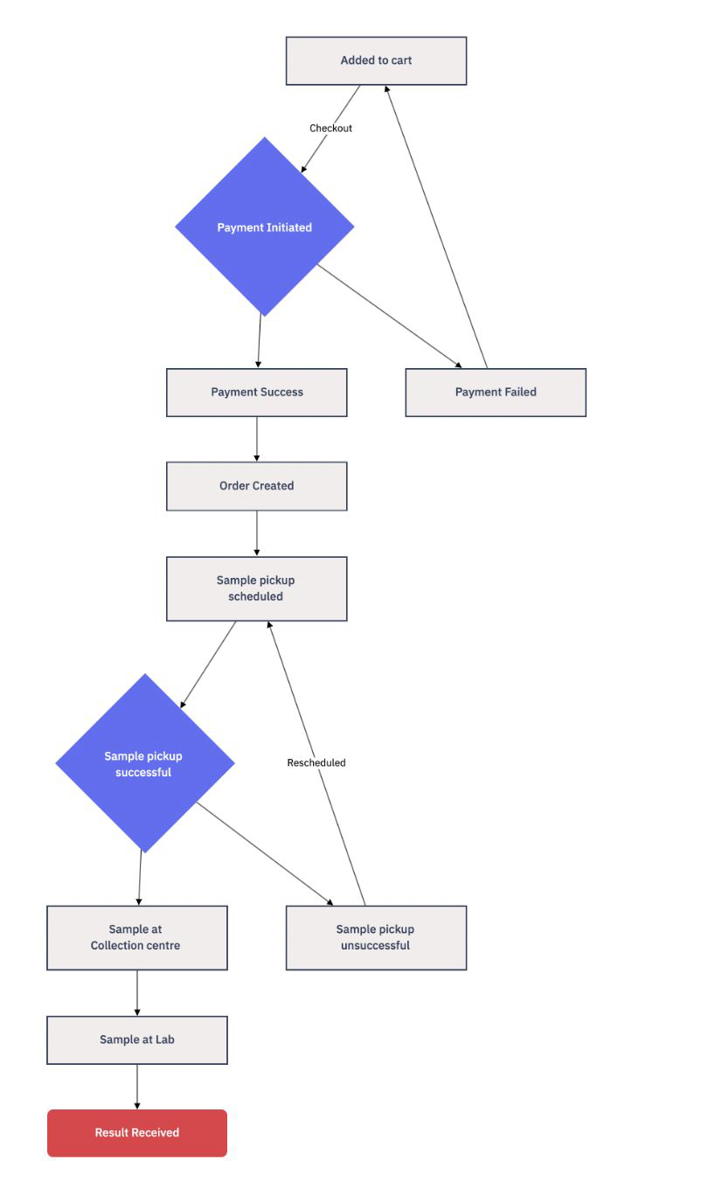
Key Initial Observations
After brainstorming, we developed a flowchart of order statuses.
We recognized the importance of having both the current order status and its history.
We plan to use views to create a standard schema structure.

Slide 8
Conceptual Modelling
After understanding the business workflow and needs, the following stage was to create critical details for the DBMS, including
Entities
Attributes
Business rules
Relationship between Entities

Slide 9
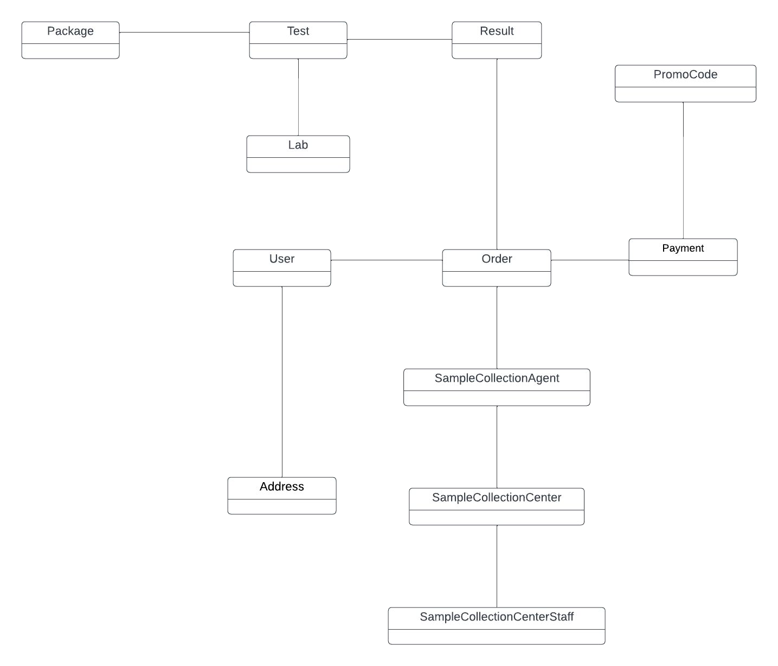
ER Diagram- Conceptual

Slide 10
Business Rules (Excerpts)
Every User must have a first name, last name, email, and phone number.
Every Order must have an associated user_id, agent_id, order_status, and order_date.
Every Payment must have an associated order_id, amount, payment_status, and payment_date.
Every Address must have a user_id, street, city, province, and zip_code.
Every SampleCollectionAgent must have an agent_name, contact_number, and is_active status.
A Package can contain multiple Tests, but a Test can belong to only one Package.
Each Order must have a corresponding OrderStatusHistory entry.
A PromoCode can be used a limited number of times, as specified by max_usage_count. The current_usage_count should not exceed the max_usage_count.
An Order can only be placed by an active User.
A SampleCollectionAgent can only collect samples if they are active.
A SampleCollectionCenter can employ multiple SampleCollectionCenterStaff, but a staff member can only work at one SampleCollectionCenter.
Each OrderDetail must have a corresponding Address.
A Payment can only be made for an Order that exists.
A LabTestMapping can only exist if the Lab and Test it refers to exist.
A PromoCode is only valid between the valid_from and valid_until dates.
No order will be scheduled for national holidays and Sundays.

Slide 11

Relationships and Associations
User to Order: A user can place multiple orders (One-to-Many).
User to Address: A user can have multiple addresses (One-to-Many).
Order to Order Details: An order has one set of details (One-to-One).
Order to Result: An order can have multiple test results (One-to-Many).
Payment to Promo Code: A payment can use zero or one promo code (One-to-One).
Order to SampleCollectionAgent: An order specifies one agent for sample collection (One-to-One).
SampleCollectionCenter to SampleCollectionCenterStaff: A sample collection center employs many staff members (One-to-Many).

Slide 12
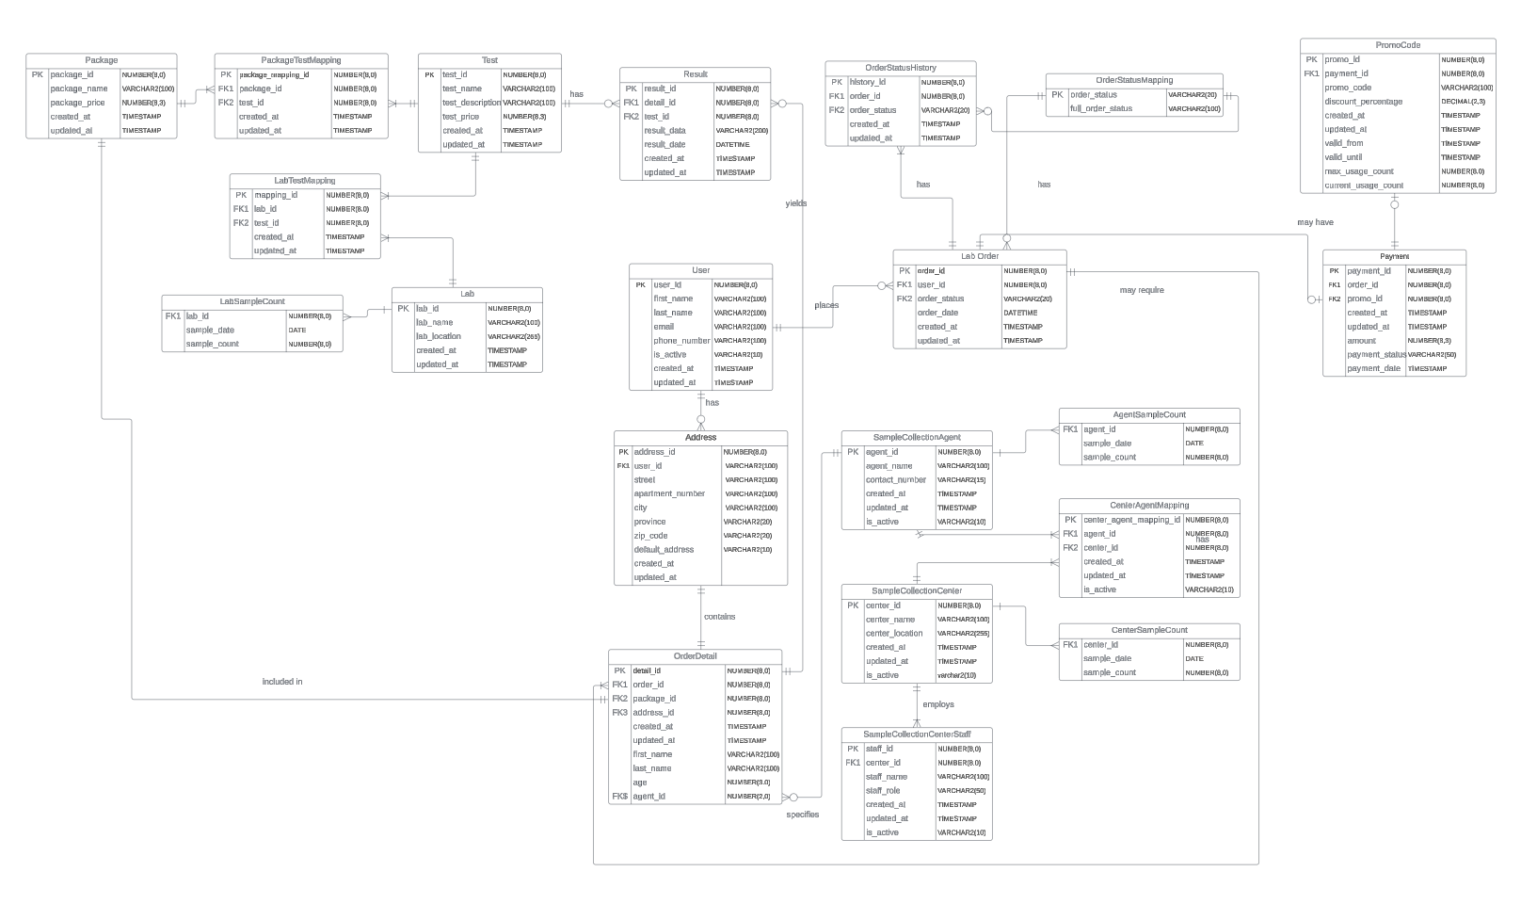
ER Diagram (Logical)

Slide 13
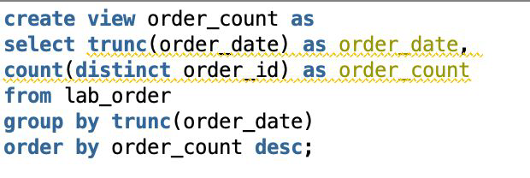
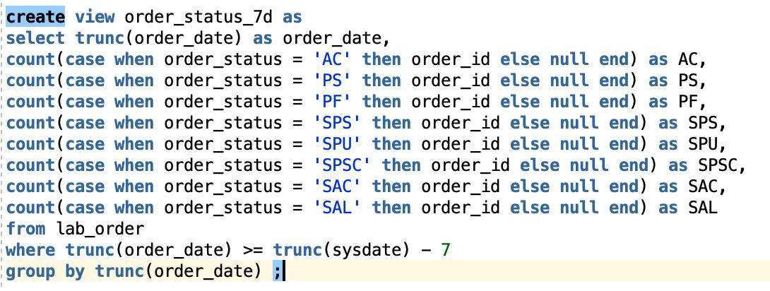
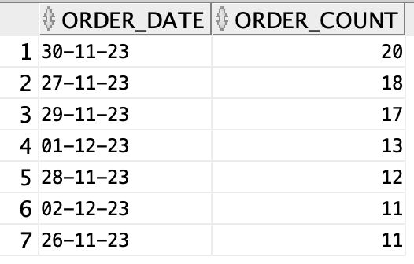
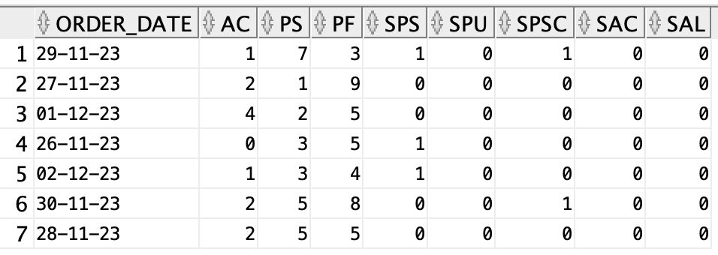
Views
Order_count
Order count aggregated on
order_date and sorted desc
Order_status_7d
Order status for orders with
order_date in the last 7 days

Slide 14
Summary
Our database design provides a solid foundation for a resilient and scalable laboratory data management system
The creation of database objects including stored procedures, functions and triggers simplify maintenance tasks and enhance the performance and security of the database by limiting direct access to tables

Slide 15
Thank you
Q & A

