Slide 1
Building Resilient Microservices
Pepared for Virtusa

Slide 2
Lesson Goals
Understand the challenges of Distributed Systems and a Microservices Architecture
Understand Timeouts
Understand Transient Faults
Understand CircuitBreakers
Understand Bulkheads

Slide 3
Hands-On Labs
Create a reliable OrderService Client leveraging
Spring Retry to handle transient faults
Netflix Hystrix to handle extended outages
Configure sensible timeouts

Slide 4
What is a Microservice?
Software architecture pattern that turns
business problems
into
distributed system problems.

Slide 5
What is a Distributed System?
A distributed computer system consists of multiple software components that are on multiple computers, but run as a single system. The computers that are in a distributed system can be physically close together and connected by a local network, or they can be geographically distant and connected by a wide area network.
-IBM

Slide 6




Distributed Systems in a Cloud World
Is this a distributed system?
Is this?
μ
Internet
Monolith
μ
μ
μ
μ
μ

Slide 7
So what’s the problem?

Slide 8
8 Fallacies of Distributed Systems
The network is reliable.
Latency is zero.
Bandwidth is infinite.
The network is secure.
Topology doesn't change.
There is one administrator.
Transport cost is zero.
The network is homogeneous.
-L Peter Deutsch & James Gosling

Slide 9
Idempotence
The property of certain operations in mathematics and computer science whereby they can be applied multiple times without changing the result beyond the initial application.
From a (micro)service standpoint, for an operation (or service call) to be idempotent, clients can make that same call repeatedly while producing the same result.

Slide 10
How do we mitigate those problems?

Slide 11
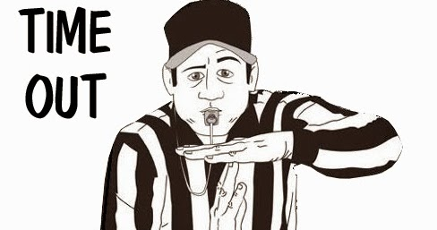
Timeouts
Fallacies:
1. The network is reliable
2. Latency is zero
3. Bandwidth is infinite
7. Transport cost is zero
8. The network is homogeneous
Myth:
Defaults are sensible in most cases

Slide 12
Timeouts
The amount of time a request or operation can take before an timeout error is returned.
Connection Timeouts
Request Timeouts
Command Timeouts
Query Timeouts
Operation Timeouts
Receive/Send Timeouts

Slide 13
Timeouts – Know your Defaults!
Tomcat – 60 seconds
Kestrel – none
Nginx – 300 seconds
Amazon Lambda – 300 seconds
ApiGee Edge Proxy – 57 seconds
Azure API Management Gateway – 300 seconds
Amazon API Gateway – 30 seconds (not configurable!)
Azure Function – 300 seconds
Logic App client request – 120 seconds
RestTemplate – none
MySQL JDBC - none
DynamoDB – none

Slide 14
Timeout Challenges
Defaults are NOT sensible
Can result in retries—manual or automatic
Client < Server timeouts can impact data integrity
Retries must be idempotent
Poor user experience

Slide 15
Rugged Timeouts
Use sensible timeouts, not the defaults.
Stop the work too! Use cancellation tokens and async all the way.
Make sure your services are idempotent. Browsers will retry a timed-out request even if the user doesn’t.
Consider asynchronous patterns, such as event driven design, for longer running operations.

Slide 16
Set your Timeouts - RestTemplate
HttpComponentsClientHttpRequestFactory requestFactory =
new HttpComponentsClientHttpRequestFactory();
requestFactory.setConnectTimeout(timeout);
requestFactory.setReadTimeout(timeout);
return new RestTemplate(requestFactory);

Slide 17
Set your Timeouts – JDBC Template
JdbcTemplate template = new JdbcTemplate(dataSource);
template.setQueryTimeout(5);

Slide 18
Set Your Timeouts - Tomcat
Spring Boot with Embedded Tomcat
server.connection-timeout=30000

Slide 19

Failures
Fallacies:
1. The network is reliable.
5. Topology doesn't change.
Your network will FAIL! Your servers will DISAPPEAR!

Slide 20
Transient Faults
Temporary disruptions in the network or services
Usually successful on an immediate retry
https://docs.microsoft.com/en-us/azure/architecture/best-practices/transient-faults

Slide 21
Transient Fault Handling
Detect the faults and retry
Be careful of Retry Storms (hint: Bulkhead Pattern and Rate Limiting)
https://docs.microsoft.com/en-us/azure/architecture/patterns/retry
https://docs.microsoft.com/en-us/azure/architecture/best-practices/retry-service-specific

Slide 22
Retry Pattern
for(int tries = 1;tries <= 3; tries++) {
try {
//...
break;
} catch(Exception e) {
if (tries == 3) throw e;
await Thread.sleep(100);
}
}

Slide 23
Transient Fault Handling Libraries
Spring Retry
Resilience4j

Slide 24
Transient Fault Handling
});
RetryTemplate retrytemplate = new RetryTemplate();
FixedBackOffPolicy fixedBackOffPolicy =
new FixedBackOffPolicy();
fixedBackOffPolicy.setBackOffPeriod(2000l);
retryTemplate.setBackOffPolicy(fixedBackOffPolicy);
retryTemplate.execute(arg0 -> {
//do some retryable work
};

Slide 25
Transient Fault Handling
@Retryable(
value = { SQLException.class },
maxAttempts = 2,
backoff = @Backoff(delay = 5000))
public void delete(long id) {
repostitory.deleteById(id)
}

Slide 26
What about extended outages?
Services are still unavailable after attempting a transient retry

Slide 27
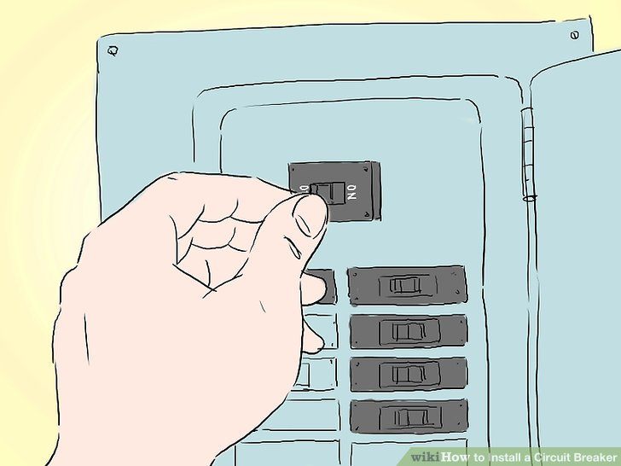
Circuit Breakers!

Slide 28
Circuit Breaker Pattern
A design pattern that stops requests from going to a failed service
Should provide an alternative response – degrade safely
Allows the failing downstream service to recover
https://docs.microsoft.com/en-us/azure/architecture/patterns/circuit-breaker
Notes:
Cascading failures

Slide 29
A Circuit Breaker has 3 states
Closed == normal operation
Open == an error condition caused the circuit breaker to trip. Calls are not made to the remote services.
Half Open == the wait period has expired and single request can be attempted.
OnError()
Closed
Open
Half Open
OnError()
OnExpire()
OnSuccess()
Notes:
Demo code

Slide 30
Circuit Breaker Libraries - Spring
Spring Cloud Netflix (deprecated)
Netflix Hystrix (EOL)
Spring Cloud Circuit Breaker
Netflix Hystrix (EOL)
Resilience4j
Spring Retry

Slide 31
Circuit Breaker Libraries
Netflix Hystrix (EOL)
Resilience4j
Spring Retry

Slide 32
Circuit Breaker with Spring Cloud Hystrix
@HystrixCommand(fallbackMethod = "defaultGreeting")
public String getGreeting(String username) {
return new RestTemplate()
.getForObject("http://localhost:9090/greeting/{username}",
String.class, username);
}
private String defaultGreeting(String username) {
return "Hello User!";
}

Slide 33
Bulkhead Pattern
Isolate elements of an application into pools so that if one fails, the others will continue to function.
This pattern is named Bulkhead because it resembles the sectioned partitions of a ship's hull. If the hull of a ship is compromised, only the damaged section fills with water, which prevents the ship from sinking.
https://docs.microsoft.com/en-us/azure/architecture/patterns/bulkhead

Slide 34
Bulkhead – A simple approach
static Semaphore bulkhead = new Semaphore(5);
try {
bulkhead.aquire();
...
} finally {
bulkhead.release();
}

Slide 35
Bulkhead Libraries
Hystrix
Resilience4j

Slide 36
Bulkheads + Circuit Breakers = Happy Service
A
B
Without bulkheads:
Service A receives concurrent requests
Service A calls Service B – Blocking
Service B is unhealthy and eventually will timeout
Service A starts timing out waiting requests
Notes:
A may have operations that don’t depend on B. These operations would also fail if calls to B eat up all the threads.

Slide 37
Bulkheads + Circuit Breakers = Happy Service
A
B
With bulkheads:
Service A receives concurrent requests
Service A calls Service B – but only allows a few calls at a time.
Service B is unhealthy and eventually will timeout
On the first timeout from B, A trips the circuit breaker and releases the semaphore
Subsequent requests sort circuit and no requests to service A timeout.
Notes:
Because only a few threads at a time can be consumed when calling B, other operations are free to complete.

Slide 38
How do you know your service is working?

Slide 39
Monitoring
Hardware metrics don’t give you the whole picture. In fact, they give you the wrong picture.
Monitor the efficiency of your service.
Latency (Efficiency)
Percentile
Median
Mean
Min
Max
Success
Request
Resources
CPU
Memory
Network
Failure

Slide 40
Monitoring
Use health checks: /health
Define what it means to be unhealthy
Include CircuitBreaker states of your dependencies.
Spring Boot Actuator
Setup monitoring for all your services.
Alert on efficiency, not resource utilization.
95th and 99th Percentile

Slide 41
Chaos Engineering
The discipline of experimenting on a distributed system in order to build confidence in the system’s capability to withstand turbulent conditions in production.
https://principlesofchaos.org/
Failure Injection Testing
Requires appropriate monitoring

Slide 42
Chaos Engineering
Killing machines/containers/nodes
Introduce CPU and memory pressure
Inject latency
Inject timeouts and failures

Slide 43
Additional Resources
https://docs.microsoft.com/en-us/azure/architecture/patterns/category/resiliency
https://www.baeldung.com/spring-cloud-netflix-hystrix
https://www.baeldung.com/spring-retry
https://github.com/resilience4j/resilience4j
https://spring.io/projects/spring-cloud-circuitbreaker

Slide 44
Thank You!

