Slide 1
Asynchronous Programming Part2
Prepared for Virtusa
Notes:
Who is running microservices in production?
Who is on that path or wants to be?
Who thinks this microservices thing is a load of rubbish and loves their monolith?

Slide 2
Lesson Goals:
Batching/Prefetching from Worker Queues
Timers
Other approaches to Thread management
Futures
Observables and Streams

Slide 3
Hands-On
Updating our logging-service to use batches
Introduce a Timer to flush the buffer before it’s full
Update the batching to use Observables

Slide 4
Batching/Pre-fetching
Challenge
Splunk allows for batched sends. Right now, we are sending one event at a time.
It’s slow and can overload Splunk
Many messaging systems support the ability to batch or pre-fetch several messages at once.

Slide 5
Timers
A facility for threads to schedule tasks for future execution in a background thread.
Tasks may be scheduled for one-time execution, or for repeated execution at regular intervals.
TimerTask flushBufferTask = new TimerTask() { public void run() { internalLogger.debug("Flush timer triggered."); LogAsync(channel).join(); } }; Timer timer = new Timer("Flush Timer"); long delay = 10000L; long period = 10000L; timer.scheduleAtFixedRate(flushBufferTask, delay, period);

Slide 6
ScheduledThreadPoolExecutor
A thread pool for repeatedly executing tasks at a given rate or delay
It is effectively a more versatile replacement for the Timer/TimerTask combination
Allows multiple service threads, accepts various time units, and doesn't require subclassing TimerTask (just implement Runnable).
Configuring ScheduledThreadPoolExecutor with one thread makes it equivalent to Timer.
ScheduledThreadPoolExecutor s = new ScheduledThreadPoolExecutor(1); s.scheduleAtFixedRate(flushBufferTask, delay, period, TimeUnit.MILLISECONDS);

Slide 7
Executor
An object that executes submitted Runnable tasks.
Decouples task submission from the mechanics of how each task will be run, including details of thread use, scheduling, etc.
An Executor is normally used instead of explicitly creating threads.
For example, rather than:
new Thread(new(RunnableTask())).start() for each of a set of tasks
We can use:
Executor executor = anExecutor;
executor.execute(new RunnableTask1());
executor.execute(new RunnableTask2());

Slide 8
ExecutorService
An Executor that provides methods to manage termination and methods that can produce a Future for tracking progress of one or more asynchronous tasks.
An ExecutorService can be shut down, which will cause it to reject new tasks.

Slide 9
ThreadPoolExecutor
An ExecutorService that executes each submitted task using one of possibly several pooled threads, normally configured using Executors factory methods.
Thread pools address two different problems:
Provide improved performance when executing large numbers of asynchronous tasks, due to reduced per-task invocation overhead
Provide a means of bounding and managing the resources, including threads, consumed when executing a collection of tasks.
The Executors factory has methods that preconfigure settings for the most common usage scenarios
Executors.newCachedThreadPool()
unbounded thread pool, with automatic thread reclamation
Executors.newFixedThreadPool(int)
fixed size thread pool
Executors.newSingleThreadExecutor()
Single background thread

Slide 10
Futures
A Future represents the result of an asynchronous computation.
Methods are provided to check if the computation is complete, to wait for its completion, and to retrieve the result of the computation.
//Execute the task on another thread
Future<String> future = executor.submit(new Callable<String>() {
public String call() {
return searcher.search(target);
}});
doOtherThings(); // do other things while searching
String searchResults = future.get(); // use future

Slide 11
FutureTask
An implementation of Future that implements Runnable, and so may be executed by an Executor
FutureTask<String> future =
new FutureTask<String>(new Callable<String>() {
public String call() {
return searcher.search(target);
}});
executor.execute(future);

Slide 12
CompletableFuture
A Future that may be explicitly completed (setting its value and status)
May be used as a CompletionStage
Supports dependent functions and actions that trigger upon its completion.
CompletableFuture<String> future =
new CompletableFuture<String>()
.thenApply(()->parse());
Executors.newCachedThreradPool().submit(new Callable<String>() {
public String call() {
String restult = searcher.search(target);
future.complete(result);
}});
doOtherThings(); // do other things while searching
String parsedResult = future.get();

Slide 13
Additional Resources
https://www.baeldung.com/java-runnable-callable
https://www.baeldung.com/java-future
https://www.baeldung.com/java-completablefuture

Slide 14

Coding Time!
Let’s improve on the threading of our Logging-Service

Slide 15
Streams

Slide 16
Streams
Streams are wrappers around a data source
Allow us to operate with that data source and making bulk processing convenient and fast.
A stream does not store data and is not a data structure.
A stream never modifies the underlying data source.
Supports functional-style operations on streams of elements.
Not to be confused with I/O streams

Slide 17
Creating Streams
Employee[] arrayOfEmps = {
new Employee(1, "Jeff Bezos", 100000.0),
new Employee(2, "Bill Gates", 200000.0),
new Employee(3, "Mark Zuckerberg", 300000.0) };
Stream.of(arrayOfEmps);
List<Employee> empList = Arrays.asList(arrayOfEmps);
empList.stream();

Slide 18
Additional Resources
https://stackify.com/streams-guide-java-8/
https://www.baeldung.com/java-8-streams

Slide 19
Coding Time!
Let’s streamline our LoggingWorker even more with Streams

Slide 20
Observables

Slide 21
Observer Pattern
A software design pattern in which an object, called the subject, maintains a list of its dependents, called observers, and notifies them automatically of any state changes.
The Observer pattern addresses the following problems:
A one-to-many dependency between objects should be defined without making the objects tightly coupled.
It should be ensured that when one object changes state an open-ended number of dependent objects are updated automatically.
It should be possible that one object can notify an open-ended number of other objects.

Slide 22
ReactiveX (RxJava)
ReactiveX is a library for composing asynchronous and event-based programs by using observable sequences.
Observables fill the gap by being the ideal way to access asynchronous sequences of multiple items
 | single items | multiple items
synchronous | T getData() | Iterable<T> getData()
asynchronous | Future<T> getData() | Observable<T> getData()
http://reactivex.io/intro.html

Slide 23
Why use observables?
The ReactiveX Observable model allows you to treat streams of asynchronous events with the same sort of simple, composable operations that you use for collections of data items like arrays.
It frees you from tangled webs of callbacks, and thereby makes your code more readable and less prone to bugs.

Slide 24
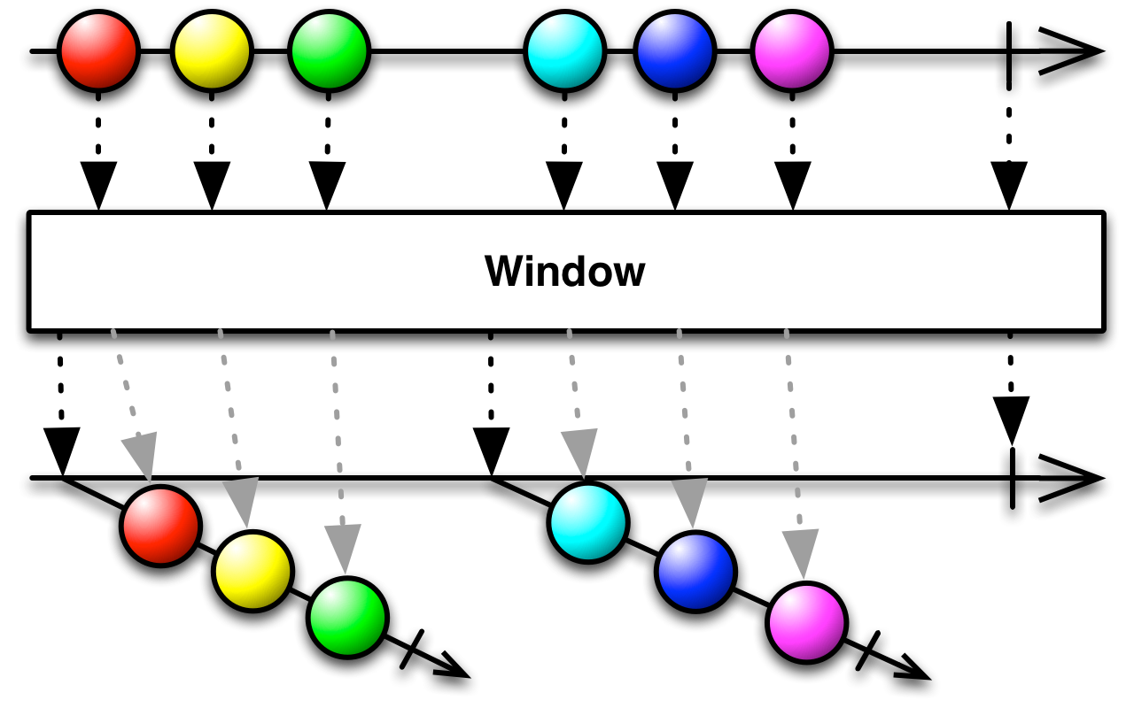
Observable: Window
Periodically subdivide items from an Observable into Observable windows and emit these windows rather than emitting the items one at a time

Slide 25
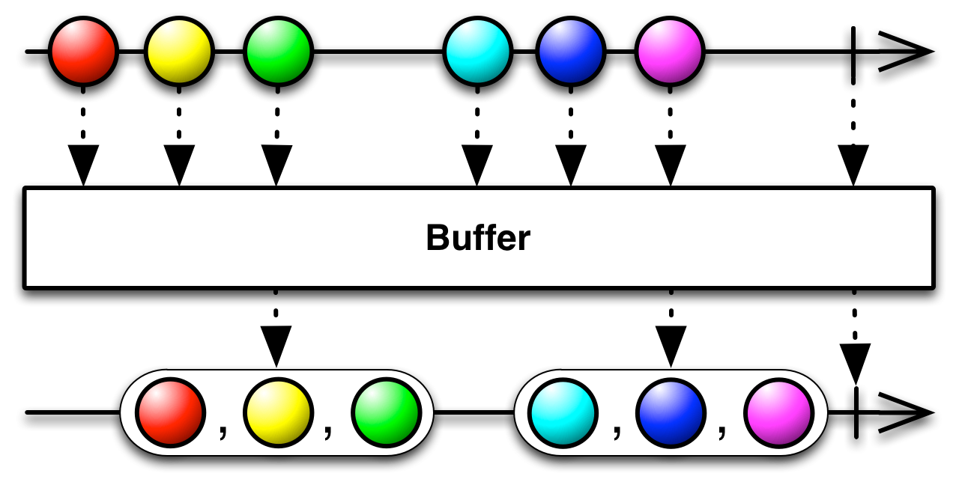
Observable: Buffer
Periodically gather items emitted by an Observable into bundles and emit these bundles rather than emitting the items one at a time

Slide 26
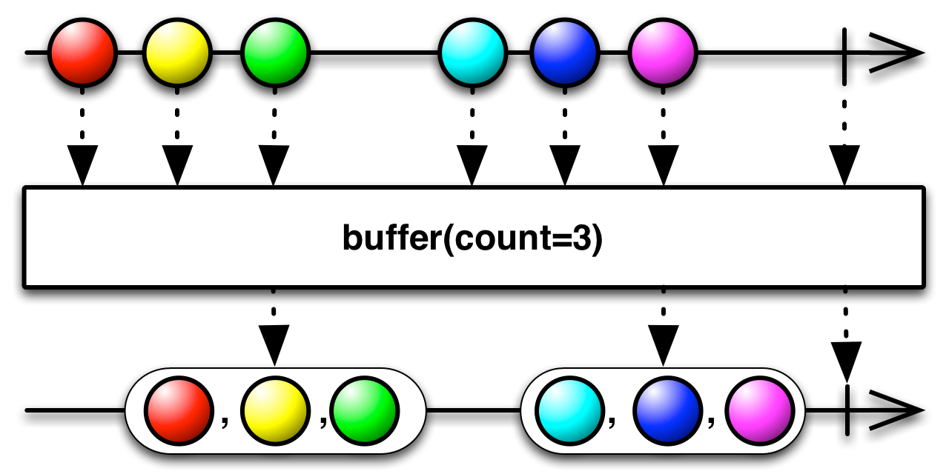
Buffer(count)
Emits non-overlapping buffers in the form of Lists, each of which contains at most count items from the source Observable
The final emitted List may have fewer than count items).

Slide 27
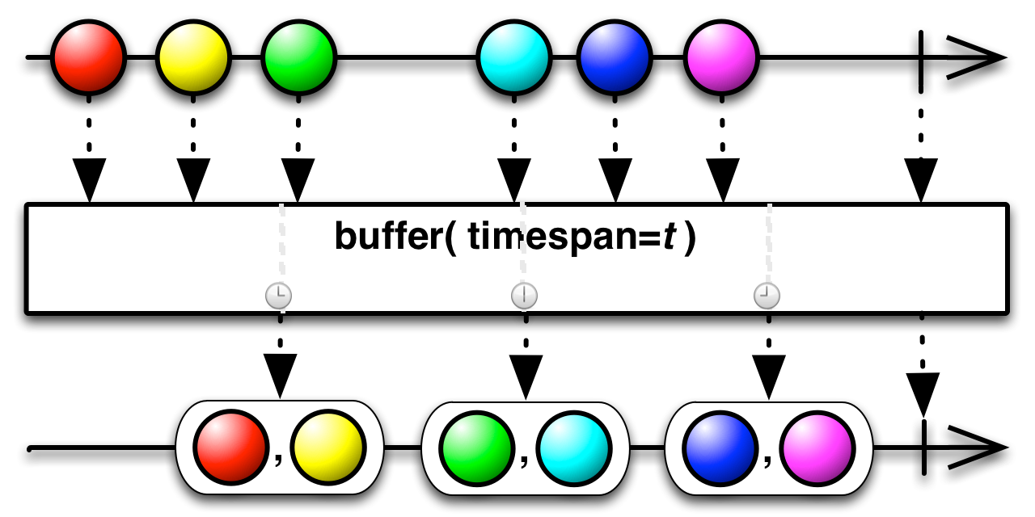
Buffer(timespan, unit)
Emits a new List of items periodically, every timespan amount of time, containing all items emitted by the source Observable since the previous bundle emission

Slide 28
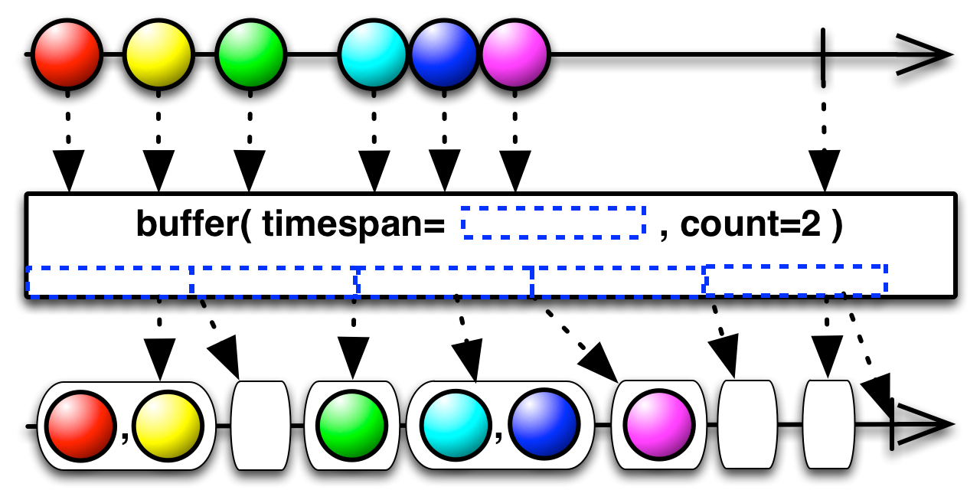
Buffer(timespan,unit,count)
Emits a new List of items for every count items emitted by the source Observable, or, if timespan has elapsed since its last bundle emission

Slide 29
Additional Resources
http://reactivex.io/
https://www.baeldung.com/rx-java
https://www.baeldung.com/rxjava-tutorial
https://www.baeldung.com/rxjava-schedulers

Slide 30
Coding Time!
Let’s streamline our LoggingWorker even more with Reactive Extensions

Slide 31
Thank You!

