Slide 1
Introduction to Microservices
Prepared for Virtusa
Notes:
Who is running microservices in production?
Who is on that path or wants to be?
Who thinks this microservices thing is a load of rubbish and loves their monolith?

Slide 2
Lesson Goals:
What is a microservice?
Why microservices?
How big/small is a “micro” service?
Domain Driven Design
Production Ready Checklist
Service Architecture for our Northwind Case Study

Slide 3
Hands-On Labs
Identifying boundaries within the larger model

Slide 4
What is a Microservice
“Microservices are small, autonomous services that work together.” –Sam Newman
Catalog
Orders
Inventory
Customer
Shipping

Slide 5
Characteristics of a Microservice Architecture
Componentization via Services
Organized around Business Capabilities
Products not Projects
Smart endpoints and dumb pipes
Decentralized Governance
Decentralized Data Management
Infrastructure Automation
Design for failure
Evolutionary Design
- Martin Fowler

Slide 6
In other words…
SOA done right.

Slide 7
Why Microservices?

Slide 8
Microservices provide benefits
Strong Module Boundaries: Microservices reinforce modular structure, which is particularly important for larger teams.
Independent Deployment: Simple services are easier to deploy, and since they are autonomous, are less likely to cause system failures when they go wrong.
Technology Diversity: With microservices you can mix multiple languages, development frameworks and data-storage technologies.
- Martin Fowler

Slide 9
But come with costs
Distribution: Distributed systems are harder to program, since remote calls are slow and are always at risk of failure.
Eventual Consistency: Maintaining strong consistency is extremely difficult for a distributed system, which means everyone has to manage eventual consistency.
Operational Complexity: You need a mature operations team to manage lots of services, which are being redeployed regularly.
- Martin Fowler

Slide 10
Considerations
“If you can’t build a well-structured monolith, what makes you think you can build a well-structured set of microservices?” –Simon Brown

Slide 11
When should we use Microservices?
When your teams, product, and business will get value from the benefits and can successfully navigate the costs.

Slide 12
What is a Microservice?
Software architecture pattern that turns
business problems
into
distributed system problems.

Slide 13
What is a Distributed System?
A distributed computer system consists of multiple software components that are on multiple computers, but run as a single system. The computers that are in a distributed system can be physically close together and connected by a local network, or they can be geographically distant and connected by a wide area network.
-IBM

Slide 14

How big/small should my microservice be?

Slide 15
Quick look at Domain Driven Design (DDD)

Slide 16
Bounded Context
Bounded Context is a central pattern in Domain-Driven Design.
It is the focus of DDD's strategic design section which is all about dealing with large models and teams.
DDD deals with large models by dividing them into different Bounded Contexts and being explicit about their interrelationships.
-Martin Fowler & Eric Evens

Slide 17
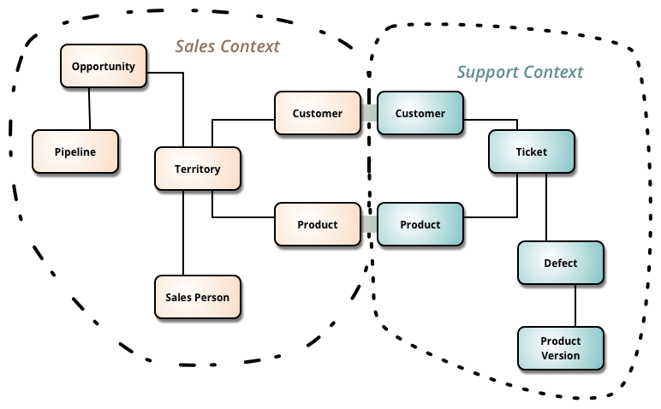
Bounded Context

Slide 18
Aggregate
A DDD aggregate is a cluster of domain objects that can be treated as a single unit.
Entities are saved and loaded in terms of their aggregate.
Transactions should not cross aggregate boundaries.
Not to be confused with an aggregate in UML.
- Martin Fowler & Eric Evens
Order
OrderItems
Shipping
Address

Slide 19
Aggregate Root
The object that is the root of the aggregate.
References from outside the aggregate should only be through the aggregate root.
Ensure data integrity of the aggregate
-Martin Fowler & Eric Evans
Order
OrderItems
Shipping
Address

Slide 20
Back to our regularly scheduled program…

Slide 21
How big/small should my microservice be?
Service boundaries typically should:
Only represent a single Bounded Context.
Provide CRUD operations and business behaviors for a single Aggregate
Don’t forget your SOLID principals.

Slide 22
DRY and Microservices
A tenet of microservices is “Don’t reuse/share code.”
This contradicts DRY, but…
If you have to share business logic, rethink the design. Your service might be too micro, or you should be making a remote API call instead.
Shared libraries are OK as long as:
Mulitple consumers don’t have to redeploy at the same time because of the dependency change.
Example: Cross cutting concerns like logging and monitoring.

Slide 23
Microservices and SRP
The (Micro)service architecture is a means of componentizing systems via services rather than libraries.
As with any component design, the component/service should have a single purpose.

Slide 24

Exercise: Where are our Bounded Contexts?
Customers
have
Addresses
Suppliers
place
purchased from
Orders
have
OrderDetails
defined by
Products
belong to
Categories
shipped by
have
picked using
and
shipped with
have a cost to ship
ProductImages
Shippers
ShippingRates
PackingSlips
have
PackingSlipDetails

Slide 25
Business Domain – Bounded Contexts
Customer Domain
Catalog Domain
Customers
Addresses
Products
Categories
Orders Domain
ProductImages
Orders
OrderDetails
Shipping Domain
Shippers
ShippingRates
Inventory Domain
Products
Suppliers
PackingSlips
PackingSlipDetails

Slide 26
Catalog and Inventory Bounded Contexts
Inventory
Catalog
Products
ProductId
ProductName
UnitPrice
QuantityPerUnit
UnitsInStock
UnitsOnOrder
ReorderLevel
Discontinued
Location
Products
ProductId
ProductName
ListPrice
QuantityPerUnit
IsInStock
Published
Categories
Suppliers
ProductImages

Slide 27
Microservice Communication
Synchronous RPC and ReST
JSON-RPC over HTTP
gRPC
SOAP over HTTP or TCP
Asynchronous Event Messaging
Queues
Topics/Subscriptions (pub/sub)
Event Streams

Slide 28
Additional Resources
Martin Fowler’s Blog: https://martinfowler.com/microservices/
“Building Microservices”, by Sam Newman
“Monolith to Microservices”, by Sam Newman
InfoQ: https://www.infoq.com/microservices
“SOA Principles of Service Design”, by Thomas Erl

Slide 29
Going to Production

Slide 30
Production Ready Checklist
Stability and Reliability
Scalability and Performance
Fault Tolerance and Disaster Recovery
Monitoring
Documentation

Slide 31
Stability and Reliability
Stable development cycle
Stable deployment cycle
Dependency Management
Onboarding + Deprecation procedures
Routing + Discovery

Slide 32
Scalability and Performance
Understanding growth-scales
Resource awareness
Dependency scaling
Constant performance evaluation
Traffic management
Capacity Planning

Slide 33
Fault Tolerance and Disaster Recovery
Avoiding Single Points of Failure (SPOF)
Resiliency Engineering
Understand failure scenario’s
Disaster Recovery Plans
Incident Management

Slide 34
Monitoring
Dashboards + Alerting for:
Service
Resource Allocation
Infrastructure
All alerts are actionable and have pre-documented procedures.
Logging

Slide 35
Documentation
Have one central landing-place for documentation for the service
Review of documentation from Engineer/ SRE/ Partners
Reviewed Regularly
What should documentation include:
Key information (ports/ hostnames etc)
Description
Architecture Diagram
API description
On-call information
Onboarding information

Slide 36
Good Book…
Production-Ready Microservices
Susan J. Fowler
O’Reilly 2017

Slide 37
Thank You!

