Slide 1
Welcome to Comprehensive Microservices!
Prepared for Virtusa
Notes:
Who is running microservices in production?
Who is on that path or wants to be?
Who thinks this microservices thing is a load of rubbish and loves their monolith?

Slide 2
Lesson Goals:
Get acquainted
Understand the goals of the course
Understand the approach we will take
Introduction to our case-study client and project
Introduction to containerization and Docker
Get our environment setup, verified, and ready to code!

Slide 3

Hands-on Labs
Setting up a local development environment with Docker and Docker Compose
Connecting to MySQL
Restoring MySQL databases
Anytime you see this, it’s stuff we will do together hands-on.

Slide 4
About Me
Jason Penniman
Founder, Chief Architect of Milestone Technology Group, LLC—an NLB Services, Inc. Learning Partner
25+ years building enterprise solutions
20+ years as a Vocational Trainer
Email: jason.penniman@milestonetg.com
Twitter: @TheArchitect452
GitHub: jpenniman

Slide 5
Classroom rules
Please slow me down if we’re moving too fast.
Please ask questions as we go.
There is no such thing as a stupid question. The only stupid question is the one that isn’t asked.

Slide 6
Learning Approach
Course Goal: Learn how to build a software solution using a microservice architecture.
To accomplish this, we will build a real-world working solution consisting of 6 microservices.
The solution will encompass all the topics we will cover in this course.
We will build some of the services together.
The final week, you will build the remaining services on your own.

Slide 7
High-Level Schedule - Tentative
Day | Topics | Hand-On Labs
1 | Introductions | Verify environment and setup databases
1-3 | Software Engineering Fundamentals, Asynchronous Programming, Containers | Threading Lab Build and deploy our Logging-Service
4-8 | Introduction to Microservices, REST, JDBC, Observability, Security, Event-Driven-Design, API Documentation | Build and deploy our Customer-Service
9-12 | Hibernate, Asynchronous Rest Controllers, Reacting to Events, Designing for Failure (resiliency) | Build and deploy our Order-Service
13-15 | Synchronizing data between services, Responding to data changes | Build and deploy our Catalog-Service v1 and Inventory-Service v1
16-20 | Final Project | Build and deploy Catalog-Service v2, Inventory-Service v2, Shipping-Service
17-25 | MuleSoft | TBD

Slide 8
Case Study
Project Background

Slide 9

Our Client
Northwind Traders
Provide organic grocery goods to restaurants and markets
Our Task
Build their next-generation Sales Order System
Data has been migrated from the legacy system to a set of MySQL databases by the data team.

Slide 10
Business Process
Customer is invoiced
Customer
Places an Order
Order is updated with shipping info
Order status is updated
Orders
Order is
Fulfilled in the Warehouse
Inventory
Freight is calculated
Fulfillments
Are Shipped
Shipping

Slide 11
High-Level Solution Approach…
Microservices Architecture
ReST-ful JSON over HTTP APIs for synchronous communication
Event Bus for asynchronous communication
Test Driven Development

Slide 12



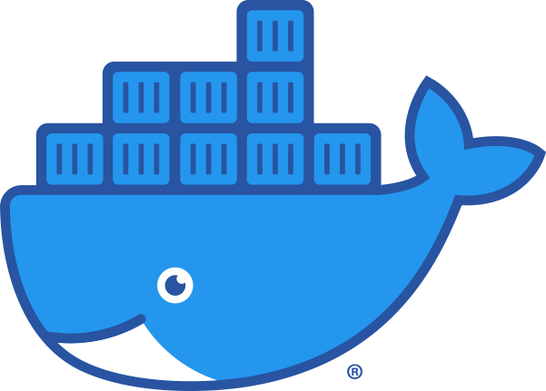
Technology Stack - Infrastructure
Datastore = MySQL
Every microservice will get it’s own database, but each database will be created in the same MySQL server instance locally to conserve developer workstation resources.
Deployed using Docker for ease of spin-up, tear-down, rebuilds, etc.
Event Bus = RabbitMQ
Deployed using Docker for ease of spin-up, tear-down, rebuilds, etc.
Logging and Metrics = Splunk
Deployed using Docker for ease of spin-up, tear-down, rebuilds, etc.
Microservice Deployment
Self-Contained deployable
Docker Containers

Slide 13
Languages and Frameworks
Java 8
Reactive Extensions
Spring
Spring Boot
Spring MVC Rest
and more…
Hibernate
JUnit

Slide 14
Toolset
IntelliJ IDEA
MySQL Workbench (or similar)
Docker Desktop
Git
Postman (or similar)

Slide 15
Let’s get setup…

Slide 16
First, a quick primer on Docker
Docker is a container runtime.
Containers are a set of linux features (namespaces, cgroups, etc) that isolate running processes from each other.
Container Images—the things that define the container—live in a repository in a Container Registry.
We “pull” images from a repository: docker pull …
We “run” the image to create a new container instance: docker run …

Slide 17
Docker commands
command | Performs | Example
pull | Gets an image from a repository on a registry | docker pull mysql:5.7
run | Create a new container instance | docker run –name training-mysql -d mysql:5.7
stop | Stop a running instance | docker stop training-mysql
start | Start an existing container instance | docker start training-mysql
ps | List container instances | docker ps
image list | List images | docker image list docker images
rm | Remove a container | docker rm training-mysql
image rm | Remove an image | docker image rm mysql:5.7

Slide 18
Docker Compose
Compose is a tool for defining and running multi-container Docker applications.
With Compose, you use a YAML file to configure your application’s services.
Then, with a single command, you create and start all the services from your configuration.
-Docker Compose Documentation (https://docs.docker.com/compose/)

Slide 19
Sample docker-compose.yml
version: '3'
services:
mysql:
image: mysql:5.7
container_name: training-mysql
hostname: training-mysql
ports:
- 127.0.0.1:3306:3306 #listener
environment:
- MYSQL_ROOT_PASSWORD=password

Slide 20
Common docker-compose Commands
command | Performs | Example
up | Creates/recreates/starts an environment. | docker-compose up -d
down | Stops and Destroys an environment | docker-compose down
stop | Stop the entire environment or service | docker-compose stop
start | Start an existing environment or service | docker-compose start

Slide 21
Let’s setup our local dev environment with docker and docker-compose
Get the images:
docker pull mysql:5.7
docker pull rabbitmq:3.8
docker pull splunk/splunk
Get the scripts from GitHub:
git clone https://github.com/jpenniman/java-ms-training
Startup the environment with docker compose:
docker-compose up -d
Verify the containers are running:
docker ps

Slide 22
Check things out…
RabbitMQ Portal: http://localhost:15672
Splunk Portal: http://localhost:8000

Slide 23
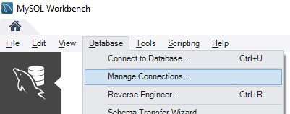
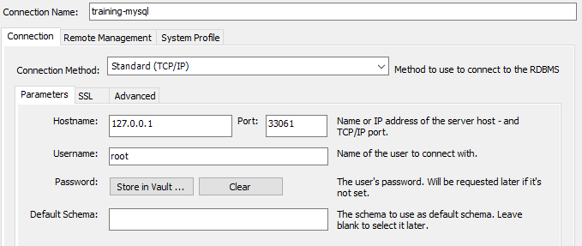
Setup Our Connection in MySQL Workbench

Slide 24
Restore Our Databases
Databases: https://github.com/jpenniman/northwind-db
git clone https://github.com/jpenniman/northwind-db.git
Restore:
mysql -e "source customer-db.sql"
mysql -e "source order-db.sql"
mysql -e "source inventory-db.sql"
mysql -e "source catalog-db.sql"
mysql -e "source shipping-db.sql"

Slide 25
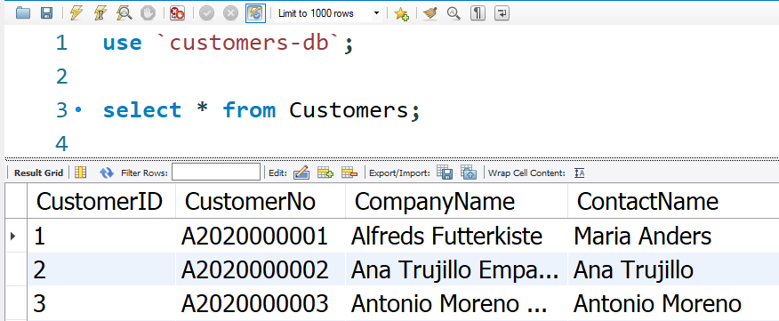
Verify

Slide 26
We’re Ready!
MySQL up and running
RabbitMQ
Splunk
Databases setup
MySQL Workbench
Git
IntelliJ
Docker
Postman

