Slide 1
Software Engineering Fundamentals Part 2
Prepared for Virtusa
Notes:
Who is running microservices in production?
Who is on that path or wants to be?
Who thinks this microservices thing is a load of rubbish and loves their monolith?

Slide 2
Lesson Goals:
Application Configuration
Application.Properties
Spring Configuration
Cloud Options
Best Practices
Application Logging
Best Practices
Loggers for Java
Logging in Spring Boot applications
Dependency Injection
Fundamentals
Object Lifetime

Slide 3
Hands-On Labs
Implement application.properties in our Logging-Service
Implementing Logging and error handling in our Logging-Service
Implement Dependency Injection in our Logging-Service

Slide 4
Application Configuration

Slide 5
Configuration
It is best practice to separate configuration from code
In a perfect world, deployment of configuration is also separate from code
Common options for storing/retrieving configuration:
Local configuration file
Local database
Configuration Service

Slide 6
Local Configuration
A file deployed with your service that contains application configuration properties
application.properties
Stores properties in key=value pairs. Akin to .ini files.
Read using java.util.Properties
YAML files
Spring offers the ability to use YAML files for configuration
XML files
Many third party libraries, such as Log4J and Logback, use XML files

Slide 7
Application.properties
splunk.server=https://127.0.0.1:8088 splunk.token=abcd1234 queue.server=127.0.0.1 queue.user=admin queue.password=password queue.name=logging-service queue.batchSize=5

Slide 8
Application.yml
splunk:
server: https://127.0.0.1:8088 token: abcd1234
queue:
server: 127.0.0.1 user: admin password: password name: logging-service batchSize: 5

Slide 9
Challenges with local files
Can’t change configuration on the fly. At least not easily.
Secrets and Keys get stored on disk

Slide 10
Using a Database
To further externalize configuration, we can store config values in our service’s database
Allows for independent deployment of configuration from code
Allows for configuration to be changed at runtime without restarting your services
The local configuration file simply contains how to connect to the database
Challenges:
Secrets and Keys are still exposed

Slide 11
Configuration Services
Rather than configuration stored locally, configuration is stored externally and exposed via an API.
Common in cloud and microservices environments
Allows for independent deployment of configuration from code
Allows for configuration to be changed at runtime without restarting your services
Allows for better secrets and key management
The local configuration file simply contains how to connect to the configuration service.

Slide 12
Configuration Services
Spring Cloud Config Server
https://cloud.spring.io/spring-cloud-config
AWS Systems Manager Parameter Store, AWS Secrets Manager
https://docs.aws.amazon.com/systems-manager/
https://docs.aws.amazon.com/secretsmanager
Azure Application Configuration Services
https://docs.microsoft.com/en-us/azure/azure-app-configuration/

Slide 13
Consuming Configuration in your Service
Recommended to create a POJO for the configuration values expected by a component.
Abstracts the configuration mechanism from the rest of the application.
public class SplunkClient {
public SplunkClient(SplunkConfig config) { ...
}
...
}
public class SplunkConfig { private final String server; private final String token; public String getServer() { return server; } public String getToken() { return token; } }

Slide 14
Reading application.properties
Read using java.util.Properties
Properties properties = new Properties();
InputStream propertiesFileStream =
AppConfig.class.getClassLoader().getResourceAsStream("application.properties");
properties.load(propertiesFileStream);
propertiesFileStream.close();

Slide 15

Coding Time!
Let’s add application.properties to our Logging-Service

Slide 16
Application Logging

Slide 17
Logging Frameworks for Java
Log4j/Log4j2 (https://logging.apache.org/log4j/2.x/)
Logback (http://logback.qos.ch/)
java.util.logging
Slf4j—Simple Logging Framework for Java (http://www.slf4j.org/)
Only a façade
Requires a logging implementation like Log4j
Apache Commons Logging (JCL) (https://commons.apache.org/proper/commons-logging/)
Only a façade
Requires an implementation like Log4j
Also supports slf4j

Slide 18
Which One?
Spring/Spring Boot uses Commons Logging
Spring Boot provides a default configuration of JCL->SLF4J->Logback
Spring Boot makes sure third party libs based on any of the loggers “just works”
Hibernate uses SLF4J
We will use SLF4J + Logback for our Logging-Service, and Commons Logging in our Spring Boot based services.

Slide 19
Log Levels – Apache Commons Logging
Level | Description/Recommendation
fatal | Severe errors that cause premature termination. Expect these to be immediately visible on a status console.
error | Other runtime errors or unexpected conditions. Expect these to be immediately visible on a status console.
warn | Use of deprecated APIs, poor use of API, 'almost' errors, other runtime situations that are undesirable or unexpected, but not necessarily "wrong". Expect these to be immediately visible on a status console.
info | Interesting runtime events (startup/shutdown). Expect these to be immediately visible on a console, so be conservative and keep to a minimum.
debug | detailed information on the flow through the system. Expect these to be written to logs only.
trace | more detailed information. Expect these to be written to logs only

Slide 20
Log Levels – SLF4J and others
No “fatal” level. Fatal maps to “error”.
Level | Description/Recommendation
error | Other runtime errors or unexpected conditions. Expect these to be immediately visible on a status console.
warn | Use of deprecated APIs, poor use of API, 'almost' errors, other runtime situations that are undesirable or unexpected, but not necessarily "wrong". Expect these to be immediately visible on a status console.
info | Interesting runtime events (startup/shutdown). Expect these to be immediately visible on a console, so be conservative and keep to a minimum.
debug | detailed information on the flow through the system. Expect these to be written to logs only.
trace | more detailed information. Expect these to be written to logs only

Slide 21
Logging Best Practices
EVERYTHING in production should be logging
ALWAYS log errors
Leverage log levels for debugging and tracing
Production should typically run with logging level INFO
NEVER log logging errors to the same logger that produced the error—will cause an infinite call loop and stack overflow.

Slide 22
Logging Exceptions
External Boundaries - Expected Exceptions
This classification includes exceptions such as FileNotFoundException that cross API/SPI boundaries, and are exposed to the user of a component/toolkit.
These are listed in the 'throws' clause of a method signature.
API's for utility functions and tools should log these at the debug level, if they are caught at all by internal code.
For higher level frameworks and middleware components, these exceptions should be:
Caught immediately prior to crossing the API/SPI interface back to user code-space
Logged with full stack trace at info level, and rethrown.
This assures that the log contains a record of the root cause for future analysis in the event that the exception is not caught and resolved as expected by the user's code.
https://commons.apache.org/proper/commons-logging/guide.html

Slide 23
Logging Exceptions
External Boundaries - Unexpected Exceptions
This classification includes exceptions such as NullPointerException that cross API/SPI boundaries, and are exposed to the user of a component/toolkit.
These are runtime exceptions/error that are NOT listed in the 'throws' clause of a method signature.
APIs for utility functions and tools should log these at the debug level, if they are caught at all.
For higher level frameworks and middleware components, these exceptions should be:
Caught immediately prior to crossing the API/SPI interface back to user code-space
Logged with full stack trace at info level, and
Rethrown/wrapped as ComponentInternalError (custom exception).
This ensures that the log contains a record of the root cause for future analysis in the event that the exception is not caught and logged/reported as expected by the user's code.
https://commons.apache.org/proper/commons-logging/guide.html

Slide 24
Logging Exceptions
Internal Boundaries
Exceptions that occur internally and are resolved internally.
These should be logged when caught as debug or info messages, at the programmer's discretion.
Significant Internal Boundaries
This typically only applies to middleware components that span networks or runtime processes.
Exceptions that cross over significant internal component boundaries such as networks should be logged when caught as info messages.
Do not assume that such a (process/network) boundary will deliver exceptions to the 'other side'.
https://commons.apache.org/proper/commons-logging/guide.html

Slide 25
Coding Time!
Let’s add internal logging to our Logging-Service

Slide 26
Dependency Injection

Slide 27
Dependency Inversion Principle (DIP)
Entities must depend on abstractions not on concretions. It states that the high level module must not depend on the low level module, but they should depend on abstractions.
Encompasses two design patterns:
Dependency Injection
Inversion of Control

Slide 28
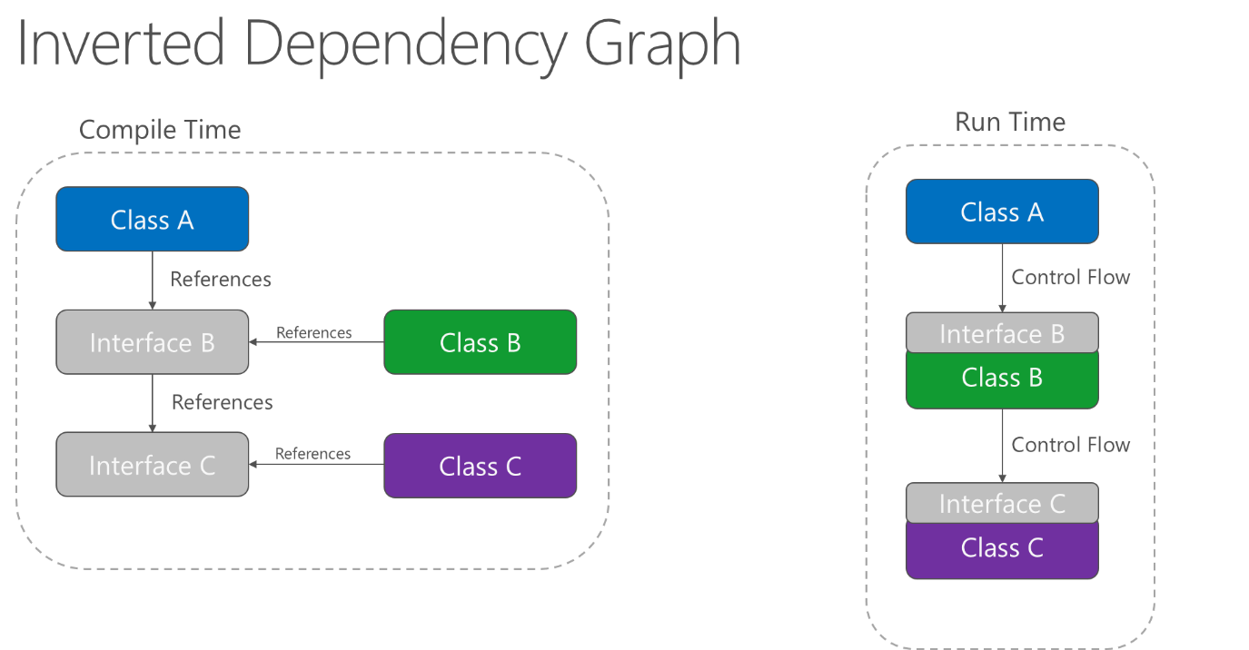
Dependency Inversion

Slide 29
What is Dependency Injection?
Programming technique that makes a class independent of its dependencies.
Dependencies are “injected”, or supplied, to the class at runtime.

Slide 30
Benefits
Aids in unit testing allowing us to mock dependencies.
Supports the Open/Closed Principle and Dependency Inversion Principle
Provides clarity and intent in our code

Slide 31
Forms of Injection
Constructor Injection (best practice)
Setter Injection (anti-pattern)
Aside:
Today’s best practices are tomorrow’s anti-patterns.

Slide 32
Constructor Injection
Dependencies are resolved and passed into the constructor of the requested type.
This is the preferred method. It clearly defines the dependencies of the service
private final Logger logger;
public ListenerService(Logger logger) {
this.logger = logger;
}

Slide 33
Setter Injection
Dependencies are resolved for marked setters.
Next best thing when constructor injection is not possible—eg. Non-static typed languages like Python and JavaScript.
Considered an anti-pattern because it hides the required dependencies.
@Inject
public Logger Logger { get; set; }

Slide 34
Service Locator Pattern
Services are resolved by explicitly querying the container.
Generally used to bootstrap the application.
It is NOT dependency injection. It is service resolution.
Considered an anti-pattern when not bootstrapping.
Hides the actual dependencies for the service.
Forces a dependency on the container itself.
Logger logger = ctx.getBean(Logger.class);

Slide 35
Popular DI/IoC Frameworks
Spring IoC
Google Guice
Dagger
JaveEE 6 CDI
PicoContainer

Slide 36
Object Lifetimes – Spring IoC
Singleton
Only a single instance is ever created in the container. The same instance is returned every time the type is resolved.
Default
Prototype
A new instance is created every time a type is resolved.
Request
This scopes a bean definition to an HTTP request.
Only valid in the context of a web-aware Spring ApplicationContext.
Session
This scopes a bean definition to an HTTP session.
Only valid in the context of a web-aware Spring ApplicationContext.
Global-Session
This scopes a bean definition to a global HTTP session. Only valid in the context of a web-aware Spring ApplicationContext.

Slide 37
Coding Time!
Let’s add Dependency Injection to our Logging-Service

Slide 38
Thank You!

