Slide 1
Software Engineering Fundamentals Part 1
Prepared for Virtusa
Notes:
Who is running microservices in production?
Who is on that path or wants to be?
Who thinks this microservices thing is a load of rubbish and loves their monolith?

Slide 2
Lesson Goals:
Object Oriented Design Fundamentals and Patterns
S.O.L.I.D. Principles and other useful acronyms
Creating, building, and packaging a basic Java Application with Gradle
Test Driven Development
Adding dependencies in Gradle

Slide 3
Hands-On
Create a new Gradle project in IntelliJ
Upgrading Gradle
Self-contained deployables with Gradle
Creating classes and interfaces
Creating immutable objects
Abstracting concrete implementations
Creating Factories and Singletons
Using the Provider Pattern
Using the Builder Pattern

Slide 4
Case Study
Logging Utility Service

Slide 5
The Challenge
Northwind is using Splunk Cloud for logging and metrics.
Possible (and very likely) failure points:
Northwind’s network
Internet
Splunk Cloud
Logging from our microservice should be fast.
Logging failures should not impact our services.
Log entries should not be lost in the event of an infrastructure failure.
Solution should support easily swapping out Splunk in the future.

Slide 6



The Solution
Build a logging service that abstracts Splunk from our microservices.
Use Worker Queue Pattern for durability and fast asynchronous processing of log events.
Micro-services
Logging
Service
sl4J
Logger places event on the queue
RabbitMQ delivers event to the logging service
Logging service worker sends events to Splunk in batches

Slide 7
But Splunk has a Java Logger?
Yes it does… but…
There are shortcomings that make is unsuitable for our needs…
It is sends 1 event at a time. It’s not buffered.
This can unnecessarily overload your Splunk Cluster.
Splunk supports the ability to batch several log events in a single request.
Our custom Splunk client will support this feature.
Plus, we need to learn some design patterns ☺

Slide 8

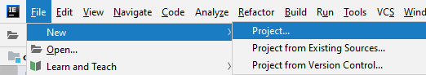
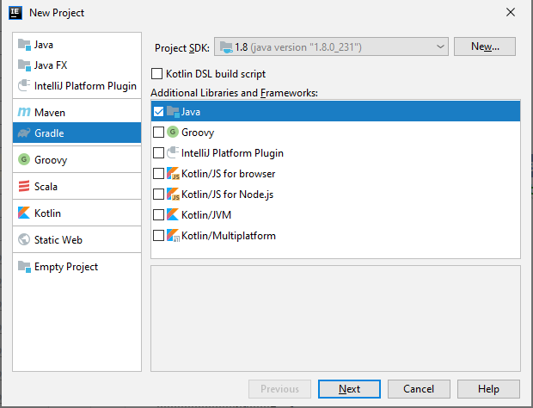
Create a new Gradle project in IntelliJ
package com.northwind.loggingservice
public class Application {
public static void main(String args) {
System.out.println(“Hello World”);
}
}

Slide 9
Upgrading Gradle
gradlew wrapper --gradle-version 6.1
gradlew tasks
Self-Contained Application
plugins {
id: application
}

Slide 10
Additional Resources
https://www.jetbrains.com/idea/documentation/
https://docs.gradle.org/current/userguide/userguide.html
https://www.infoq.com/gradle/
https://www.pluralsight.com/courses/intellij-ce-getting-started (PAID)
https://www.pluralsight.com/courses/gradle-fundamentals (PAID)
https://www.udemy.com/course/object-oriented-programming-using-java-and-intellij-hands-on/ (FREE)

Slide 11
OOP (OOD) Fundamentals

Slide 12
What is Object Oriented Design?
Software Design approach where a business/system is thought of in terms of Objects—the “things” or “nouns” that make up the business/system
Example:
Customers
Orders
Products
Employees
Vendors

Slide 13
Four Pillars of OOP
Abstraction
Implementation details should be hidden (abstracted) away from the consumer.
Encapsulation
All business logic for an object should be contained (encapsulated) within that object.
Inheritance
Derived classes should further define/refine attributes and behaviors of the parent.
Polymorphism
Objects can share the same interface but may perform those behaviors differently.

Slide 14
OOP Core Constructs
Object
Represents a “thing” in the system.
Instance of a class.
Business Object is an object that defines a business entity (“thing”) in the system.
Class
Template that defines an object.
Attribute
Things that describe the things. The “data” of the “thing”.
In Java, these are our fields/properties.
Operation
Behaviors of the objects. What they “do”.
In Java, these are our methods.
Interface
Defines how we interact with the object.

Slide 15
Example Java Class
public class Customer {
private long id;
private String name;
public long getId() {
return id;
}
public String getName() {
return name;
}
public void setName(String name) {
if (name == null || name.trim().length() == 0 || name.trim().length() > 50)
throw new IllegalArgumentException();
this.name = name;
}
public void changeAddress() {
return name;
}
}

Slide 16
Additional Resources
https://www.udemy.com/course/object-oriented-programming-using-java-and-intellij-hands-on/ (FREE)
https://www.udemy.com/course/basics-of-java-programming-language/ (FREE)
https://www.udemy.com/course/java-tutorial/ (FREE)

Slide 17


Good books…
Head First Object Oriented Analysis and Design
The Object Oriented Thought Process

Slide 18
Exercise: What are our Objects?
Customer is invoiced
Customer
Places an Order
Order is updated with shipping info
Order status is updated
Orders
Order is
Fulfilled in the Warehouse
Inventory
Freight is calculated
Fulfillments
Are Shipped
Shipping

Slide 19
SOLID and other useful acronyms

Slide 20
Stay D.R.Y.
Don’t
Repeat
Yourself
Why?
Reduces technical debt
Repeated code means repeated bugs
Increases maintainability
Increases velocity and efficiency

Slide 21
If you don’t need it, don’t write it! - YAGNI
You
Aren’t
Going to
Need
It
… till you need it.
Writing code for the sake of writing code or “just in case”…
Increases technical debt
Adds code that needs to be tested that may never be used
Decreases velocity
Instead, write the code when you need it. That’s a fundamental characteristic of iterative, agile development.

Slide 22
"Everything should be made as simple as possible, but no simpler."
-Albert Einstein.

Slide 23
The K.I.S.S. Principle
Keep
It
Simple and
Stupid
Your design and implementation should be simple and able to understood by the “average” developer.
Notes:
The credit is given to Clarence "Kelly" Johnson for coining the phrase, though there is a little lost in translation over time. He was referring to the need for repairs to the planes he and his team were designing/building to be able to be performed by the average mechanic with simple, basic tools, and for those repairs to be made quickly. Keeping the design/engineering simple, allowed them to be repaired quickly by the average mechanic with the basic tools in any tool box. So we should really say: Keep it simple and stupid. This applies to software engineering just as well as mechanical engineering. Make sure your design and code implementation can be read, understood, and maintained by the "average" developer.

Slide 24
???????????
public int GetTotalMilliseconds(TimeSpan time)
{
int hours = time.Hours * 3600 * 1000;
int minutes = time.Minutes * 60 * 1000;
int seconds = time.Seconds * 1000;
return time.Milliseconds + hours + minutes + seconds;
}

Slide 25
Simple.
time.TotalMilliseconds;
public int GetTotalMilliseconds(TimeSpan time)
{
time.TotalMilliseconds;
}

Slide 26
Why keep it simple?
Saves time
Increases developer productivity
Decreases the potential for bugs
Improves the stability of the system
Increases the maintainability of the code

Slide 27
S.O.L.I.D
Single Responsibility Principle
Open/Close Principle
Liskov Substitution Principle
Interface Segregation Principle
Dependency Inversion Principle

Slide 28
Single Responsibility Principle (SRP)
A class should have one and only one reason to change, meaning that a class should have only one job.
Can also be applied to methods, modules, packages, and microservices.
These things should do one thing and do it well.
The challenge is defining that “one thing”.
Notes:
FaaS, like Amazon Lambda, drive this principle home
Code should fit in your head… figuratively and literally.

Slide 29
Open/Closed Principle (OCP)
Objects or entities should be open for extension, but closed for modification.
Design Patterns
Factory/Abstract Factory Pattern
Provider Pattern
Visitor Pattern
Decorator Pattern
Notes:
A good example is CCG Gateway.

Slide 30
Liskov Substitution Principle (LSP)
Introduced by Barbara Liskov, MIT Professor, in a 1987 conference keynote address titled Data abstraction and hierarchy.
Let q(x) be a property provable about objects of x of type T. Then q(y) should be provable for objects y of type S where S is a subtype of T.
In other words, every derived class should be substitutable for their base class.

Slide 31
Interface Segregation Principle (ISP)
A client should never be forced to implement an interface that it doesn't use or clients shouldn't be forced to depend on methods they do not use.
Notes:
Example: XmlReader, XmlWriter.
Microservices? Stay away from generic endpoints. Define clear, intuitive, understandable contracts.

Slide 32
Dependency Inversion Principle (DIP)
Entities must depend on abstractions not on concretions. It states that the high level module must not depend on the low level module, but they should depend on abstractions.
Encompasses two design patterns:
Dependency Injection
Inversion of Control

Slide 33
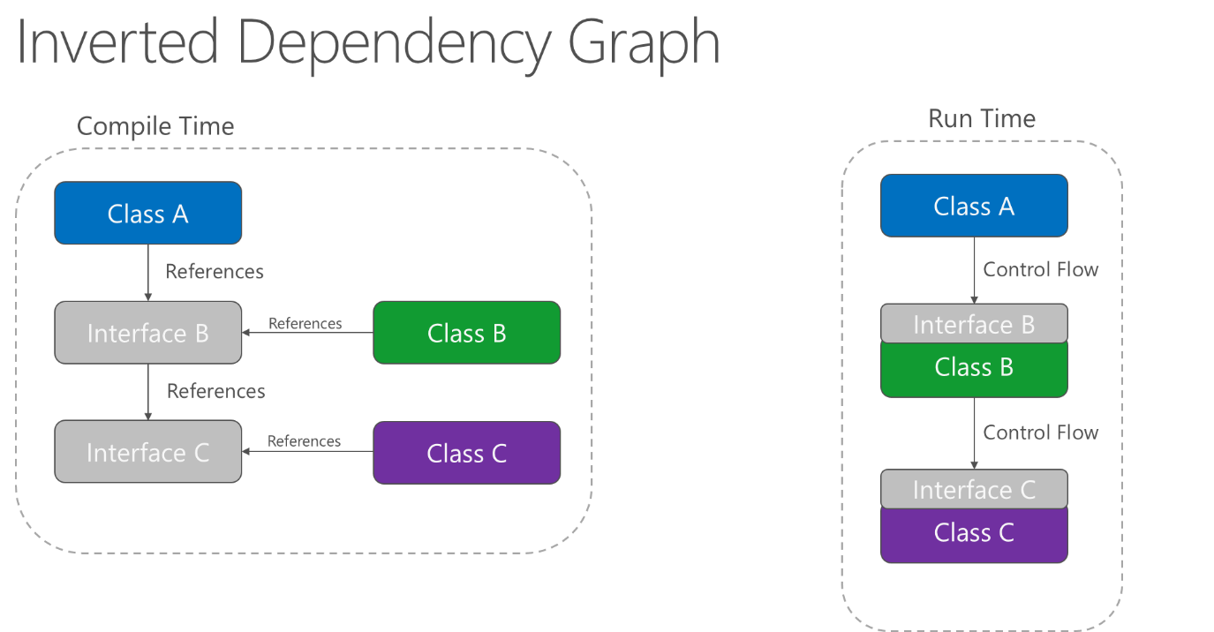
Dependency Inversion

Slide 34
SOLID Resources
https://www.baeldung.com/solid-principles

Slide 35
Object Oriented Design Patterns
Predetermined, repeatable pattern to solving common problems in OOP

Slide 36
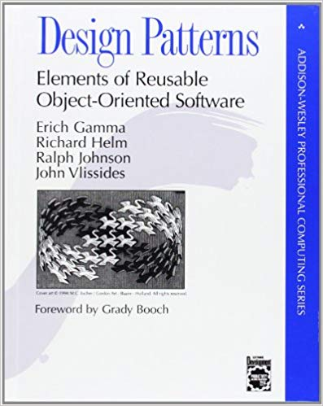

Additional Resources
https://www.baeldung.com/design-patterns-series
Head First Design Patterns
Design Patterns: Elements of Reusable Object-Oriented Software

Slide 37
Decorator Pattern
Attaches additional responsibilities to an object dynamically without changing the implementation.
Traditionally done using a “wrapper”—a class that wraps another to add additional functionality.
What problems can it solve?
Responsibilities should be added to (and removed from) an object dynamically at run-time.
A flexible alternative to subclassing for extending functionality should be provided.

Slide 38
Decorator Pattern – Java Annotations
Java supports Annotations to “decorate” classes and members.
Annotations, a form of metadata, provide data about a program that is not part of the program itself.
Annotations have no direct effect on the operation of the code they annotate.
Annotations have a number of uses, among them:
Information for the compiler — Annotations can be used by the compiler to detect errors or suppress warnings.
Compile-time and deployment-time processing — Software tools can process annotation information to generate code, XML files, and so forth.
Runtime processing — Some annotations are available to be examined at runtime.

Slide 39
Quick primer on TDD and JUnit

Slide 40
Test Driven Development (TDD)
A software development approach in which tests are written first, then implementation code is written till the tests pass.
“Are tests for programmers by programmers” – Uncle Bob Martin
Compliments Behavior Driven Development (BDD)—you’re testing use-cases, not classes/methods.

Slide 41
Benefits of TDD
Writing the tests first requires you to really consider what do you want from the code.
You receive fast feedback. You are able to identify the errors and problems quickly.
Creates a detailed specification.
Reduces time spent on rework.
You spend less time in the debugger.
Tells you whether your last change (or refactoring) broke previously working code.
Allows the design to evolve and adapt to your changing understanding of the problem.
Forces the radical simplification of the code.
Creates SOLID code.
Creates code that is maintainable, flexible, and easily extensible.
The resulting unit tests are simple and act as documentation for the code.
The programmer’s productivity is increased. TTM is shorter.
Reduces development costs.
Quality is improved. Bugs are reduced.

Slide 42
JUnit – Testing Framework for Java
Testing framework used by Spring Boot
Gradle plugin
Integrates with IntelliJ – run, report, coverage
jUnit 4
dependencies {
testImplementation 'junit:junit:4.12’
}
test {
useJUnit()
}
jUnit 5
test {
useJUnitPlatform()
}

Slide 43
Creating Tests with JUnit
Test methods are annotated with the @Test annotation
The @Test annotation tells Junit to execute that method and report the results
import org.junit.jupiter.api.Test;
...
public class When_saving_a_customer {
static final String validName = "ABCDEFGHIJKLMNOPQRSTUXWXYZABCDEFGHIJKLMNOPQRSTUXWX";
@Test
public void given_a_valid_and_name_then_op_should_succeed() {
long id = 1;
Customer customer = new Customer(id, validName);
assertEquals(validName, customer.getName());
}
}

Slide 44
Additional Resources
https://junit.org/
https://www.baeldung.com/junit-5
https://www.infoq.com/presentations/junit-5-new/
http://blog.cleancoder.com/uncle-bob/2014/12/17/TheCyclesOfTDD.html

Slide 45
Let’s build our logging service…

Slide 46
logging-service
Logging
Service
Worker
LoggingProvider
Receive Message
Transform
Message
Deserialize
Send

Slide 47
Coding time!
Creating a logging provider for Splunk using a TDD and what we learned about OOP. We’ll start with our request/response for Splunk.

Slide 48
Immutable Objects
Objects, who’s state, once created, cannot be changed (mutated).
public class Config {
private final String server;
private final int port;
public Config(String server, int port) {
this.server = server;
this.port = port;
}
public String getServer() { return server; }
public int getPort() { return port; }
}
Final fields

Slide 49
Coding Time!
Let’s make SplunkResponse Immutable

Slide 50
Object Oriented Design Patterns
Predetermined, repeatable pattern to solving common problems in OOP

Slide 51
Provider Pattern
Provider pattern allows the developers to create pluggable components.
An interface is defined for the behavior we want the provider to provide.
We, or third parties, can implement that interface to provide specific implementations.
What problems does it solve?
Used to provide extensibility to a system.

Slide 52
Provider Pattern
LoggingProvider
+ sendEvent(LogEvent)
SplunkLoggingProvider
LogglyLoggingProvider

Slide 53
Testing with Mocks
A Mock is a mocked up, or “fake”, implementation of a class.
Allows us to test business logic without needing external dependencies such as databases or other services.
Can be created manually or with a framework such as Mockito or EasyMock

Slide 54
Coding Time!
Let’s create our Splunk Logger using the Provider Pattern

Slide 55
Builder Pattern
Provide a flexible solution to various object creation problems in object-oriented programming. The intent of the Builder design pattern is to separate the construction of a complex object from its representation.
What problem does it solve:
How can a class (the same construction process) create different representations of a complex object?
How can a class that includes creating a complex object be simplified?

Slide 56
Builder Pattern
public class Config {
private final String server;
private final int port;
private Config(String server, int port) {
this.server = server;
this.port = port;
}
public static class Builder {
...
}
}
Config c = new Config.Builder()
.withServer(“localhost”)
.withPort(8080)
.build();
public static class Builder {
private String server;
private int port;
public Builder withServer(String server) {
this.server = server;
return this;
}
public Builder withPort(int port) {
this.port = port;
return this;
}
public Config build() {
return new Config(server, port);
}
}

Slide 57
Coding Time!
Let’s implement a SplunkConfig POJO using the Builder Pattern

Slide 58
Factory Pattern
Factories handle object creation.
Factory Methods
Simple Factories
Abstract Factories
What problems does it solve?:
Allows construction of classes with a component of a type that has not been predetermined, but only defined in an "interface", or which is defined as a dynamic type.
Allows construction of subclasses to a parent whose component type has not been predetermined, but only defined in an interface, or which is defined as a dynamic type.
Allows for more readable code in cases where multiple constructors exist, each for a different reason.
Allows a class to defer instantiation to subclasses, and to prevent direct instantiation of an object of the parent class type.

Slide 59
Factory Method
Often used in leu of constructor overloads or when only a single, no-arg constructor must exist (ie. Serialization and Hibernate scenerios)
Common in many DI implementations
public class Customer {
private int id;
private String name;
public Customer() { }
public static Customer create(int id, String name) {
Customer c = new Customer();
c.id = id;
c.name = name;
return c;
}
}

Slide 60
Simple Factory
public class CustomerFactory {
public Customer create(int id, String name) {
Customer c = new Customer();
c.setId(id);
c.setName(name);
return c;
}
}
A separate class for creating an object
Common in Dependency Injection scenarios when the dependent object needs to create a more personalized version of the dependency. (ie logger)

Slide 61
Abstract Factory
public interface LogProviderFactory {
public LogProvider getLogProvider(String logger) {
switch logger {
case "splunk":
return new SplunkLogProvider();
case "loggly":
return new LoggyLogProvider();
}
throw IllegalArgumentException();
}
}
Provide an interface for creating families of related or dependent objects without specifying their concrete classes.
Creates different concrete implementations for the same interface.

Slide 62
Singleton Pattern
Ensures only a single instance of an object is ever created
Singleton instances exist only ONCE per JVM instance
Can be Eagerly Loaded
Created at application startup
Sometimes called Early Loading
Or Lazily Loaded (lazy loading)
Created on the first request for an instance
What problem does it solve?:
How can it be ensured that a class has only one instance?
How can the sole instance of a class be accessed easily?
How can a class control its instantiation?
How can the number of instances of a class be restricted?

Slide 63
Eager Loading
public class RegionCache {
private static RegionCache instance = new RegionCache();
public static RegionCache getInstance() {
return instance;
}
private RegionCache() {}
}

Slide 64
Lazy Loading
BAD!
public class RegionCache {
private static RegionCache instance;
public static RegionCache getInstance() {
if (instance == null)
instance = new RegionCache();
return instance;
}
private RegionCache() {}
}

Slide 65
Lazy Singleton the Correct Way!
public class RegionCache {
private volatile static RegionCache instance;
public static RegionCache getInstance() {
if (instance == null) {
synchronized(RegionCache.class) {
if (instance == null)
instance = new RegionCache();
}
}
return instance;
}
private RegionCache() {}
}
volatile
Check it twice!

Slide 66

Coding time!
Let’s build a RestTemplateFactory to manage singleton instances of RestTemplate

Slide 67
Thank You!

