Slide 1
Signatures Classification
Mike Zhou and Yujie Li
27
May

Slide 2
Problem
forged signatures in contracts, checks, etc.
Develop a model that can identify signatures as real or forged.
More importantly, catch forged signatures. Reduce the likeliness of fraudulent signatures.

Slide 3
Dataset
Images of repeated signatures of 69 different people.
Images are various in size.
Half real, half forge.
1649 train images, 500 test images

Slide 4
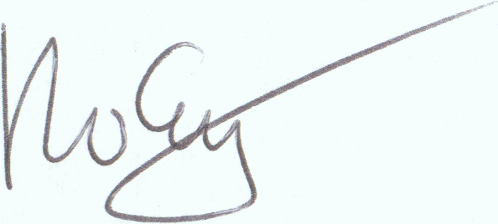
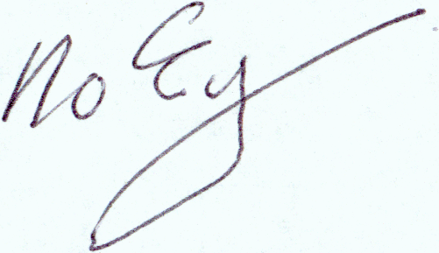
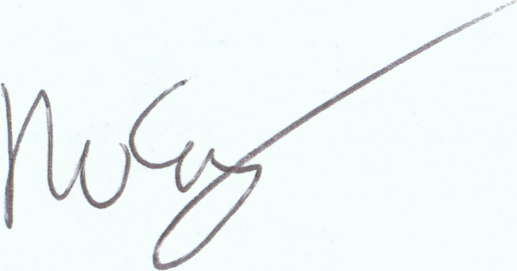
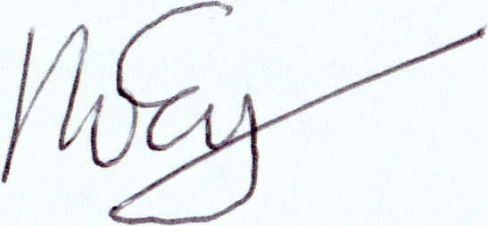
Real Forged
train
test

Slide 5
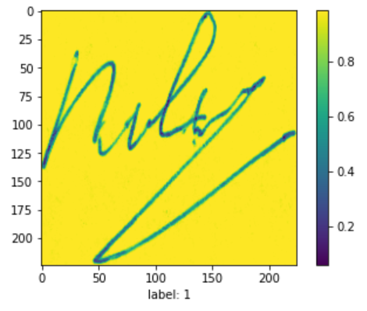
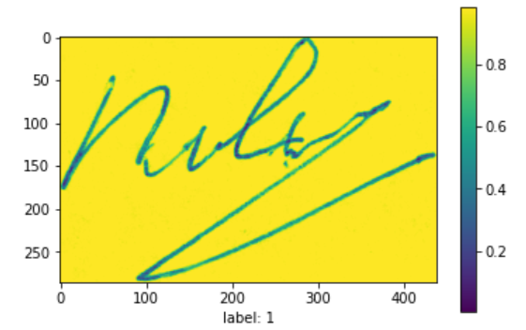
Data preprocessing
To gray scale 2. resize

Slide 6
Model: Convolutional Neural Network
Suitable for image classification (pattern detection)
Patterns can be smaller than the whole image
Similar patterns can appear in different regions
Subsampling will be change the image

Slide 7
CNN: General
Convolutional layers
Max pooling
Activation functions
Flattening

Slide 8
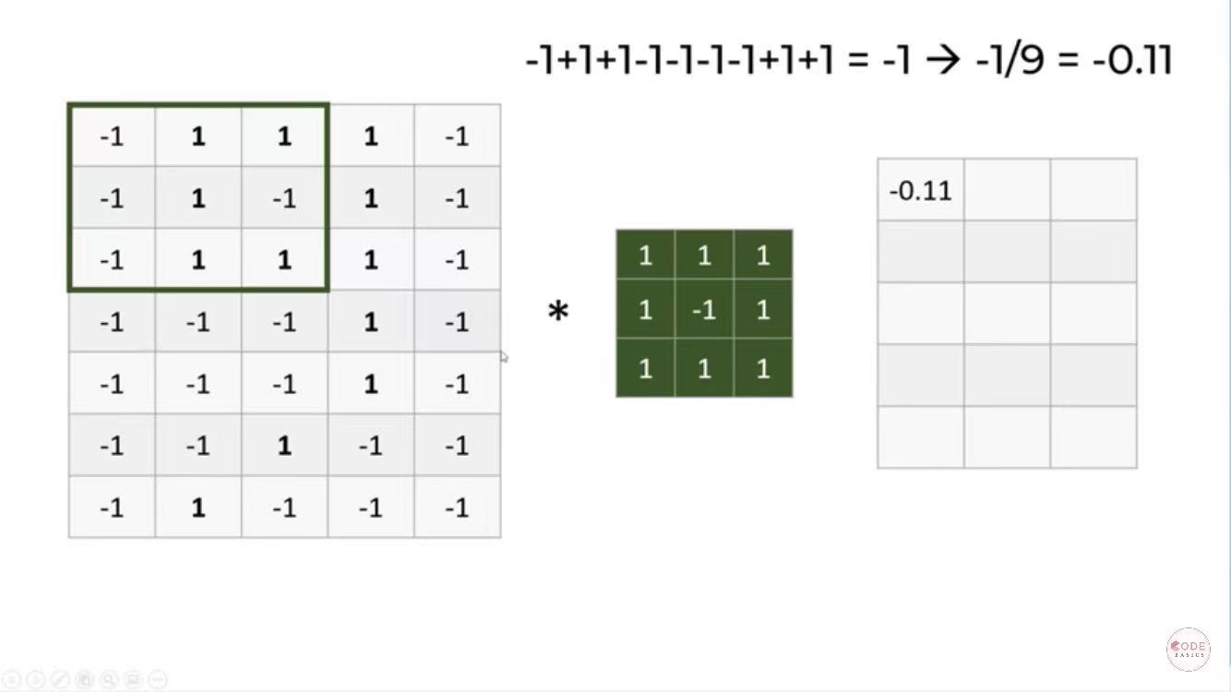
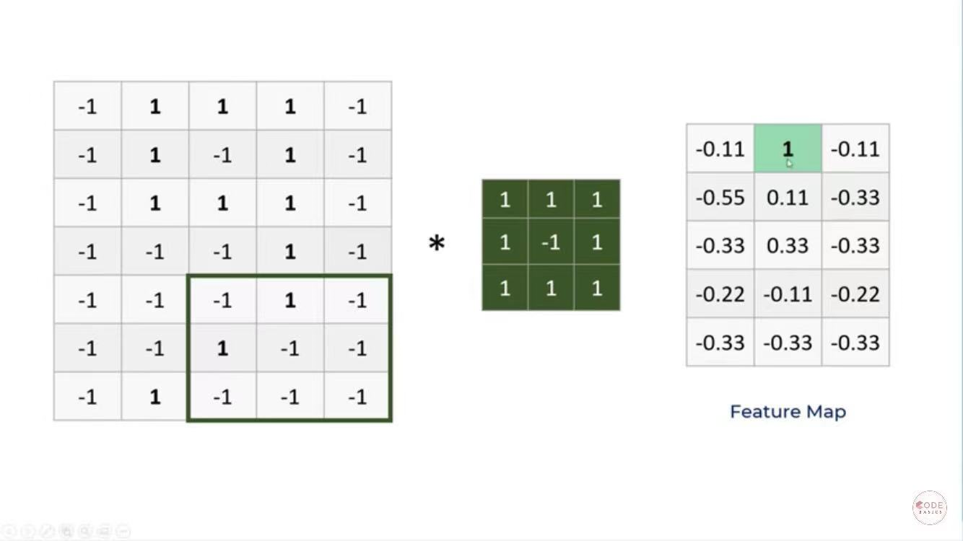
CNN: Convolutional Layers
Filter: walk through
Capture certain features
Apply the filters to the input image. Dot product
Generate a feature map
Image credit: Codebasics

Slide 9
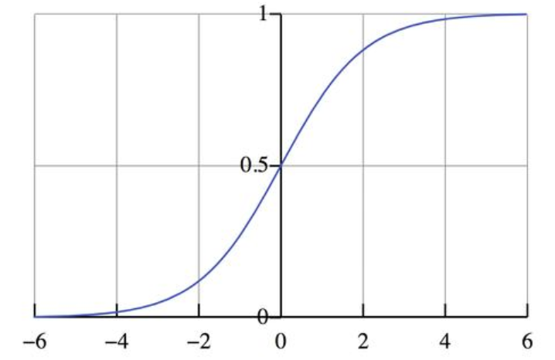
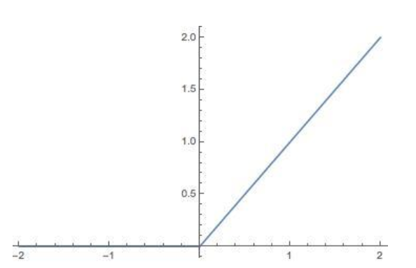
CNN: Activation Functions
Add nonlinear factors
Activation: ReLU
Better slop
Less computation
Final activation function: sigmoid
Binary classification

Slide 10
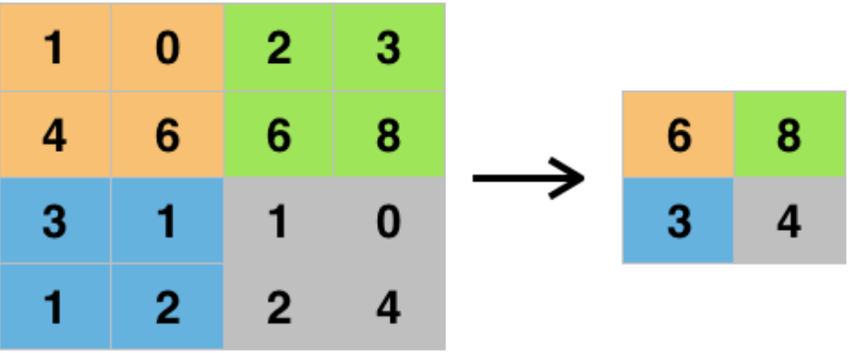
CNN: Max Pooling
Operate on the current feature map
Reduction in dimension and thus computation
Capture the main features. Reduce noise.

Slide 11
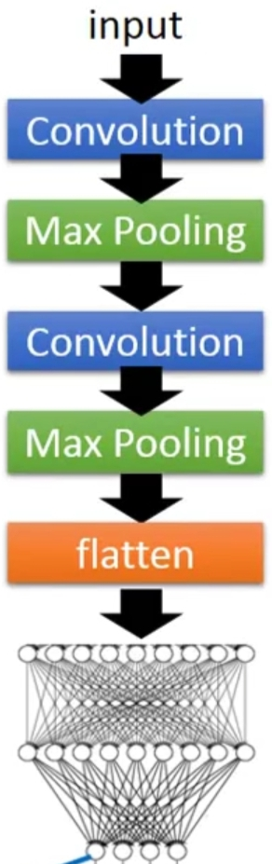
CNN: Flattening
Flattening

Slide 12
Testing result
Precision = 1
Recall = 0.91
Accuracy = 0.956
True Positive | False Negative | True Negative | False Positive
226 | 22 | 252 | 0

Slide 13
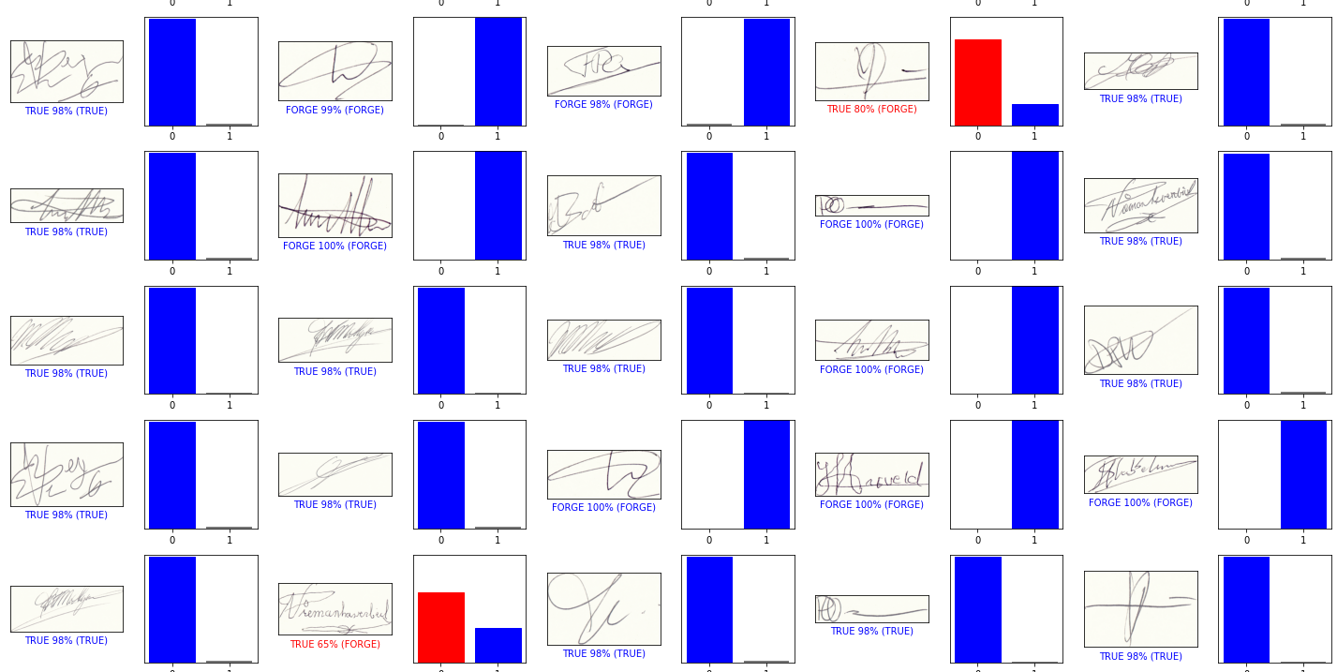
Visualizing the results

Slide 14
Setting a threshold for the sigmoid function
For the false negatives, the model does believe, at least to some extent, that those signatures could be forged (positive), and is not so confident that they are real compared to the true negatives.
Solution: setting an arbitrary threshold for the sigmoid function.
If there is a significant probability that a signature can be forged, mark it as forged.

Slide 15
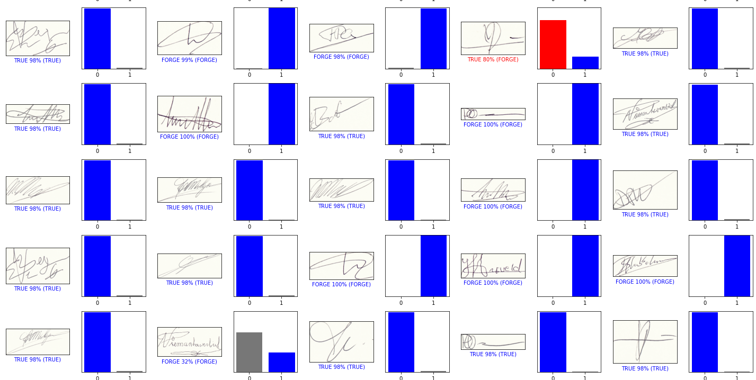
New results

Slide 16
Testing result
Without arbitrary
threshold
Precision = 1, recall = 0.911, accuracy = 0.956
With arbitrary
threshold
Precision = 1, recall = 0.948, accuracy = 0.974
True Positive | False Negative | True Negative | False Positive
226 | 22 | 252 | 0
True Positive | False Negative | True Negative | False Positive
235 | 13 | 252 | 0

Slide 17
Future goals
Working with a larger dataset
Customize loss function to penalize FN

Slide 18
Questions?

Slide 19
