Slide 1
CMSE 830: Midterm Project Presentation
Cherry Leaf Powdery Mildew Detection Using Machine Learning
Jazlyn Salazar
Michigan State University
October 22, 2026

Slide 2
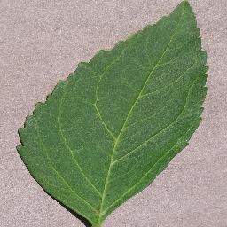
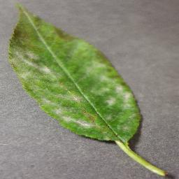
Motivation and Problem
Goal: Detect powdery mildew in cherry leaves using image-derived features and machine learning
Dataset: PlantVillage Cherry Leaf Dataset
1,906 images
2 classes: Healthy and Powdery Mildew
Audience: Researchers, educators, plant pathologists, students interested in plant health monitoring
Healthy cherry leaf
Powdery mildew infected cherry leaf
Notes:
Powdery mildew is a common fungal disease that affects cherry leaves. The goal of this project was to determine whether simple image-derived features could be used to distinguish healthy leaves from infected leaves. The intended audience includes plant scientists, horticultural researchers, and students interested in applied machine learning. To explore this question, I used 1,906 cherry leaf images from the PlantVillage dataset.

Slide 3
Turning Images Into Data
Workflow:
Challenge: Machine learning models cannot directly analyze image files
Extracted Features:
Average Red
Average Green
Average Blue
Brightness
Why These Features:
Quantify leaf color characteristics
Easy to calculate
Interpretable
Suitable for multiple machine learning algorithms
Leaf Images
Feature Extraction
Feature Dataset
Machine Learning Models
Notes:
Instead of using deep learning, I wanted to investigate how much information could be captured using simple color and brightness features. These features transformed each image into numerical data that could be analyzed statistically and used for classification.

Slide 4
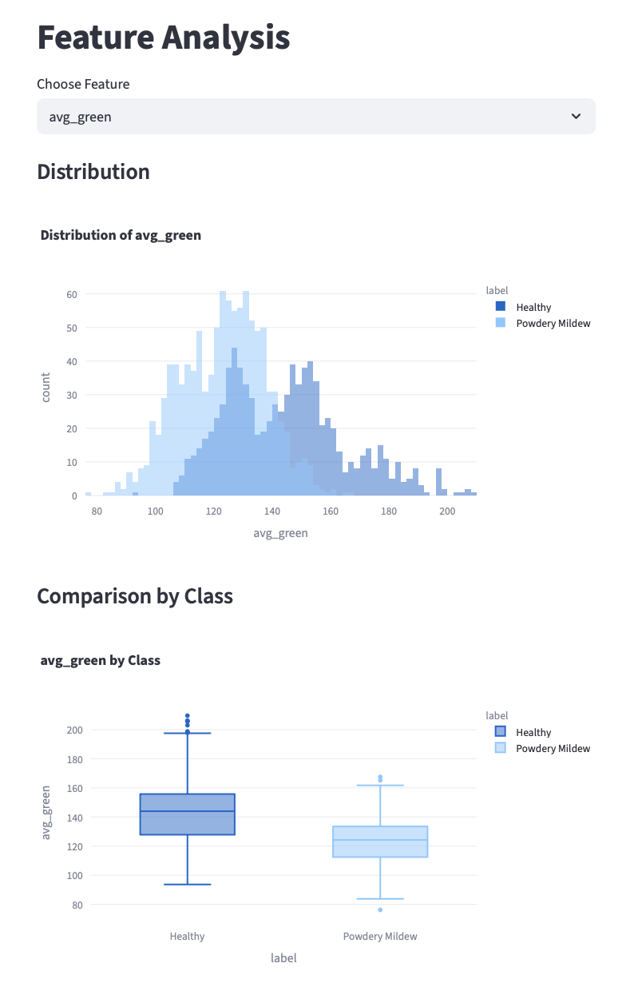
Exploratory Data Analysis
What Patterns Exist in the Data?
Questions Explored:
Do healthy and infected leaves differ visually?
Are color features useful predictors?
Are some features strongly related?
Key Findings:
Brightness differed between classes
RGB values differed between classes
Correlation analysis revealed relationships among features
Notes:
Exploratory analysis suggested that healthy and diseased leaves exhibit measurable differences in both color intensity and brightness. While the groups overlap, these patterns indicated that the extracted features contained useful classification information. They are not able to be used alone to differ between the classes, but when combined, they are useful for training the models.

Slide 5
Model Selection and Comparison
Logistic Regression
Simple baseline classifier
Fast and interpretable
Random Forest
Captures nonlinear relationships
Handles interactions among features
Support Vector Machine (SVM)
Effective for classification
Performs well with smaller feature sets
Handles complex decision boundaries
Results:
Model | Accuracy
Logistic Regression | 71.5%
Random Forest | 72.5%
Support Vector Machine | 74.9%
Notes:
I evaluated models with different levels of complexity rather than deciding on a model from the beginning. Between the three analyzed models, the SVM achieved the highest accuracy and was selected as the final model for deployment.

Slide 6
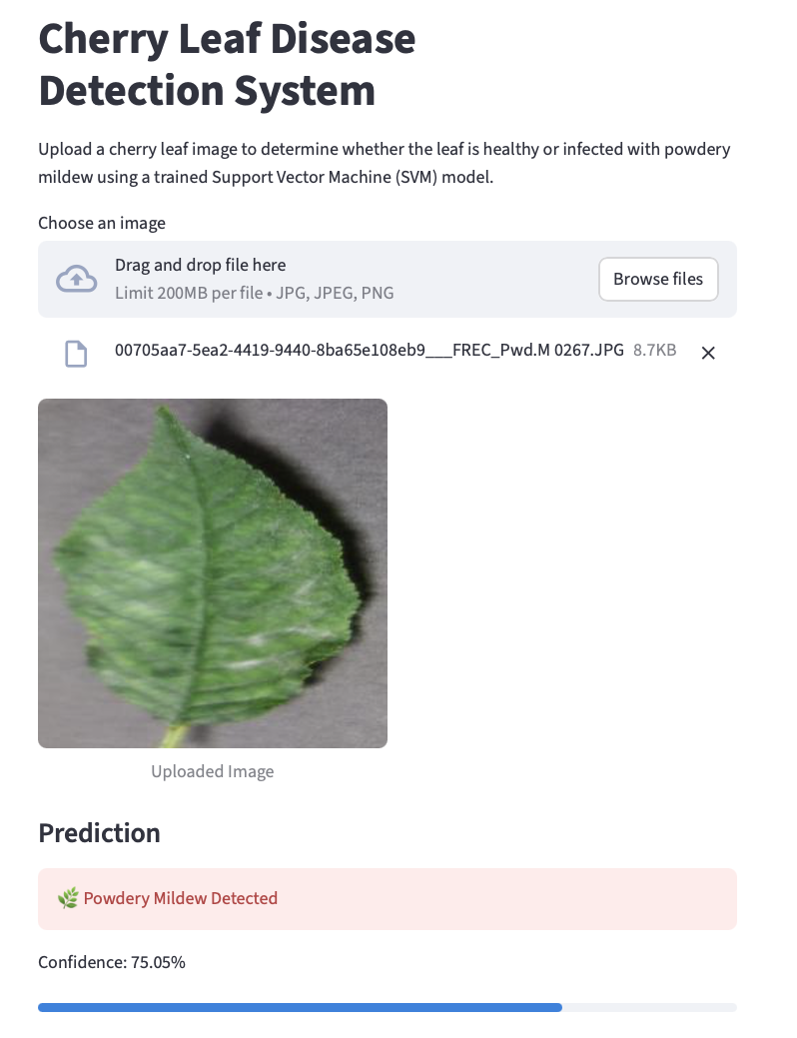
Results & Streamlit Application
Best Model: Support Vector Machine
Performance:
Accuracy: 74.9%
Precision: 76.0%
Recall: 75.0%
F1 Score: 74.0%
Streamlit Dashboard:
Dataset exploration
Interactive visualizations
Model evaluation
Live image prediction
Notes:
The project resulted in a functioning machine learning pipeline and an interactive dashboard. Users can explore the dataset, review model performance, and upload new images for real-time disease prediction.

Slide 7
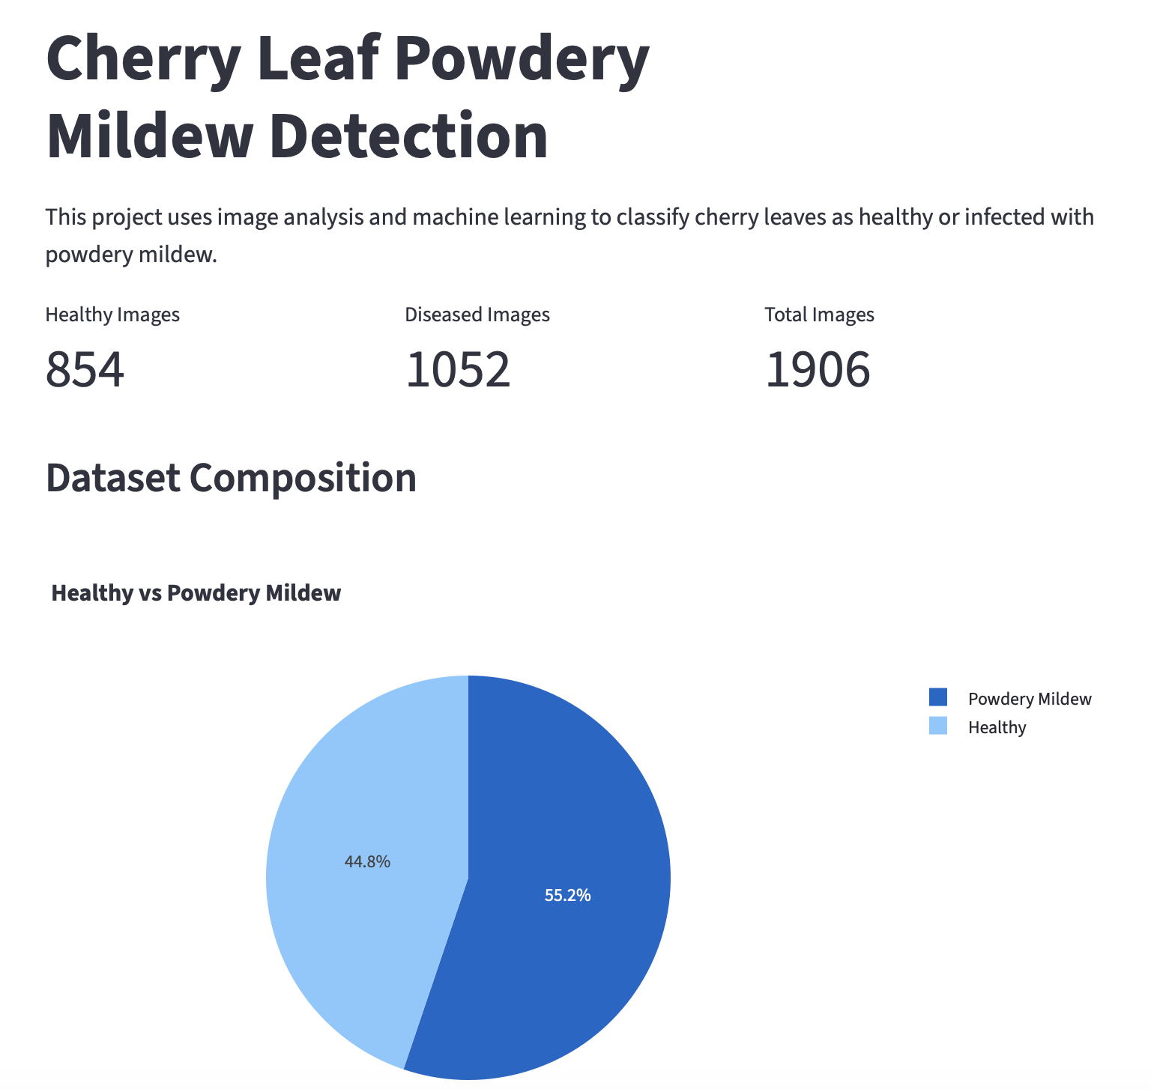
Conclusions and Future Work
Key Findings:
Color and brightness features were useful predictors
The SVM achieved the strongest performance
The workflow was able to successfully connect image analysis, machine learning, and creating an interactive app
Future Work:
Integrating:
  Texture-based features
  Convolutional Neural Networks (CNNs)
Final Takeaway: Simple image derived features can provide meaningful information for detecting powdery mildew in cherry leaves and serve as the foundation for a more robust machine learning application
Notes:
This project demonstrates a complete workflow from image processing and exploratory analysis through model development and deployment. Future improvements will focus on incorporating more advanced image features and improving model performance.

