Slide 1

Data Scientist Presentation
Jazmin Logroño
SUID: 342872033
JMLogron@syr.edu

Slide 2


Agenda
Data Collection: Using tools to organize data.
Data analysis: Identify patterns in the data via visualization, statistical analysis, and data mining.
Strategy and decisions: Develop alternative strategies based on the data.
Implementation: Develop a plan of action to implement the business decisions.

Slide 3
1. Data Collection: Using tools to organize data
Data storage, access, and retrieval are essential to set up data users for successful analysis and decision-making.
IST 659 introduced valuable design concepts to ensure data accuracy and accommodate business processes.

Slide 4
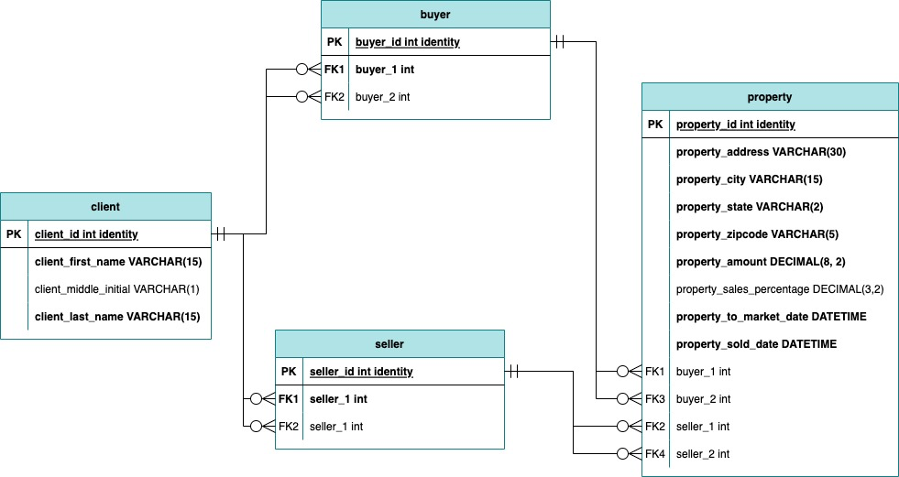
1. Data Collection: Using tools to organize data
Ashley Lew is a Real Estate agent representing Buyers and Sellers in California.
Sales Transaction data collected from Ashley’s website.
A Database designed to track Sales Transactions and provide Ashley with valuable information about her business.

Slide 5
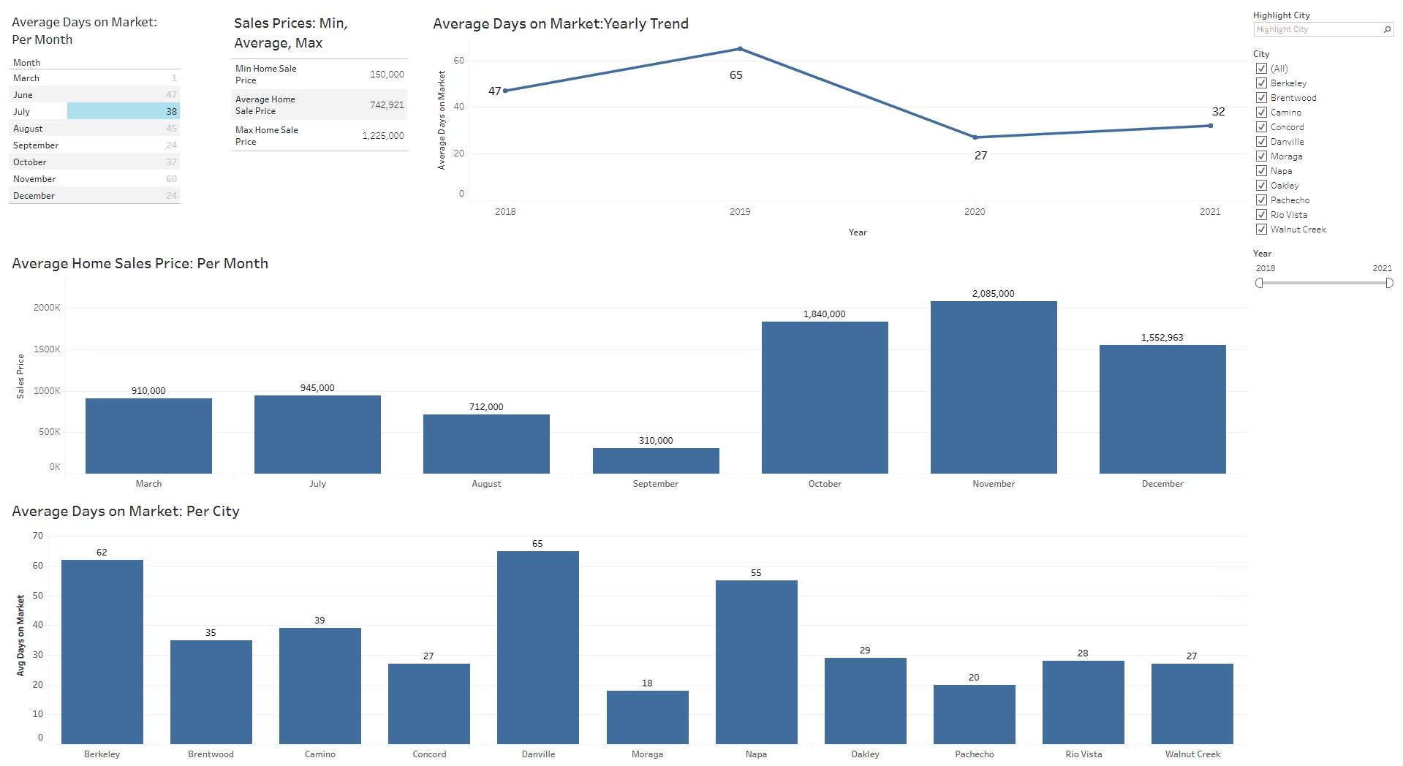
1. Data Collection: Using tools to organize data
Database coded in SQL Server Management Studio.
Tableau Dashboard as End User Interface to provided answers to Business questions.
Challenges: Normalizing

Slide 6
2. Data analysis: Identify patterns in the data via visualization, statistical analysis, and data mining
Data Visualizations help reveal meaningful relationships and patterns between variables.
IST 719 emphasized the importance of simple but meaningful visualizations.

Slide 7
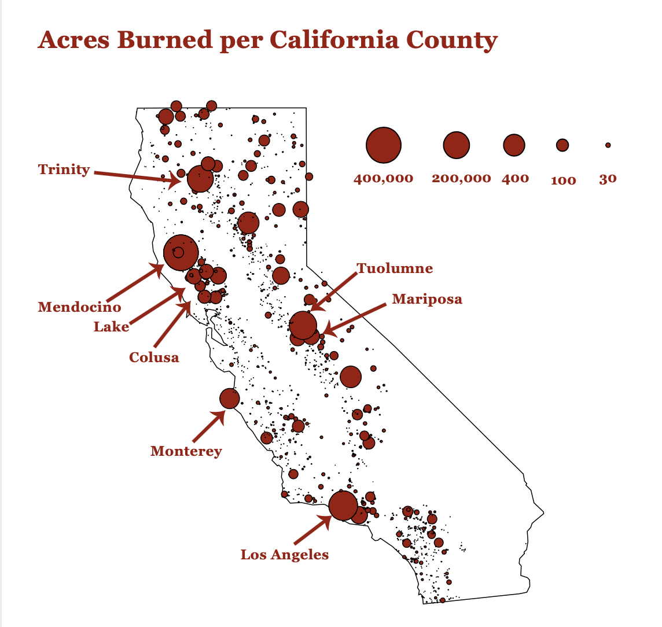
2. Data analysis: Identify patterns in the data via visualization, statistical analysis, and data mining
California wildfires are a “hot” topic of conversation.
California wildfires do not stop people from moving to California.
Evaluating historical wildfires can provide insight into Counties at risk for future wildfires.

Slide 8
3. Strategy and decisions: Develop alternative strategies based on the data
Applying Statistical Analysis and Machine Learning methods to data can help reveal actionable insights.
IST 707 encouraged students to exercise using the Data Science Lifecycle to pinpoint actionable insights.

Slide 9
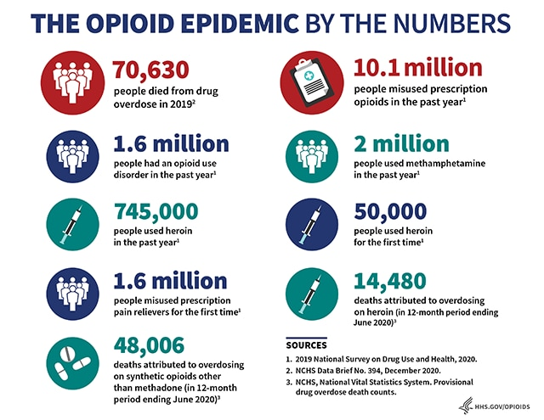
3. Strategy and decisions: Develop alternative strategies based on the data
The United States Opioid Epidemic crisis stems from doctors overprescribing opioids.
The Center for Medicare and Medicaid Services (CMS) hosts data for opioid prescribers in the United States.

Slide 10
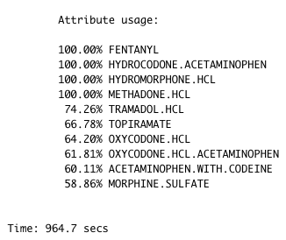
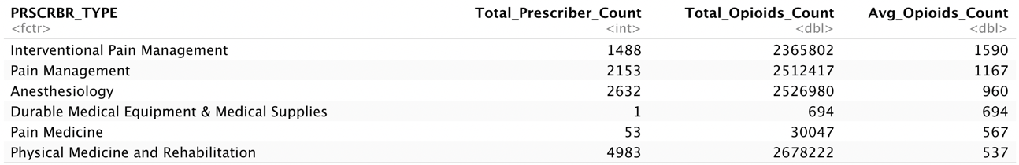
3. Strategy and decisions: Develop alternative strategies based on the data
Statistical Analysis and Data Mining techniques highlighted crucial factors contributing to the Opioid Epidemic.

Slide 11
4. Implementation: Develop a plan of action to implement the business decisions
Data comes in all forms: structured, unstructured, and semi-structured.
IST 736 introduced the application of Data Science to unstructured data.

Slide 12
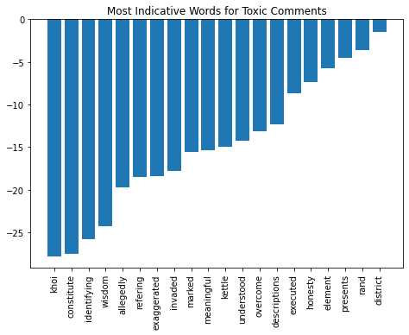
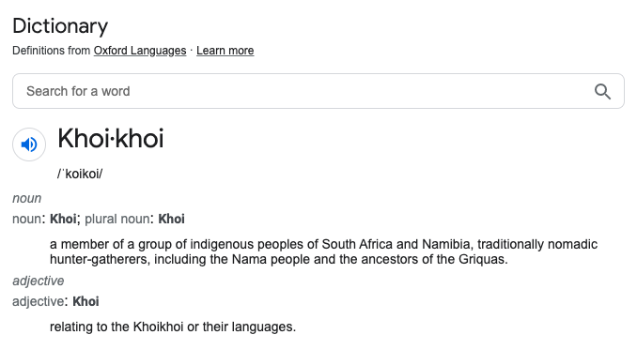
4. Implementation: Develop a plan of action to implement the business decisions
Identify toxic Wikipedia Comments to diminish internet hostility and reduce exposure to harassment.
When implementing a model to perform a task, a business must consider the potential bias naturally built into datasets.

Slide 13

Conclusion

