Slide 1
COP 3503 – Lab Session #1 Basics & Simple C++ Programs
Hesam Salehian

Slide 2
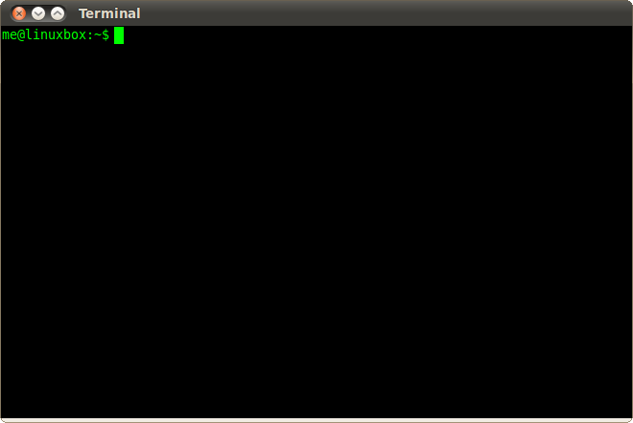
Let’s Start!
You need a CISE account to log in to the computers.
Pick a Linux machine, enter your information and log in!
Then, open a Terminal…

Slide 3
Access remotely
You can access CISE servers remotely, through Linux, MacOS or Putty terminal.
E.g., [storm, thunder, sun1].cise.ufl.edu
>> ssh [cise_user_name]@storm.cise.ufl.edu
>> [cise_user_name]@storm.cise.ufl.edu's password:
.
.
.
>> storm:1%

Slide 4
Access remotely (cont.)
In order to make secure file transfers (e.g., FTP) to/from the same servers, you can use one of the following software:
Cyberduck
WinSCP
FileZilla
SFTP
For more information, visit http://cise.ufl.edu/help/access/remote/

Slide 5
Create a new file
Enter the following command in the terminal:
>> gedit helloworld.cpp
This will open a new file for you, named “helloworld.cpp”, where you can create your first C++ program!

Slide 6
Helloworld!
Enter the following code segment, into your cpp file:
// helloworld.cpp
#include <iostream>
int main()
{
std::cout << "Hello World!\n";
return 0;
}

Slide 7
Compile and run
Once you are done with writing the code, save the file, and go to the terminal…
1. Compile the code:
>> g++ -o helloworld.out helloworld.cpp
2. Run the code:
>> ./helloworld.out
Output:
>> Hello World!

Slide 8
A more complicated sample!
Write a code to determine if a given integer is prime. Also, print all its divisors.
#include <iostream>
int main(){
int n; std::cin >> n; int k = 0;
for (int i = 1; i <= n; i++){
if (n % i == 0){
std::cout << i << " , "; k++;
}
}
std::cout << "\n";
if (k == 2) std::cout << "Prime!\n";
else std::cout << "Not Prime!\n";
return 0;
}

Slide 9
Compile and run
Once you are done with writing the code, save the file, name it “prime.cpp”, and go to the terminal…
1. Compile the code:
>> g++ -o prime.out prime.cpp
2. Run the code:
>> ./prime.out

Slide 10
Compile and run (cont.)
>> ./prime.out
52
1 , 2 , 4 , 13 , 26 , 52 ,
Not Prime!
-----------------------------------------
>> ./prime.out
97
1 , 97 ,
Prime!
Input
Output
Input
Output

Slide 11
Exercise (1)
Write a code to determine if a number is a power of 2.
1, 2, 4, 8, … are powers of 2
3 is not.

Slide 12
Exercise (2)
Write a code to determine if a number is a palindrome.
A palindrome number is equal to its reverse.
121, 14541 are palindrome
134 is not

Slide 13
Exercise (3)
Write a code to print the Fibonacci series up to a given number
Fibonacci Sequence: 1, 1, 2, 3, 5, 8, 13, 21, 34, …
N = 4. → Output: 1,1,2,3.

Slide 14
Exercise (4)
Write a code to compute the Greatest Common Divisor (GCD) of a pair of numbers.
Input: 8, 12
Output: 4

Slide 15
Any Questions?

