Slide 1
Assignment T1A2
Portfolio Website
Presented by Jun Zeng

Slide 2
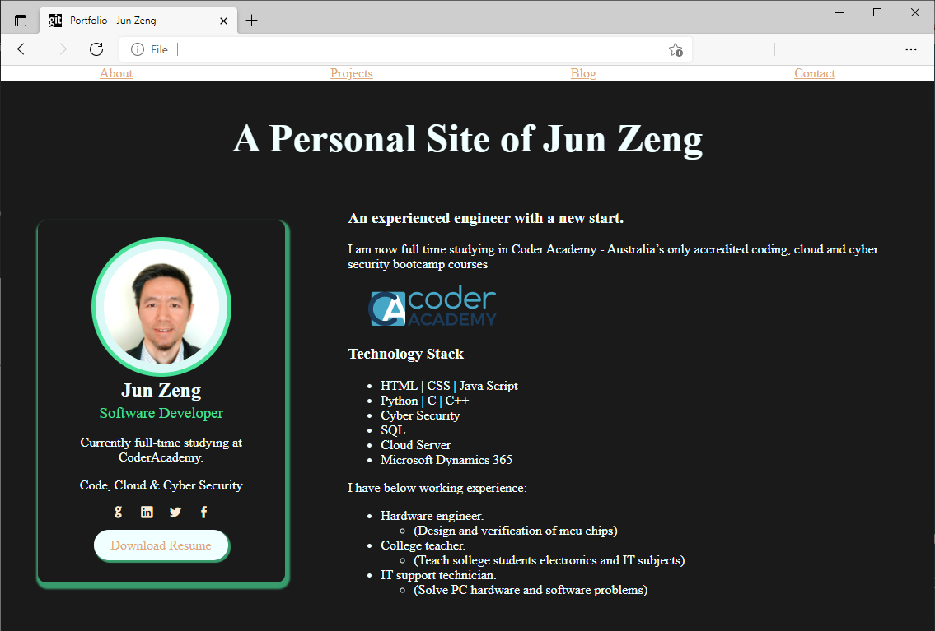
Overview
A simple website based on HTML and CSS.

Slide 3
Design Process
Take reference from different portfolio sites.
Draw Wireframes
Choose one colour scheme
Code from scratch
Error → Research → Trial→ Loop… ⌛
Time to submit!

Slide 4
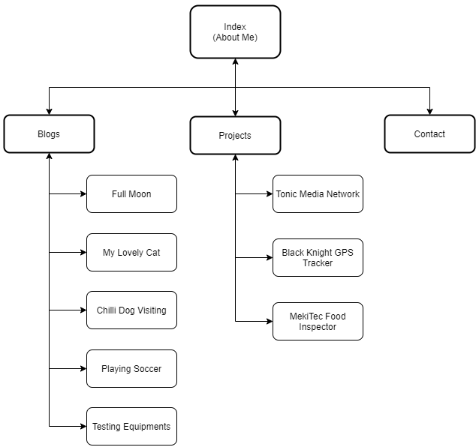
Sitemap
4 main components
A fixed navigation bar
Link to return to the list

Slide 5
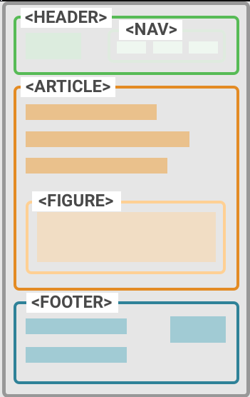
Components / Features
Semantic HTML

Slide 6
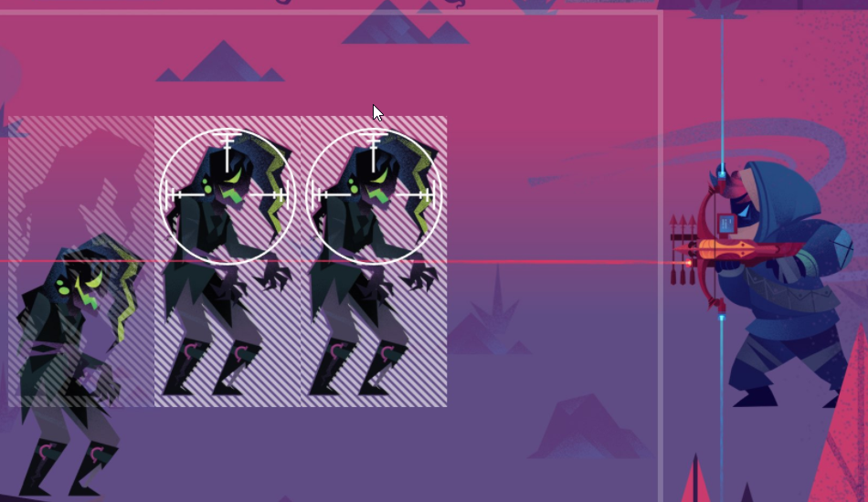
Components / Features
Semantic HTML
CSS | Flex

Slide 7
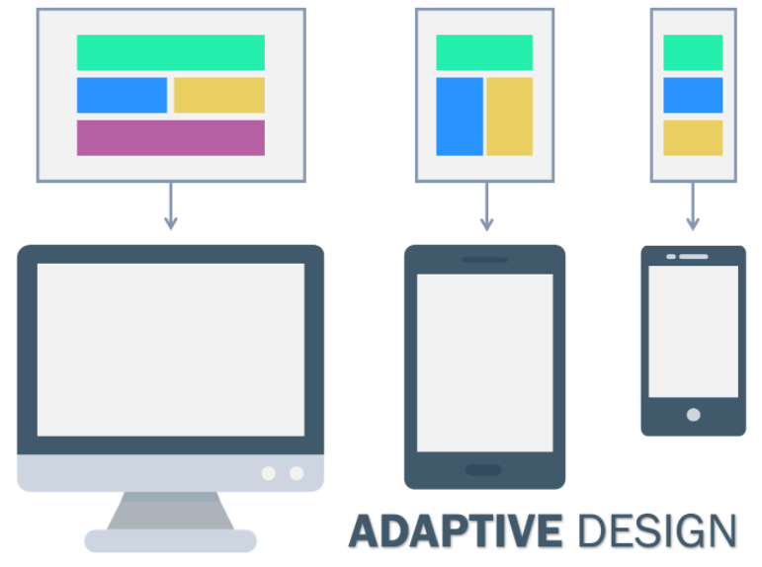
Components / Features
Semantic HTML
CSS | Flex
Responsive Layout

Slide 8
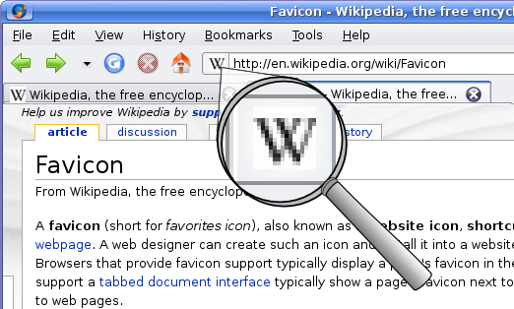
Components / Features
Semantic HTML
CSS | Flex
Responsive Layout
Favicon

Slide 9
Components / Features
Semantic HTML
CSS | Flex
Responsive Layout
Favicon
Fixed Navigation Bar
Button with hover effect
Form for sending message
Blog

Slide 10
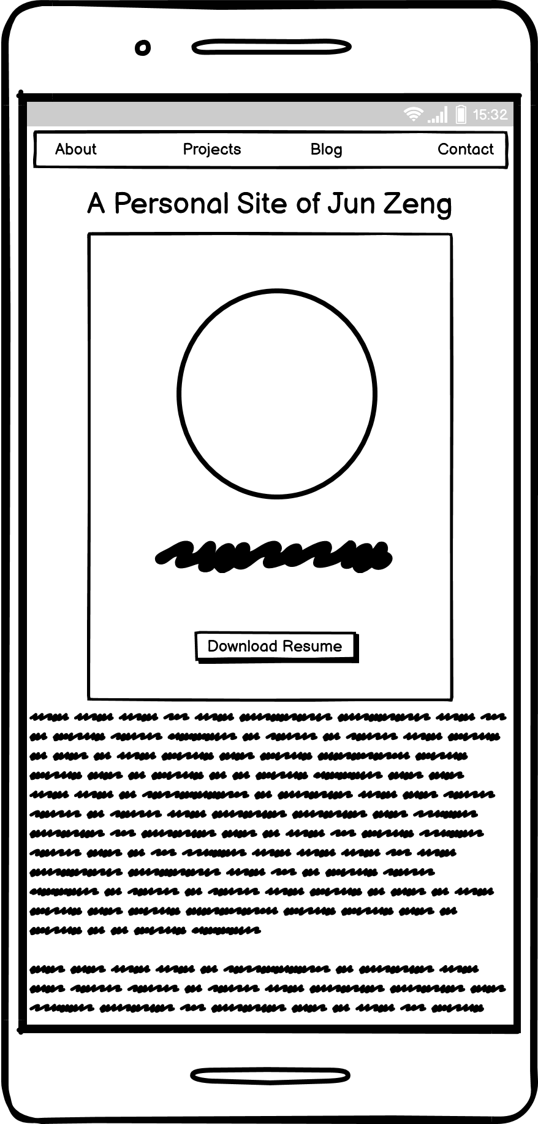
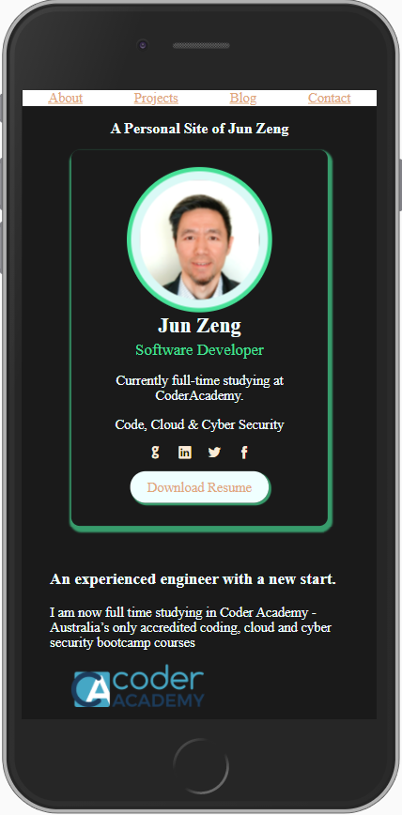
About Page
Mobile Screen
A name-card-style box
Border with radius and shadow
A button with hover effect
Icon-font

Slide 11
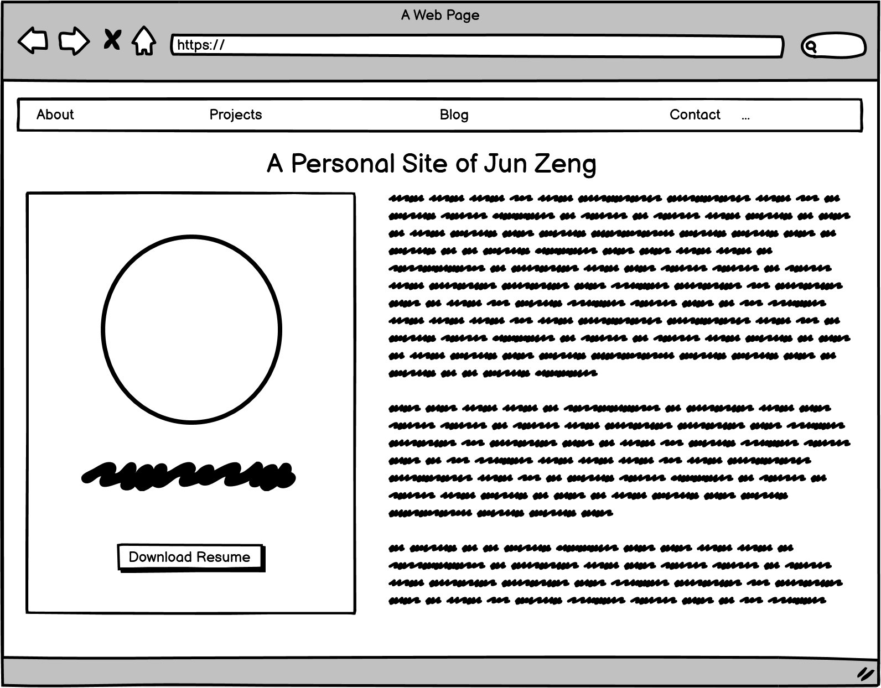
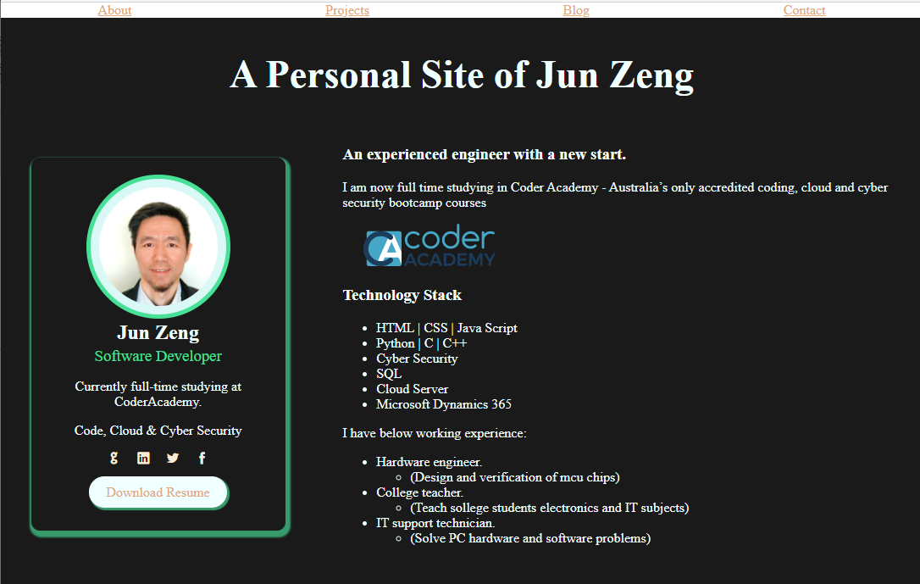
About Page – Desktop

Slide 12
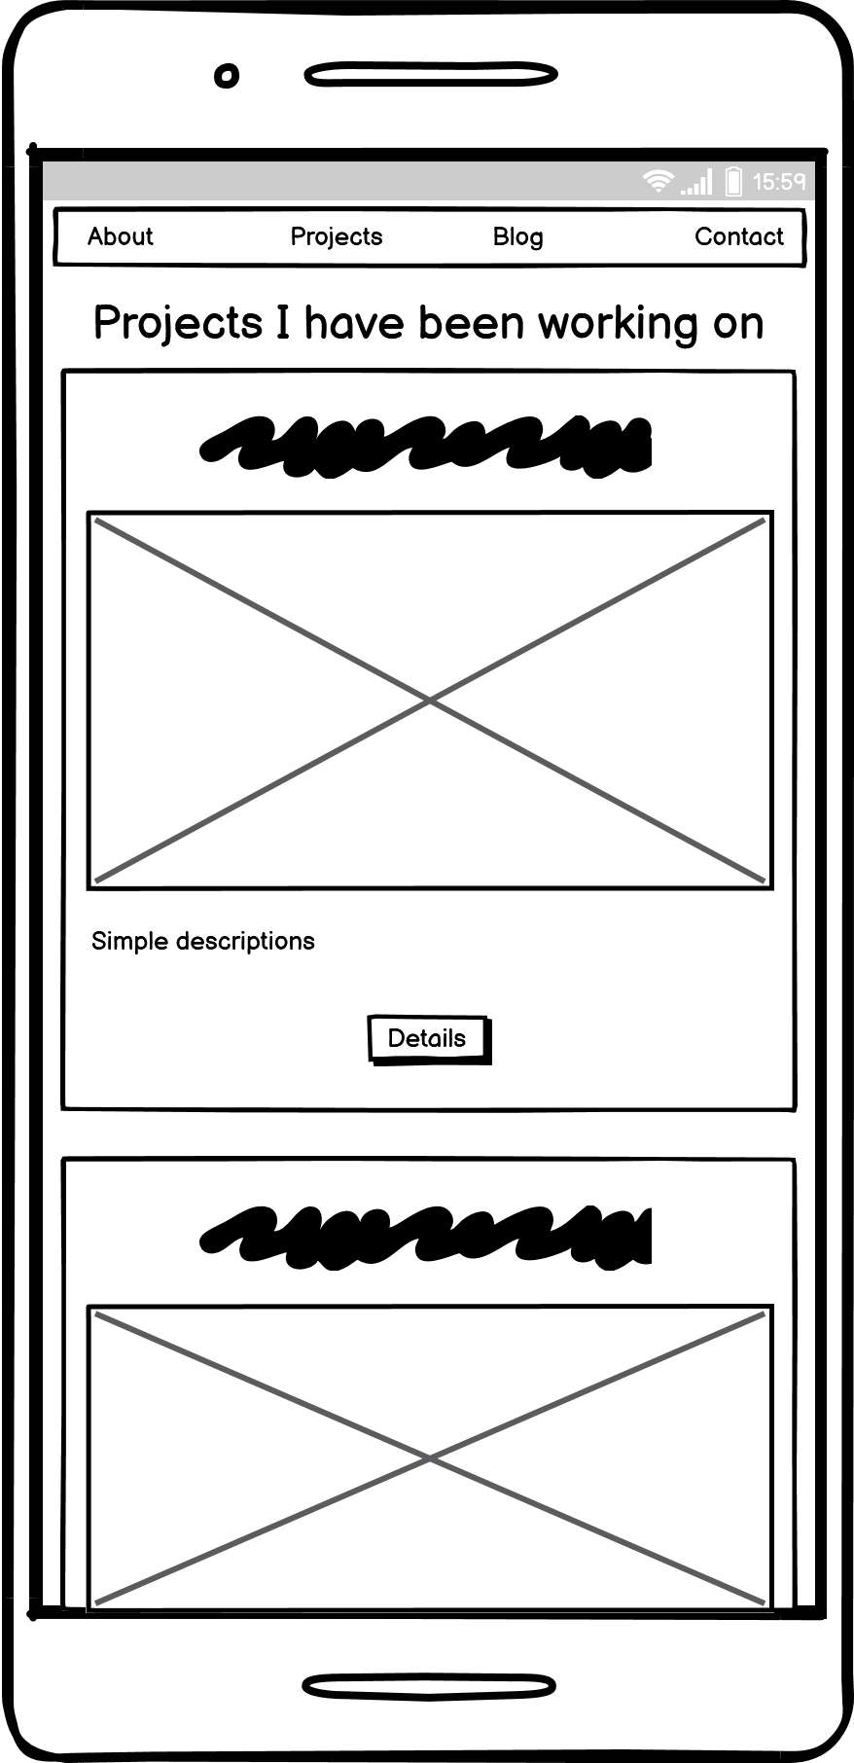
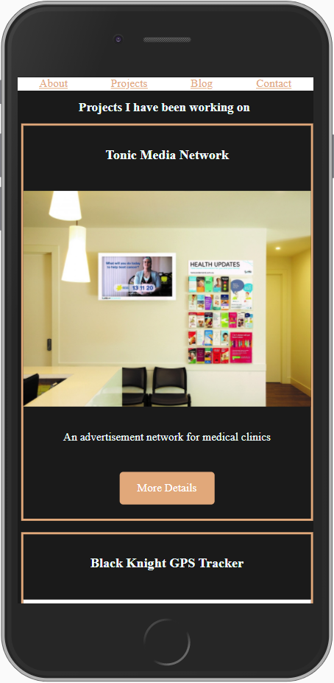
Projects Page
Card list
Border with matching colour scheme
Button for more detail

Slide 13
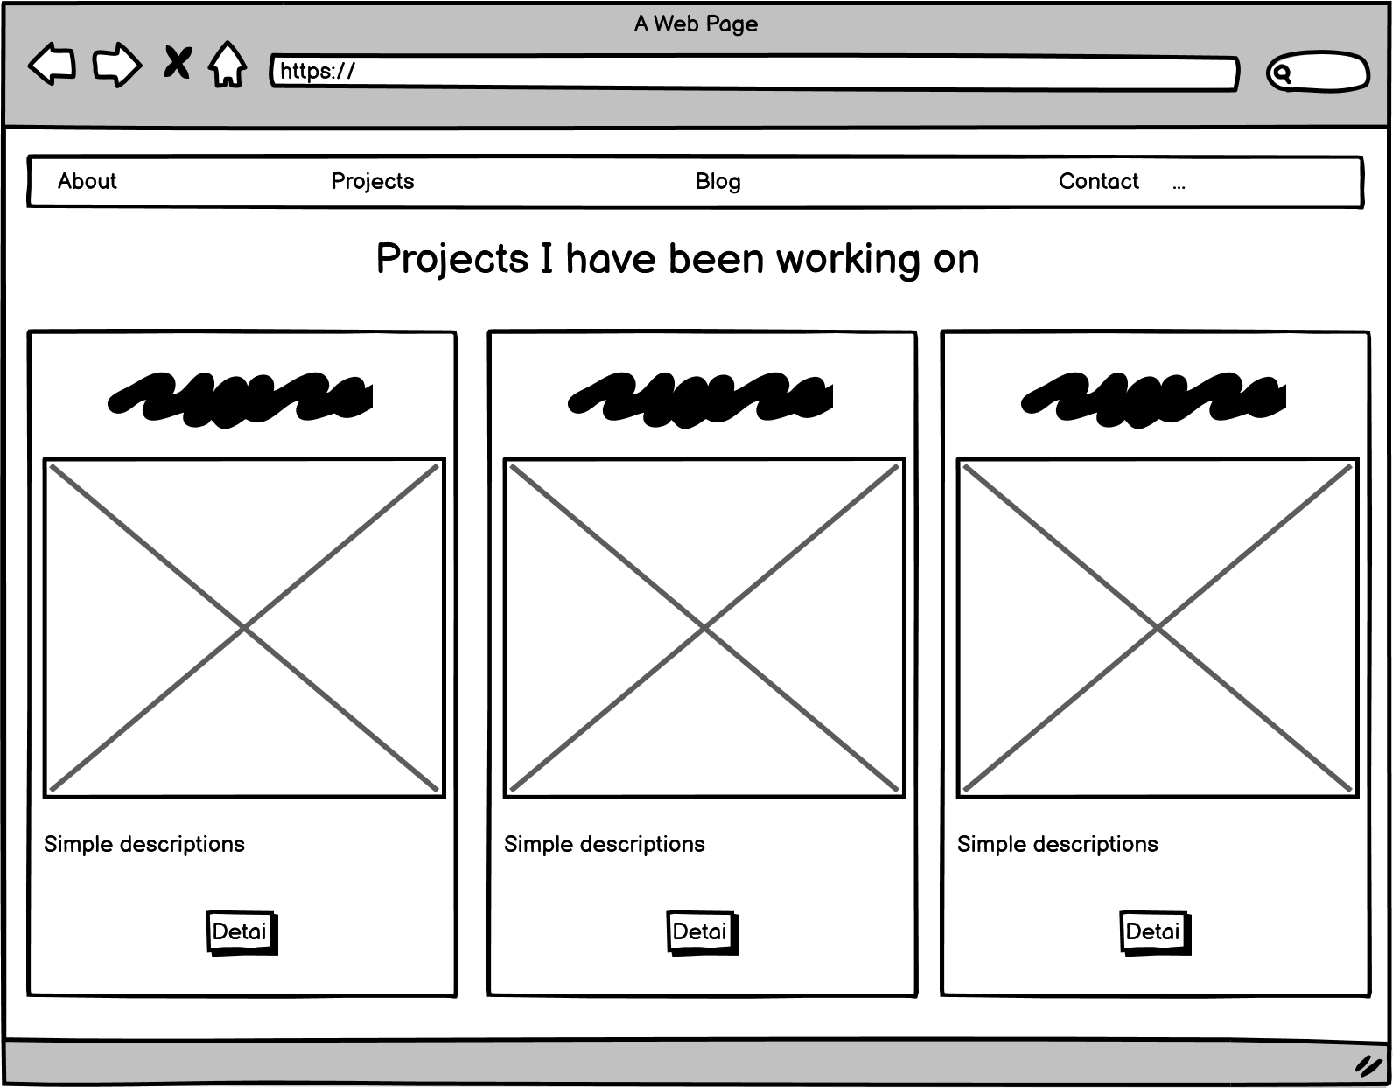
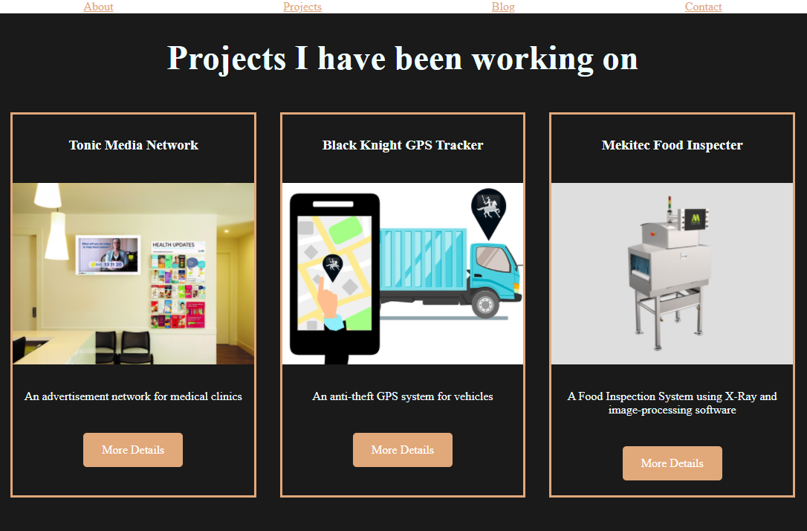
Projects Page – Desktop

Slide 14
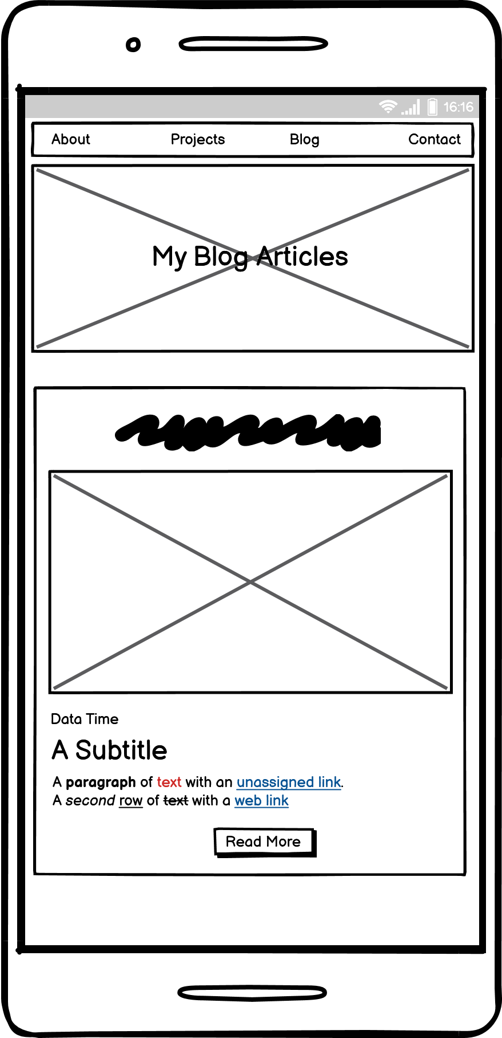
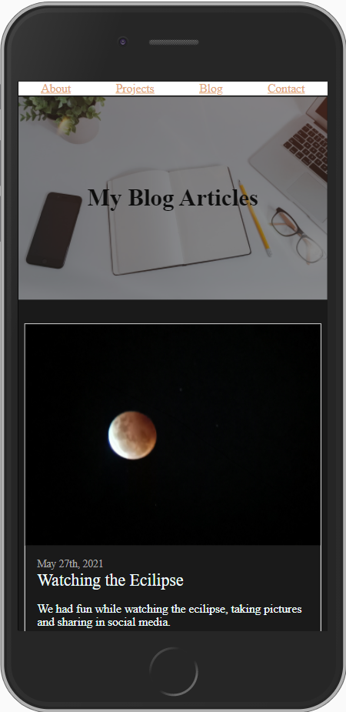
Blog Page
Title with a background picture with opacity
Matching size and colour of data, blog title, and blog text

Slide 15
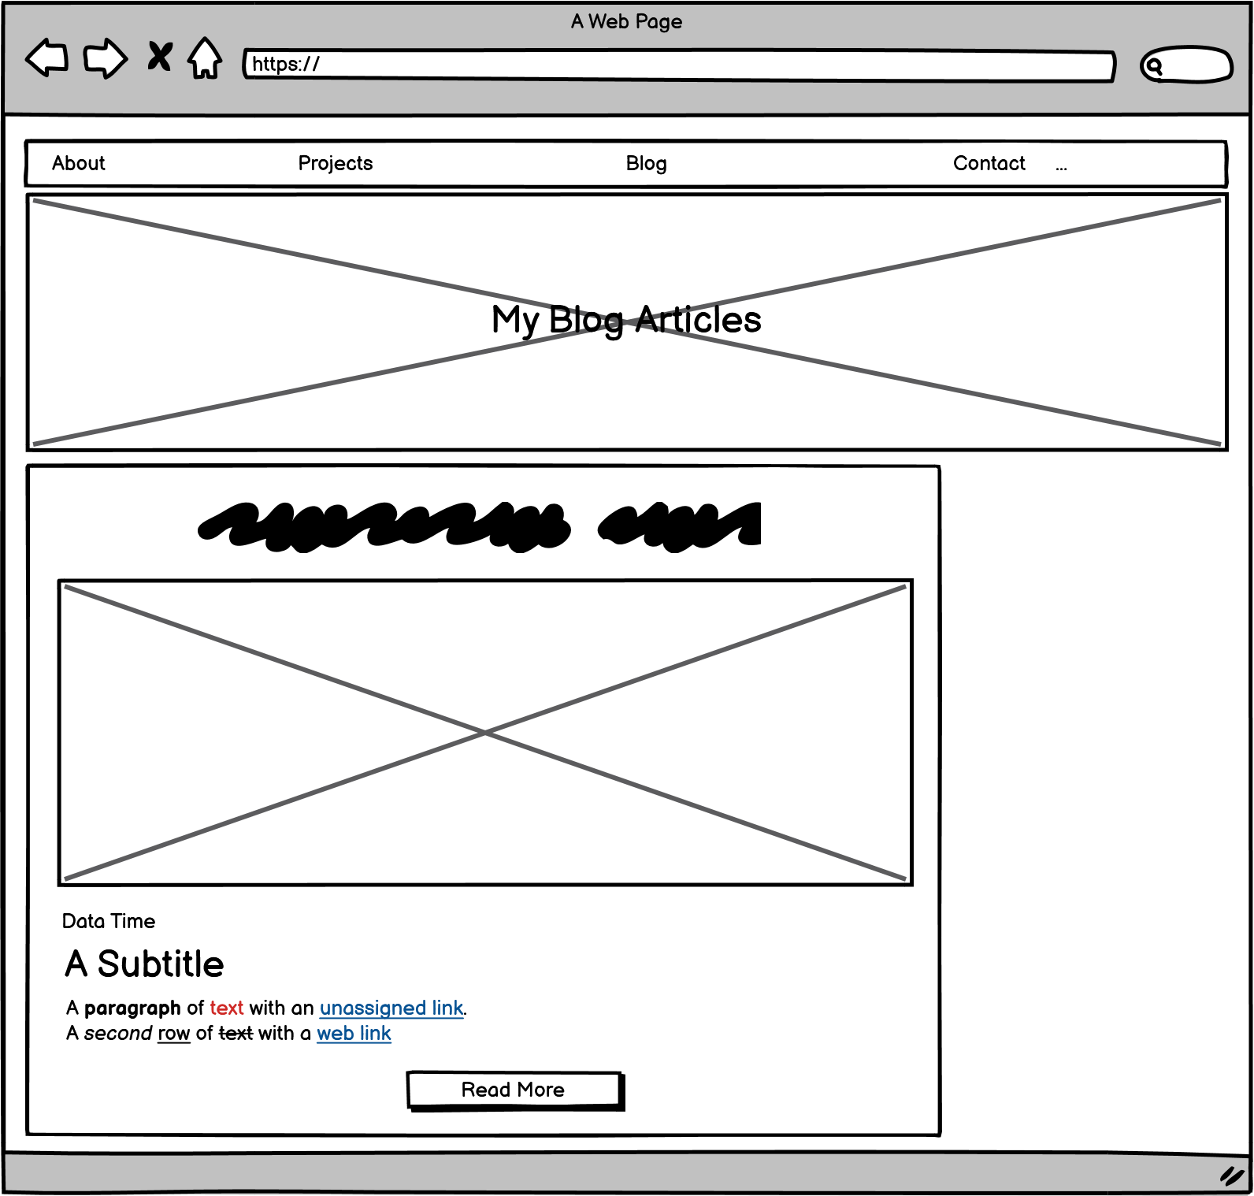
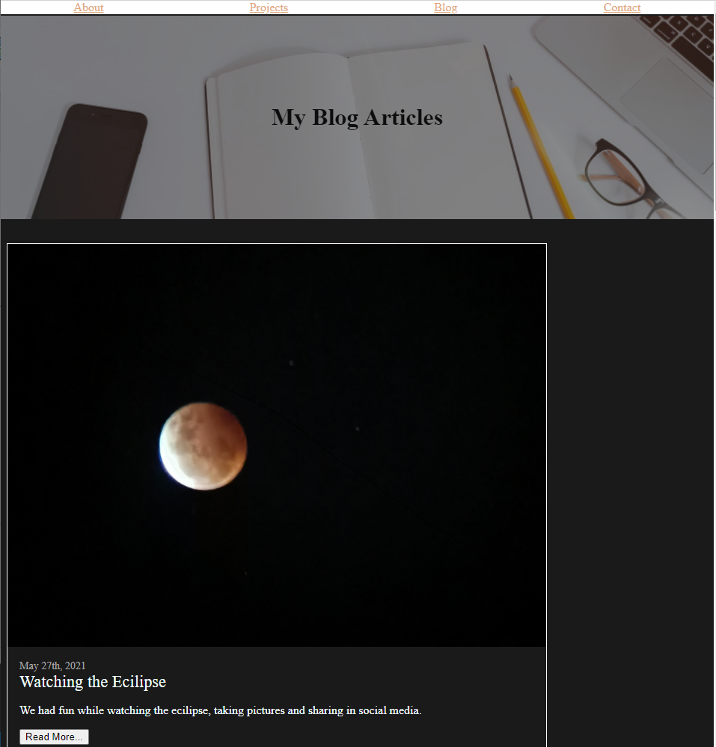
Blog Page - Desktop

Slide 16
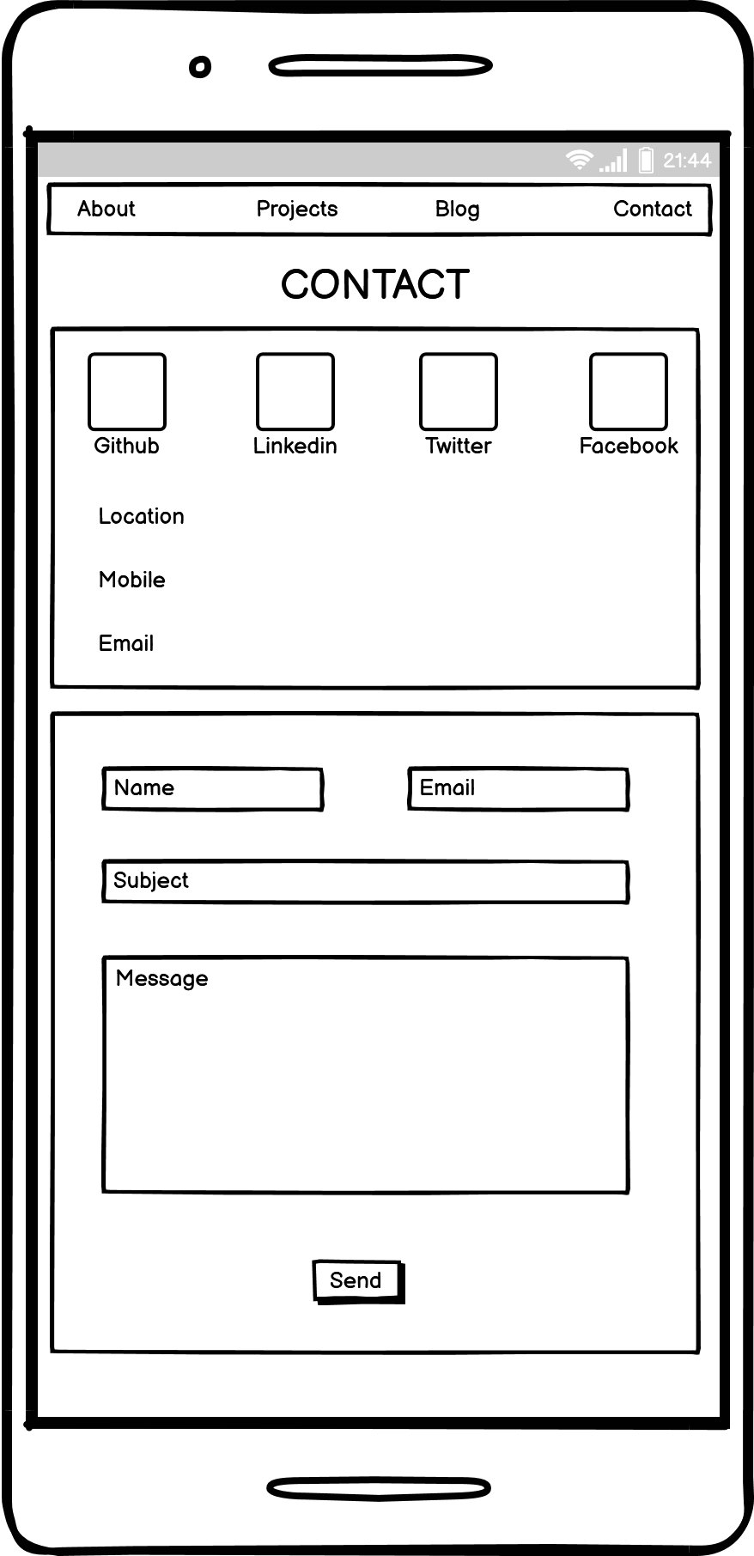
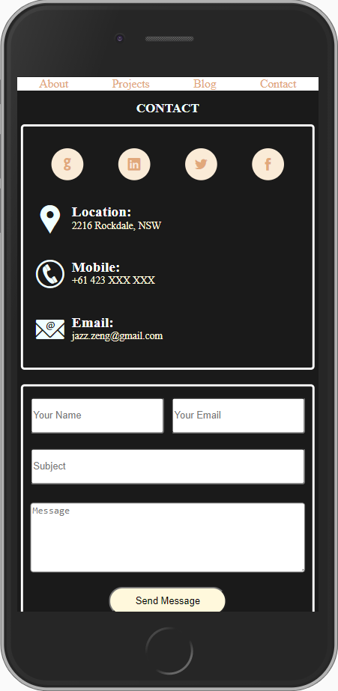
Contact Page
Icons of social media with round background
Big icons of contact methods
A form for sending message
A button with hover effect

Slide 17
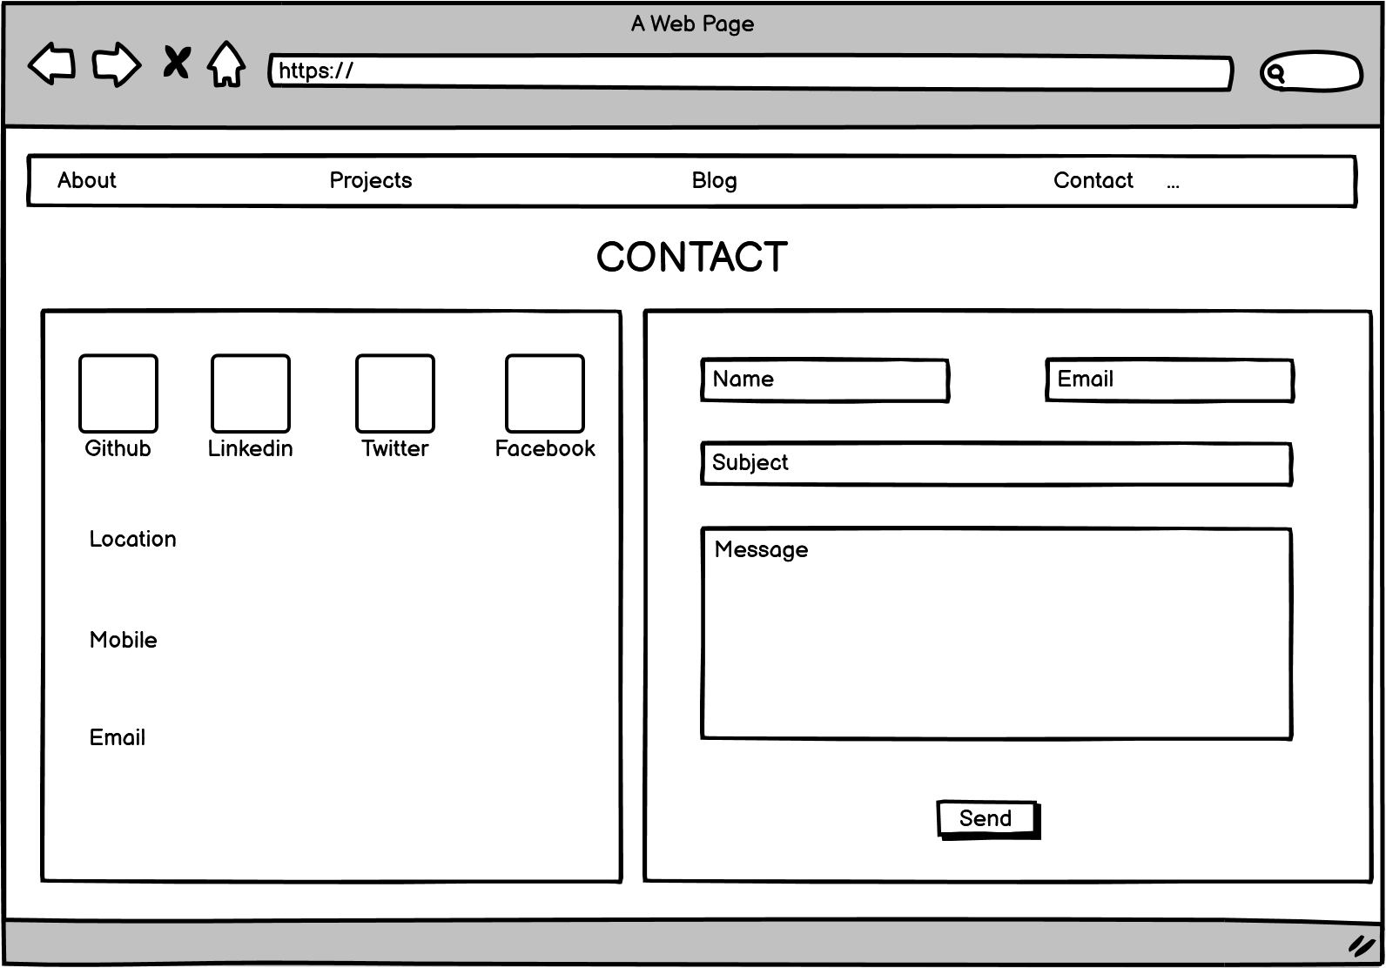
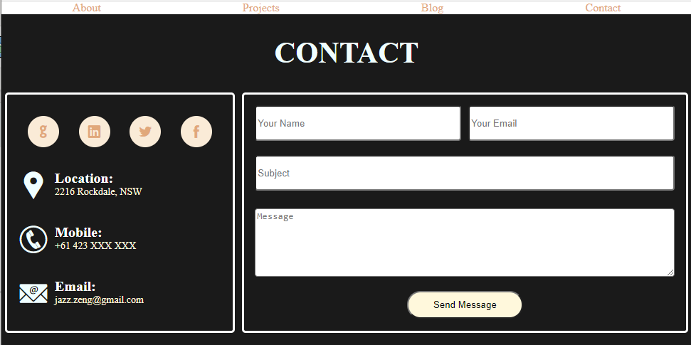
Contact Page – Desktop

Slide 18
A Small Lesson I Learned
What if {width: 130%} ?
What if {width: 100%; margin: 10px;} ?

Slide 19
Thank You (●’◡’●)

