Slide 1

TEAM LEASTCODERS
problem statement-2

Slide 2
idea
1
2
method-1: HSV_Threshold Image Processing approach.
-this is a no-machine learning model suitable for real time detection.
- upon testing, we have realised, this model has surpassed expectation in detecting no-smoke images.
3
4
5
6
method-2: Custom based Pixel CNN model.
-useful for processing 3D data like medical scans and videos because it analyzes spatial relationships in all directions.
7
8
9
method-3 (Final model) : Hybrid model.
-to get a better accuracy.
-As HSV is a no-CNN approach, training and testing time is avoided and can be an advantage for real-time detection.

Slide 3
Pre Processing the data
1
-we utilized OpenCV and Pillow libraries using thresholding and contour analysis, and finding circles using Hough Transform with adjusted parameters for circle size detection. These methods identify borders and circles within images while preserving content, with parameters like threshold values and shrink factors being adjustable for optimization.
-The (input)frames are resized into 244x244 size better suited as it is in square dimensions.
-we also use Gaussian Blur to remove noises from each frame.
-10 frames at a time are appended into an array parallely their labels being appended into a seperate array.
2
3
4
5
6
7
8
9

Slide 4



Training, Validation &Testing
1
2
3
Dataset- 60 videos
training - 80% (48 videos)
validation-10% (6 videos)
testing-10% (6 videos)
Number of epochs- 10
Batch size-16
Loss-
4
5
6
Hardware: tested and ran our models and implementation on kaggle private virtual machines (dataset integrity was maintained - it was uploadedasprivateonly access) ➢
GPU- T4 x2
Tools-Tensorflow 2.15.1, keras, opencv ➢
7
8
9
No of hours taken for training- 2 hours (for input size 244x244, 48 videos each running at 10 epochs with batch size of 16.

Slide 5
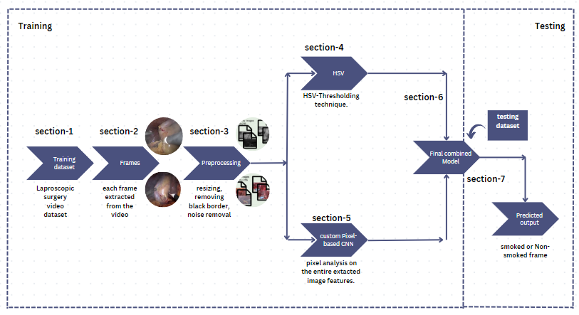
Architecture
1
2
3
4
5
6
7
8
9

Slide 6


1
2
3
4
Metrics
5
6
7
8
9

Slide 7
inference results:
1
2
sr.no | method | Accuracy | F!-Score | Recall | Precision
1 | HSV-Threshold | 89.10 | 50.22 | 33.98 | 59.56
2 | Custom based Pixel CNN | 86.83 | 55.97 | 62.12 | 50.93
3 | Hybrid | 83.13 | 82.9 | 83.16 | 82.7
3
4
5
6
7
8
9

Slide 8
inference speed:
1
2
sr.no | method | Time (in seconds)
1 | HSV-Threshold | 99
2 | Custom Pixel CNN | 1066
3 | Hybrid | 816
3
4
5
6
7
8
9

Slide 9
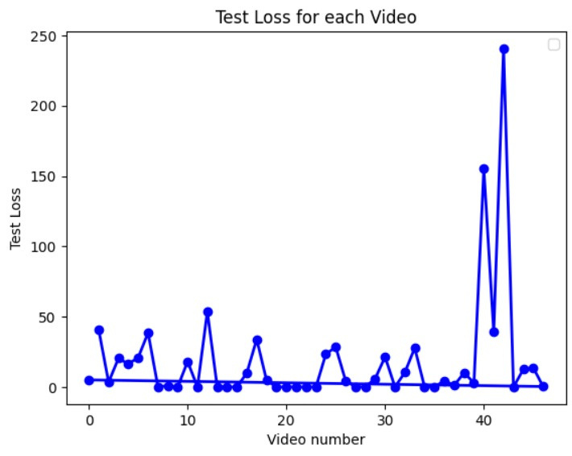
loss curves
1
2
3
4
5
6
7
8
9

Slide 10



confusion matrix
hsv-thresholding
Custom based pixel CNN
hybrid

Slide 11
1
2
3
4
5
bonus
6
challenge
7
8
real-time smoke detection
9
10

Slide 12
1
We process the video 10 frames at a time to consider the temporal correlation of the sequences for finding the smoke development across frames.
Each of these sequences are sent for prediction to our combined Pixel CNN model & HSV threshold technique which gives a weighted prediction of the individual predictions ie. smoke or no smoke.
After getting the predictions we label all the frames using PILLOW library and then stitch the frames back together and add it to the output video at real time.
Our inference is that sequence by sequence detection for smoke over say 10 frames is better than frame by frame detection as the temporal consistency ensures we can gather more features in regards to the smoke’s development in the video at real time
2
3
4
5
6
7
8
9
10
11

