Slide 1

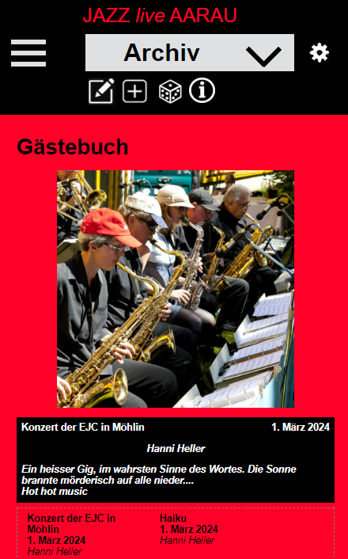



Classes DisplayImage and DisplayImageText

Slide 2
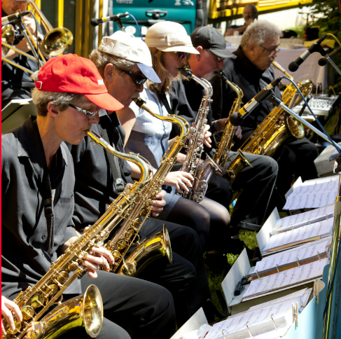
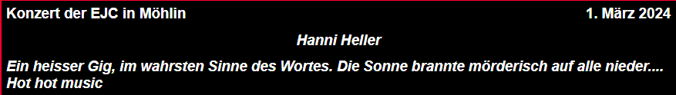
Class DisplayImage (fctn_str= ‘jazz_guests’, id_container)
id_div_jazz_guests cl_div_regular_content
id_div_jazz_guests_group_fix_pos cl_div_jazz_guests_group_fix_pos
id_div_jazz_guests_display_image_container cl_div_jazz_guests_display_image_container
id_div_display_image_toolbars_jazz_guests
id_container_left_
image_toolbar_
jazz_guests_
id_display_image_jazz_guests
id_container_right_
image_toolbar_
jazz_guests_
id_div_group_all_texts_my_function group_all_texts_style_str clear both

Slide 3
Member display image functions
setScalePositionDisplayImage (i_image)
{
UtilImage.replaceImageInDivContainer(i_image, ..);
}
hideImageContainerDiv()
displayImageContainerDiv()
Member setting functions
setImageContainerHeight m_image_container_height

Slide 4
Class DisplayImageText (fctn_str= ‘jazz_guests’, id_container)
id_div_text_container_jazz_guests m_style_text_group_all
Member display text functions
setLabelText m_label_text
setTextOne m_text_one_str
setTextTwo m_text_two_str
setTextThree m_text_three_str
setTextFour m_text_four_str
id_div_group_one_text_jazz_guests m_style_text_group_one = clear: both
id_div_text_one_jazz_guests
m_style_text_one = float: left
id_div_text_two_jazz_guests
m_style_text_two = float: right
id_div_group_two_text_jazz_guests m_style_text_group_two = clear: both
Member setting functions
setStyleLabelAllTextString m_style_label_all_text
setStyleTextGroupAll m_style_text_group_all
setStyleTextGroupOne m_style_text_group_one
setStyleTextGroupTwo m_style_text_group_two
setStylTextOneString m_style_text_one
setStylTextZwoString m_style_text_two
setStylTextThreeString m_style_text_three
setStylTextFourString m_style_text_four
display()
id_div_text_three_jazz_guests m_style_text_three = clear: both
id_div_text_four_jazz_guests m_style_text_four = clear: both

Slide 6
Class DisplayImage
id_div_display_image_my_fctn_rec_x m_style_display_image = clear: both
id_div_display_image_group_icons_my_fctn style_display_image_group_icons = clear: both
id...._my_fctn_icon_four
m_style_icon_one =
float: right
id...._my_fctn_icon_three
m_style_icon_two =
float : right
id...._my_fctn_icon_two
m_style_icon_three =
float : right
id...._my_fctn_icon_one
m_style_icon _four =
float : right
id_div_display_image_picture_my_fctn m_style_picture = clear: both
id_div_group_all_texts_my_function group_all_texts_style_str clear both
id_div_group_one_text_my_function group_one_style_str clear: both
id_div_text_one_my_function
m_style_text_one = float: left
id_div_text_two_my_function
m_style_text_two = float: right
id_div_group_two_text_my_function group_two_style_str clear: both
id_div_text_three_my_function
m_style_text_three = clear: both
id_div_text_four_my_function
m_style_text_four = clear: both

