Slide 1
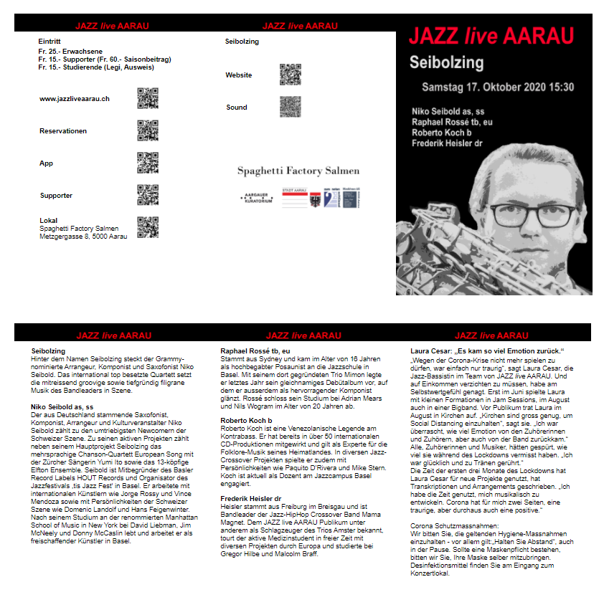
Flyer Application
Flyer is a web application but it is also based on Flyer function in the Windows application Admin.
The tasks for the Flyer application are:
Input and edit of band and musician texts for the flyers
Input and edit of free texts for the flyers
Creation and adding of QR Codes and images for the flyers
Creation of the season flyers as HTML elements (models)
Print of – creation of PDF print jobs for - the season flyers
QR codes
band
QR codes
JAZZ live AARAU
Image
sponsors
Image
concert
Page 5 Page 6 Page 1
Band text
Free text
Muscian texts
Muscian
text
Page 2 Page 3 Page 4

Slide 2
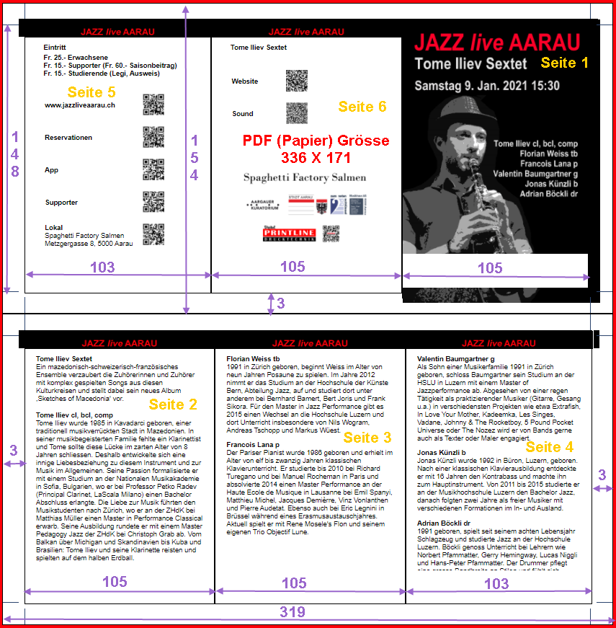
Input data to the printer are two PDF files (or two pages of a PDF file).
The flyer is defined in millimeter.
The size of the pages that will be printed are 319 X 154 millimeter. Three millimeters will be cut away.
The resulting size is 313 X 148 mm.
After folding, the size of the Flyer is 105 X 148 millimeter, i.e. format A6

Slide 3
Element PagePrint id= id_page_print_one
Element PageFiveBox
Element PageSixBox
Element PageOneBox
Element PagePrint id= id_page_print_two
Element PageTwoBox
Element PageThreeBox
Element PageFourBox

Slide 4
Datei FlyerFoldedA6.htm:
head
PageTwoBox
List of (.css) files with style data
div logo
List of (.js) files with JavaScript functions
div text column
div logo
body onload= mainFlyerA6(…)
div band name
div header
div band text
table Dropdown for login, icon flyer and div for help
div musician name
div musician text
div Create PDF files (not yet used)
div musician name
div musician text
PagePrint
div musician name
PageFiveBox
PageSixBox
PageOneBox
div musician text
PagePrint
PageThreeBox
PageTwoBox
PageThreeBox
PageFourBox
div logo
div text column
div logo
div musician name
div musician text
div dropdowns
div edit XML
div name and warning
div musician name
div musician text
div musician name
div musician text
div musician name
div element errors
div musician text

Slide 5
Server directories and files for the Flyer application
Pictures
www
Flyer
FlyerFoldedA6.htm
AdminXml
EditTexts
Logos
QrCodes
Scripts
Style
JazzApplication.xml
Saison_2025-2026
Saison_2025-2026
SubDirectoryNames.xml
FlyerBild_01.jpg
EditTextBand_1.xml
UsersPasswords.xml
EditTextBand_12.xml
FlyerBild_12.jpg
QrCode_Band_01_Sound-png
QrCode_Band_01_Website-png
QrCode_Band_12_Sound-png
QrCode_Band_12_Website-png
SaisonProgramm.xml

Slide 6
g_user_case_str
Parameter telling if the user is the administrator, a musician writing text for a concert or the person that creates (prints) the flyer (a PDF file)
Values: Admin, Drucker, Tester or concert/band number 1, 2, ....., 12
g_subdirectory_names_xml
XML object corresponding to the XML file SubDirectoryNames.xml in directory AdminXml holding the names of the subdirectories for the current seasons.
Example: Saison_2024-2025 and Saison_2025-2026
g_name_users_passwords_xml
XML object corresponding to the XML file UsersPaawords.xml in directory AdminXml holding the user names and passwords
g_application_xml
XML object corresponding to the application XML file JazzApplication.xml in directory AdminXml holding JAZZ live AARAU information
g_current_season_xml
XML object corresponding to the current season XML file SaisonProgramm.xml in directory AdminXml/Saison_20NN-20MM/ holding information about the concerts
g_xml_edit_objects
Array of XML objects corresponding to the XML Edit files EditTextBand_x.xml in directory EditTexts/Saison_20NN-20MM/ holding the flyer texts
g_xml_edit_file_names
Array of XML Edit file names corresponding to g_xml_edit_objects
g_flyer_application_mode
Flyer application mode flag.
AdminXml: Display flyer texts AdminXml/Saison_20NN-20MM/SaisonProgramm.xml
EditXml: Display flyer texts EditTexts/Saison_20NN-20MM/EditTextBand_x.xml
g_current_season_number
The current season dropdown number
g_current_concert_number
The current concert dropdown number
g_current_musician_number
The current musician dropdown number
g_current_text_number
The current edit dropdown number

Slide 7
Startup Flyer
eventSelectLoginDropDown
User selected user name
afterLoadXmlEditCaseOne
setGlobalParametersLoadXml
Input: User name
displayPagePrintOne
displayPagePrintTwo
g_user_case_str = Admin, Drucker, Tester, Band
loadSeasonXmlSetDropdowns
g_current_season_xml
afterLoadSeasonXml
loadSubdirNames
g_subdirectory_names_xml
For g_user_case_str= Admin or Tester or Drucker
setAndHideElementsForAdministratorTesterPrinter
afterLoadSubdirNames
g_current_season_number
For g_user_case_str= Admin
setAndHideElementsForAdministrator
loadApplicationXml
g_application_xml
For g_user_case_str= Tester
setAndHideElementsForTestert
afterLoadApplicationXml
setPublishTextCheckbox
setMusiciansDropDown
setTextsDropDown
setConcertTextarea
initLoadSeasonXml
g_current_season_xml
case_load = 1, edit_number=1
setWarningTextarea
setTextHeader
setTextInstrument
setLabelTextareaConcert
setLabelTextHeader
setLabelInstrument
loadXmlEdit
g_xml_edit_objects g_xml_edit_file_names
Recursive calls for all concerts
setAllTexts
setAllImages
setXmlEditControls
hideToolTipTextInputCaseDropdown
afterLoadXmlEdit
For Musician setAndHideElementsForMusician
For Drucker setAndHideElementsForPrinter
changeApplicationHeader
checkFlyerConcertData

Slide 8
Neue Saison
eventSelectSeasonDropDown
User selected another seano
afterLoadXmlEditCaseTwo
loadSeasonXml
g_current_season_xml
g_current_concert_number = 1
setConcertsDropDown
loadXmlEdit
g_xml_edit_objects g_xml_edit_file_names
Recursive calls for all concerts
setMusiciansDropDown
setTextsDropDown
setConcertTextarea
setWarningTextarea
afterLoadXmlEdit
setTextHeader
setTextInstrument
setLabelTextareaConcert
setLabelTextHeader
setLabelInstrument
setAllTexts
setAllImages
setXmlEditControls
checkFlyerConcertData

