Slide 1



Mach gerne eine Zeichnung für unser Gästebuch, scanne sie mit der Kamera und lade das Foto mit dieser Funktion hoch.
Ein Selfie oder ein anderes Konzert Foto sind auch willkommen.
Bild aufladen
2
1
Name(n) und E-Mail
Gästebuch-Bild hochladen
E-Mail öffnen
Name
Name(n) eingeben …
E-Mail
E-Mail Adresse eingeben …
Code verlangen
3
4

Slide 2
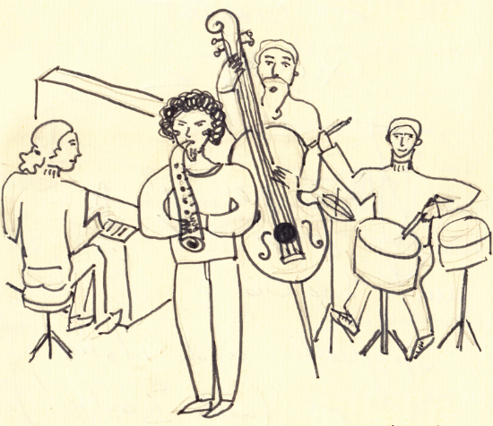
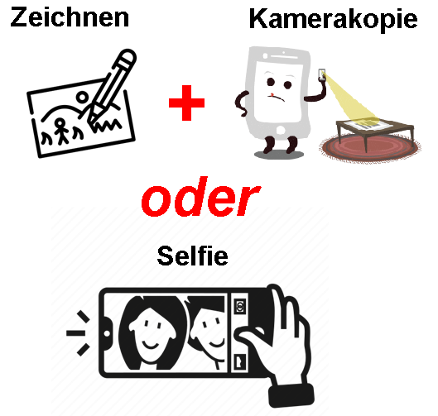
Code verlangen und eingeben
Bild wählen
Daten eingeben
Gästebuch-Bild hochladen
Gästebuch-Bild hochladen
Gästebuch-Bild hochladen
Name
Name(n) eingeben …
Bild wählen
Konzert wählen (optional)
E-Mail
E-Mail Adresse eingeben …
Titel
Datei
Name des ausgewählte Bildes
Kurzer Bildtext
Code verlangen
Text (optional)
Code
Code eingeben …
Freier Text
Weiter
Bemerkung (optional)
Freier Text
Zurück
Weiter
Zurück
Speichern
5
6
7

Slide 4
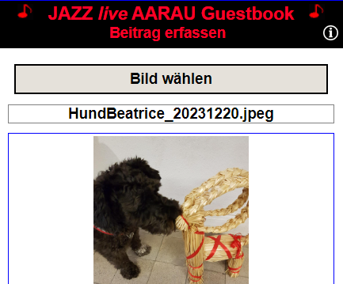
HTML
<input id="id_fileupload" type="file" accept="image/png, …"
style= "width: 0; height: 0; … Siehe CSS " />
<label for= "id_fileupload" style= "Frei ,,,">Bild wählen </label>
JavaScript
Element_fileupload.addEventListener
("change", function() {userSelectedFiles(this, input_data);
function async userSelectedFiles(input_object, input_data)
{
var image_file = input_object.files[0];
var image_size = image_file.size;
var file_type_str = image_file.type;
uploadImageToServer(image_file, new_file_name);
}
function async uploadImageToServer(image_file, new_file_name)
{
var form_data = new FormData();
form_data.append("key_file_input", image_file);
form_data.append("to_file_name", new_file_name);
var response = await fetch('UploadImageToServer.php',
{
method: "POST",
body: form_data
}
if (response.ok)
{
Etwas mit der augeladenen Bild-Datei machen …
}
}
CSS
style= "width: 0; height: 0; z-index: -1; position: absolute;
overflow: hidden; opacity: 0 "
PHP
<?php
// File: UploadImageToServer.php
$file_name = $_FILES[‘key_file_input']['name'];
$file_temp_server = $_FILES[‘key_file_input']['tmp_name’];
$upload_file_name = $_POST['to_file_name’];
if (move_uploaded_file($file_temp_server, $upload_file_name) )
{
echo 'Success';
}
else
{
echo 'Failure’;
}
?>

Slide 5

HTML
<form action="UploadFileToServer.php" method="post" enctype="multipart/form-data">
<input type="file" id="id_upload_button" name=“key_file_input" onchange="eventFileSelected" accept=".doc,.docx">
</form>
PHP
<?php
// File: UploadFileToServer.php
$target_dir = "../Documents/";
$file_name = basename($_FILES[“key_file_input"]["name"]);
$upload_file_name = $target_dir . $file_name ;
$file_temp_server = $_FILES[‘key_file_input']['tmp_name’];
if (move_uploaded_file($file_temp_server, $upload_file_name) )
{
echo 'Success';
}
else
{
echo 'Failure’;
}
?>
JavaScript
function eventFileSelected()
{
Etwas mit der augeladenen Datei machen …
}

Slide 6
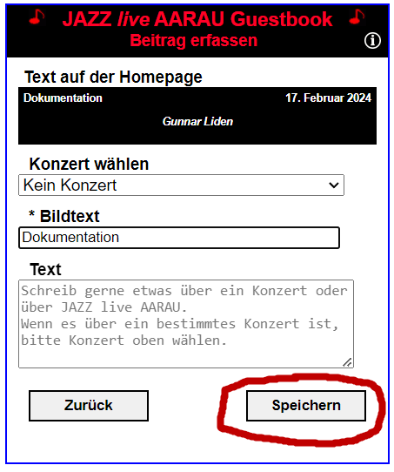
GuestbookData
All data set by the user g_guestbook_data
onClickForwardThreeButton
saveNewRecordAlsoToJazzGuestsXml
saveNewGuestbookUploadedRecord
backupJazzGuestsXml
appendSetSaveGuestbookUploadData
g_guests_uploaded_xml
backupJazzGuestsUploadedXml
saveJazzGuestsUploadedXmlOnServer
JazzGuestsUploaded.xml
copyImageFromUploadToGuestbookDir
sendNewRecordNotificationEmailToAdmin
appendSetSaveGuestbookData
g_guests_xml
GuestStorage.setGuestbookData
saveJazzGuestsXmlOnServer
JazzGuests.xml

Slide 7
Class AppendBothXml
start
Call UtilLock.lock
reloadJazzGuestsObject
Reload JazzGuests.xml
reloadJazzGuestsUploadedObject
Reload JazzGuestsUploaded.xml
appendXmlUserInputData
Append record to and save JazzGuestsUploaded.xml
constructImageFileNameAndCopy
Construct image file name and copy uploaded image
appendXmlUploadedData
Append record to and save JazzGuests.xml
unlockFiles
Call UtilLock.unlock
sendNotificationEmail
Send notification email to the administrator
onClickForwardThreeButton
User clicked save
callbackAppendBothXml
Reload page

Slide 8
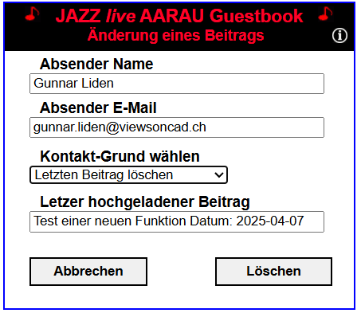
Class ChangeLastUploadedRecord
start
Do nothing if no local storage or record is missing in XML
LastUploadedRecord.getXmlRecordNumber
reloadJazzGuestsObject
reloadJazzGuestXmlObject
backupJazzGuestsXml
UtilServer.copyFileCallback
setGuestbookDataForEdit
GuestStorage.addGuestbookDataForEdit
backupRegImage
UtilServer.copyFileCallback
finish
setControlsEditLastUploadedRecord
executeContactRequest

Slide 9
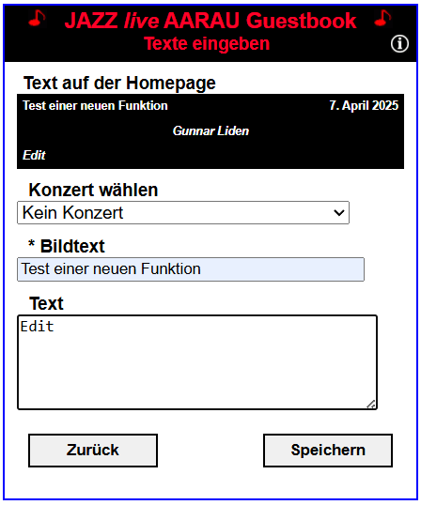
Class SaveEditedRecord
start
UtilLock.lock
copyNewImageFile
UtilServer.copyFileCallback
reloadJazzGuestsObject
reloadJazzGuestXmlObject
backupJazzGuestsXml
UtilServer.copyFileCallback
changeXmlRecordAndSaveFile
UtilServer.saveFileCallback
unlockFiles
UtilLock.unlock
sendNotificationEmail
sendNoticationEmailToAdministrator
finish
GuestStorage.setGuestbookData
onClickForwardThreeButton

Slide 10
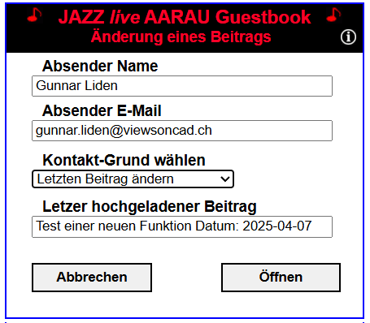
Class DeleteLastUploadedRecord
start
Do nothing if no local storage or record is missing in XML
UtilLock.lock
reloadJazzGuestsObject
reloadJazzGuestXmlObject
reloadJazzGuestsUploadedObject
reloadJazzGuestUploadedXmlObject
backupJazzGuestsUploaded
UtilServer.copyFileCallback
backupJazzGuestsXml
UtilServer.copyFileCallback
moveImageFromUploadedToBackupDir
getDeleteRecordNumber for object JazzGuestsUploaded.xml
JazzGuestsXml.getGuestFileName
GuestbookServer.getUploadedXmlDirUrl, getBackupDirUrl
UtilServer.moveFileCallback
moveImageFromJazzGuestDirToBackupDir
getDeleteRecordNumber for object JazzGuests.xml
JazzGuestsXml.getGuestFileName
GuestbookServer.getUploadedXmlDirUrl, getBackupDirUrl
UtilServer.moveFileCallback
deleteRecordSaveJazzGuestsUploadedXml
UtilServer.saveFileCallback
deleteRecordSaveJazzGuestsXml
UtilServer.saveFileCallback
unlockFiles
sendNoticationEmail
finish
executeContactRequest

Slide 11
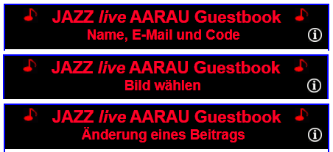
UploadWindow
Sets the title for the active upload window
Member variables
m_el_div_window_title
Container <div> element for the window title
m_active_window_index
Active window index
m_windows_title_array= GuestStr.getUploadWindowTitleArray()
Array with titles for the upload windows
m_n_forward_max= arraylength - 2
Maximum index number for function forward
m_n_forward_min = 1
Minimum index number for function backward
m_contact_active_window_index = arraylength - 2
Active index for window contact (change of record)
Member functions
init
Initialization
setTitle
Sets the title defined by m_active_window_index
forward
Sets the title for the next window
backward
Sets the title for the previous window
toContact
Sets the title for the page contact
toUploadImage
Sets the title for the page upload window
cancelContact
Sets title for back from contact (page 1)
getInfoUrl
Returns the URL to the page information HTML file

Slide 12
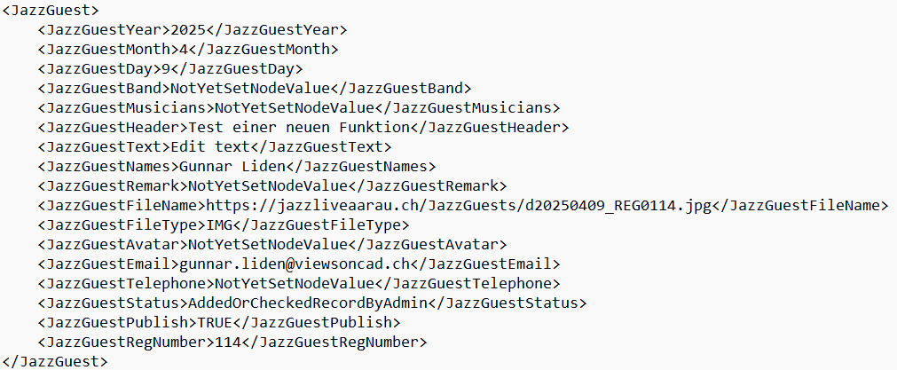
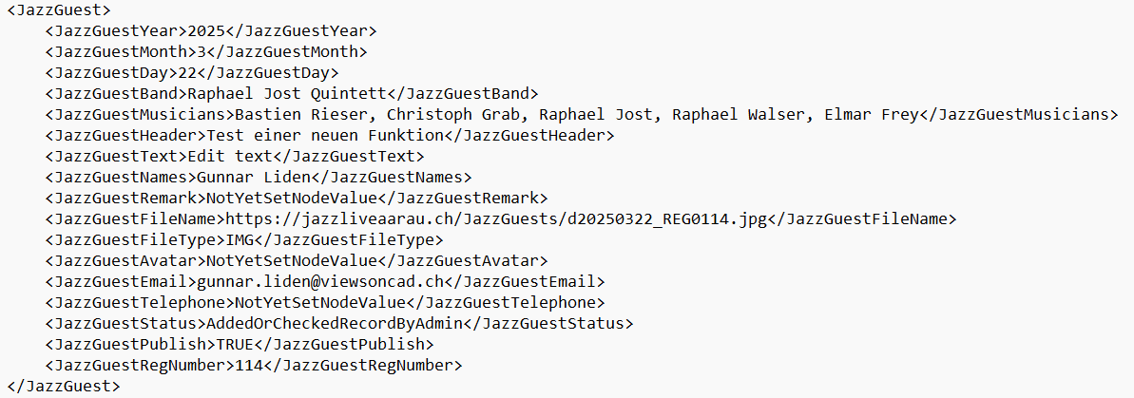
JazzGuests.xml

Slide 13
GuestbookData
Holds all data for a guest record
GuestStorage
Functions to get and set local storage strings
Member variables
m_names
m_email
m_title
m_remark
m_band
m_musicians
m_year
m_month
m_day
m_image_file
m_file_name
m_reg_number
m_append_both_callback
m_uploaded_xml_new_record_number
m_xml_new_register_number
m_xml_new_register_image_file_name
m_user_opened_record_for_edit
Generated upload code
Input upload code from the user
Member set and get functions for all members
Member functions
getGuestbookData
Returns object GuestbookData
setGuestbookData(i_guestbook_data)
Sets storage data from object GuestbookData
getNames, getEmail, getTitle, …
setNames, setEmail, setTitle, …
getKeyNames, getKeyEmail, getKeyTitle, ….

Slide 14
www
JazzGuests
JazzGuests.xml
Images
LockUnlock
LockUnlock.txt
Uploaded
JazzGuestsUploaded.xml
Images

Slide 15
Create JazzUploadImage(input_data)
Init()
Fill container
Add event listener for image selection
userSelectedFiles()

Slide 16
Server Ordner
www
Guestbook
Version_1
Version_x
Info
GuestbookUpload.htm
Icons
jQuery
Php
Scripts
Styles
GuestbookAdmin.htm
favicon.ico
Computer (GitHub) Ordner
WwwGuestbook
GuestbookUpload.htm
Icons
jQuery
Php
Scripts
Styles
GuestbookAdmin.htm
Description
Info
XmlTestData
favicon.ico

Slide 17
Server Ordner: XML Dateien, Bilder
www
Guestbook
JazzGuests
XML
JazzGuests.xml
Backups
LockUnlock
d20231007_REG0064.jpg
Uploaded
JazzGuestsUploaded.xml
d20250322_REG0113.jpg
Image_20240127_1ß_03_34.jpg
Image_20250402_09_20_40.jpg

Slide 18
GuestbookUpload
Global Variables
g_guestbook_data Class GuestbookData
Holds all the user input data
g_guestbook_data_last_record Class GuestbookData
Holds data from the last uploaded record
g_upload_image_object Class JazzUploadImage
Control for the upload of an image
g_email_secure = 'guestbook@jazzliveaarau.ch
g_upload_test_version_mobile_telephone = false
For test of mobile phones with Querystring ?TestVersion&MobileTelephone

Slide 19
id_upload_page cl_upload_page clear both
id_upload_logo cl_upload_logo clear both
id_div_upload_names_email_code clear both
id_div_ upload_container_part_two clear both
id_div_upload_texts clear both

Slide 20
id_div_upload_names_email_code clear both
id_... cl_div_upload_names clear both
id_... cl_div_upload_email clear both
id_... cl_div_upload_button_code clear both
id_... cl_div_upload_input_code clear both
id_... cl_div_upload_button_send clear both

Slide 21
id_div_upload_container_part_two clear both
id_div_upload_input_file_image clear both Container for JazzUploadImage
id_div_guestbook_fileupload
Bild wählen
id_guestbook_fileupload
id_div_guestbook_file_name clear both
Name des ausgewählte Bildes
id_div_image_container clear both
id_div_upload_button_back_forward_part_two clear both
id_upload_button_back_two float left
id_upload_button_forward_two float right
Zurück
Weiter

Slide 22
id_div_upload_texts clear both
id_div_upload_texts_concert clear both
Gästebuch-Bild hochladen
id_div_upload_texts_title clear both
id_div_upload_texts_title clear both
Konzert wählen (optional)
Titel
id_div_upload_texts_text clear both
Kurzer Bildtext
Text (optional)
id_div_upload_texts_remark clear both
Freier Text
Bemerkung (optional)
id_div_upload_button_back_forward_part_three clear both
Freier Text
id_upload_button_back_three float left
id_upload_button_forward_three float right
Zurück
Speichern
Zurück
Senden

Slide 23

Foto von der gescannten Gästebuch-Zeichnung, Selfie oder ein anderes Konzert-Foto

Slide 24








Zu-
fügen
Admin
Zufall
Voll-
bild
Kein
Bild

Slide 25


Slide 26

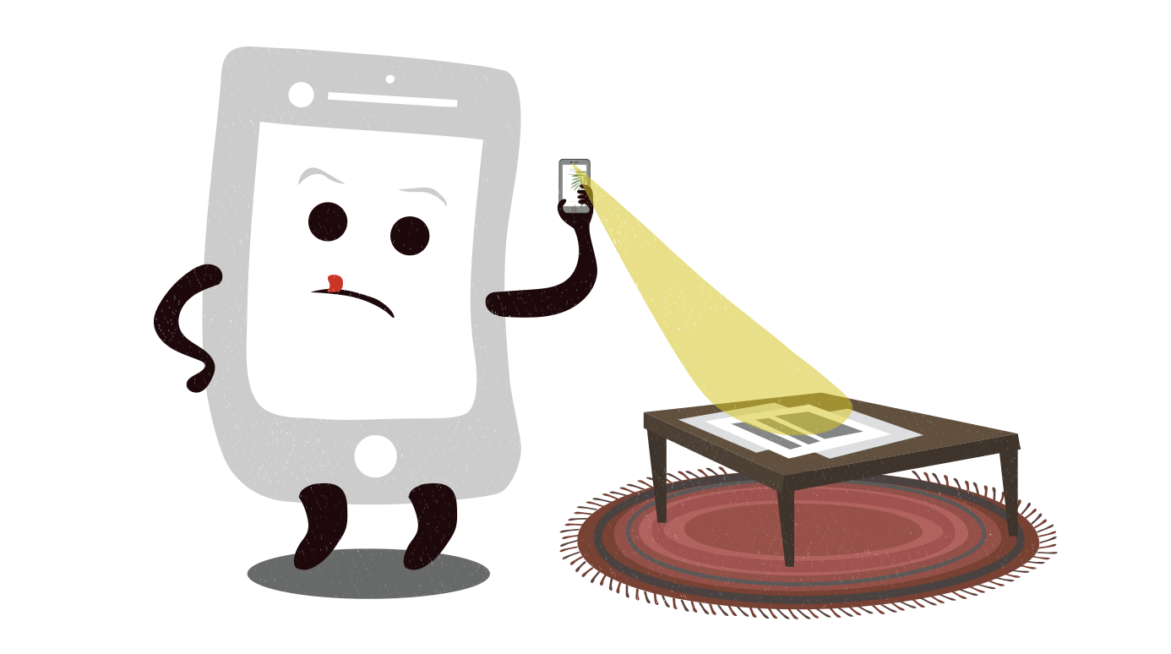

Zeichnen
Kamerakopie
+
oder
Selfie

