Slide 1

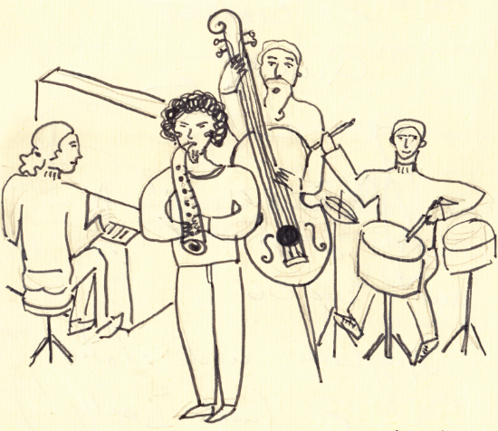
Gästebuch Admin
Eintrag wählen
Nummer
<JazzGuestRegNumber>
Titel … <JazzGuestHeader>
<JazzGuestFileName>
Nur neu zugefügte Bilder
Upload
Download
Status
<JazzGuestStatus>
Konzert wählen (optional)
Datum
<JazzGuestYear> <JazzGuestMonth> <JazzGuestDay>
Band
<JazzGuestBand>
Bandmitglieder
<JazzGuestMusicians>
Titel
<JazzGuestHeader>
Text
<JazzGuestText>.
Name(n)
E-Mail
<JazzGuestNames>
<JazzGuestEmail>
Bemerkung
<JazzGuestRemark>
Publizieren
<JazzGuestPublish>
Löschen
Speichern

Slide 2
Id_admin_page cl_admin_page clear both
id_admin_logo cl_admin_logo clear both
id_admin_login_logout
Id_admin_content clear both
id_guest_admin_dropdown_number cl_guest_admin_dropdown_number clear both
id_... cl_guest_admin_dropdown float left
id_... cl_guest_admin_number float left
id_guest_admin_image_row cl_guest_admin_Image_row clear both
id_... cl_guest_admin_image_row_left
id_... cl_guest_admin_image_row_right
id_guest_admin_band cl_guest_admin_band clear both
id_guest_admin_musicians cl_guest_admin_musicians clear both
id_guest_admin_header cl_guest_admin_header clear both
id_guest_admin_text cl_guest_admin_text clear both
id_guest_admin_names_email cl_guest_admin_names_email clear both
id_... cl_guest_admin_names float left
id_... cl_guest_admin_email float left
id_guest_admin_remark cl_guest_admin_remark clear both
id_guest_admin_bottom_row cl_guest_admin_bottom_row clear both

Slide 3
id_guest_admin_image_row cl_guest_admin_Image_row clear both
id_ guest_admin_image_row_left cl_guest_admin_image_row_left
id_ guest_admin_image_row_left cl_guest_admin_image_row_left
id_guest_admin_filename cl_guest_admin_filename
id_guest_admin_checkbox_new cl_guest_admin_checkbox_new
id_guest_admin_image_container cl_guest_admin_image_container clear both
id_guest_admin_upload_download cl_guest_admin_upload_download
id_guest_admin_upload cl_....
id_guest_admin_download cl_....
id_guest_admin_status cl_guest_admin_status
id_guest_admin_dropdown_concert cl_guest_admin_dropdown_concert
id_guest_admin_date cl_guest_admin_date
id_guest_admin_bottom_row cl_guest_admin_bottom_row clear both
id_guest_admin_publish cl_guest_admin_publish
id_guest_admin_delete cl_guest_admin_delete
id_guest_admin_save cl_guest_admin_save

