Slide 1

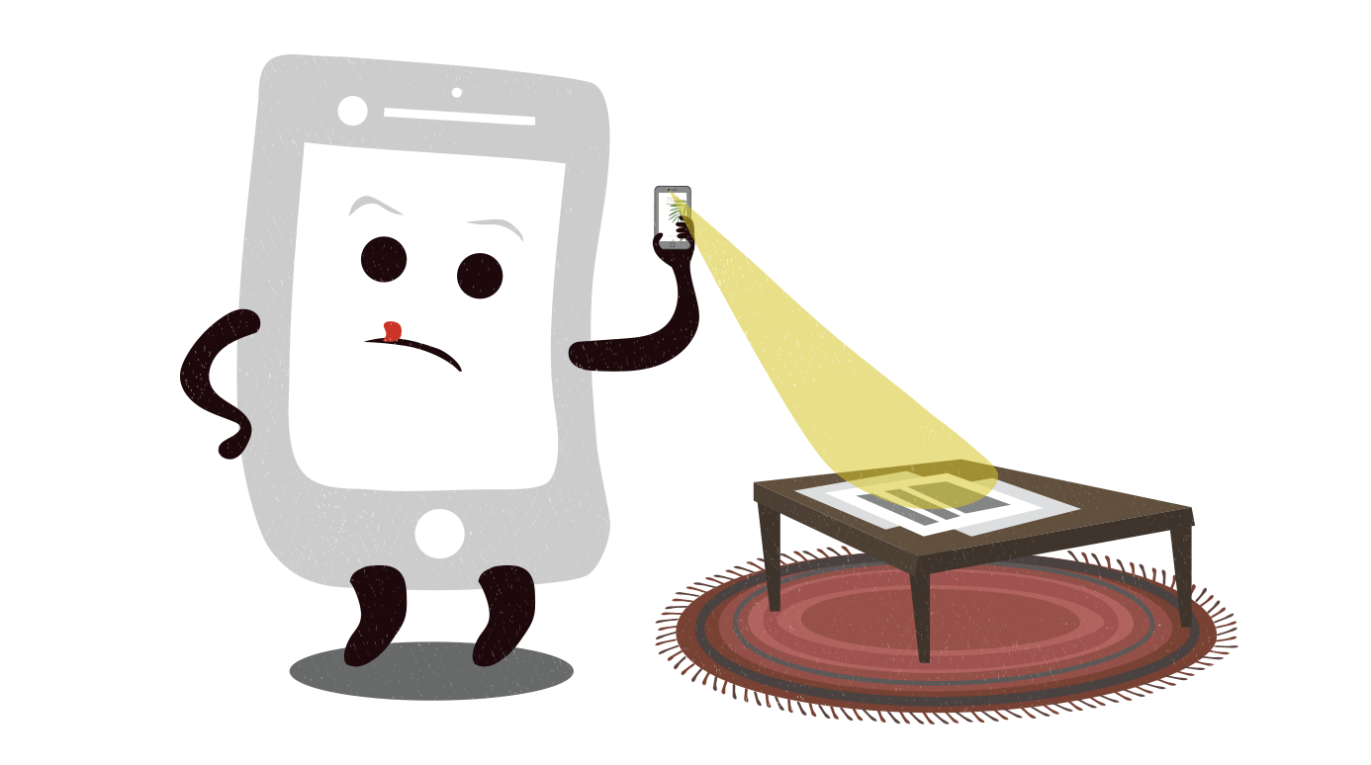




Zeichnen
Kamerakopie
+
Bild aufladen
oder
Selfie
2
1
Name(n) und E-Mail
Gästebuch-Bild hochladen
E-Mail öffnen
Name
Name(n) eingeben …
E-Mail
E-Mail Adresse eingeben …
Code verlangen
3
4

Slide 2
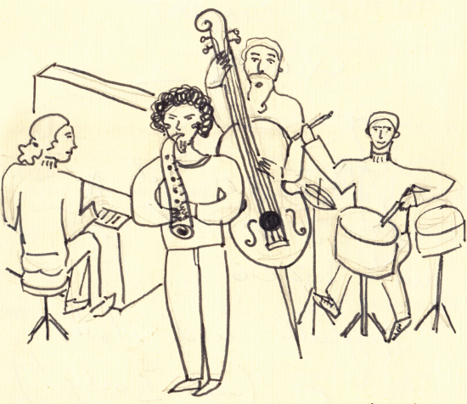
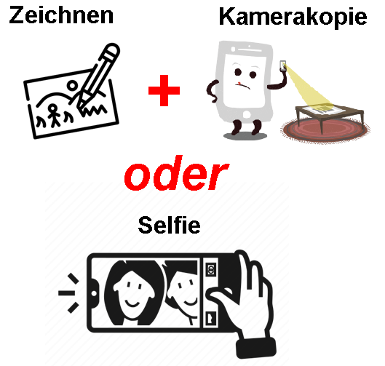
Code verlangen und eingeben
Bild wählen
Daten eingeben
Gästebuch-Bild hochladen
Gästebuch-Bild hochladen
Gästebuch-Bild hochladen
Name
Name(n) eingeben …
Bild wählen
Konzert wählen (optional)
E-Mail
E-Mail Adresse eingeben …
Titel
Datei
Name des ausgewählte Bildes
Kurzer Bildtext
Code verlangen
Text (optional)
Code
Code eingeben …
Freier Text
Weiter
Bemerkung (optional)
Freier Text
Zurück
Weiter
Zurück
Speichern
5
6
7

Slide 3
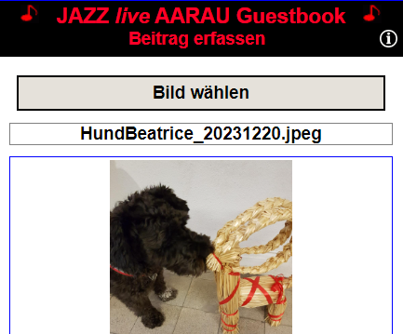
HTML
<input id="id_fileupload" type="file" accept="image/png, …"
style= "width: 0; height: 0; … Siehe CSS " />
<label for= "id_fileupload" style= "Frei ,,,">Bild wählen </label>
JavaScript
Element_fileupload.addEventListener
("change", function() {userSelectedFiles(this, input_data);
function async userSelectedFiles(input_object, input_data)
{
var image_file = input_object.files[0];
var image_size = image_file.size;
var file_type_str = image_file.type;
uploadImageToServer(image_file, new_file_name);
}
function async uploadImageToServer(image_file, new_file_name)
{
var form_data = new FormData();
form_data.append("key_file_input", image_file);
form_data.append("to_file_name", new_file_name);
var response = await fetch('UploadImageToServer.php',
{
method: "POST",
body: form_data
}
if (response.ok)
{
Etwas mit der augeladenen Bild-Datei machen …
}
}
CSS
style= "width: 0; height: 0; z-index: -1; position: absolute;
overflow: hidden; opacity: 0 "
PHP
<?php
// File: UploadImageToServer.php
$file_name = $_FILES[‘key_file_input']['name'];
$file_temp_server = $_FILES[‘key_file_input']['tmp_name’];
$upload_file_name = $_POST['to_file_name’];
if (move_uploaded_file($file_temp_server, $upload_file_name) )
{
echo 'Success';
}
else
{
echo 'Failure’;
}
?>

Slide 4

HTML
<form action="UploadFileToServer.php" method="post" enctype="multipart/form-data">
<input type="file" id="id_upload_button" name=“key_file_input" onchange="eventFileSelected" accept=".doc,.docx">
</form>
PHP
<?php
// File: UploadFileToServer.php
$target_dir = "../Documents/";
$file_name = basename($_FILES[“key_file_input"]["name"]);
$upload_file_name = $target_dir . $file_name ;
$file_temp_server = $_FILES[‘key_file_input']['tmp_name’];
if (move_uploaded_file($file_temp_server, $upload_file_name) )
{
echo 'Success';
}
else
{
echo 'Failure’;
}
?>
JavaScript
function eventFileSelected()
{
Etwas mit der augeladenen Datei machen …
}

Slide 5
Create JazzUploadImage(input_data)
Init()
Fill container
Add event listener for image selection
userSelectedFiles()

Slide 6
id_upload_page cl_upload_page clear both
id_upload_logo cl_upload_logo clear both
id_div_upload_names_email_code clear both
id_div_ upload_container_part_two clear both
id_div_upload_texts clear both

Slide 7
id_div_upload_names_email_code clear both
id_... cl_div_upload_names clear both
id_... cl_div_upload_email clear both
id_... cl_div_upload_button_code clear both
id_... cl_div_upload_input_code clear both
id_... cl_div_upload_button_send clear both

Slide 8
id_div_upload_container_part_two clear both
id_div_upload_input_file_image clear both Container for JazzUploadImage
id_div_guestbook_fileupload
Bild wählen
id_guestbook_fileupload
id_div_guestbook_file_name clear both
Name des ausgewählte Bildes
id_div_image_container clear both
id_div_upload_button_back_forward_part_two clear both
id_upload_button_back_two float left
id_upload_button_forward_two float right
Zurück
Weiter

Slide 9
id_div_upload_texts clear both
id_div_upload_texts_concert clear both
Gästebuch-Bild hochladen
id_div_upload_texts_title clear both
id_div_upload_texts_title clear both
Konzert wählen (optional)
Titel
id_div_upload_texts_text clear both
Kurzer Bildtext
Text (optional)
id_div_upload_texts_remark clear both
Freier Text
Bemerkung (optional)
id_div_upload_button_back_forward_part_three clear both
Freier Text
id_upload_button_back_three float left
id_upload_button_forward_three float right
Zurück
Speichern
Zurück
Senden

Slide 10

Foto wählen
oder
Foto machen

Slide 11





Zu-
fügen
Admin
Zufall
Voll-
bild
Kein
Bild

