Slide 1

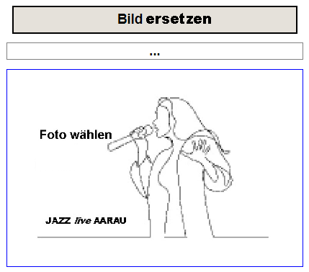
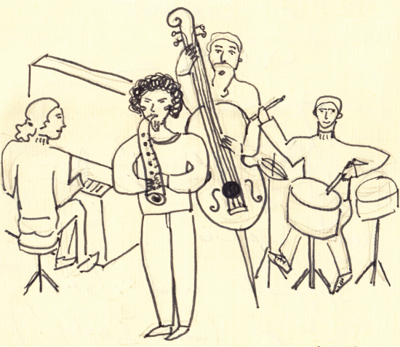
Gästebuch Admin
Eintrag wählen
Nur neu
Titel … <JazzGuestHeader>
<JazzGuestFileName>
Band
<JazzGuestBand>
Bandmitglieder
<JazzGuestMusicians>
Titel
<JazzGuestHeader>
Text
<JazzGuestText>.
Datum
Konzert wählen (optional)
<JazzGuestYear> …
Name(n)
E-Mail
<JazzGuestNames>
<JazzGuestEmail>
Bemerkung
<JazzGuestRemark>
Status
<JazzGuestStatus>
Publizieren
<JazzGuestPublish>
Löschen
Speichern

Slide 2
Id_admin_page cl_admin_page clear both
id_admin_logo cl_admin_logo clear both
id_admin_login_logout
Id_admin_content clear both
id_div_admin_dropdown_number cl_div_admin_dropdown_number clear both
id_div_admin_image_row cl_div_admin_Image_row clear both
id_... cl_div_admin_image_row_left
id_... cl_div_admin_image_row_right
id_div_admin_band cl_div_admin_band clear both
id_div_admin_musicians cl_div_admin_musicians clear both
id_div_admin_header cl_div_admin_header clear both
id_div_admin_text cl_div_admin_text clear both
id_div_admin_names_email cl_div_admin_names_email clear both
id_... cl_div_admin_names float left
id_... cl_div_admin_email float left
id_div_admin_remark cl_div_admin_remark clear both
id_div_admin_bottom_row cl_div_admin_bottom_row clear both

Slide 3
id_div_admin_dropdown_number cl_div_admin_dropdown_number clear both
id_... cl_div_admin_dropdown float left
id_div_admin_checkbox_new cl_div_admin_checkbox_new
id_... cl_div_admin_number float left
id_div_admin_image_row cl_div_admin_Image_row clear both
id_div_admin_image_row_left cl_div_admin_image_row_left float left
id_div_admin_image_row_right cl_div_admin_image_row_right float left
id_div_admin_filename cl_div_admin_filename clear both
id_div_admin_status cl_div_admin_status
id_div_admin_image_container cl_div_admin_image_container clear both
id_div_admin_upload_download cl_div_admin_upload_download
id_div_admin_upload cl_....
id_div_admin_download cl_....
id_div_admin_band_date cl_div_admin_band_date clear both
id_div_admin_dropdown_concert cl_div_admin_dropdown_concert
id_div_admin_date cl_div_admin_date
id_div_admin_bottom_row cl_div_admin_bottom_row clear both
id_div_admin_publish cl_guest_admin_publish
id_div_admin_delete cl_guest_admin_delete
id_div_admin_save cl_guest_admin_save

Slide 4
Nummer
<JazzGuestRegNumber>
Upload
Download

