Slide 1

Member Login-Logout Menu
body
id_xyz_page cl_xyz_page
id_div_login_logout Placeholder for the login-logout controls
Label for textbox
id_login_logout_text_box
id_login_logout_button
onClickLoginLogoutButton()
id_xyz_content cl_xyz_content

Slide 2
Application (Main.js)
Class WebLoginLogout
Class LoginLogout
Class JazzApplicationXml
g_web_login_logout WebLoginLogout
m_application_xml JazzApplicationXml
m_id_text_box_login_name
m_callback_function_name
m_tags JazzApplicationTags
initTestLogin()
Set hide/display array
Create WebLoginLogout
WebLoginLogout.LoadXml
m_user_name_object JazzUserName
m_id_button_login_logout
m_login_logout LoginLogout
m_id_div_container
loadOneXmlFile()
m_hide_display_elements Hide elements
m_button_event_function_name
createLoginControlsAfterXml()
WebLoginLogout.createLoginControlsAfterXml
m_callback_function_xml createLoginControlsAfterXml
m_user_name
getNumberOfMembers()
getMemberName() getMemberPassword()
callbackWebLoginIfPossible
(name, b_logged_in)
WebLogiLogout.callbackWebLoginIfPossible
m_user_has_logged_in Flag telling if logged in
m_user_is_logged_in
loadXml()
Create JazzApplicationXml.
Callback createLoginControlsAfterXml
Strings, captions, file names and styles
namePasswordIsOk(name, p_word)
loginIfPossible(callback XML)
getUserName() Returns m_user_name
Call of LoginLogout.php (query function)
callbackWebLoginLogout(name, b_logged_in)
onClickWebLoginButton()
WebLoginLogout.onClickWebLoginButton
createLoginControlsAfterXml()
Create JazzUserName
JazzUserName.getUserName().
Create LoginLogout
LoginLogout.loginIfPossible(callback)
Class JazzUserName
callbackOnClickWebLoginButton
(name, b_logged_in, warning_msg)
WebLogiLogout.callbackOnClickWebLoginButton
m_application_xml JazzApplicationXml
m_user_name
m_local_storage_jazz_user_name
clickLoginLogoutButton(callback event)
getUserName() Returns m_user_name
Call of LoginLogout.php (query function)
callbackOnClickWebLoginButton
(name, b_logged_in, warning_msg)
callbackWebLoginIfPossible
(name, b_logged_in)
setUserHasLoggedIn(b_logged_in)
LoginLogout.createSetControls(name)
requestSetUserName()
requestUserName()
Set name in local storage
Set m_user_name
Return name
Class JazzTextBox
setLabelTextPositionLeft,
setReadOnlyFlag
SetValue
SetLabelText
SetTitle
onClickWebLoginButton()
Case Not logged in:
JazzUserName.requestSetUserName()
LoginLogout.setUserName(name)
LoginLogout.loginIfPossible(callback)
Case Logged in:
LoginLogout.clickLoginLogoutButton(callback)
createSetControls(name)
Create JazzTextBox
Create JazzButton
setElementStyles(name)
requestUserName()
Get user name and password
Check password: namePasswordIsOk
Return user name
namePasswordIsOk()
Get user name and password
JazzApplicationXml.namePasswordIsOk
Return user name
Class JazzButton
hideDisplayElements(b_logged_in)
Hide or display elements depending
on if the user has logged in or not
Directory /www/Tasks/Php/Data/
setLabelTextPositionLeft,
setOnClickFunctionName
SetCaption
SetTitle
LoginLogout.txt
login_name
Browser local storage
Directory /www/XML
jazz_user_name_str
JazzApplication.xm

Slide 3
Start Web Application
Click Login Logout
WebLoginLogout.createControlsAfterXml
WebLoginLogout.createControlsAfterXml
WebLoginLogout.onClickWebLoginButton
WebLoginLogout.onClickWebLoginButton
JazzUserName.getUserName
JazzUserName.getUserName
JazzUserName.getUserName
JazzUserName.getUserName
LoginLogout.loginIfPossible
LoginLogout.loginIfPossible
callBackWebLoginIfPossible
(name, b_logged_in)
callBackWebLoginIfPossible
(name, b_logged_in)
callbackOnClickWebLoginButton
(name, b_logged_in, warning_msg)
callbackOnClickWebLoginButton
(name, b_logged_in, warning_msg)
WebLoginLogout.
callBackWebLoginIfPossible
(name, b_logged_in)
WebLoginLogout.
callBackWebLoginIfPossible
(name, b_logged_in)
WebLoginLogout.
callbackOnClickWebLoginButton
(name, b_logged_in, warning_msg)
WebLoginLogout.
callbackOnClickWebLoginButton
(name, b_logged_in, warning_msg)

Slide 4
Login
Admin Tasks
Apps only read
Request user name and password.
Check password
Request user name and password.
Check password
Checkin failed
Check (on the server) if someone else is logged in
Try later
OK
OK

Slide 5
Application Admin Tasks (JazzTasks.js)
g_application_xml JazzApplicationXml
g_web_login_logout WebLoginLogout
g_user_name_object JazzUserName
initJazzTasks()
Create JazzApplicationXml Callback initJazzTasksAfterLoadOfXml
1
initJazzTasksAfterLoadOfXml()
initLoginLogout()
2
initLoginLogout()
Create JazzUserName and LoginLogout
LoginLogout.LoginIfPossible Callback callbackLoginIfPossible
3
callbackLoginIfPossible()
setUserHasLoggedIn():
g_user_has_logged_in(‘?) and LoginLogout.setUserIsLoggedIn
LoginLogout.createSetControls:
Create and set the Login Logout Controls
4
onClickLoginLogoutButton()
user_name = JazzUserName.getUserName()
If not set: JazzUserName.requestSetUserName (from local storage)
if not yet set: LoginLogout.setUserName and .loginIfPossible
If set: LoginLogout.clickLoginLogoutButton PHP returns the logged in person
5

Slide 6
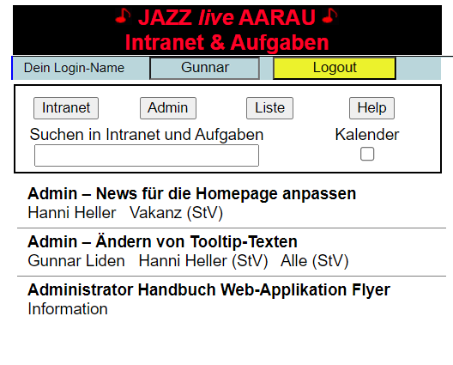
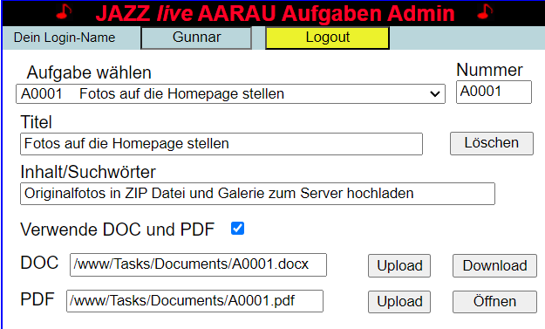
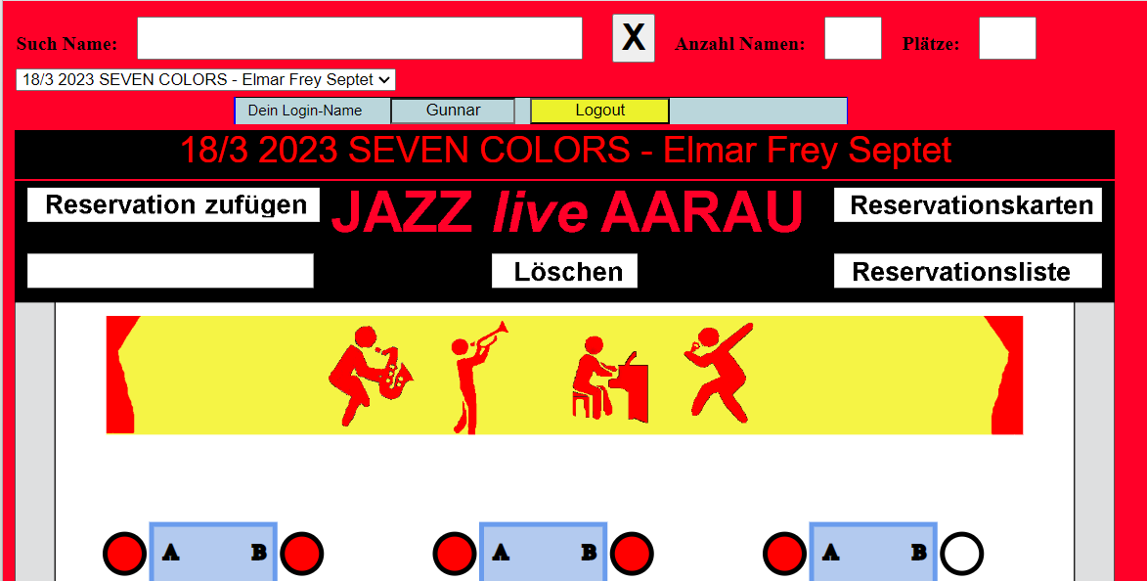
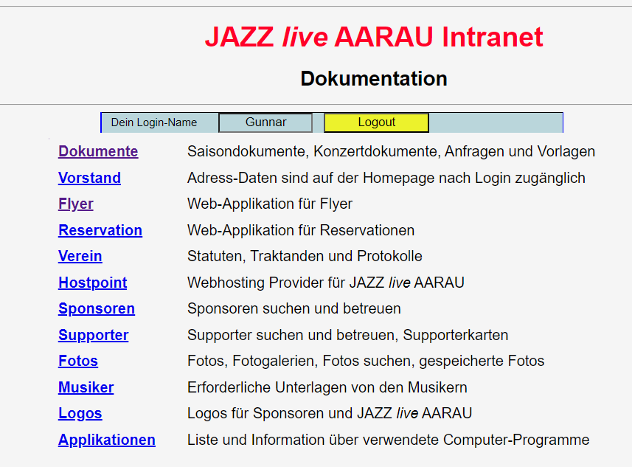
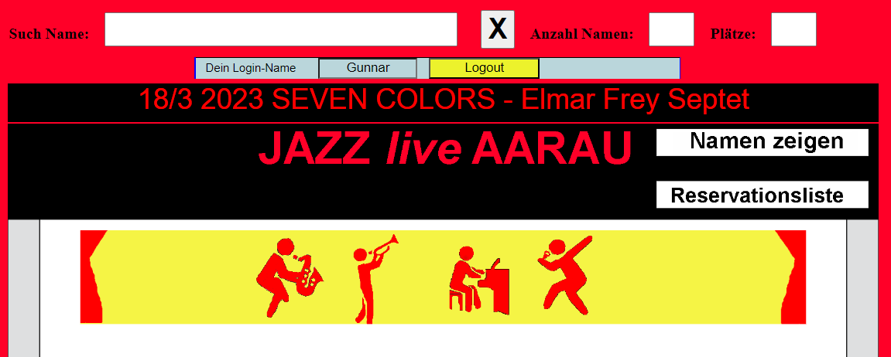
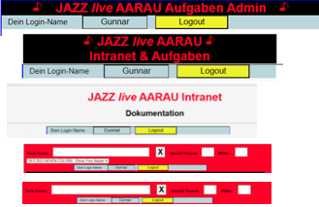

Slide 8
Application
Class LoginLogout
PHP LoginLogout
var g_log = new LoginLogout(….)
xyzFunction (i_callback_fctn)
Switch execution case
2
3
1
Call of LoginLogout.php (jQuery function)
xyzFunction(parameters …)
echo ‘var1_var2’ (result in one string)
clickEventFunction
g_log.xyzFunction(callbackClickEventFunction)
Parameters (same for all functions)
Execution case
User name
…..
4
extractOneEchoString(var1_var2)
extractTwoEchoString(var1_var2)
i_callback_fctn(var_1, var_2)
callbackClickEventFunction(i_var_1, i_var_2)
Do something ….
5
extractOneEchoString(i_echo_str)
return var_1
extractTwoEchoString(i_echo_str)
return var_1

Slide 10
Obsolete
Application (Main.js)
Class WebLoginLogout
g_application_xml JazzApplicationXml
m_login_logout
LoginLogout
GetLoginLogoutObject()
g_web_login_logout WebLoginLogout
createControls()
Create UserName
initTestLogin()
Create WebLoginLogout
Callback createLoginLogoutControlsAfterLoadOfXml
m_user_name_object
JazzUserName
GetUserNameObject()
createLoginLogoutControlsAfterLoadOfXml()
WebLoginLogout.createLoginLogoutControlsAfterLoadOfXml
Class LoginLogout
onClickWebLoginLogoutButton()
WebLoginLogout.onClickWebLoginLogoutButton
callbackOnClickWebLoginLogoutButton
(name, b_logged_in, warning_msg)
WebLogiLogout.callbackOnClickWebLoginLogoutButton
callbackWebLoginIfPossible
(name, b_logged_in)
WebLogiLogout. callbackWebLoginIfPossible

