Slide 1
QR Code Show
onloadQrCodeShow
getSeasonStartYear
SeasonStartYear.php
noCodeInQueryStringOrEqualToLocal() or
QR code data is saved in local storage
callbackSeasonStartYearShow
setInputQrQodeElementWithQueryString
Let the user klick the button ‘Save QR Code’
displayQrCodeWithDataFromLocalStorage

Slide 3
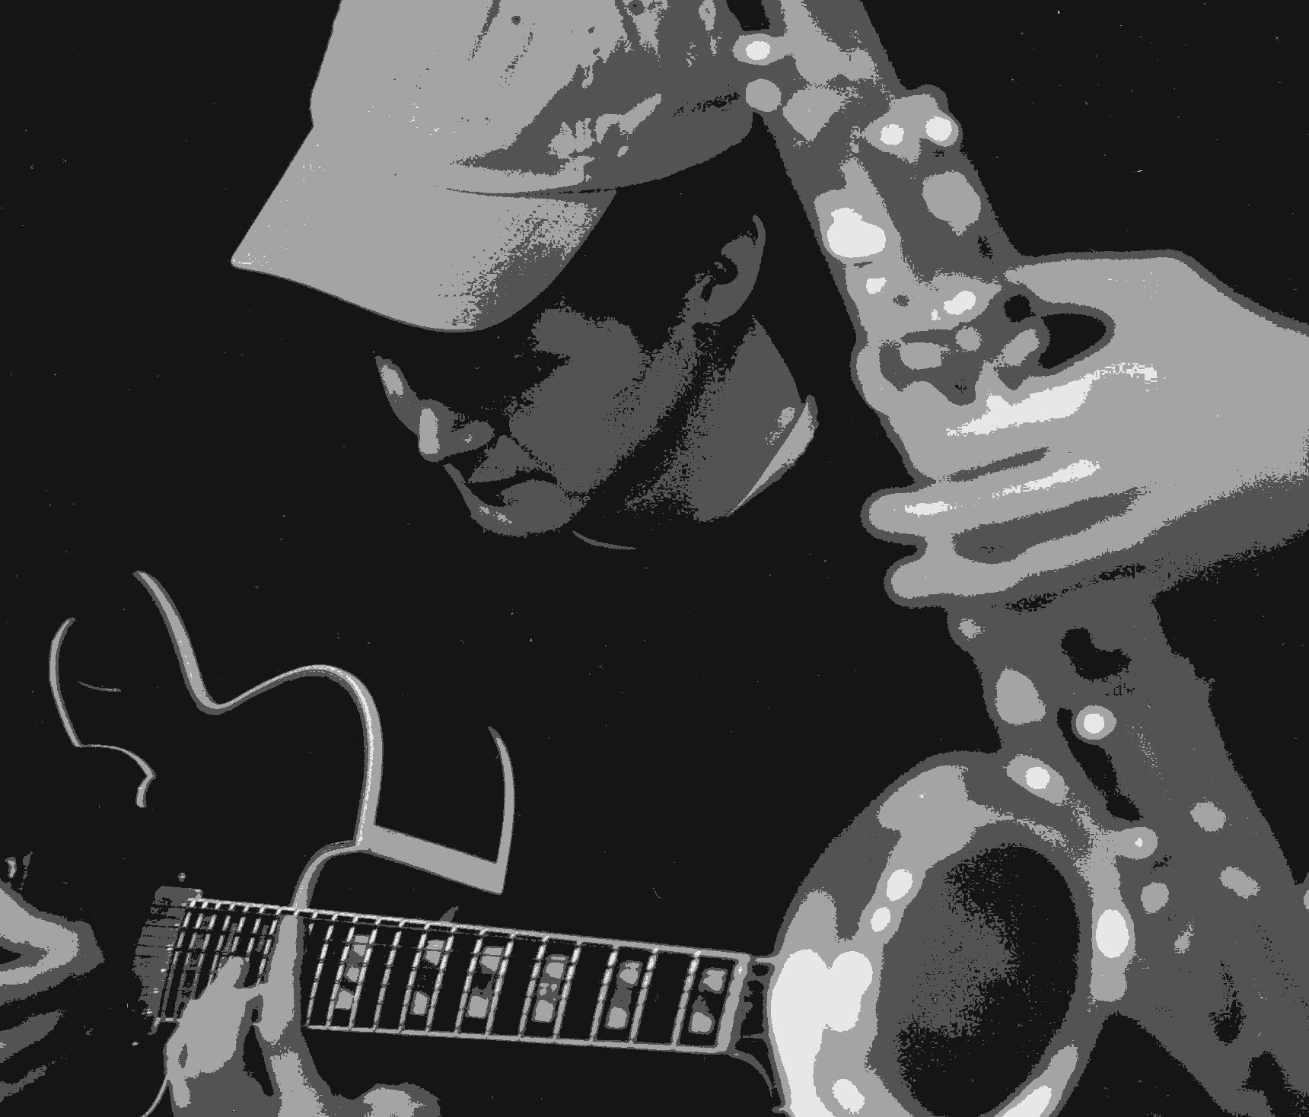
JAZZ live AARAU
JAZZ live AARAU
JAZZ live AARAU
JAZZ live AARAU
JAZZ live AARAU
JAZZ live AARAU

Slide 4
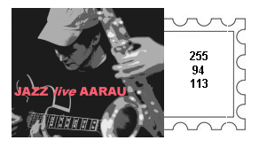
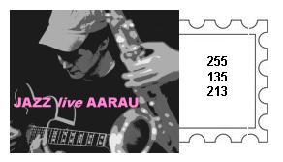
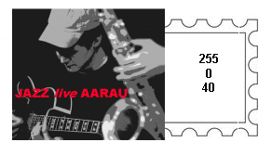
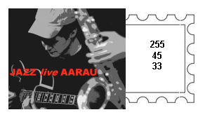
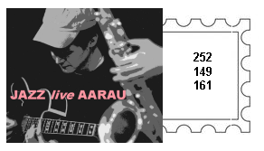
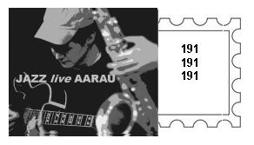
255, 0, 40
255, 94, 113
255, 135, 213
JAZZ live AARAU
JAZZ live AARAU
JAZZ live AARAU
255, 45, 33
252, 149, 161
191, 191, 191
JAZZ live AARAU
JAZZ live AARAU
JAZZ live AARAU

Slide 5
PrintPage 210X 297 mm
PrintPage 210X 297 mm
cl_div_alt_one_upper_margin
cl_div_alt_one_upper_margin
cl_div_alt_one_container_msg
cl_div_alt_one_container_to_address
id_div_alt_one_message cl_div_alt_one_message
cl_div_alt_one_show_msg_qr
cl_div_alt_one_show_qr
cl_div_alt_one_to_address
cl_div_alt_one_show_msg
id..img_one
id..img_two
cl_div_alt_one_container_qr_code
cl_div_alt_one_container_from_address
cl_div_alt_one_two_qr_cards
cl_div_alt_one_two_qr_cards_person_two
cl_div_alt_one_from_address
cl_div_alt_one_lower_margin
cl_div_alt_one_lower_margin

Slide 6
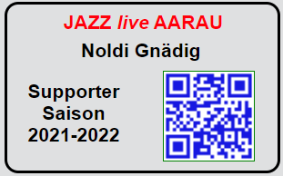
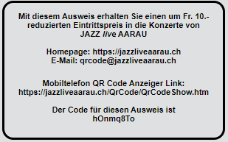
cl_div_supporter_card_front 78 X 48 mm
cl_div_supporter_card_reverse 78 X 48 mm
cl_div_supporter_card_logo
cl_div_supporter_card_reverse_text
cl_div_supporter_card_name
cl_div_supporter_card_text_canvas
cl_div_supporter_card_text
cl_div_supporter_card_qr_image
id_supporter_card_qr_image
cl_supporter_card_qr_image
cl_div_supporter_card_reverse_qr_show

Slide 7

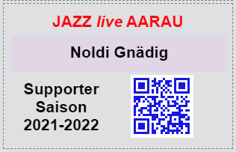
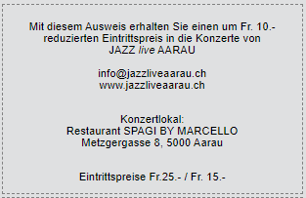
105 mm
45 mm
17.25
mm
17.25
mm
Guten Tag Noldi Gnädig
Xxxxxxxxxxxxxxxxxxxxxxxxxxxxx
Yyyyyyyyyyyyyyyyyyyyyyyyyyyyy
Zzzzzzzzzzzzzzzzzzzzzzzzzzzzzzzz
Sssssssssssssssssssssssssssss
Kkkkkkkkkkkkkkkkkkkkkkkkkkkkkk
Herzliche Grüsse
Das JAZZ live AARAU Team
30.5 mm
30.5 mm
Seite 1
Seite 1
210 mm
70 mm
47.75 mm
131
mm
131 mm
45 mm
PowerPoint 104%
262 mm
148.5 mm
148.5 mm
297 mm

Slide 8


15 mm
15 mm
Absender
JAZZ live AARAU
Gunnar Lidén
Kapellenweg 10
5722 Gränichen
25 mm
15 mm
Noldi Gnädig
Delfterstrasse 43
5004 Aarau
17.25
mm
60 mm
17 .25
mm
Seite 2
Seite 2
210 mm
15 mm
131 mm
131 mm
PowerPoint 104%
262 mm
148.5 mm
148.5 mm
297 mm

Slide 9
15 mm
30 mm
Guten Tag Noldi Gnädig
Xxxxxxxxxxxxxxxxxxxxxxxxxxxxx
Yyyyyyyyyyyyyyyyyyyyyyyyyyyyy
Zzzzzzzzzzzzzzzzzzzzzzzzzzzzzzzz
Sssssssssssssssssssssssssssss
Kkkkkkkkkkkkkkkkkkkkkkkkkkkkkk
Herzliche Grüsse
Das JAZZ live AARAU Team
118.5 mm
80 mm
34.25 mm
34.25 mm
15 mm
50 mm
118.5mm
15 mm
15 mm
17 mm
130 mm
210 mm
113 mm
148.5 mm
297 mm
97 mm
PowerPoint 104%
Seite 1
16 mm

Slide 10
Seite 2
16 mm
21 mm
15 mm
Noldi Gnädig
Delfterstrasse 43
5004 Aarau
73 mm
90 mm
43.5 mm
113 mm
15 mm
35 mm
148.5 mm
25 mm
15 mm
154 mm
15 mm
130 mm
210 mm
97 mm
128 mm
15 mm
15 mm
17 mm
60
mm
128 mm
Absender
JAZZ live AARAU
Gunnar Lidén
Kapellenweg 10
5722 Gränichen
15 mm
50 mm
40 mm
34.25 mm
34.25 mm
73.5 mm
80 mm
42 mm
30 mm
297 mm

Slide 11
C or F
Source control files (pull & push)
Jazz
Ignored files (FTP download)
WwwTasks
WwwReservation
WwwQrCode
WwwFlyer
WwwIntranet
WwwHomepage
QrCodeFiles.htm
Descriptions
Icons
jQuery
Php
QrCodeLib
Scripts
Styles
QrCodeShow.htm
QrCodeScan.htm
QrFiles
XmlTestData
QrCodePrint.htm
Season_202i_202j
Supporter.xml
QrCodeText_sNBWg8Tg.txt
QrFiles.xml
QrCodeImage_sNBWg8Tg.txt
QrCodeImage
and
QrCodeText
files for all generated QR codes

Slide 12
QrFiles.js
QrUtils.js
onloadQrCodeFiles()
getSeasonStartYear(callback)
QrCodeFiles.js
callbackSeasonStartYearFiles(i_season_start_year)
createQrFileXmlIfNotAlreadyExisting(year, callback)
QrCodeFiles.js
afterCreateQrFileXmlIfNotAlreadyExisting()
g_qr_xml = new QrFilesXml(callback, year)
loadSeasonXmlFileCreateConcertData(g_season_start_year)
g_se_xml = new JazzSeasonXml(year, callback)
ConcertData.js
QrCodeFiles.js
afterLoadOfQrFilesXml()
g_su_xml = new SupporterXml(callback, year)
ConcertData.js
afterLoadSeasonXmlFileCreateConcertData(se_xml)
QrCodeFiles.js
afterLoadOfSupporterXmlFile(su_xml)
ConcertData.js
co_data = setConcertDataArrayFromXmlObject(se_xml)
sup_data = setSupporterDataArrayFromXmlObject(su_xml)
ConcertData.js
updateQrFilesXmlUploadQrFilesConcert(co_data, g_qr_xml)
register = create array
SupporterData.js
updateQrFilesXmlUploadQrFilesSupporter(sup_data, g_qr_xml)
register = array defining files to be registered and uploaded
registerAndUploadQrFilesXmlMusician(register, se_xml, qr_xml)
qr_xml.appendNode
setDataOfAppendedQrFilesNodeAndUploadMusician(ConcertData)
uploadQrFileImageAndTextMusician((file_number, qr_xml)
generateQrCodeOnePersonDataUrl(qr_text)
saveFileWithJQueryPostFunction(path, content)
qr_xml.saveXmlFileOnServerCallback(callback)
SupporterData.js
ConcertData.js
SeasonXml.js
QrCodeFilesXml,js
registerAndUploadQrFilesXmlSupporter(register, su_xml, qr_xml)
qr_xml.appendNode
setDataOfAppendedQrFilesNodeAndUploadSupporter(SupportData)
uploadQrFileImageAndTextSupporter((file_number, qr_xml)
generateQrCodeOnePersonDataUrl(qr_text)
saveFileWithJQueryPostFunction(path, content)
qr_xml.saveXmlFileOnServerCallback(callback)
SupporterData.js
SupporterXml.js
QrCodeFilesXml,js
QrFilesXml.js
QrFilesXml.saveXmlFileOnServerCallback(callback)
QrCodeFiles.js
callbackAfterUpdateAndSaveOfQrFilesXml()
QrCodeFiles.js
createAllControls()

Slide 13
eventClickQrSupporterButton()
eventClickQrSponsorButton()
setActiveCategory
QrStrings.getQrCategorySupporterString()
setActiveCategory
QrStrings.getQrCategorySponsorString()
g_files_active_number = dropdownArray(1)
g_files_active_number = dropdownArray(1)
setSupporterDropdown()
setSponsorDropdown()
setControlsSupporter()
setControlsSponsor()
displayControlSupporters()
displayControlSponsor()
setCategoryButtonSupporterSelected()
setCategoryButtonSponsorSelected()
eventClickQrSupporterButton()
eventClickQrMusicianButton()
setActiveCategory
QrStrings.getQrCategoryFreeString()
setActiveCategory
QrStrings.getQrCategoryMusicianString()
g_files_active_number = dropdownArray(1)
g_files_active_number = dropdownArray(1)
setFreeDropdown()
setMusicianDropdown()
setControlsFree()
setControlsMusician()
displayControlFree()
displayControlMusician()
setCategoryButtonFreeSelected()
setCategoryButtonMusicianSelected()

Slide 14
eventSelectFileDropdown()
Set g_files_active_number
Call getActiveCategory()
setControlsSupporter()
setControlsSponsor()
setControlsFree()
setControlsMusician()

Slide 15
Fee
Bank
Input
Application Adressen
Save
Application
QR Code
JazzLiveAdressen.csv
QrFiles
Season_202i_202j
Supporter.xml

Slide 16
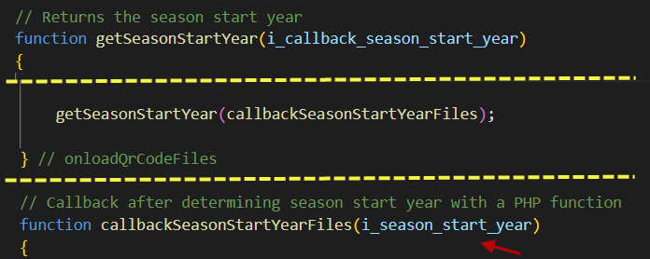
www
QrCode
QFiles
Php
SeasonStartYear.php
2
1
Season_2021_2022
Season_2022_2023
Supporter.xml
Returned
season start year
2021

Slide 17
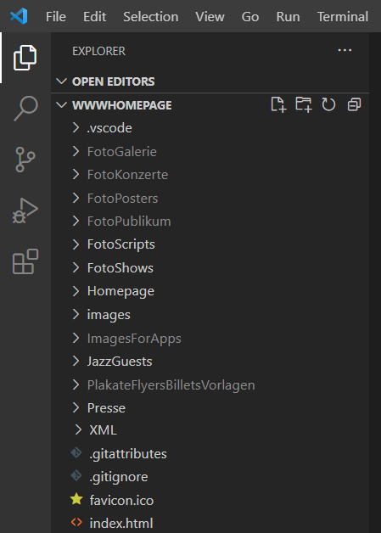
o
on
on
on
1. Stage
Vorstufe-
Repository
2. Commit
Lokales Computer
Repository
3. Push
GitHub
Server
Repository
4. Pull
5. FTP
on
Hostpoint
Server
Quellcode
on
on
on

