Slide 1
C or F
Source control files (pull & push)
Jazz
Ignored files (FTP download)
WwwTasks
WwwReservation
WwwQrCode
WwwFlyer
WwwIntranet
WwwHomepage
QrCodeFiles.htm
Descriptions
Icons
jQuery
Php
QrCodeLib
Scripts
Styles
QrCodeShow.htm
QrCodeScan.htm
QrFiles
XmlTestData
QrCodePrint.htm
Season_202i_202j
Supporter.xml
QrCodeText_sNBWg8Tg.txt
QrFiles.xml
QrCodeImage_sNBWg8Tg.txt
QrCodeImage
and
QrCodeText
files for all generated QR codes

Slide 2
onloadQrCodeFiles()
callbackSeasonStartYearFiles(i_season_start_year)
afterCreateQrFileXmlIfNotAlreadyExisting()
afterLoadOfQrFilesXml()
afterLoadOfSupporterXmlFile(i_supporter_xml)
setSupporterDataArrayFromXmlObject(i_supporter_xml)
Any text ….
callbackAfterUpdateAndSaveOfQrFilesXml()
createAllControls()
loadSeasonXmlFileCreateConcertData(g_season_start_year)
afterLoadSeasonXmlFileCreateConcertData(i_xml)
setConcertDataArrayFromXmlObject(i_xml)
on
on
on
on

Slide 3
eventClickQrSupporterButton()
eventClickQrSponsorButton()
setActiveCategory
QrStrings.getQrCategorySupporterString()
setActiveCategory
QrStrings.getQrCategorySponsorString()
g_files_active_number = 1
g_files_active_number = 1
setSupporterDropdown()
setSponsorDropdown()
setControlsSupporter()
setControlsSponsor()
displayControlSupporters()
displayControlSponsor()
setCategoryButtonSupporterSelected()
setCategoryButtonSponsorSelected()
eventClickQrSupporterButton()
eventClickQrMusicianButton()
setActiveCategory
QrStrings.getQrCategoryFreeString()
setActiveCategory
QrStrings.getQrCategoryMusicianString()
g_files_active_number = 1
g_files_active_number = 1
setFreeDropdown()
setMusicianDropdown()
setControlsFree()
setControlsMusician()
displayControlFree()
displayControlMusician()
setCategoryButtonFreeSelected()
setCategoryButtonMusicianSelected()

Slide 4
eventSelectFileDropdown()
Set g_files_active_number
Call getActiveCategory()
setControlsSupporter()
setControlsSponsor()
setControlsFree()
setControlsMusician()

Slide 5
Fee
Bank
Input
Application Adressen
Save
Application
QR Code
JazzLiveAdressen.csv
QrFiles
Season_202i_202j
Supporter.xml

Slide 6
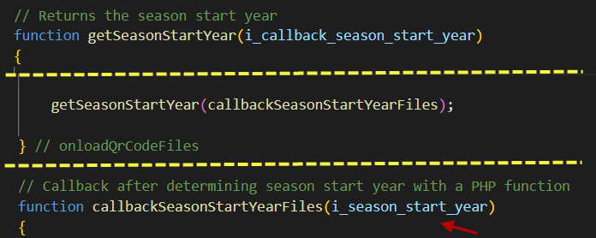
www
QrCode
QFiles
Php
SeasonStartYear.php
2
1
Season_2021_2022
Season_2022_2023
Supporter.xml
Returned
season start year
2021

Slide 7
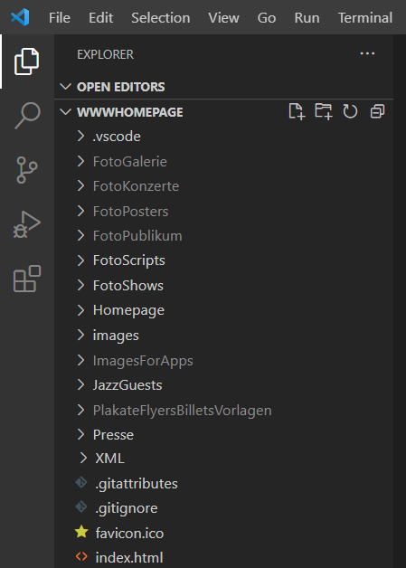
o
on
on
on
1. Stage
Vorstufe-
Repository
2. Commit
Lokales Computer
Repository
3. Push
GitHub
Server
Repository
4. Pull
5. FTP
Hostpoint
Server
Quellcode

