Slide 1
C or F
Source control files (pull & push)
Jazz
Ignored files (FTP download)
WwwTasks
WwwReservation
WwwQrCode
WwwFlyer
WwwIntranet
WwwHomepage
QrCodeFiles.htm
Descriptions
Icons
jQuery
Php
QrCodeLib
Scripts
Styles
QrCodeShow.htm
QrCodeScan.htm
QrFiles
XmlTestData
QrCodePrint.htm
Season_202i_202j
Supporter.xml
QrCodeText_sNBWg8Tg.txt
QrFiles.xml
QrCodeImage_sNBWg8Tg.txt
QrCodeImage
and
QrCodeText
files for all generated QR codes

Slide 2
QrFiles.js
QrUtils.js
onloadQrCodeFiles()
getSeasonStartYear(callback)
QrCodeFiles.js
callbackSeasonStartYearFiles(i_season_start_year)
createQrFileXmlIfNotAlreadyExisting(year, callback)
QrCodeFiles.js
afterCreateQrFileXmlIfNotAlreadyExisting()
g_qr_xml = new QrFilesXml(callback, year)
loadSeasonXmlFileCreateConcertData(g_season_start_year)
g_se_xml = new JazzSeasonXml(year, callback)
ConcertData.js
QrCodeFiles.js
afterLoadOfQrFilesXml()
g_su_xml = new SupporterXml(callback, year)
ConcertData.js
afterLoadSeasonXmlFileCreateConcertData(se_xml)
QrCodeFiles.js
afterLoadOfSupporterXmlFile(su_xml)
ConcertData.js
co_data = setConcertDataArrayFromXmlObject(se_xml)
sup_data = setSupporterDataArrayFromXmlObject(su_xml)
ConcertData.js
updateQrFilesXmlUploadQrFilesConcert(co_data, g_qr_xml)
register = create array
SupporterData.js
updateQrFilesXmlUploadQrFilesSupporter(sup_data, g_qr_xml)
register = array defining files to be registered and uploaded
registerAndUploadQrFilesXmlMusician(register, se_xml, qr_xml)
qr_xml.appendNode
setDataOfAppendedQrFilesNodeAndUploadMusician(ConcertData)
uploadQrFileImageAndTextMusician((file_number, qr_xml)
generateQrCodeOnePersonDataUrl(qr_text)
saveFileWithJQueryPostFunction(path, content)
qr_xml.saveXmlFileOnServerCallback(callback)
SupporterData.js
ConcertData.js
SeasonXml.js
QrCodeFilesXml,js
registerAndUploadQrFilesXmlSupporter(register, su_xml, qr_xml)
qr_xml.appendNode
setDataOfAppendedQrFilesNodeAndUploadSupporter(SupportData)
uploadQrFileImageAndTextSupporter((file_number, qr_xml)
generateQrCodeOnePersonDataUrl(qr_text)
saveFileWithJQueryPostFunction(path, content)
qr_xml.saveXmlFileOnServerCallback(callback)
SupporterData.js
SupporterXml.js
QrCodeFilesXml,js
QrFilesXml.js
QrFilesXml.saveXmlFileOnServerCallback(callback)
QrCodeFiles.js
callbackAfterUpdateAndSaveOfQrFilesXml()
QrCodeFiles.js
createAllControls()

Slide 4
eventClickQrSupporterButton()
eventClickQrSponsorButton()
setActiveCategory
QrStrings.getQrCategorySupporterString()
setActiveCategory
QrStrings.getQrCategorySponsorString()
g_files_active_number = 1
g_files_active_number = 1
setSupporterDropdown()
setSponsorDropdown()
setControlsSupporter()
setControlsSponsor()
displayControlSupporters()
displayControlSponsor()
setCategoryButtonSupporterSelected()
setCategoryButtonSponsorSelected()
eventClickQrSupporterButton()
eventClickQrMusicianButton()
setActiveCategory
QrStrings.getQrCategoryFreeString()
setActiveCategory
QrStrings.getQrCategoryMusicianString()
g_files_active_number = 1
g_files_active_number = 1
setFreeDropdown()
setMusicianDropdown()
setControlsFree()
setControlsMusician()
displayControlFree()
displayControlMusician()
setCategoryButtonFreeSelected()
setCategoryButtonMusicianSelected()

Slide 5
eventSelectFileDropdown()
Set g_files_active_number
Call getActiveCategory()
setControlsSupporter()
setControlsSponsor()
setControlsFree()
setControlsMusician()

Slide 6
Fee
Bank
Input
Application Adressen
Save
Application
QR Code
JazzLiveAdressen.csv
QrFiles
Season_202i_202j
Supporter.xml

Slide 7
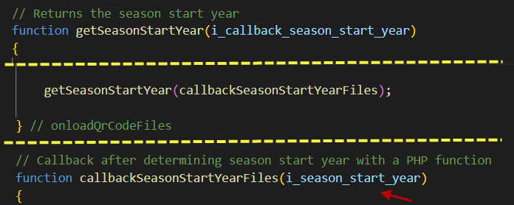
www
QrCode
QFiles
Php
SeasonStartYear.php
2
1
Season_2021_2022
Season_2022_2023
Supporter.xml
Returned
season start year
2021

Slide 8
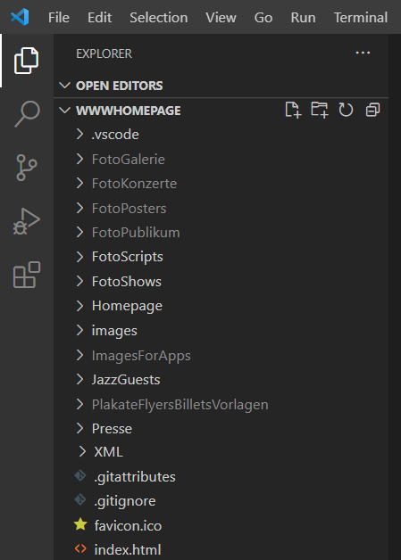
o
on
on
on
1. Stage
Vorstufe-
Repository
2. Commit
Lokales Computer
Repository
3. Push
GitHub
Server
Repository
4. Pull
5. FTP
on
Hostpoint
Server
Quellcode
on
on
on

