Slide 1
C or F
Source control files (pull & push)
Jazz
Ignored files (FTP download)
WwwTasks
WwwReservation
WwwQrCode
WwwFlyer
WwwIntranet
WwwHomepage
Index.html
Descriptions
Icons
jQuery
Php
QrCodeLib
Scripts
Styles
QrFiles
XmlTestData
Season_202i_202j
Supporter.xml
QrCodeText_sNBWg8Tg.txt
QrFiles.xml
QrCodeImage_sNBWg8Tg.txt
QrCodeImage
and
QrCodeText
files for all generated QR codes

Slide 2
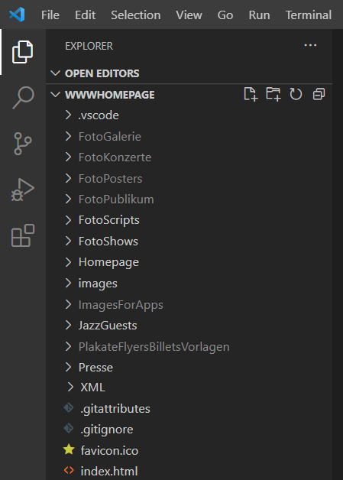
1. Stage
Vorstufe-
Repository
2. Commit
Lokales Computer
Repository
3. Push
GitHub
Server
Repository
4. Pull
5. FTP
Hostpoint
Server
Quellcode

