Slide 1
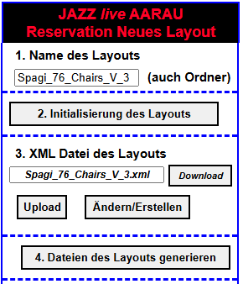
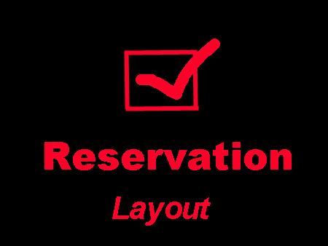
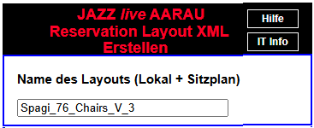
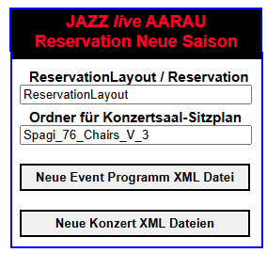
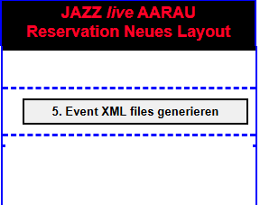
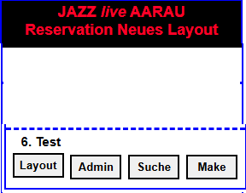
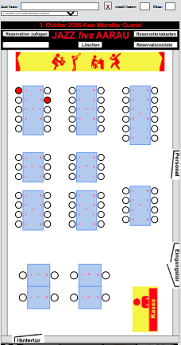
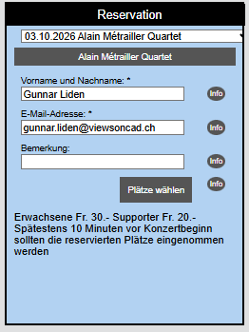
Intranet

Slide 2
Create object UtilCopyArrayData that holds
all data for the copying process
UtilCopyArrayData
Holds data for the copying process
setAbsoluteOriginDirUrl
setAbsoluteTargetDirUrl
setAbsoluteTargetPhpDirUrl
setAbsoluteOriginScriptsDirUrl
setAbsoluteTargetScriptsDirUrl
setAbsoluteTargetDirArray
setOriginFileUrlArray
setTargetFileUrlArray
setBoolDeleteOriginFileArrayToFalse
Set origin and target directories for the coping
Call UtilCopyArrayData member functions
Set absolute target directotory URLs
Call UtilCopyArrayData. setAbsoluteTargetDirArray
Set origin, target and delete origin (bool) arrays
Call UtilCopyArrayData. setOriginFileUrlArray
Call UtilCopyArrayData. setTargetFileUrlArray
Call UtilCopyArrayData. setBoolDeleteOriginFileArrayToFalse
UtilCopyArray
Copy files
Copy files
Call of UtilCopyArray.copyFilesCreateDirs
copyFilesCreateDirs

Slide 3
Server Ordner des Lokals
XML Datei
HTML Datei
HTML Datei
HTML Datei
HTML Datei

Slide 4
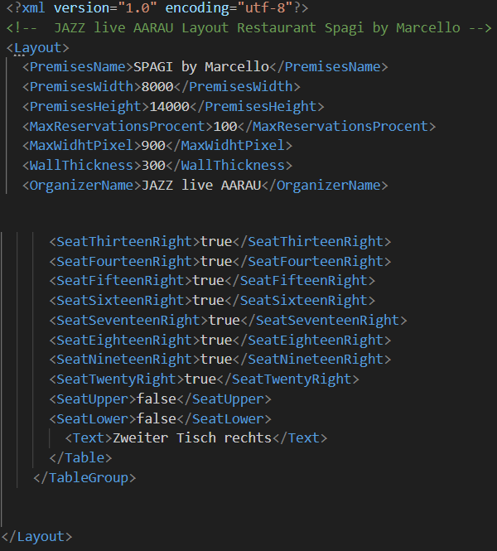

Slide 5
Generated directories for a seating plan
ReservationLayout
or
Reservation
Layout premises/version
Spagi_76_Chairs_V_1
App: Select seats
(homepage opens)
MakeReservation.htm
JavaScripts
Libs
XML
Captions
ImagesApp
Layout images
ImagesLayout
Season XML files
SaisonXML
App: Administrate reservations
AddReservation.htm
Defines the layout
Spagi_76_Chairs_V_1.xml
Event program XML file
Event reservation XML files
App: Display and search reservations
SearchReservation.htm
App: Display layout
ShowLayout.htm
List reservations
ReservationList.htm
Print reservations
ReservationPrint.htm

Slide 6
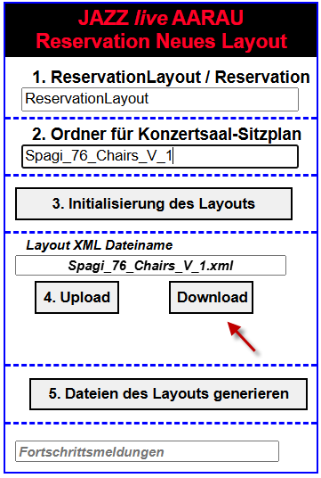
Generated directories for a seating plan
Reservation
ReservationLayout
XML Datei
Tischplan/Layout
Spagi_76_Chairs_V_1
Tischplan/Layout
Spagi_76_Chairs_V_2
Tischplan/Layout
Spagi_76_Chairs_V_3
MakeReservation.htm
MakeReservation.htm
MakeReservation.htm
AddReservation.htm
AddReservation.htm
AddReservation.htm
SearchReservation.htm
SearchReservation.htm
SearchReservation.htm
ShowLayout.htm
ShowLayout.htm
ShowLayout.htm
ReservationList.htm
ReservationList.htm
ReservationList.htm
ReservationPrint.htm
ReservationPrint.htm
ReservationPrint.htm
Tischplan/Layout
Spagi_76_Chairs_V_2
Tischplan/Layout
Spagi_76_Chairs_V_2
Reservation
EventReservation.htm
Tischplan/Layout
Spagi_76_Chairs_V_1
SaisonXML
MakeReservation.htm
AddReservation.htm
XML
Event program XML file
Event reservation XML files
SearchReservation.htm
ShowLayout.htm
Spagi_76_Chairs_V_1.xml

Slide 7
UtilCopyArray.js and UtilCopyArrayData.js
g_util_copy_array_data
Object of class UtilCopyArrayData
UtilCopyArrayData
Holds data for the class UtilCopyArray
static UtilCopyArray
Copy or move files based on class UtilFiles
m_domain_url
Domain
m_abs_php_util_file_dir
Absolute URL the directory with the file UtilFiles.php for class UtiFiles
m_abs_origin_dir_url
Absolute URL to the origin directory
m_abs_target_dir_url
Absolute URL to the target directory
m_abs_target_php_dir_url
Absolute URL to the target UtilFiles.php directory
m_php_file_name = 'UtilFiles.php’
Name of the PHP file used by class UtilFiles
m_abs_origin_scripts_dir_url
Absolute URL to the origin scripts_directory
m_input_target_file_url_array
Input target file URL array
m_abs_origin_file_url_array
Absolute origin file URL array
m_abs_target_file_url_array
Absolute target file URL array
m_bool_delete_origin_file_array
Array of booleans delete origin file
m_abs_target_dir_array
Array of absolute target directories that shall be created
m_abs_target_dir_existing_array
Array of existing directories that already exist
Data is set by UtilCopyArray
m_abs_target_dir_not_existing_array
Array of not existing directories that shall be created
Data is set by UtilCopyArray
copyFilesCreateDirs
Copy files and create directories
checkInput
Checks the input data
checkIfOriginDirExists
Checks if the origin directory exists
checkIfTargetDirExists
Checks if the target directory exists
createTargetDir
Create the target main directory
getExistingDirsRecursive
Get the directories that exist and that not yet exist
dirExists
Append directory to m_abs_target_dir_existing_array
dirExistsNot
Append directory to m_abs_target_dir_not_existing_array
createDirsRecursive
Create directories recursively
copyFilesRecursive
Copy files recursively
finish
All files have been copied
inputToConsole
Output input data to console
Debug
Debug output to the console

Slide 8
NewSeasonStorage.js
NewSeasonStorage
Storage of NewSeasonData in Computer
NewSeasonData
Data for the creation of new season files
setLocal(i_new_season_data)
Sets the new season data as windows local storage
setSession(i_new_season_data)
Sets the new season data as windows session storage
(not yet used)
getLocal()
Returns object NewSeasonData from local storage
getSession()
Returns object NewSeasonData from session storage
initLocal()
Initialization of not yet set storage variables
initSession()
Initialization of not yet set session variables
keyMainDir()
Returns key organisation directory name
keyResultDir()
Returns key result directory name
m_main_dir_name
Name of the server main directory name:
ReservationLayout or Reservation
getMainDir()
setMainDir(i_main_dir_name)
m_result_directory_name
Name of the server result directory name
For instance Spagi_76_Chairs_V_2
getResultDir()
setResultDir(i_result_directory_name)
m_data_is_valid
Flag telling if the input data is valid
checkData()
Checks the data
dataIsValid()
Returns true if the data is valid

Slide 9
ReservationLayout
Styles
jQuery
Scripts
Libs
Php
Description
ReservationNewLayout.htm
Spagi_76_Chairs_V_3
Generate files for a new layout
SaisonXML
Event program XML file
Event reservation XML files
Reservation
Spagi_76_Chairs_V_3
SaisonXML
Event program XML file
Event reservation XML files

Slide 10
www
ReservationLayout
Reservation
ReservationNewSeason.htm
Spagi_76_Chairs_V_3
Spagi_76_Chairs_V_2
Spagi_76_Chairs_V_3
SaisonXML
SaisonXML
SaisonXML
Event program XML file
Event reservation XML files
Event program XML file
Event reservation XML files
Event program XML file
Event reservation XML files
www
www
Reservation
ReservationLayout
Reservation
Spagi_76_Chairs_V_1
Spagi_76_Chairs_V_2
Spagi_76_Chairs_V_3
Spagi_76_Chairs_V_3
Spagi_76_Chairs_V_3
SaisonXML
SaisonXML
SaisonXML
Event program XML file
Event reservation XML files
Event program XML file
Event reservation XML files
Event program XML file
Event reservation XML files
SaisonXML
SaisonXML
Event program XML file
Event reservation XML files
Event program XML file
Event reservation XML files

Slide 11
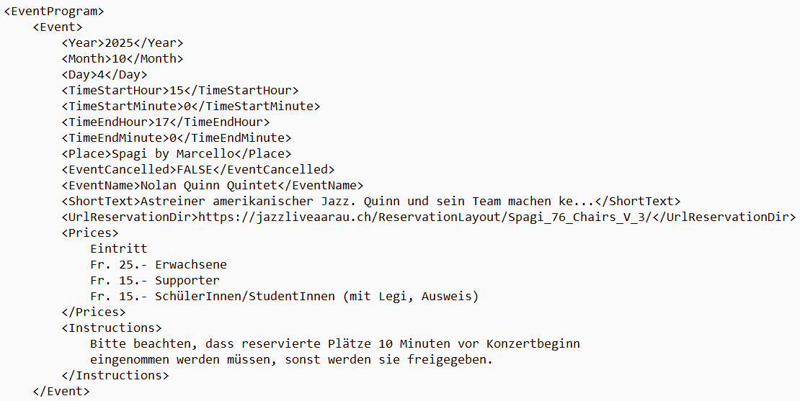

Slide 12
EventProgramXml
Handles an event program
EventProgramTags
Tags of the XML event program file
constructor(i_subdir_xml, i_event_program_file_name, i_callback_function_name)
{
The subdirectory for the event XML file, e.g. SaisonXml
this.m_subdir_xml = i_subdir_xml;
Name of the event program XML file
this.m_event_program_file_name = i_event_program_file_name;
Call back function name
this.m_callback_function_name = i_callback_function_name;
Object holding the tags
this.m_tags = new EventProgramTags();
Loads the XML event file, creates the XML object and calls the function m_callback_function_name
this.loadOneXmlFile(this, this.getXmlEventProgramFileName(), this.m_callback_function_name);
}
Get and set functions for all XML data (for all tags)
Appends an event node
appendEventNode()
Returns the number of events
getNumberOfEvents()
Returns an array of event names
getEventNameArray(i_b_only_coming)
getDateNameEventArrayStartNumber(i_b_only_coming)
getEventDateArray(i_b_only_coming, i_date_format)
getEventNumberForNextEvent()
getXmlEventProgramFileName()
this.m_tag_event = "Event";
this.m_tag_reg_number = “RegNumber";
this.m_tag_day = "Day";
this.m_tag_month = "Month";
this.m_tag_year = "Year";
this.m_tag_start_hour = "TimeStartHour";
this.m_tag_start_minute = "TimeStartMinute";
this.m_tag_end_hour = "TimeEndHour";
this.m_tag_end_minute = "TimeEndMinute";
this.m_tag_place = "Place";
this.m_tag_address = "Address";
this.m_tag_event_cancelled = "EventCancelled";
this.m_tag_event_name = "EventName";
this.m_tag_short_text = "ShortText";
this.m_tag_url_reservation_dir = "UrlReservationDir";
this.m_tag_prices = "Prices";
this.m_tag_instructions = "Instructions";
this.m_tag_max_reservations = "MaxReservations";
this.m_tag_email_subject = "EmailSubject";
this.m_tag_email_header = "EmailHeader";
this.m_tag_email_content = "EmailContent";
this.m_tag_email_seats = "EmailSeats";
this.m_tag_pay_method = "PayMethod";

