Slide 1
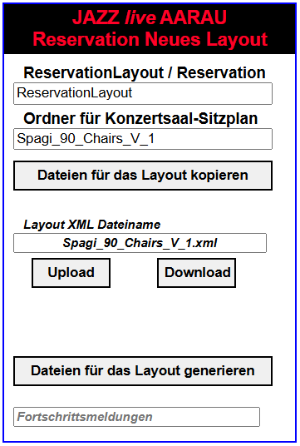
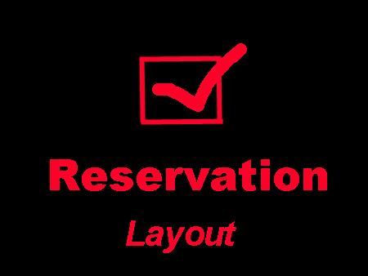
Intranet

Slide 2
Generated directories for a seating plan
ReservationLayout
or
Reservation
Layout premises/version
Spagi_90_Chairs_V_1
App: Select seats
MakeReservation.htm
Libs
ImagesLayout
XML
ImagesApp
SaisonXML
App: Adminstrate
reservations
AddReservation.htm
JavaScripts
Layout images
Caption images
Event program XML file
Event reservation XML files
App: Display and search
reservations
SearchReservation.htm
Spagi_90_Chairs_V_1.xml
App: Display the layout
ShowLayout.htm
Defines the layout
App: List reservationns
ReservationList.htm
App: Print reservationns
ReservationPrint.htm

Slide 3
NewSeasonStorage.js
NewSeasonStorage
Storage of NewSeasonData in Computer
NewSeasonData
Data for the creation of new season files
setLocal(i_new_season_data)
Sets the new season data as windows local storage
setSession(i_new_season_data)
Sets the new season data as windows session storage
(not yet used)
getLocal()
Returns object NewSeasonData from local storage
getSession()
Returns object NewSeasonData from session storage
initLocal()
Initialization of not yet set storage variables
initSession()
Initialization of not yet set session variables
keyMainDir()
Returns key organisation directory name
keyResultDir()
Returns key result directory name
m_main_dir_name
Name of the server main directory name:
ReservationLayout or Reservation
getMainDir()
setMainDir(i_main_dir_name)
m_result_directory_name
Name of the server result directory name
For instance Spagi_76_Chairs_V_2
getResultDir()
setResultDir(i_result_directory_name)
m_data_is_valid
Flag telling if the input data is valid
checkData()
Checks the data
dataIsValid()
Returns true if the data is valid

Slide 4
ReservationLayout
Styles
jQuery
Scripts
Libs
Php
Description
ReservationNewLayout.htm
Spagi_76_Chairs_V_3
Generate files for a new layout
SaisonXML
Event program XML file
Event reservation XML files
Reservation
Spagi_76_Chairs_V_3
SaisonXML
Event program XML file
Event reservation XML files

Slide 5
www
ReservationLayout
Reservation
ReservationNewSeason.htm
Spagi_76_Chairs_V_3
Spagi_76_Chairs_V_2
Spagi_76_Chairs_V_3
SaisonXML
SaisonXML
SaisonXML
Event program XML file
Event reservation XML files
Event program XML file
Event reservation XML files
Event program XML file
Event reservation XML files
www
www
Reservation
ReservationLayout
Spagi_76_Chairs_V_1
Spagi_76_Chairs_V_2
Spagi_76_Chairs_V_3
Spagi_76_Chairs_V_3
SaisonXML
SaisonXML
SaisonXML
Event program XML file
Event reservation XML files
Event program XML file
Event reservation XML files
Event program XML file
Event reservation XML files
SaisonXML
Event program XML file
Event reservation XML files

Slide 6
