Slide 1
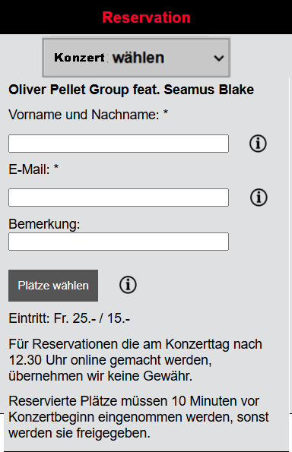
id_unique_input_form
id_unique_div_header
id_unique_div_dropdown
id_unique_div_event_name
id_unique_div_label_name
id_unique_div_name_info
id_unique_div_name
id_unique_div_info_name
id_unique_div_label_email
id_unique_div_email_info
id_unique_div_email
id_unique_div_info_email
id_unique_div_label_remark
id_unique_div_remark_info
id_unique_div_remark
id_unique_div_info_remark
id_unique_div_button_info
id_unique_button
id_unique_div_info_button
id_unique_div_prices
id_unique_div_instructions

