Slide 2
ReservationLayout
Styles
jQuery
Scripts
Libs
Php
Description
ReservationNewSeason.htm
Spagi_76_Chairs_V_3
Create event program XML Generate concert XML files
SaisonXML
Event program XML file
Event reservation XML files
Reservation
Spagi_76_Chairs_V_3
SaisonXML
Event program XML file
Event reservation XML files

Slide 3
EventProgram.xml
<event>
<Year>2025</Year>
<Month>1</Month>
<Day>11</Day>
<Place>Spagi by Marcello</Place>
<Street>Metzgergasse 8</Street>
<City>5000 Aarau</City>
<EventName>Oliver …</EventName>
<Prices>Eintritt: ..</Prices>
<Instructions>Für Reserv…</Instructions>
</event>

Slide 4
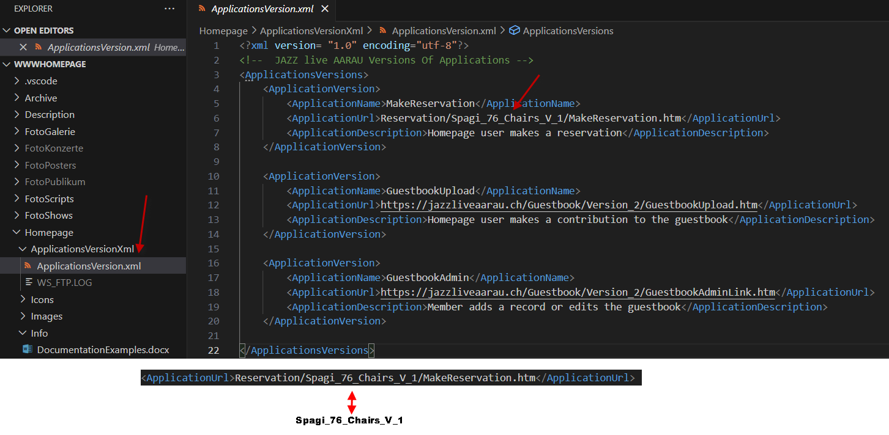

Slide 5
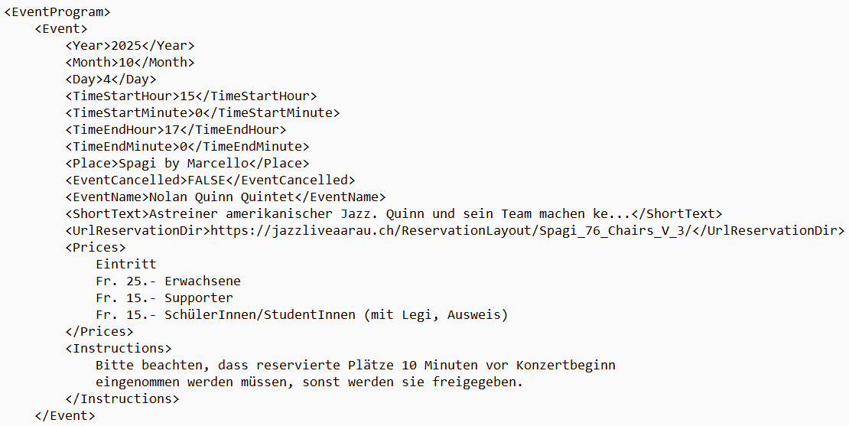

Slide 10
Generated directories for a seating plan
ReservationLayout
or
Reservation
Layout premises/version
Spagi_76_Chairs_V_2
App: Select seats
SelectReservation.htm
Libs
ImagesLayout
XML
SaisonXML
App: Adminstrate
reservations
AdminReservation.htm
JavaScripts
Layout images
Reservation XML file for each event
App: Display and search
reservations
DisplayReservation.htm
Spagi_76_Chairs_V_2.xml
App: Display the layout
DisplayLayout.htm
Defines the layout
App: List reservationns
ReservationList.htm
EventProgram.xml
Defines all events
App: Print reservationns
ReservationPrint.htm

