Slide 1
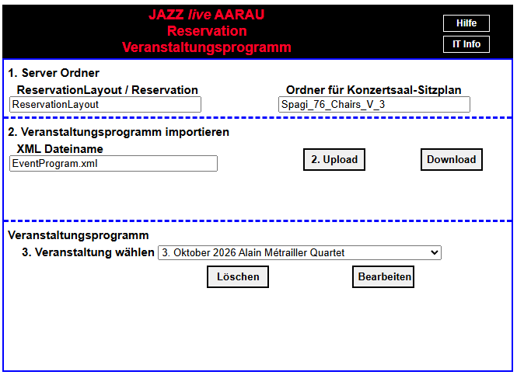
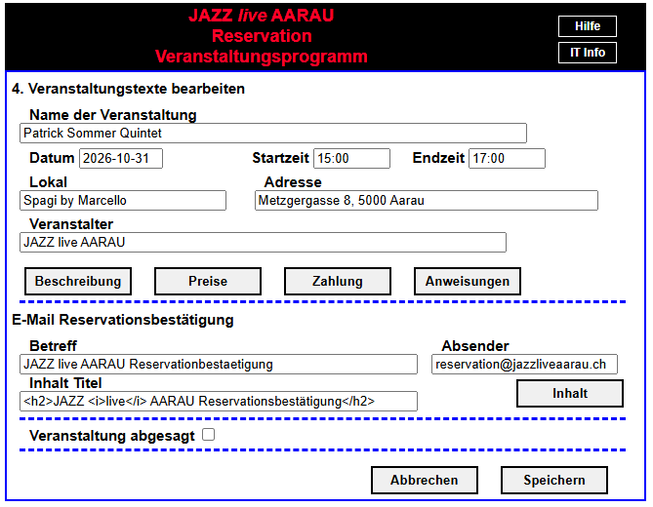
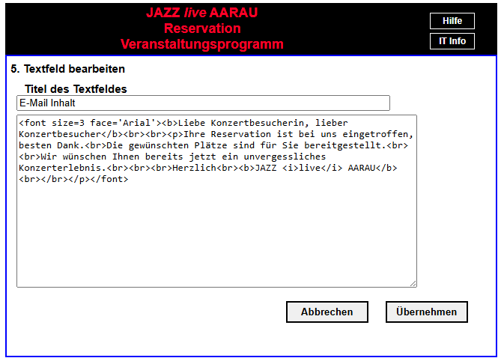

Slide 3
SeasonToEventProgramXml.js
SeasonToEventProgramXml
Creates event XML program from season XML program
start
Check exitence of g_new_season_files_data
Create season XML object. Call seasonXmlObject
seasonXmlObject
Create object SeasonXml Callback function createEventXmlStartFile
Set g_season_to_event_data.m_season_xml
createEventXmlStartFile
Create start file with tag <EventProgram>
Call UtilServer.saveDirFile with callback function eventObjectXml
eventObjectXml
Create instance of EventProgramXml callback fromSeasonToEvent
Set g_season_to_event_data. m_event_xml
fromSeasonToEvent
Append event XML records with data from season XML records
Call modifyEventStrings
modifyEventStrings
Shorten band names in interaction with user
Call saveEventXml
saveEventXml
Call of UtilServer.saveCallback
Callback function g_season_to_event_data. m_callback_fctn

Slide 4
EventProgram.xml
<event>
<Year>2025</Year>
<Month>1</Month>
<Day>11</Day>
<Place>Spagi by Marcello</Place>
<Street>Metzgergasse 8</Street>
<City>5000 Aarau</City>
<EventName>Oliver …</EventName>
<Prices>Eintritt: ..</Prices>
<Instructions>Für Reserv…</Instructions>
</event>

Slide 5
