Slide 1

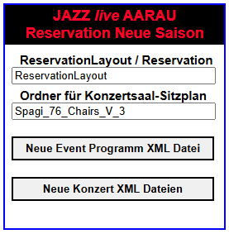
Intranet

Slide 2
SeasonToEventProgramXml.js
SeasonToEventProgramXml
Creates event XML program from season XML program
start
Check exitence of g_new_season_files_data
Create season XML object. Call seasonXmlObject
seasonXmlObject
Create object SeasonXml Callback function createEventXmlStartFile
Set g_season_to_event_data.m_season_xml
createEventXmlStartFile
Create start file with tag <EventProgram>
Call UtilServer.saveDirFile with callback function eventObjectXml
eventObjectXml
Create instance of EventProgramXml callback fromSeasonToEvent
Set g_season_to_event_data. m_event_xml
fromSeasonToEvent
Append event XML records with data from season XML records
Call modifyEventStrings
modifyEventStrings
Shorten band names in interaction with user
Call saveEventXml
saveEventXml
Call of UtilServer.saveCallback
Callback function g_season_to_event_data. m_callback_fctn

Slide 3
CreateXmlEventFiles.js
CreateXmlEventFiles
Creates new event XML file
start
Check exitence of g_new_season_files_data
Create event XML object. Call eventObjectXml
eventObjectXml
Create object EventProgramXml Callback function initEventXmlArray
initEventXmlArray
Initialize array for XML file objects. First call of createObjectRecursively
createObjectRecursively
Create instance of ReservationEventXml.
Calback function createObjectRecursively and for last object
and for the last object setEventXmlObjects
setEventXmlObjects
Sets all event XML objects with data from the event program XML object
Call saveEventXmlFilesRecursively
saveEventXmlFilesRecursively
Call of ReservationEventXml
Calback function saveEventXmlFilesRecursively and for last object
and for the last object allEventXmlFilesSaved
allEventXmlFilesSaved
Message to the user

Slide 4
ReservationNewSeasonData
Data for the creation of the new season files
ReservationNewSeasonData .js
m_season_case
Case current, previous or next
m_main_dir
Reservation (Release) or ReservationLayout (Development)
m_result_dir
For instance Spagi_76_Chairs_V_2
m_sub_xml_dir
SaisonXML
m_xml_filename
EventProgram.xml
m_event_program_callback_fctn
Callback function name for the event program file creation
m_abs_event_program_url
Absolute URL for m_xml_filename
m_abs_result_dir_url
Absolute URL to result directory
m_rel_event_program_dir_url
Relative URL to result directory
m_rel_event_files_dir_url
Relative URL to result directory
m_input_data_ok
Flag telling if the input data is OK
m_season_start_year
Season program start year
m_season_xml
Instance of SeasonXml
m_event_xml
Instance of EventProgramXml
m_event_object_index
Current index for m_event_xml_array in recursive loop
m_event_xml_array
Array with event XML objects
m_file_name_add_str = 'Salmen’;
m_event_files_sub_dir
Subdirectory m_result_dir/m_sub_xml_dir/
g_new_season_files_data =
new ReservationNewSeasonData (…)

Slide 5
NewSeasonStorage.js
NewSeasonStorage
Storage of NewSeasonData in Computer
NewSeasonData
Data for the creation of new season files
setLocal(i_new_season_data)
Sets the new season data as windows local storage
setSession(i_new_season_data)
Sets the new season data as windows session storage
(not yet used)
getLocal()
Returns object NewSeasonData from local storage
getSession()
Returns object NewSeasonData from session storage
initLocal()
Initialization of not yet set storage variables
initSession()
Initialization of not yet set session variables
keyMainDir()
Returns key organisation directory name
keyResultDir()
Returns key result directory name
m_main_dir_name
Name of the server main directory name:
ReservationLayout or Reservation
getMainDir()
setMainDir(i_main_dir_name)
m_result_directory_name
Name of the server result directory name
For instance Spagi_76_Chairs_V_2
getResultDir()
setResultDir(i_result_directory_name)
m_data_is_valid
Flag telling if the input data is valid
checkData()
Checks the data
dataIsValid()
Returns true if the data is valid

Slide 6
ReservationLayout
Styles
jQuery
Scripts
Libs
Php
Description
ReservationNewSeason.htm
Spagi_76_Chairs_V_3
Create event program XML Generate concert XML files
SaisonXML
Event program XML file
Event reservation XML files
Reservation
Spagi_76_Chairs_V_3
SaisonXML
Event program XML file
Event reservation XML files

Slide 7
www
ReservationLayout
Reservation
ReservationNewSeason.htm
Spagi_76_Chairs_V_3
Spagi_76_Chairs_V_2
Spagi_76_Chairs_V_3
SaisonXML
SaisonXML
SaisonXML
Event program XML file
Event reservation XML files
Event program XML file
Event reservation XML files
Event program XML file
Event reservation XML files
www
www
Reservation
ReservationLayout
Spagi_76_Chairs_V_1
Spagi_76_Chairs_V_2
Spagi_76_Chairs_V_3
Spagi_76_Chairs_V_3
SaisonXML
SaisonXML
SaisonXML
Event program XML file
Event reservation XML files
Event program XML file
Event reservation XML files
Event program XML file
Event reservation XML files
SaisonXML
Event program XML file
Event reservation XML files

Slide 8
EventProgram.xml
<event>
<Year>2025</Year>
<Month>1</Month>
<Day>11</Day>
<Place>Spagi by Marcello</Place>
<Street>Metzgergasse 8</Street>
<City>5000 Aarau</City>
<EventName>Oliver …</EventName>
<Prices>Eintritt: ..</Prices>
<Instructions>Für Reserv…</Instructions>
</event>

Slide 9
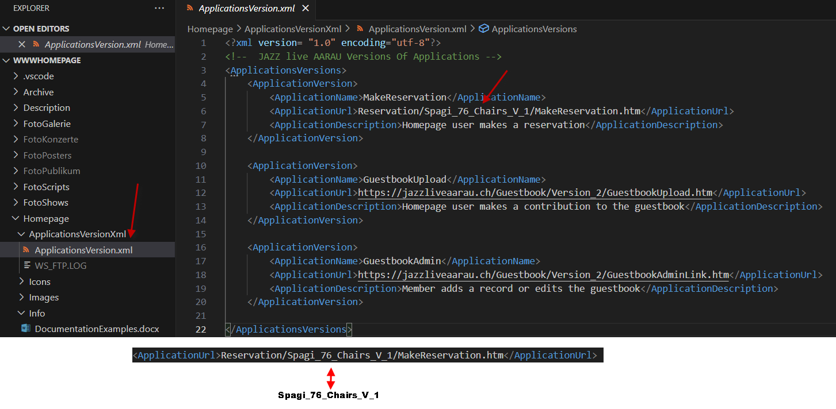

Slide 10
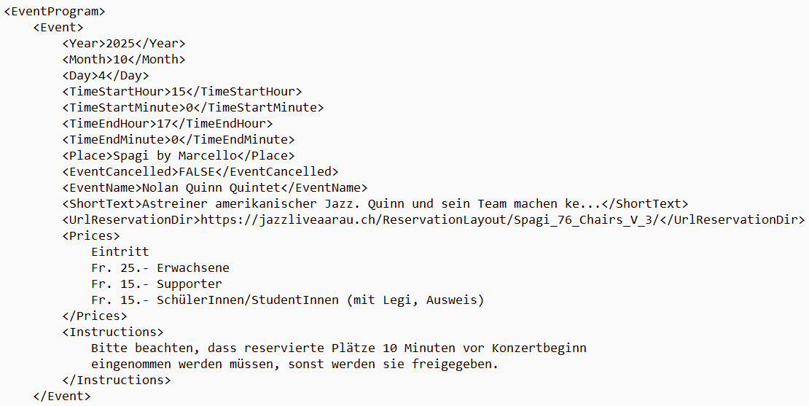

Slide 13
Generated directories for a seating plan
ReservationLayout
or
Reservation
Layout premises/version
Spagi_76_Chairs_V_2
App: Select seats
SelectReservation.htm
Libs
ImagesLayout
XML
SaisonXML
App: Adminstrate
reservations
AdminReservation.htm
JavaScripts
Layout images
Reservation XML file for each event
App: Display and search
reservations
DisplayReservation.htm
Spagi_76_Chairs_V_2.xml
App: Display the layout
DisplayLayout.htm
Defines the layout
App: List reservationns
ReservationList.htm
EventProgram.xml
Defines all events
App: Print reservationns
ReservationPrint.htm

