Slide 1
SeasonToEventProgramXml.js
SeasonToEventProgramXml
Creates event XML program from season XML program
SeasonToEventProgramXmlData
Data for the SeasonToEventProgramXml functions
start
Create data object. Set g_season_to_event_data
Check input. Calls checkInput
Construct URLs for output file.
Get season program start year
Create season XML object. Call seasonXmlObject
seasonXmlObject
Create object SeasonXml Callback function createEventXmlStartFile
Set g_season_to_event_data.m_season_xml
createEventXmlStartFile
Create start file with tag <EventProgram>
Call UtilServer.saveDirFile with callback function eventObjectXml
eventObjectXml
Create instance of EventProgramXml callback fromSeasonToEvent
Set g_season_to_event_data. m_event_xml
fromSeasonToEvent
Append event XML records with data from season XML records
Call modifyEventStrings
modifyEventStrings
Shorten band names in interaction with user
Call saveEventXml
saveEventXml
Call of UtilServer.saveCallback
Callback function g_season_to_event_data. m_callback_fctn
m_season_case
Case current, previous or next
m_main_dir
Reservation (Release) or ReservationLayout (Development)
m_result_die
For instance Spagi_76_Chairs_V_2
m_sub_xml_dir
SaisonXML
m_xml_filename
EventProgram.xml
m_callback_fctn
Callback function name when file has been created
m_abs_event_program_url
Absolute URL for m_xml_filename
m_abs_result_dir_url
Absolute URL to result directory
m_rel_event_program_dir_url
Relative URL to result directory
m_input_data_ok
Flag telling if the input data is OK
m_season_start_year
Season program start year
m_season_xml
Instance of SeasonXml
m_event_xml
Instance of EventProgramXml
g_season_to_event_data =
new SeasonToEventProgramXmlData (…)

Slide 2
ReservationLayout
Styles
jQuery
Scripts
Libs
Php
Description
ReservationNewSeason.htm
Spagi_76_Chairs_V_3
Create event program XML Generate concert XML files
SaisonXML
Event program XML file
Event reservation XML files
Reservation
Spagi_76_Chairs_V_3
SaisonXML
Event program XML file
Event reservation XML files

Slide 3
EventProgram.xml
<event>
<Year>2025</Year>
<Month>1</Month>
<Day>11</Day>
<Place>Spagi by Marcello</Place>
<Street>Metzgergasse 8</Street>
<City>5000 Aarau</City>
<EventName>Oliver …</EventName>
<Prices>Eintritt: ..</Prices>
<Instructions>Für Reserv…</Instructions>
</event>

Slide 4
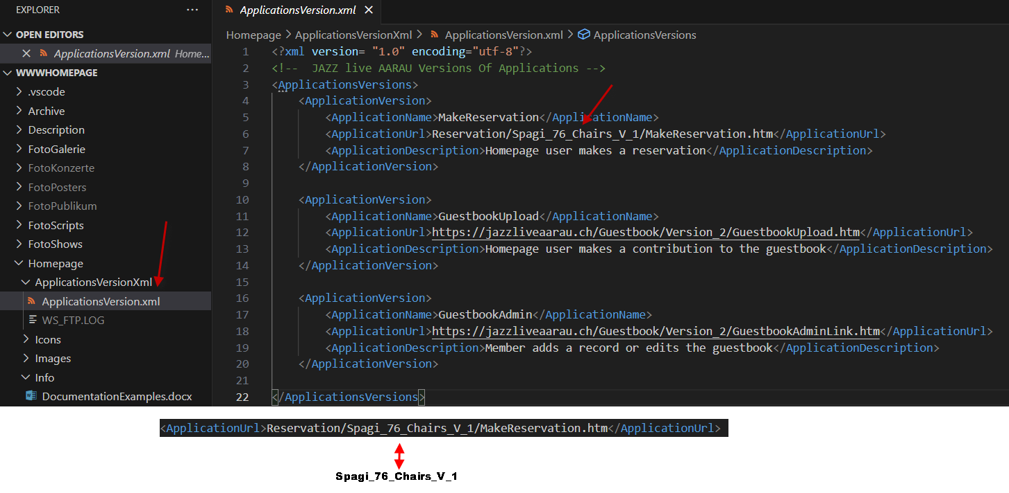

Slide 5
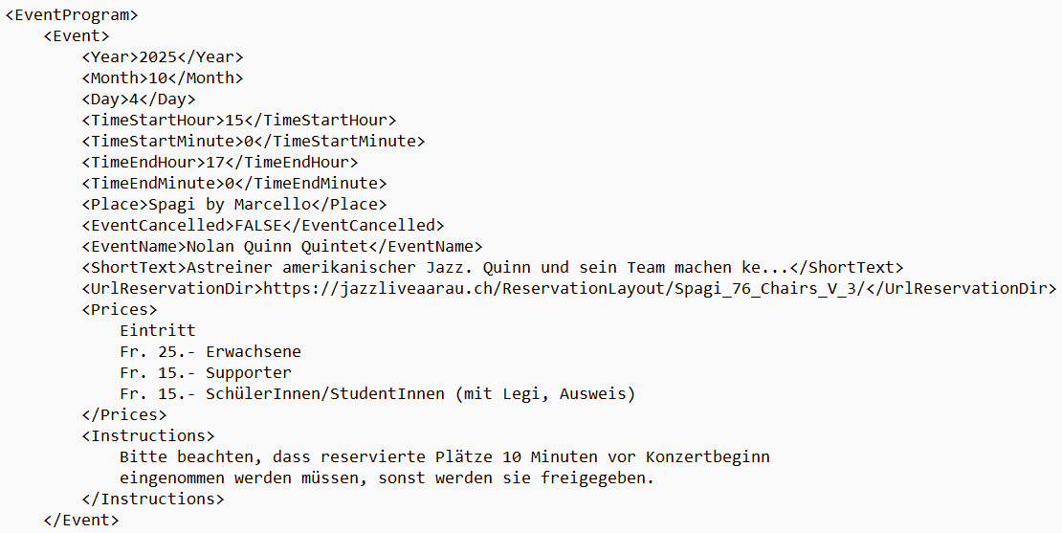

Slide 10
Generated directories for a seating plan
ReservationLayout
or
Reservation
Layout premises/version
Spagi_76_Chairs_V_2
App: Select seats
SelectReservation.htm
Libs
ImagesLayout
XML
SaisonXML
App: Adminstrate
reservations
AdminReservation.htm
JavaScripts
Layout images
Reservation XML file for each event
App: Display and search
reservations
DisplayReservation.htm
Spagi_76_Chairs_V_2.xml
App: Display the layout
DisplayLayout.htm
Defines the layout
App: List reservationns
ReservationList.htm
EventProgram.xml
Defines all events
App: Print reservationns
ReservationPrint.htm

