Slide 1
Administration von Aufgaben
JAZZ live AARAU Aufgaben
Aufgabe wählen
Nummer
Aufgabe Titel
Delete
Beschreibung
Benutzerhandbuch in
Aufgabe A0047
‘Web-Applikation Aufgaben Intranet’
Beschreibung in
Aufgabe A0121
‘Implementation der Web-Applikation Aufgaben’
Bemerkung
Link DOC Dokument
Upload
Download
Link PDF Dokument
Upload
Download
Referenz wählen
Referenz Link
Referenz Beschreibung
Datum Erinnerung
Datum Fertig
Wählen
Verantwortlich
Stellvertreter
Intranet aktualisieren
Test
Aufgabe speichern

Slide 2
Seitenumriss cl_tasks_page
Header cl_tasks_header
Select Task and Reg. number cl_div_select_reg_number
Select Task cl_tasks_select_task
Reg. number cl_div_reg_number
Title and delete cl_div_title_delete_number
Title cl_tasks_task_title
Delete cl_tasks_task_delete
Description cl_tasks_task_description
Remark cl_tasks_task_remark
DOC, Upload and Download cl_div_display_upload_button
DOC cl_tasks_task_link_file
Upload cl_div_upload_button
Download cl_div_download_button
DOC upload fom: Select, display and submit button cl_div_upload_form
PDF, Upload and Download cl_div_display_upload_button
PDF cl_tasks_task_link_file
Upload cl_div_upload_button
Download cl_div_download_button
PDF upload fom: Select, display and submit button cl_div_upload_form
Remind and due date cl_div_dates
Remind date cl_div_date
Due date cl_div_date
Responsible and deputy cl_div_responsible_deputy
Deputy cl_div_deputy_dropdown_text
Responsible cl_div_responsible
Deputy dropdown cl_div_deputy_dropdown
Deputy text cl_div_deputy_text

Slide 3
3 Aufgaben .cl_tasks_selection_add_delete
.cl_tasks_select_task
.cl_tasks_add_task
.cl_tasks_delete_task
.cl_tasks_task_title
.cl_tasks_task_description_reference
.cl_tasks_task_description_remarks
.cl_tasks_task_reference_reminder
.
. .cl_tasks_task_choose_reference
.cl_tasks_task_description
. .cl_tasks_task_reference_link
. . .cl_tasks_task_reference_description
.cl_tasks_task_remark
. . . .cl_tasks_task_reminder_frame
. .cl_tasks_task_reminder_date
. . .cl_tasks_task_deadline
. .cl_tasks_task_link_doc_file
. .cl_tasks_task_link_pdf_file
. .cl_tasks_task_link_html_website
.cl_tasks_task_responsible_deputy
. .cl_tasks_task_responsible
.cl_tasks_task_deputy
. .cl_tasks_task_update_intranet
.cl_tasks_task_update_safe
.cl_tasks_task_saving
. .cl_tasks_test_button

Slide 4
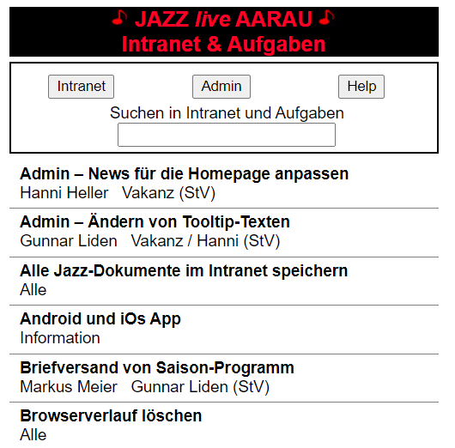
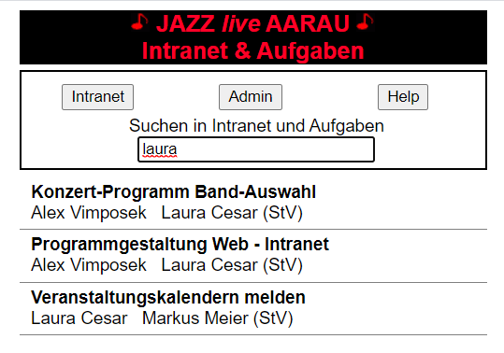
Intranet: Präsentation von Aufgaben

Slide 5
Application
Class LoginLogout
PHP LoginLogout
var g_log = new LoginLogout(….)
xyzFunction (i_callback_fctn)
Switch execution case
2
3
1
Call of LoginLogout.php (jQuery function)
xyzFunction(parameters …)
echo ‘var1_var2’ (result in one string)
clickEventFunction
g_log.xyzFunction(callbackClickEventFunction)
Parameters (same for all functions)
Execution case
User name
…..
4
extractOneEchoString(var1_var2)
extractTwoEchoString(var1_var2)
i_callback_fctn(var_1, var_2)
callbackClickEventFunction(i_var_1, i_var_2)
Do something ….
5
extractOneEchoString(i_echo_str)
return var_1
extractTwoEchoString(i_echo_str)
return var_1

