Slide 1
Computer (GitHub) Ordner
WwwUtils
TestUtils.htm
Icons
Images
Php
PhpMerge
Scripts
Styles
favicon.ico
Description

Slide 2
UtilLock
Functions for locking/unlocking of files
Member variables
m_lock_dir
Absolute or relative URL to the lock file
m_file_name = 'LockUnlock.txt’
The file name
m_content_locked_str = 'files_locked’
Text of file for locked files
m_content_unlocked_str = 'files_unlocked'
Text of file for unlocked files
m_locking_failed_callback_fctn
Name of the function to be called when the files have been locked
m_unlocked_callback_fctn
Name of the function that shall be called when the files have been unlocked
Member functions
Functions to set the callback functions name
lock()
Locks the files.
unlock()
Unlocks the files
globalObjectVariableNameIsOk()
Checks if the global variable name of this object is g_util_lock_object

Slide 3
UtilImage
Replace, scale and position an image in a div
// Define two event functions before setting source for the new image
static replaceImageInDivContainer(i_image, i_el_div)
{
var el_image = new Image();
var el_image = UtilImage.getImageElement(i_el_div);
el_image.onload = function ()
{
UtilImage.callbackAfterLoad(el_image, el_image, i_el_div);
};
el_image.addEventListener
('error', UtilImage.callbackImageNotFound);
el_image.src = i_image_file_name;
}
// This event function will execute when the image has been loaded
static callbackAfterLoad (el_image, el_image, i_el_div)
{
// Calculates height. width for the new image
// Callis getFitImageToDivScaleFactor
// Replaces the existing with the new scaled image
// Centers the image. Calls centerImage
}
static callbackImageNotFound { alert(“Error message”); }
Member functions
replaceImageInDivContainer
Replace and fit an image in a container <div>
callbackAfterLoad
Replace an image in a <div> container after load of the new picture
centerImage
Place the picture in the center. Vertically and horizontally
getImageElement
Returns the image element of the image container div
getFitImageToDivScaleFactor
Returns the scale factor for an image that makes it fit to a given div element
callbackImageNotFound
Error message image not found

Slide 6
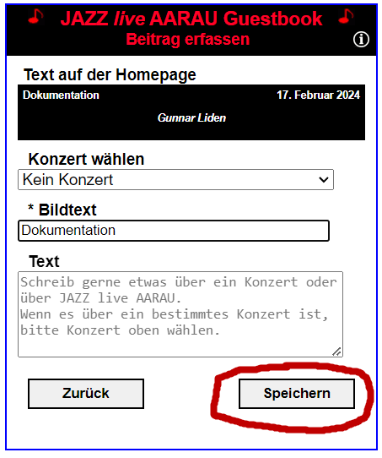
Pictures to copy ……
GuestbookData
All data set by the user g_guestbook_data
onClickForwardThreeButton
saveNewRecordAlsoToJazzGuestsXml
saveNewGuestbookUploadedRecord
backupJazzGuestsXml
appendSetSaveGuestbookUploadData
g_guests_uploaded_xml
backupJazzGuestsUploadedXml
saveJazzGuestsUploadedXmlOnServer
JazzGuestsUploaded.xml
copyImageFromUploadToGuestbookDir
sendNewRecordNotificationEmailToAdmin
appendSetSaveGuestbookData
g_guests_xml
GuestStorage.setGuestbookData
saveJazzGuestsXmlOnServer
JazzGuests.xml

Slide 7
Server Ordner
Pictures to copy ……
www
Guestbook
Version_1
Version_x
Info
GuestbookUpload.htm
Icons
jQuery
Php
Scripts
Styles
GuestbookAdmin.htm
favicon.ico

