Slide 1
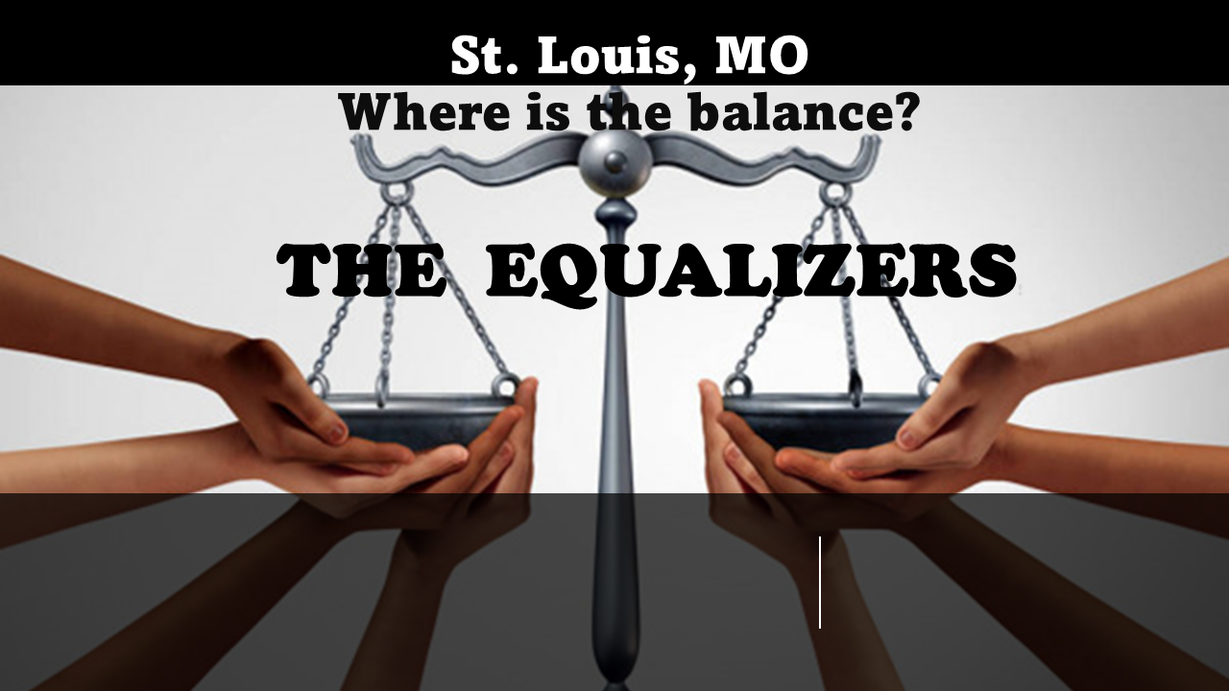
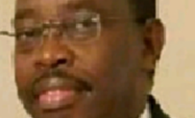
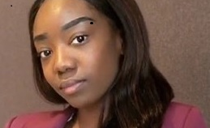
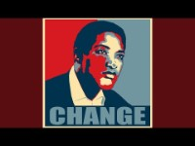
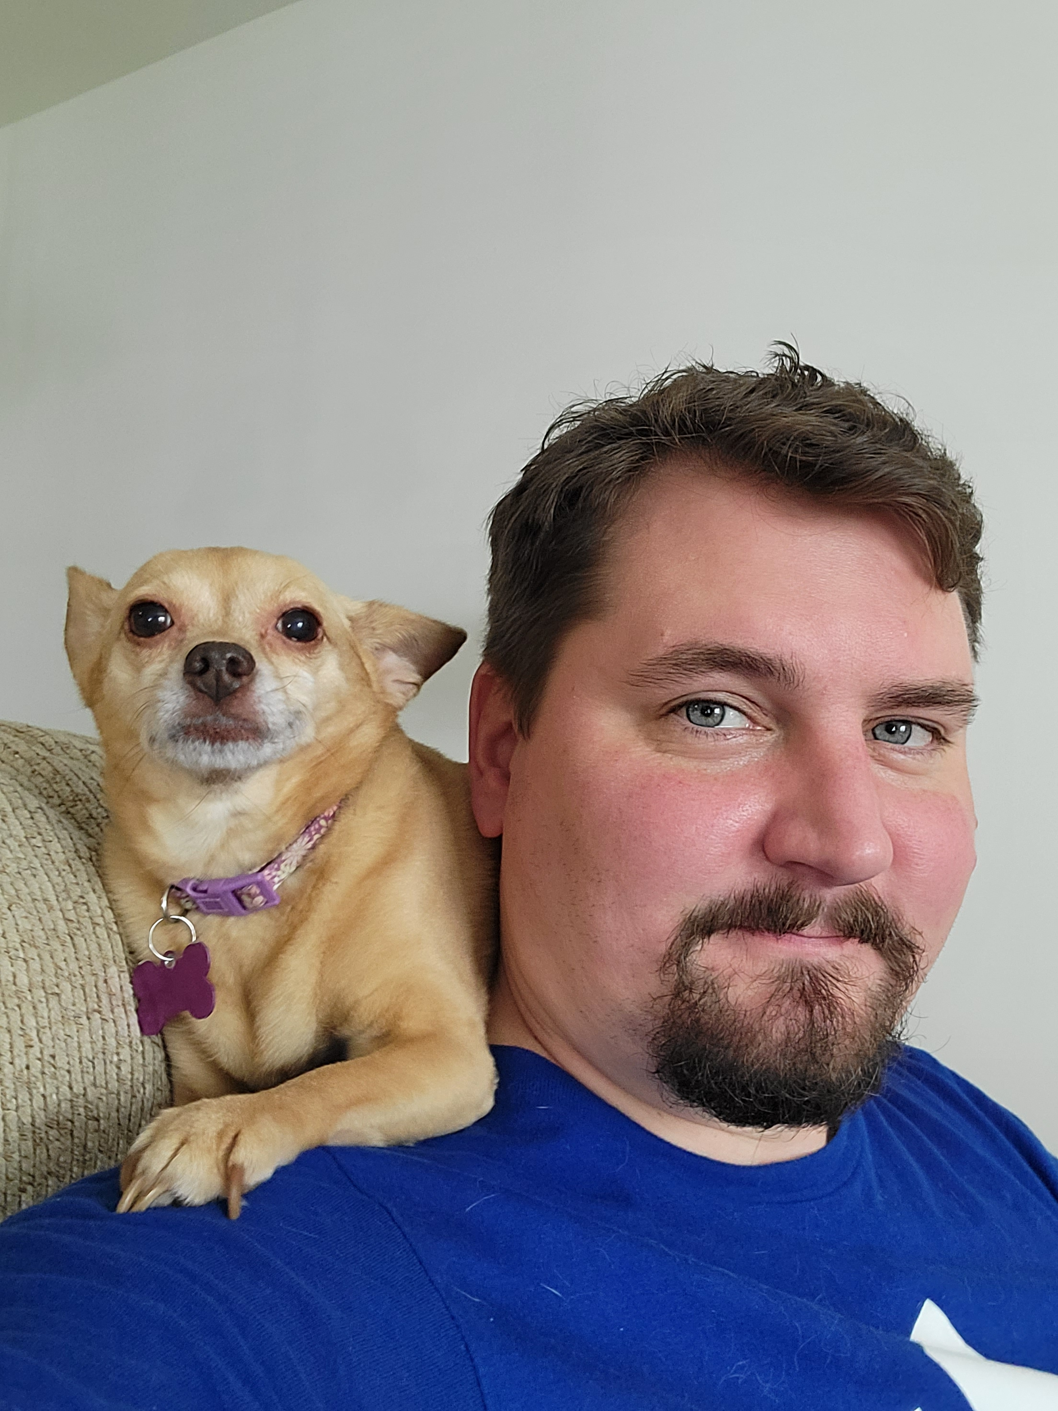

DR. Munene Kanampiu(Mentor)
Miss Jasmine Trapier
Investigating Systemic Racial Bias in Public funded Services in the Great City of St. Louis, MO
The EQUALIZERS
Does racial bias exist in allocation of public-funded services in the great city of St. Louis? (Sample data examples: Public saftey,Public health, Public education)
Impact: Racial Injustice Awareness for the residents of St. Louis & greater Missouri state
Mr. Kristin Mannino
DR. Rebecca Caldwell (Co-Mentor)

