Slide 1
Build MVC apps with the Microsoft Graph .NET SDK

Slide 2
Intro to the Microsoft Graph API
Getting started
SDKs & Code Samples
Resources
Notes:
In this unit, you'll learn how Microsoft Graph fits into the larger Microsoft 365 platform. You'll then learn how to use Microsoft Graph in an ASP.NET MVC application to display events from the currently signed in user's calendar.

Slide 3
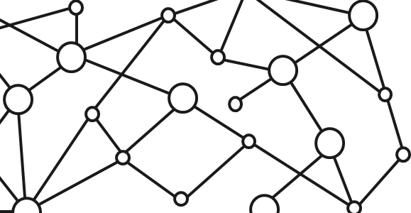
Microsoft 365 Platform
Extend Microsoft 365 experiences
web, device, and service apps
Build your experience
Documents
Pages
Conversations
Timeline
iOS/Android/Windows/Web
1
Microsoft Graph
Notes:
Our Office 365 developer vision focuses on the Users’ experience and their data. As a developer you can bring your applications into their user experience. With over 1.2+ billion users of Office worldwide, this is a huge opportunity to provide a window into your applications. As well as being able to connect into their data and add intelligence to your applications. There are currently 850 million events created a month and a total of 470Pb+ of data stored in the service that can add value to for our Users’.

Slide 4
Microsoft Graph Gateway to your data in the Microsoft-cloud
https://graph.microsoft.com
Office 365
Windows 10
Enterprise Mobility + Security
Users, Groups, Organizations
Outlook
SharePoint
OneDrive
Teams
Planner
Excel
OneNote
Activities
Device Relay
Commands
Notifications
Azure AD
Intune
Identity Manager
Advanced Threat Analytics
Advanced Threat Protection
Mail, Calendar,
Contacts and Tasks
Sites and Lists
Drives and Files
Channels, Messages
Tasks and Plans
Spreadsheets
Notes, and more…
Identity Management
Access Control
Synchronization
Domains
Administrative Units
Applications and Devices
Advanced Threat Analytics
Advanced Threat Protection
Alerts
Policies
and more…
Notes:
Microsoft Graph is the gateway to your data in the Microsoft Cloud as you can see from the list of resources, services and entities at the bottom of the slide, there are a lot of things we can take advantage of in the Microsoft 365 platform. We can work with mail, calendar, contacts, tasks in addition to content inside of SharePoint sites and lists, files inside of OneDrive, interact with Microsoft Teams and many more things we can take advantage of.
Each of these services typically has it’s own API that we can leverage to read and write to these different services. However it can be challenging and cumbersome to work with these different services as each has implemented their own endpoint, permission model, syntax for performing some operations like searching and other subtleties. Each endpoint is also secured with Azure AD which means that developers will need to authenticate with Azure AD and obtain an OAuth access token for each service they want to work with.
The Microsoft Graph addresses many of these challenges by acting as a proxy to a lot of these different services. It encompasses data residing in Office 365 such as mail, calendar, contacts and OneDrive as well as many others. In addition, it also provides access to Windows 10 and Enterprise Mobility + Security under a single endpoint. This endpoint, https://graph.microsoft.com, allows developers to create applications that will only have to authenticate once and obtain a single access token that can be used to retrieve data from multiple sources, greatly simplifying the development process.
Each service will sill have their individual permissions, or scopes, but all these permissions are defined in a single place under the Microsoft Graph endpoint, and it handles the underlying calls and permission requests to each of these different endpoints.

Slide 5
Microsoft Graph, gateway to Microsoft 365
Single resource that proxies multiple Microsoft services
Simplifies token acquisition and management
Eliminates the need to traditional discovery (using “me” and “myorganization”)
Allows for easy traversal of objects and relationships
Notes:
As the previous slide stated, the Microsoft Graph is your gateway to all data in Microsoft 365. It is a single resource that proxies multiple Microsoft services.
Because the Microsoft Graph acts as a proxy endpoint to multiple endpoints for each Microsoft 365 service, it will simplify the process of obtaining OAuth access tokens that you must include with each request to one of these endpoints. Unlike the process of obtaining a different token for each endpoint, the Microsoft Graph enables you to obtain a single access token to submit requests that can retrieve data from all the services and endpoints the Microsoft Graph exposes.
One of the other challenges we used to have with these different services was determining the endpoint URL for each service as some were unique per user. To address this, Microsoft created a directory service that you could query to determine what the URL was for the different services. However, the Microsoft Graph greatly simplifies this for you with two special endpoints. The /me and /myorganization endpoints will take you to the root of your user entity or your organization in the Microsoft Graph.
This module will explain how you can easily find relationships between entities in the Microsoft Graph and traverse these objects to find related content. Using the /me and /myorganization endpoint in combination with the ability to traverse related entities, the Microsoft Graph makes it easy to access your data.

Slide 6
Accessing the Microsoft Graph
Direct REST API
Any platform
Any language
Any framework
Native SDKs
Utilize framework & platform specific implementations
Abstracts the details of constructing & processing REST requests over HTTP
.NET, iOS, Android, PhP, Ruby, JavaScript, etc.
Notes:
Developers can create all sorts of applications that will communicate with the Microsoft Graph. To support as many developers and platforms as possible, the Microsoft Graph has two options for developers to choose from when integrating the Microsoft Graph into their applications.
At its core, the Microsoft Graph is a REST API. This means that developers can use any platform, any framework and any programming language they are most comfortable with. The only requirement is that they can issue common HTTP requests and process HTTP responses, which all recent platforms, frameworks and languages can do.
In addition, the Microsoft Graph also provides multiple native SDKs for developers who want to leverage a rich programming model within their applications. These SDKs are available for multiple platforms and simplify the process of interacting with the Microsoft Graph’s REST API, abstracting away the tasks of constructing, submitting and processing the REST requests and responses with the Microsoft Graph REST API.
You will likely find an existing SDK for the platform and language you are working on as you’ll find all the popular platforms covered, including .NET, iOS, Android, Java, PhP, Ruby, JavaScript and many more.

Slide 7
Authentication Options
Azure AD only
Separate auth flow supports Azure AD accounts only
Azure AD and Microsoft Accounts
Converged auth flow supports Azure AD accounts and Microsoft accounts (LiveID - hotmail.com, etc.)
Notes:
The Microsoft Graph supports two styles of authentication. One option supports users to authenticate using either an Azure AD account, also known as a Work & School account, or a Microsoft Account. The former account is typically used to access content and resources within Office 365 and Microsoft 365. The latter account type, a Microsoft Account, is used to access consumer resources such as OneDrive Consumer, Outlook.com and other related services.

Slide 8
Microsoft Account + Azure AD
Many apps want to sign users in from both Microsoft account and Azure AD
Single endpoint, OpenID Connect and OAuth 2.0
Single SDK
Single end user sign in experience
Single app registration experience
Works with Microsoft Graph
Single API endpoint, business and consumer data
Notes:
What’s nice about the Microsoft Graph supporting both styles of authentication, is that the same API and endpoints can be used to create applications that will expose business data in Microsoft 365 or consumer data within Microsoft’s consumer services. This makes it easy for developers to learn a single API and have the ability to configure their application to support both business and consumer data that is driven strictly by the user and what type of account they login with.

Slide 9
Creating an ASP.NET web application configured with MSAL & OWIN middleware for authentication with Azure AD

Slide 10
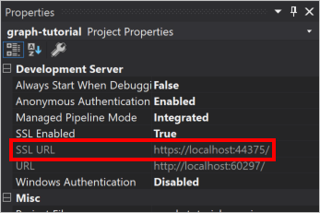
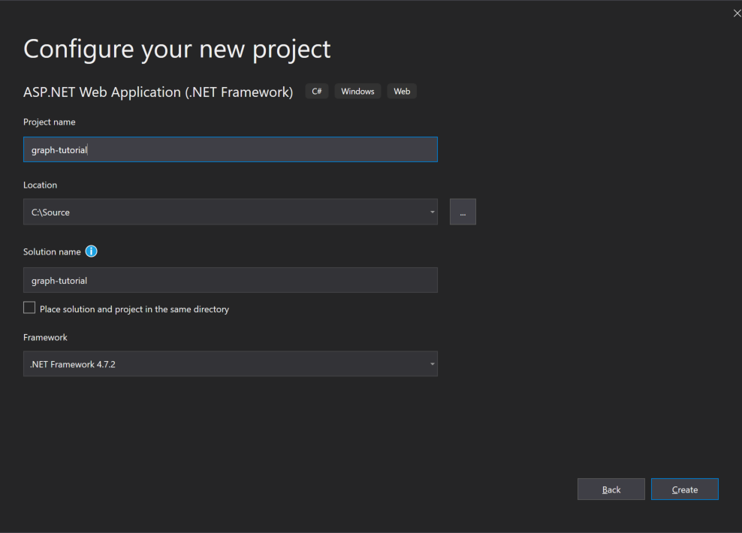
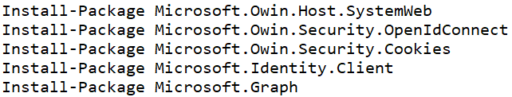
Create ASP.NET MVC Web Application
Create the ASP.NET MVC web application
Do not use the Visual Studio wizard to configure authentication
Configure it to use SSL
The redirect URL must be HTTPS to work with Azure AD applications
Configure it for MSAL & OWIN middleware
This involves installing a few NuGet packages and modifying the project code.
Notes:
Developers can use Microsoft Graph in many different types of applications. In this module, you'll add support for calling Microsoft Graph to display events from the currently signed in user's calendar in an ASP.NET MVC web application.
The first step is to create an ASP.NET MVC web application using the Visual Studio project creation wizard. Next, add, and configure the Microsoft Authentication Library (MSAL) for .NET and the OWIN middleware. This enables the web application to allow users to sign in and to obtain access tokens from Azure AD to use when submitting requests to Microsoft Graph. These two libraries will require you to install a few libraries into your project. The libraries are available as NuGet packages.
Next, ensure that your application is using SSL. When you register an application with Azure AD, you'll need to specify the redirect URL where users will be sent to after a successful sign-in. This URL must be configured to use HTTPS to work with an Azure AD application.

Slide 11
Install NuGet Packages
Microsoft’s Authentication Library (MSAL) & OWIN middleware is distributed using packages
The following NuGet packages include MSAL, OWIN middleware and dependent packages:
Install-Package Microsoft.Owin.Host.SystemWeb
Install-Package Microsoft.Owin.Security.OpenIdConnect
Install-Package Microsoft.Owin.Security.Cookies
Install-Package Microsoft.Identity.Client
Install-Package Microsoft.Graph
Notes:
At the time of this writing, the Microsoft.Identity.Client package is pre-release, make sure to include pre-release packages either using the checkbox in the GUI or including the –pre switch on the command line during preview.
Once the production bits are released, make sure to use the production version.

Slide 12
DEMO

Slide 13
Registering Applications in the Azure Portal
Configure credentials
Select the type of application
Configure permissions

Slide 14

Endpoint versions
v1
Microsoft account
Azure Active Directory v2.0 endpoint
Converged authentication accepts sign in from both Microsoft personal accounts and Azure AD work and school accounts.
Enables the same code for using Microsoft Graph for things like reading mail or retrieving contacts.
Dynamic consent, requesting permissions when you need them.
Additional Microsoft Graph capabilities for AAD users such as SharePoint and Microsoft Teams.
Azure Active Directory v1 endpoint
Enables access to Azure protected resources
v2
v1
Azure Active Directory
AD
AD
AD
Notes:
Azure AD contains two authentication and token endpoints. The v2 endpoint is the recommended endpoint for all applications that use Microsoft Graph should adopt. To understand why, it helps to understand what the benefits of it are over the v1 endpoint.
The Azure AD v1 endpoint only supports the Azure AD authentication. It doesn't support any other styles of authentication such as a Microsoft Account. What that meant is that if the user was logging in with a personal account or consumer account, also known as a Microsoft Account, and they wanted to access things like their OneDrive consumer account or Outlook.com, the developer of the application would have to write special authentication code to handle these types of accounts. This is a disadvantage of the v1 endpoint as it only supports work in school accounts (Azure AD accounts).
Another other challenge with the v1 endpoint is that it only supports static consent. Static consent means all single permissions that an application needs must be defined ahead of time and the user, on their first login, would be required to grant consent to the application for all permissions.

Slide 15
Key improvements v2.0 versus v1
scope instead of resource parameter for interop
v1: resource=https://graph.microsoft.com
v2: scope=https://graph.microsoft.com/User.Read or scope=User.Read
Dynamic instead of static consent for incremental consent
id_token claims updated to OpenID Connect standard
Single app registration to represent native and web application combination
Well-known OpenID scopes
offline_access: Enables retrieving refresh tokens
openid: Allows your app to sign the user in and receive an app-specific identifier for the user
email: Allows your app access to the user’s primary email address via the email claim in the token
profile: Allows your app access to all other basic information such as name, preferred username, object ID, and others.
Notes:
The Azure AD v2 endpoint addresses these two shortcomings with the v1 endpoint. First, it implements converged authentication that merges the Microsoft account and the work and school (Azure AD) account sign-in experiences together. Developers no longer need to direct users to specific sign-in experiences; all users are sent to the converged sign-in experience and rely on Microsoft identity to determine the type of account. This also enables developers to write the same code to access Microsoft Graph for things like reading, mail, and retrieving contacts.
Another benefit to the v2 endpoint is dynamic consent. Dynamic consent differs from static consent in that when a user signs in, the application requests the permissions it needs at that time. Microsoft identity will determine if the user has previously consented to the requested permissions. If one or more hasn't been consented to, the user is presented with the consent dialog for only those new permissions requests.
The v2 endpoint also supports the OpenID Connect standard of including an **id token** when requested at sign-in. This is an extension to the authentication protocol and once the user successfully signed in, will be returned in the sign-in request to the application. The ID token contains information about the current user, such as their email address and their name. While the v1 endpoint had some support for OpenID Connect, the v2 endpoint better conforms to the OpenID connect specification.

Slide 16
Registering an Azure AD application in the Azure Portal

Slide 17
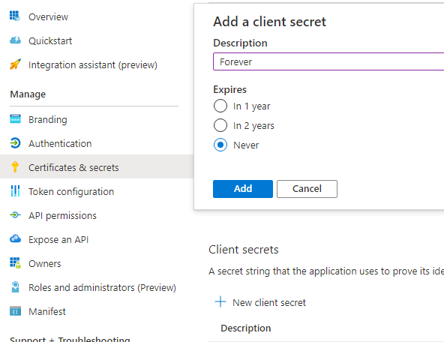
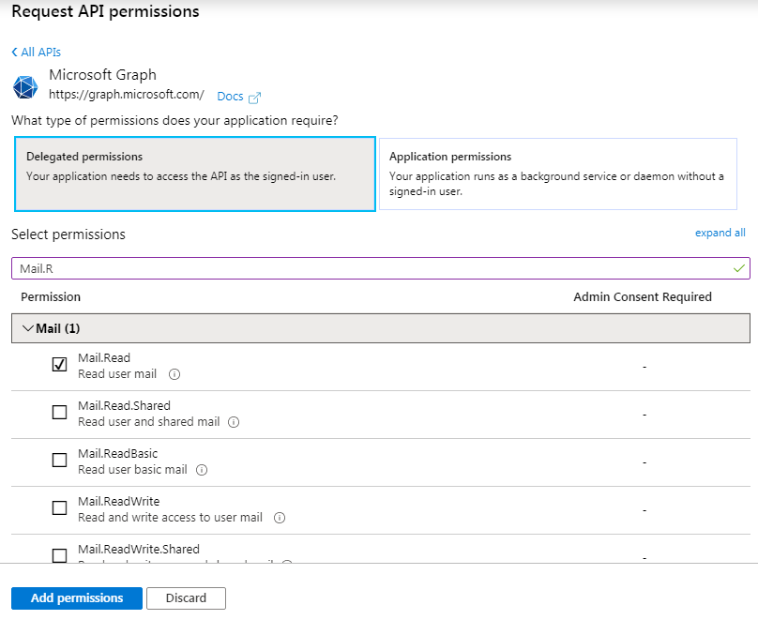
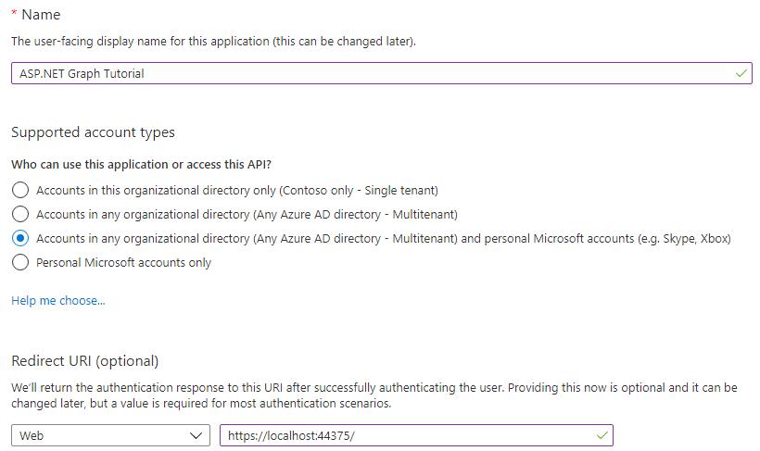
Application registration
Create a new application
Create a new application in the Application Registration Portal. A unique identifier is created for your app.
Create a client secret
Add a “password” for your application
Add permissions
Add permissions that your application will need if your admin will consent for all users.
Notes:
All apps that need to be granted permissions to use other apps must be registered in Azure AD. App registration is done through the Azure AD admin center at **https://aad.portal.azure.com**. The Azure AD admin center doesn't require users have a paid Azure subscription to manage users and apps. A user must have access to read and edit users, groups, app, or manage the directory. The admin center unifies various app management portals previously available to developers and administrators under one site. From this portal, you can manage apps that were created to use the v1 and v2 Microsoft identity endpoints.
Custom applications can use one of the authentication libraries provided by Microsoft. Each of the two libraries is made available through various SDKs for each of the platforms and languages supported by Microsoft identity.
Apps that use the v2 endpoints can use the Microsoft Authentication Library (MSAL) SDKs. MSAL replaced the previous library, Azure AD Authentication Library (ADAL) that only works with the v1 endpoints.
For apps that are integrated with Microsoft Graph, Microsoft recommends developers use the Microsoft identity v2 endpoints, and therefore use the MSAL library.

Slide 18
DEMO
Notes:
In this module, we're using an ASP.NET MVC web application to DEMOnstrate how to request and display events from a user's calendar with Microsoft Graph. This scenario implements the OAuth 2.0 authorization code grant flow to obtain an access token from Azure AD. The access token is included in each request submitted to Microsoft Graph to authenticate the user and application.
The web app must authenticate with Azure AD when it requests the access token. As part of the access token request, the app must include its app ID, also known as the client ID, and a secret. The secret can be an x509 certificate or a string.
The web app must also tell Microsoft identity the address of the web app that Microsoft identity should redirect the user to on a successful login. This address is called the *redirect URI*. The redirect URI included in the login must match the address in the app registration.
The last step in the app registration process in the Azure AD admin center is to specify any permissions the app will need. This can include either delegated permissions or application permissions. Delegated permissions are those that the user grants the app to act on their behalf when they're signed into the app. Application permissions are used by the app when no interactive user session is present as in the case of a service app or daemon app. Permissions defined within the Azure AD admin center are static permissions, not dynamic permissions. Users are presented with these permissions when they sign in to the application the first time as part of the common consent previously discussed.

Slide 19
NuGet Packages
Authenticate with Azure AD
Create instance of the GraphServiceClient
Issue request and process results
Notes:
In this unit, you'll learn how to customize and configure an ASP.NET MVC web application to request and integrate data obtained from Microsoft Graph.

Slide 20
Obtaining a GraphServiceClient (API)
First, obtain an access token from Azure AD by authenticating:
public async Task<string> GetUserAccessTokenAsync()
{
var idClient = ConfidentialClientApplicationBuilder.Create(appId)
.WithRedirectUri(redirectUri)
.WithClientSecret(appSecret)
.Build();
var tokenStore = new SessionTokenStore(idClient.UserTokenCache, HttpContext.Current, ClaimsPrincipal.Current);
var accounts = await idClient.GetAccountsAsync();
// By calling this here, the token can be refreshed
// if it's expired right before the Graph call is made
var result = await idClient.AcquireTokenSilent(graphScopes, accounts.FirstOrDefault()).ExecuteAsync(); return result.AccessToken;
}
Notes:
All communication with Microsoft Graph is handled though the `GraphServiceClient`. The `GraphServiceClient` must be configured to include an access token in each request. Therefore, the first step is for the web application to obtain an access token once the user has signed-in. This can be done using following code that DEMOnstrates how to obtain an access token <see slide>
This method first starts by creating an instance of a confidential client that is defined in the OAuth 2 protocol specification. Confidential clients are those clients that can have an app ID and secret that won't be exposed to the user of the application. Another type, a public client, is used in mobile or desktop apps as the app secret would have to be distributed with the app's executable code to the user's mobile device or desktop.
The confidential client is created using the registered app ID, secret, and configured redirect URI the user should be sent to once they've successfully signed in with Microsoft identity.
Next, the code obtains a reference to the current user and attempts to retrieve a previously obtained access token from the token store using the `AcquireTokenSilent()` method. If the `AcquireTokenSilent()` method fails, the user should be presented with an interactive login.
Now that the application has an access token, it can move onto the next step and create an instance of the `GraphServiceClient`.

Slide 21
Obtaining a GraphServiceClient (API)
Then, use the access token to create an instance of the GraphServiceClient to call the Microsoft Graph API:
public static GraphServiceClient GetAuthenticatedClient()
{
DelegateAuthenticationProvider provider = new DelegateAuthenticationProvider(
async (requestMessage) => {
string accessToken = await SampleAuthProvider.Instance.GetUserAccessTokenAsync();
requestMessage.Headers.Authorization = new AuthenticationHeaderValue("bearer", accessToken);
});
GraphServiceClient graphClient = new GraphServiceClient(provider);
return graphClient;
}
Notes:
Once the application has an access token for Microsoft Graph, create a new instance of the `GraphServiceClient` and configure it to include the access token in each request submitted to Microsoft Graph as shown in the following code <see slide>
The constructor of the `GraphServiceClient` expects an authentication provider as a single parameter. In this method, we're creating an instance of the `DelegateAuthenticationProvider` that is configured to obtain an access token when a new HTTP request is submitted. Once it obtains the access token, it modifies the HTTP request to include the HTTP **Authorization** header with the value of the access token.
Now, the access token will be added to each request to Microsoft Graph.

Slide 22
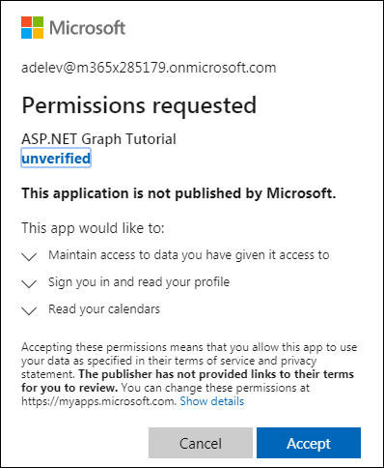
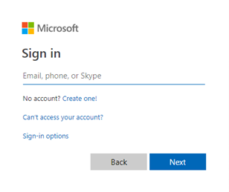
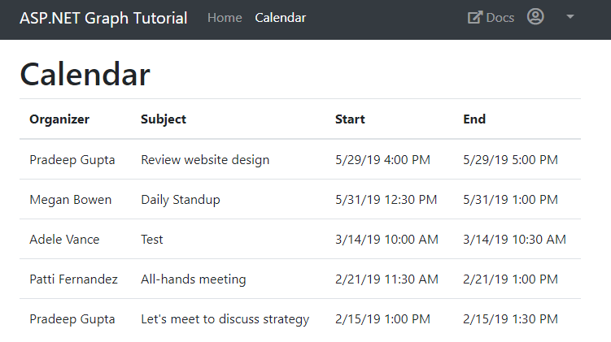
Application experience
User prompted to sign in
The user is prompted to sign in.
Prompt for consent
The user is prompted to grant consent to the application if admin consent was not already granted to the entire tenant.
Data from Microsoft Graph is returned
The Microsoft Graph API is queried and data is returned to the client.
Notes:
So what does the experience look like for our end user?
The user is first prompted to sign in and that's going to redirect them over to the Microsoft identity sign-in page. Once they sign in the first time using the web application, they wouldn't have yet granted this application permission to Microsoft Graph. The may request a new permission that the user hasn't yet to granted consent to.
In this case, the user is prompted to grant consent to the app. Finally, upon a successful sign-in, the user is redirected back to the ASP.NET MVC application what will show the user events from their calendar obtained using the Microsoft Graph .NET SDK.

Slide 23

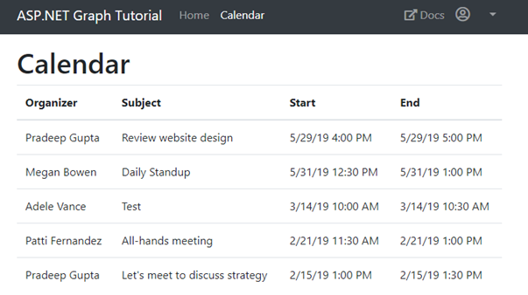
Overview of the sample
https://login.microsoftonline.com/
https://graph.microsoft.com
Sign in, get token
Teams
Groups
Access token
Tasks
Get calendar items
Chats
Calendar
Files
Calendar items
Insights
Microsoft Graph
Messages
Coworkers
User
Meetings
Devices
People
Notes:
Let's look at an overview of the application.
The user first indicates they want to sign in to the web application. The web app redirects them over to the Microsoft identity sign-in page. Once the user authenticates with Microsoft identity, and goes through the consent experience previously covered, is then redirected back to the ASP.NET MVC web app.
The redirect includes an *authorization code*. The authorization code is given to the web app that will use that code to request an access token from Microsoft identity. This request happens server side and is done using the `ConfidentialClient` previously discussed. Once the web app has the access token, it can then make a call to Microsoft Graph to fetch all my calendar items using the .NET SDK.

Slide 24
Authorization code grant and v2 endpoint
https://login.microsoftonline.com/common
Application
/common/OAuth/v2.0/authorize
/common/OAuth/v2.0/token
https://graph.microsoft.com
?scope=offline_access+openid+profile+User.Read+User.ReadBasic.All&response_type=code&client_id=…
Sign in, consent
authorization code
?scope=offline_access+openid+profile+User.Read+User.ReadBasic.All&grant_type=authorization_code&code=…
access_token, refresh_token, id_token
/v1.0/me (access token)
Current user’s profile
Token expires
?grant_type=refresh_token&refresh_token=…
access_token, refresh_token, id_token
/v1.0/me (access token)
Current user’s profile
Notes:
Before proceeding to the next unit, let's explore how the OAuth v2 authorization code grant flow works once it obtains the access token? The above diagram is an overview of the entire process from the ASP.NET MVC application on the left, the two Microsoft identity v2 endpoints for authorization and token acquisition, and ultimately Microsoft Graph on the right.
Once the access token is acquired, your application is going to call Microsoft Graph without having to go through the steps to obtain the access token again. Instead, the web application caches the access token locally and it keeps using it until at some point in the future where that token expires.
In this case, a *refresh token* is used to obtain a new access token without requiring the user to sign in again. This is one of the advantages to using the MSAL library because while its important to understand what is happening, the MSAL library handles this token caching and, when necessary, refreshing the token for you.
Your code follows a simple pattern to acquire a token silently. If that fails, your application will then guide the user through acquiring the interactively. Silently acquiring the token means that MSAL first tries to retrieve the token from cache or by using a refresh token if the token has expired.

Slide 25
DEMO

