Slide 1
SQL (STRUCTURED QUERY LANGUAGE)

Slide 2
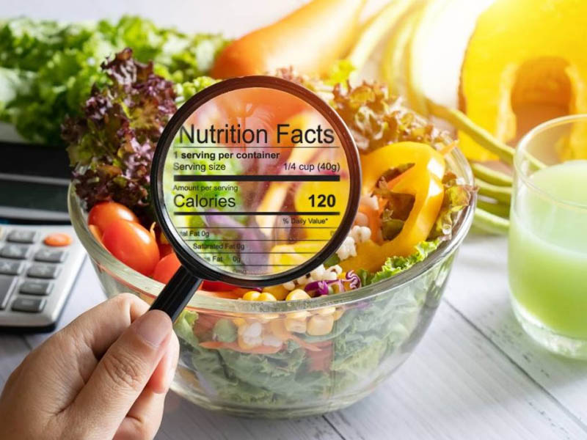
PROJECT TITLE: “FEEDING THE FUTURE: DATA ANALYSIS FOR BETTER NUTRITION WITH SQL”
PRESENTED BY:
NIVETHITHA T
UNDER GUIDENCE:
Mr.Kavi Bharathi
(Besant tech)

Slide 3
NUTRITION ANALYSIS
Foods are composed of a complicated matrix of compounds. Among these compounds are nutrients that are essential for life and growth.
For human food, these nutrients have been defined and mandated by governments to be disclosed on food packaging in most countries around the world.
These mandates are intended to help populations reduce nutrient deficiencies and preventable diseases caused by malnutrition.
A nutritional analysis is the description of the method used to determine the amounts of these nutrients in a particular food.
Nutrients are generally reported on a one hundred gram basis as a certificate of analysis

Slide 4
Food is the fuel the body needs to replenish itself with. Each civilization has given profound importance to food types and consumption patterns.
Hence, it can be easily assumed that food has the power to influence bodily metabolism and organ health directly. After ingestion, food is digested through our gut with the help of various digestive juices and ends in being absorbed in bloodstreams as different types of biomolecules which are known as Nutrients.
If food is the reason, Nutrition is the result. We consume food so that we can obtain proper nutrition.
Nutrition is the process by which important beneficial biomolecules or Nutrients, after reaching their destination within the body, positively helps in functioning, maintaining, or improving important bio metabolisms like building muscles, producing energy, thriving body cells, improving body health, replenish malnourishment, and strengthening immunity.

Slide 5
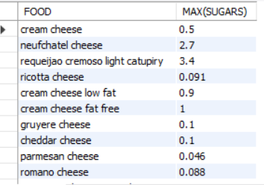
Select the max(sugar) in food
SELECT MAX(SUGAR)
FROM FOODS
GROUP BY FOOD;

Slide 6
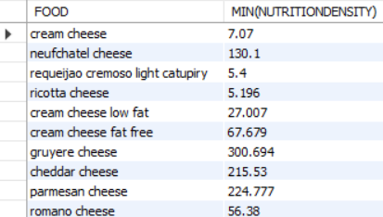
Select the min(nutrition density) for each food
SELECT FOOD, MIN(NUTRITIONDENSITY)
FROM FOODS
GROUP BY FOOD;

Slide 7
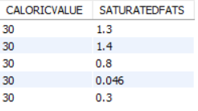
Select the saturated value where caloric value is 30
SELECT CALORICVALUE,SATURATEDFATS
FROM FOODS
WHERE CALORICVALUE=30;

Slide 8

Select the max(protein) where vitamin c is 0
SELECT VITAMINC,MAX(PROTEIN)
FROM FOODS
WHERE VITAMINC=0;

Slide 9

Select the max(food) which was eaten by everyone
SELECT MAX(FOOD)
FROM FOODS;

Slide 10
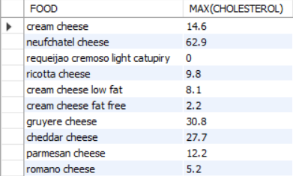
Select the max(cholesterol) in each food
SELECT FOOD,MAX(CHOLESTEROL)
FROM FOODS
GROUP BY FOOD;

Slide 11
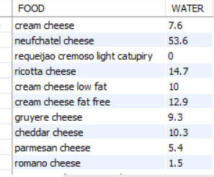
Select the water content available in each food
SELECT FOOD,WATER
FROM FOODS
GROUP BY FOOD,WATER;

Slide 12
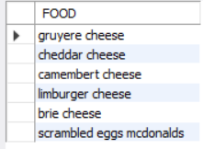
Select the food which has sugar value is 0.1
SELECT FOOD
FROM FOODS
WHERE SUGARS=0.1;

Slide 13
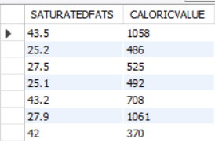
Select the caloric value where saturated fats is greater than 25
SELECT SATURATEDFATS,CALORICVALUE
FROM FOODS
WHERE SATURATEDFATS>25;

Slide 14
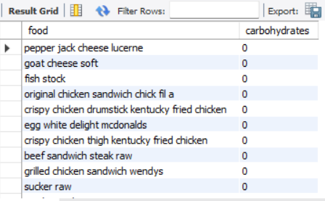
Write a query to display name of the food which has 2nd minimum carbohydrate
SELECT food , carbohydrates
from foods
where carbohydrates in
(select min(carbohydrates)
from foods)>
(select min(carbohydrates)from foods);

Slide 15
THANK YOU

