Slide 1
intro2PCBdesign – lab64
bad boards

Slide 2
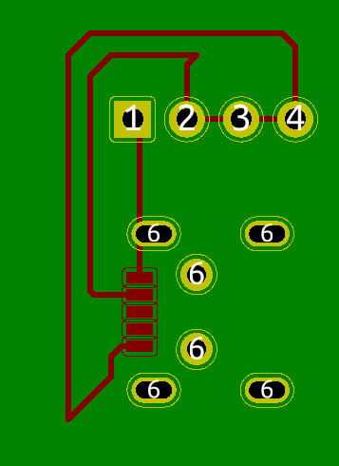
board1

Slide 3
board1
Trace loops
EMI disaster

Slide 4
board1
Trace loops
EMI disaster
Loops of wires creates an antenna; aka “Loop antenna”

Slide 5
board1
Trace loops
EMI disaster
Loops of wires creates an antenna; aka “Loop antenna”
Acute trace angles
Induced coupling between traces

Slide 6
board1
Trace loops
EMI disaster
Loops of wires creates an antenna; aka “Loop antenna”
Acute trace angles
Induced coupling between traces
Induces noise in those traces

Slide 7
board1
Trace loops
EMI disaster
Loops of wires creates an antenna; aka “Loop antenna”
Acute trace angles
Induced coupling between traces
Induces noise in those traces
These faults will destroy any high frequency projects.

Slide 8
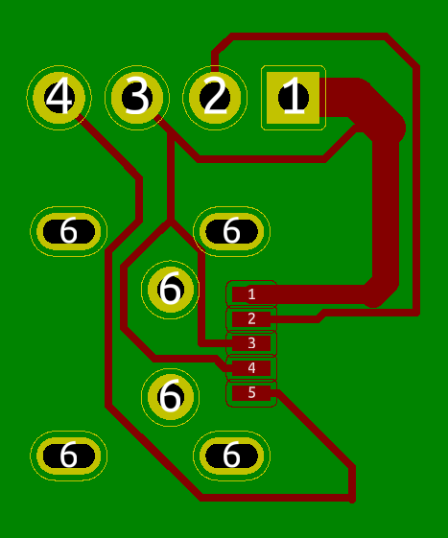
board2

Slide 9
board2
Different widths on the same trace

Slide 10
board2
Different widths on the same trace
Different impedances on same trace

Slide 11
board2
Different widths on the same trace
Different impedances on same trace
Reflections in high frequency signals
Byebye signal

Slide 12
board2
Different widths on the same trace
Different impedances on same trace
Reflections in high frequency signals
Byebye signal
Acute angles

Slide 13
board2
Different widths on the same trace
Different impedances on same trace
Reflections in high frequency signals
Byebye signal
Acute angles
IPC-2152 - Standard for Determining Current-carrying Capacity in Printed Board Design
IPC – “The global trade association serving the printed board and electronics assembly industries, their customers and suppliers”
http://www.ipc.org/

Slide 14
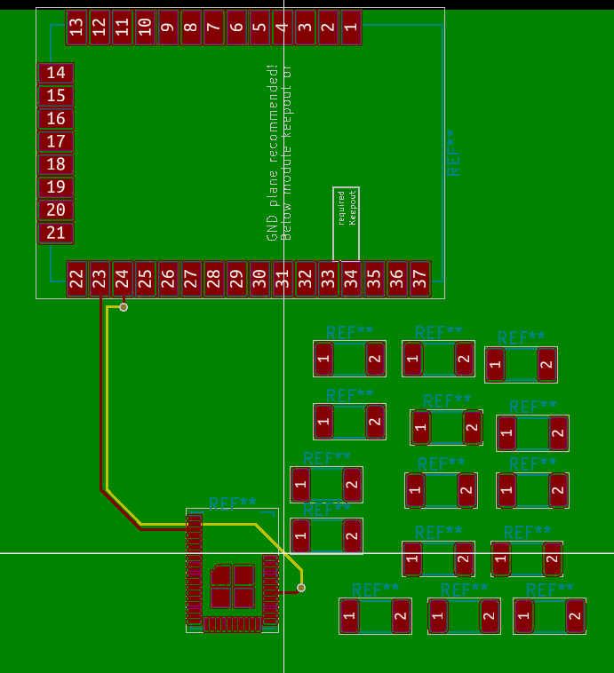
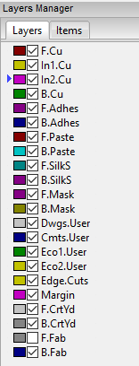
board3

Slide 15
board3
Different signal, but parallel traces

Slide 16
board3
Different signal, but parallel traces
Induces coupling
Induces noise
Adjacent signal layers

Slide 17
board3
Different signal, but parallel traces
Induces coupling
Induces noise
Adjacent signal layers
No ground plane in between can induce noise
Ground bounce (where is ground?)

Slide 18
board3
Different signal, but parallel traces
Induces coupling
Induces noise
Adjacent signal layers
No ground plane in between can induce noise
Ground bounce (where is ground?)
Bad component placement makes bad trace routing seem like a good idea

Slide 19
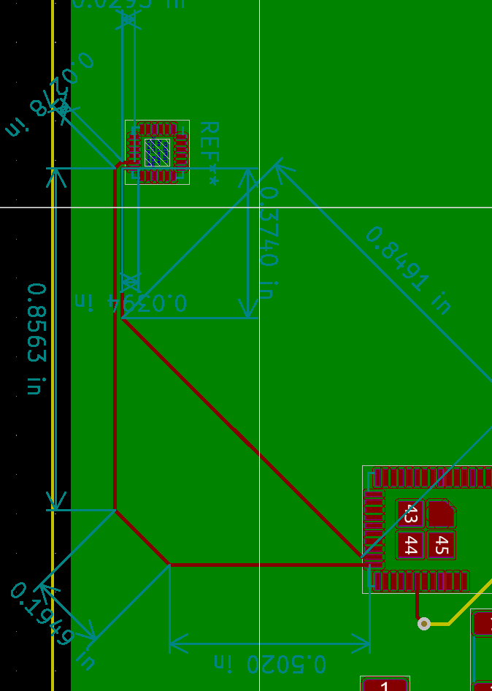
board4

Slide 20
board4
Mismatched lengths for a critical signal

Slide 21
board4
Mismatched lengths for a critical signal
Different lengths means different arrival times

Slide 22
board4
Mismatched lengths for a critical signal
Different lengths means different arrival times
Outer trace = 1.6105 in
Inner trace = 1.2625 in
Difference = 0.348 in
Dielectric Constant FR-4 dielectric ~= 4
Speed of EM signal in a vacuum ~= 11.8in/ns
Very rough estimate:
Td = 0.348 in / (11.8 in/ns / sqrt(Ereff)) =50ps delay in propagation
https://blog.zuken.com/how-to-calculate-trace-length-from-time-delay-value-for-high-speed-signals/

Slide 23
board4
Mismatched lengths for a critical signal
Different lengths means different arrival times
Outer trace = 1.6105 in
Inner trace = 1.2625 in
Difference = 0.348 in
Dielectric Constant FR-4 dielectric ~= 4
Speed of EM signal in a vacuum ~= 11.8in/ns
Very rough estimate:
Td = 0.348 in / (11.8 in/ns / sqrt(Ereff)) =50ps delay in propagation
Rise times for modern digital signals are faster than this!
https://blog.zuken.com/how-to-calculate-trace-length-from-time-delay-value-for-high-speed-signals/

Slide 24
parting thoughts
A lot can go wrong when making a PCB

Slide 25
parting thoughts
A lot can go wrong when making a PCB
Poor layout
Mistakes in fabrication
Mistakes in assembly

Slide 26
parting thoughts
A lot can go wrong when making a PCB
Poor layout
Mistakes in fabrication
Mistakes in assembly
Defensive driving exists for good reason – defend against risks
Same idea – layout PCBs with a defensive mindset

