Slide 1
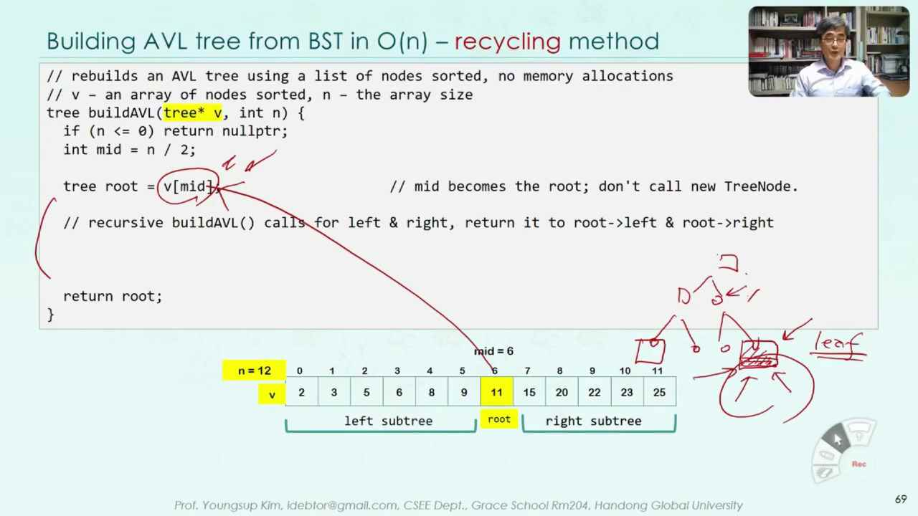
Homework
When you rebuild an AVL tree from BST using recycling, how the left and right of the leaf nodes are to set to nullptr. Explain how they are being set in your code.
You may add new pages of ppt to answer the question.

