Slide 1
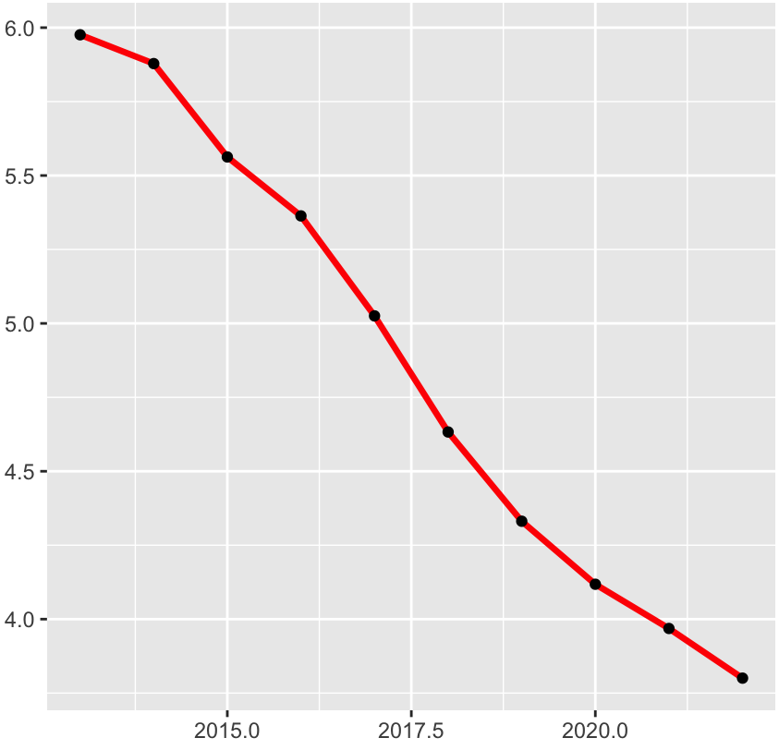
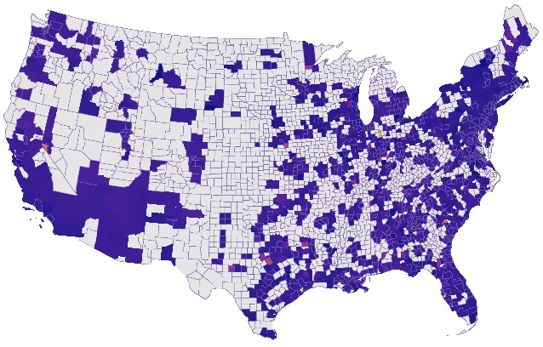
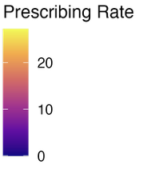
Analyzing Medicare Part D Opioid Prescribing Patterns Across the United States
Josiah Barnes
INTRODUCTION
RESULTS
Southeastern and Appalachian regions showed the most intense prescribing clusters.
Western and rural counties had many white (missing or suppressed) areas.
This spatial map reveals stark regional disparities not seen in state averages.
Some counties may lack non-opioid options or pain management resources.
Missing data disproportionately affect rural and underserved areas, limiting visibility.
Together, these figures illustrate both national progress and local disparities.
High-risk counties can be prioritized for intervention and further investigation.
The opioid epidemic disproportionately impacts older adults and is underrepresented in surveillance data.
Medicare Part D offers an opportunity to evaluate opioid prescribing among seniors.
Older adults often have chronic pain and multiple medication exposures.
Analyzing geographic trends can uncover disparities in opioid prescribing practices.
Mapping and visualization tools are useful for identifying regional variations in prescribing patterns.
The data used can inform local interventions and public health priorities.
Over 3,000 U.S. counties met inclusion criteria for this analysis.
Approximately 10–15% of counties were excluded due to suppressed data.
Prescribing Rate (Rx per 1,000 beneficiaries)
HYPOTHESIS &/OR OBJECTIVE
CONCLUSIONS
Research Question:
How do opioid prescribing rates vary across U.S. counties?
What demographic or structural factors explain geographic disparities in prescribing?
Objectives:
Quantify opioid prescribing rates by county for older beneficiaries.
Identify counties significantly above or below the national average rates.
Analyze how income, rurality, race, and education influence trends.
Create visualizations to support data-driven public health strategies.
Significant opioid prescribing disparities exist across counties and states.
County-level data highlights areas of overuse or unmet care needs.
LIS concentration strongly correlates with higher prescribing intensity.
Gaps in data pose risks to accurate local surveillance efforts.
Spatial tools and normalization allow for equitable comparisons across regions.
Older adults should be central to opioid surveillance and response planning.
Calendar Year
Figure 1. Average Opioid Prescribing Rate by Year (2013–2023) [ Red line indicates national average; black dots represent annual data points]
REFERENCES
METHODS
Alexander & Saloner, 2020 – JAMA Network Open
Chan & Miller, 2022 – Frontiers in Public Health
CMS, 2024 – Medicare Part D Public Use File
Essien et al., 2021 – JAMA Health Forum
Wickham, 2016; Pebesma, 2018 – R packages and geospatial tools
Observational retrospective study using Medicare Part D claims data (2013–2023).
Population: Beneficiaries aged 65+ who filled at least one opioid prescription.
Key variables: Claims, total beneficiaries, drug costs, LIS cost share.
Prescribing rate calculated per 1,000 beneficiaries per county annually.
Missing or suppressed values were excluded from aggregate county analyses.
R used for analysis (dplyr, ggplot2, tmap, sf packages).
County shapefiles joined using FIPS codes for spatial visualization.
Data validated through manual checks and documentation of transformations.
Analysis included maps, bar graphs, and trendlines by year.
Figure 2. U.S. County-Level Map of Opioid Prescribing Intensity (2022)
ACKNOWLEDGEMENTS
In Figure 1, a consistent decline is visible, from 6.0 to below 4.0 opioid prescriptions per beneficiary.
This 35% drop suggests national policy shifts may be taking effect.
Figure 2 displays opioid prescribing intensity by county across the U.S.
Counties ranked by highest to lowest prescribing rate (yellow>red>purple *gray=missing data)
Dr. Jeane Silva for project mentorship and guidance throughout the research.
CMS for providing publicly available Medicare Part D data used in this analysis.
Dr. Andrew Balas and the Augusta University School of Public Health for their support.
This poster has been adapted from an academic capstone project. University branding has been removed, and the analysis is presented for educational and portfolio purposes using publicly available CMS Medicare Part D data.

