Slide 1
NUTRITIONAL PROFILES OF
BRANDED FOOD PRODUCTS
Outlier Cleaning, Nutrient Density,
Clustering, and Intra-Category Analysis
Jean Batista | DS 580 | Dr. Jianyuan Ni | April 2026

Slide 2
Presentation Overview
01
The Ingredient Problem
Cooking inputs distort comparative analysis. We filter them first.
02
Outlier Detection
2,189 impossible values flagged. Sodium mean drops 72% after cleaning.
03
Nutrient Density Score
79.5% of products score negative. Category labels don't predict this.
04
Clustering
Five natural nutrient archetypes cut across USDA food categories.
05
Intra-Category Deep Dives
Cheese, snacks, and yogurt: the variation inside a category is as large as across categories.

Slide 3
The Ingredient Problem
The USDA database mixes cooking ingredients with ready-to-eat foods.
Salt, spices, vanilla extract, and cooking oils appear alongside pizza, almonds, and yogurt.
No person consumes a serving of table salt as a meal. Including these in comparisons distorts every score and ranking.
Herbs and spices scored worst on NDS in the unfiltered data at -118.6. This is not a dietary insight. It is an artifact of comparing a cooking ingredient against food.
3,283
Seasoning Mixes, Salts,
Marinades Removed
762
Herbs & Spices
Products Removed
5,917
Total Ingredient
Products Excluded
169,083 products remain for comparative analysis.
Jean Batista | DS 580 | USDA Branded Food Analysis – Project 2

Slide 4
Outlier Detection: Cleaning the Dataset
2,189 flagged
0.11% of all nutrient cells. A small share with outsized impact on means.
Sodium: -72% mean
Mean drops from 1,620 mg to 453 mg after removing impossible values.
Median unchanged
278 mg to 274 mg. The central distribution was structurally sound.
Calories minimal shift
271.6 to 270.0 kcal. Max drops from 37,600 to 5,000 kcal.
Use the cleaned dataset for any means-based analysis or modeling.
Jean Batista | DS 580 | USDA Branded Food Analysis – Project 2

Slide 5
Nutrient Density Score (NDS)
HOW THE SCORE IS BUILT
121,171
BENEFICIAL (+)
products scored (ingredient cats excluded)
Protein
% of 50g DV
Fiber
79.5%
% of 28g DV
LIMITING (−)
of products score NEGATIVE
Sodium
% of 2,300mg DV
Saturated Fat
-14.9
% of 20g DV
Total Sugar
% of 50g DV
median NDS per 100 kcal
NDS = (Protein%DV + Fiber%DV) − (Sodium%DV + SatFat%DV + Sugar%DV)
divided by calories per serving, scaled to per 100 kcal
Positive = delivers more beneficial nutrients than limiting ones per 100 kcal.
Jean Batista | DS 580 | USDA Branded Food Analysis – Project 2

Slide 6
NDS Rankings: What Scores Well, What Scores Poorly
Jean Batista | DS 580 | USDA Branded Food Analysis – Project 2

Slide 7
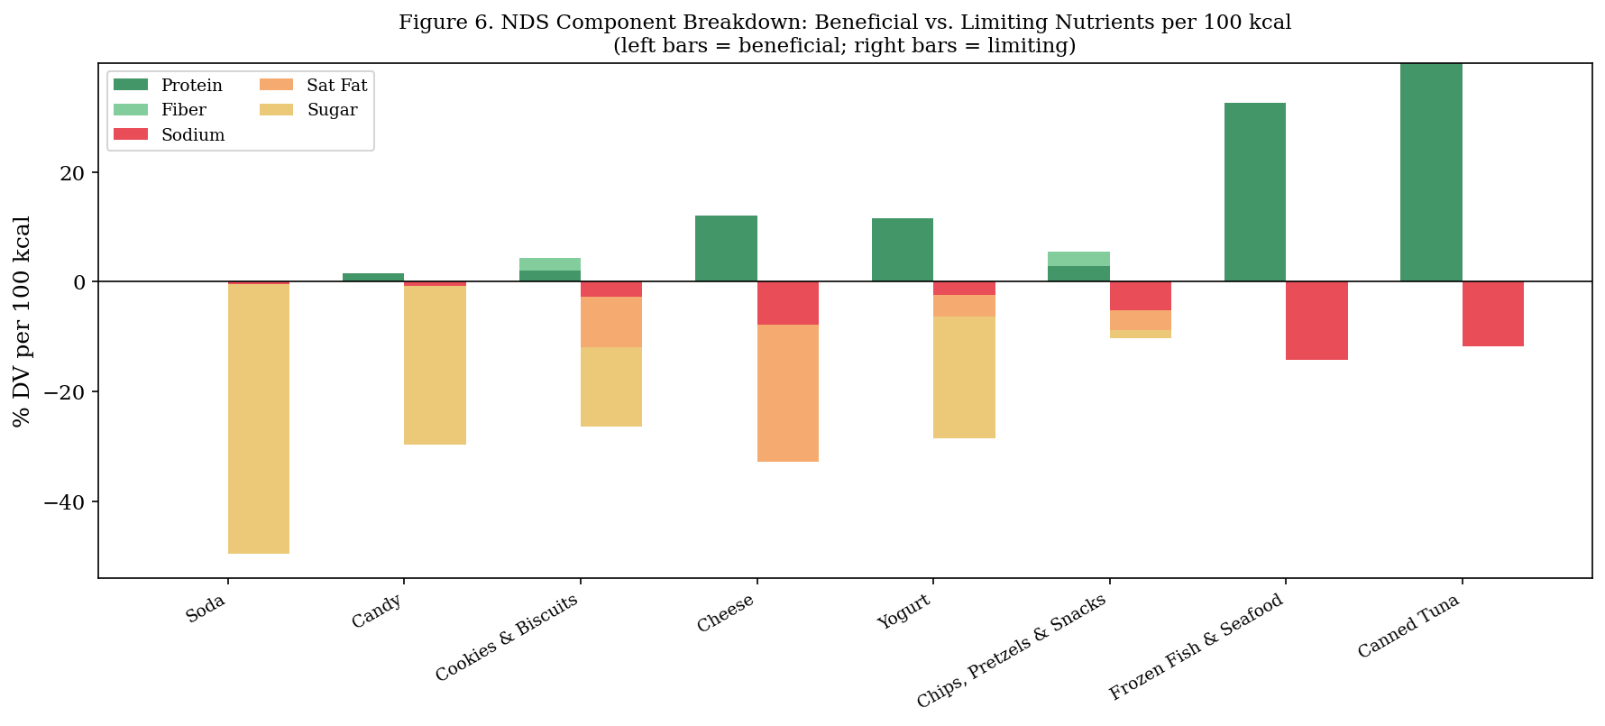
Why Categories Score the Way They Do
The NDS total score alone does not tell you why a category ranks where it does. Canned tuna earns its score from protein with almost no limiting penalty. Soda earns its negative score entirely from sugar with zero beneficial nutrients. Chips score near zero because sodium and fat penalties cancel out their modest protein.
Jean Batista | DS 580 | USDA Branded Food Analysis – Project 2

Slide 8
K-Means Clustering: Five Nutrient Archetypes
Calorie-Dense
Nuts & Bars
Light /
Moderate
Sweet
Processed
Starchy &
Savory
High-Protein
High-Fat
n = 3,484
n = 15,878
n = 7,370
n = 7,641
n = 5,627
Calories
Calories
Calories
Calories
Calories
536
89
415
372
304
Protein
Protein
Protein
Protein
Protein
17.9g
3.0g
3.8g
8.0g
18.3g
Carbs
Carbs
Carbs
Carbs
Carbs
36.7g
11.7g
67.4g
62.1g
3.6g
Fat
Fat
Fat
Fat
Fat
37.5g
1.6g
16.1g
8.8g
21.4g
Sodium
Sodium
Sodium
Sodium
Sodium
250mg
157mg
168mg
488mg
722mg
Sugar
Sugar
Sugar
Sugar
Sugar
6.2g
3.5g
44.6g
3.6g
0.0g
Jean Batista | DS 580 | USDA Branded Food Analysis – Project 2

Slide 9
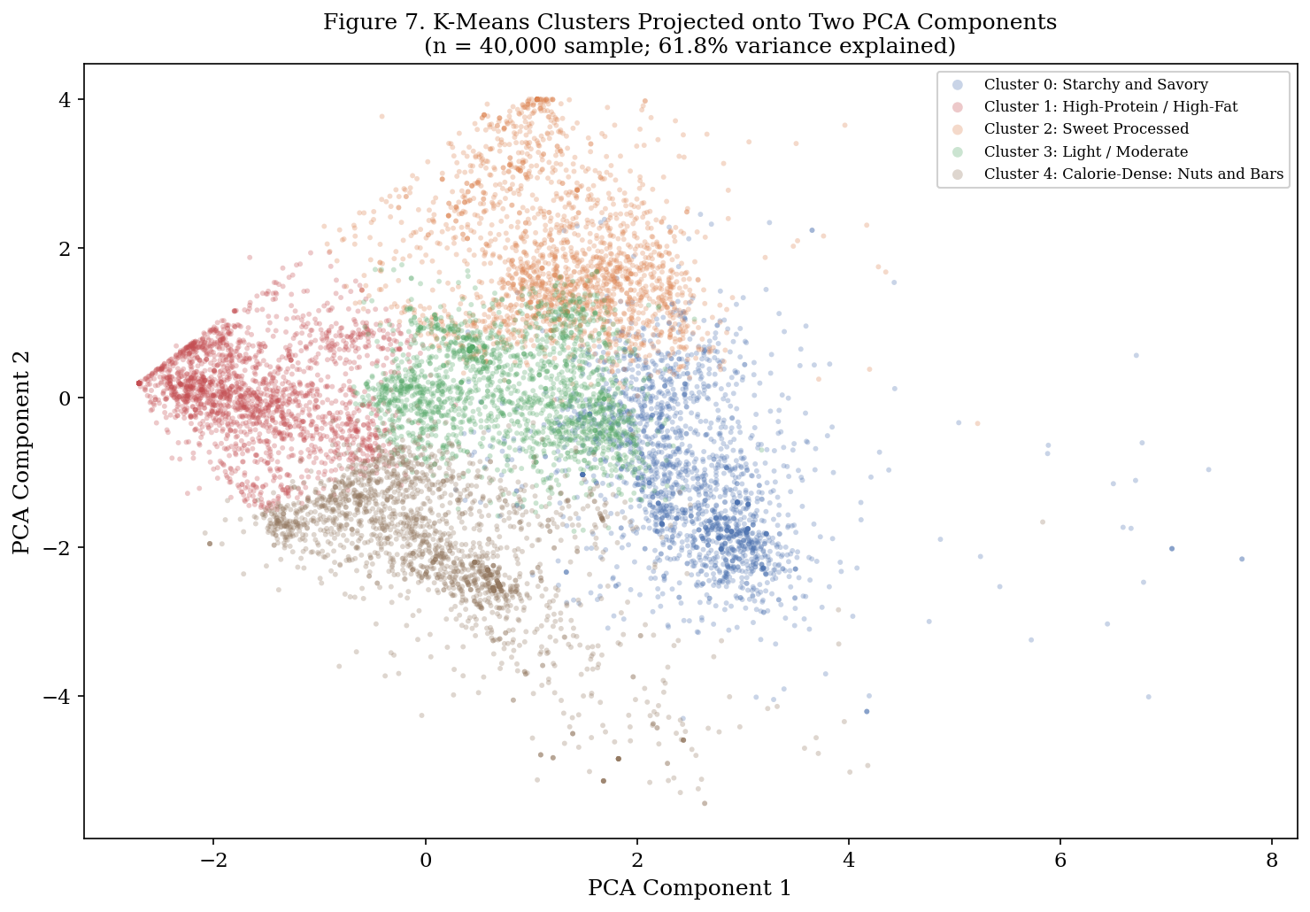
What Clustering Reveals About Categories
Cheese = Deli Meats
Both land in the High-Protein/High-Fat cluster. Different USDA categories, same nutrient structure.
Ice Cream = Frozen Dinners
Small serving sizes keep per-serving values low for both. Category is not the driver.
.
Jean Batista | DS 580 | USDA Branded Food Analysis – Project 2

Slide 10
Inside Cheese: Calories Per Serving Vary 4x
Fat consistent across hard cheeses
Cheddar, Swiss, Gouda, Blue, Brie all cluster at 28 to 32g of fat per serving. Switching between them does not reduce fat meaningfully.
Parmesan leads on protein
32.1g protein per 28g serving, ahead of Swiss (26.5g) and cheddar (23.8g). Best protein-per-serving in the dataset.
Sodium varies 6x
Swiss: 211 mg. American: 1,316 mg. Similar calorie ranges. Sodium is driven by processing, not dairy composition.
Jean Batista | DS 580 | USDA Branded Food Analysis – Project 2

Slide 11
Inside Snacks: Fat-Driven vs. Carb-Driven
Seeds & Nuts
536 kcal, 13.3g protein, 283mg sodium. Highest calories, highest protein, lowest sodium.
Cookies
Highest sugar: 33.3g. 55% of calories from carbohydrates.
Chips & Pretzels
Highest sodium: 607mg. 60.7g carbs per serving.
Energy Bars
14.7g protein. Nutritional character varies widely within the subcategory.
Jean Batista | DS 580 | USDA Branded Food Analysis – Project 2

Slide 12
Inside Yogurt: Greek Does Not Mean Low Sugar
Skyr leads on protein calories
40 kcal from protein per serving vs. 32 kcal for Greek. Both are well above the 14 kcal from flavored yogurt.
Greek is not low sugar
Most Greek yogurts in this dataset are flavored. 37 of 81 kcal (46%) come from sugar. Close to flavored yogurt at 42 of 87 kcal.
Plain is the safest bet
Only 20 kcal from sugar out of 69 total (29%). The plain format is the most reliable low-sugar option.
Jean Batista | DS 580 | USDA Branded Food Analysis – Project 2

Slide 13
The Central Finding: Labels Are Not Enough
You add Greek yogurt for protein.
You get 8g of protein and 37 kcal from sugar. Flavored Greek yogurt is not a low-sugar choice.
You swap to cheese for protein and calcium.
American cheese: 23g protein, 1,781mg sodium. Swiss: 28.6g protein, 253mg sodium. Same category. Very different product.
You reduce soda intake.
The soda category includes diet sodas at near-zero calories and protein sodas. The category label tells you nothing about the nutritional consequence of the substitution.

Slide 14
Key Takeaways
01
02
03
Filter cooking ingredients first
Clean outliers before modeling
79.5% of products score negative NDS
Seasoning mixes and spices are not food products in the dietary sense. Removing 5,917 products produces a dataset where comparisons are meaningful.
0.11% of values inflate the sodium mean by 3.6x. The median is robust, but cleaning is more reliable for regression or correlation work.
Most branded foods deliver more limiting nutrients than beneficial ones per 100 kcal. The score ranks products, not condemns them.
04
05
Cluster beats category as a model feature
Variation inside categories is as large as across them
Cheese and deli meats share a nutrient cluster. Frozen dinners and ice cream share one too. Use cluster membership in downstream models.
American cheese has 7x the sodium of Swiss. Greek yogurt is not low sugar when flavored. Seeds outperform chips on protein and sodium.
Jean Batista | DS 580 | USDA Branded Food Analysis – Project 2

