Slide 1

TRIBHUVAN UNIVERSITY
INSTITUTE OF ENGINEERING
Kathmandu Engineering College
Kalimati, Kathmandu
H-Mate: The Hospital Application
Presented By:
Aditya Gnawali [KAT077BCT005]
Bhuwan Shrestha [KAT077BCT014]
Jyoti Bhusan Dahal [KAT077BCT028]
Mohit Raj Aryal [KAT077BCT030]
Date: 2080/03/12

Slide 2
SLIDE OVERVIEW:
Introduction
Problem Statement
Objectives
Scope and Applications
Existing System
Limitations of the Existing System
Solution Proposed by Our System
Methodology: Incremental Development Model
Why Incremental?
System Block Diagram
Flowchart
Gantt Chart
Tools Used

Slide 3
1. INTRODUCTION
H-Mate is a mobile-based application that provides basic health-related services like doctor appointments, and doctor recommendations.
Medical applications have revolutionized the way individuals interact with healthcare providers. It increases access to health services.
The application also acts as an awareness medium for individuals about common health-related issues and their precautions.

Slide 4
2. PROBLEM STATEMENT
In Nepal, there is a lack of proper medical care for people whose salary is less than the average.
There is long waiting hours for medical services and a tight schedule with a lack of ability for timely and routine checkups.
The geographical condition of Nepal makes it difficult to provide proper health services to people due to lack of mobility.
The significant costs associated with infrastructure, transportation, and manpower pose challenges in delivering affordable healthcare.

Slide 5
3. OBJECTIVES
The major objectives of this project are:
To provide a platform for everyone to book an appointment with a specialist doctor based on their symptoms.
To make a hospital management system where hospital staff can keep a record of patients.

Slide 6
4. SCOPE AND APPLICATIONS
Hospital-based application is not a new concept in Nepal as it has been in use for a few years.
Some hospital-based applications or websites are: Hamro Doctor, Nepal Mediciti, Okhati, and others.

Slide 7
4. SCOPE AND APPLICATIONS
The application of this software is to schedule appointments for patients and ensure timely access to healthcare services
This software can also manage different medical files and resources for doctors and hospitals
The main application of this software is used to enhance patient experience, streamline and effective resource management.

Slide 8
5. EXISTING SYSTEMS
Some of the existing hospital-based applications in Nepal that are:
Hamro Doctor
Okhati
Saral Health

Slide 9
6. LIMITATIONS OF THE EXISTING SYSTEMS
Applications aren’t introducing any new kind of features.
Fails to meet some requirements of the users.

Slide 10
7. SOLUTIONS PROPOSED BY OUR SYSTEM
Our application provides users extra features like recommending specialist doctors according to their symptoms.
Easy to use application without any difficulties as the UI used in the application will be simple and user-friendly.
Availability of various features in a single application thus limiting the need to use multiple applications.

Slide 11
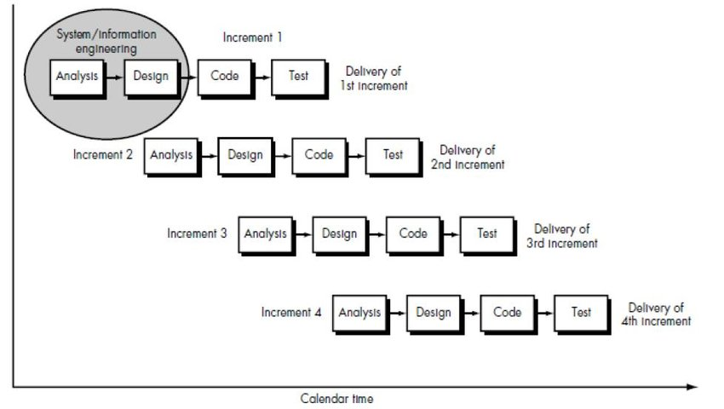
8. METHODOLOGY: INCREMENTAL DEVELOPMENT MODEL

Slide 12
9. WHY INCREMENTAL?
Incremental model flexibility and adaptability during the development process.
Number of features that could be designed and implemented within the timeframe.
Projects face risks and uncertainties the incremental model assists in risk mitigation.

Slide 13
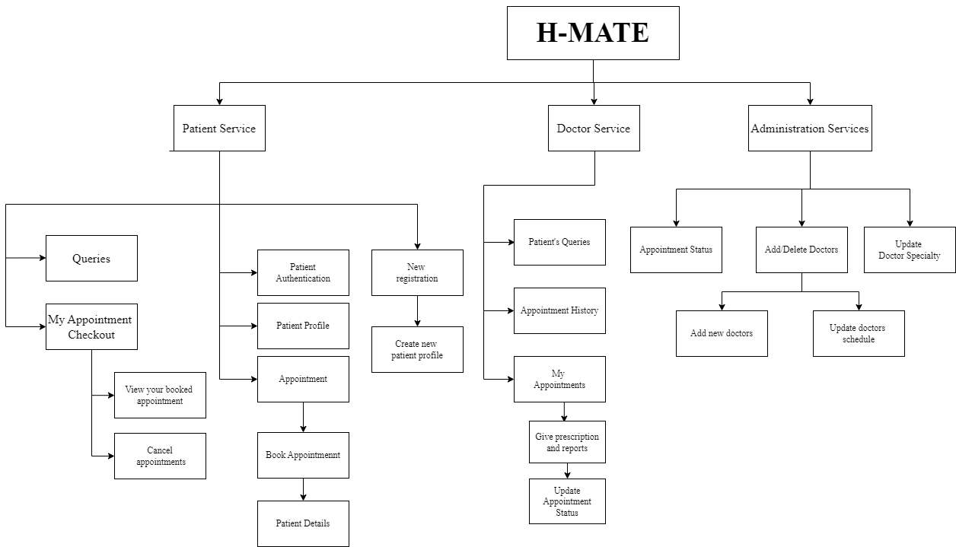
10. SYSTEM BLOCK DIAGRAM

Slide 14
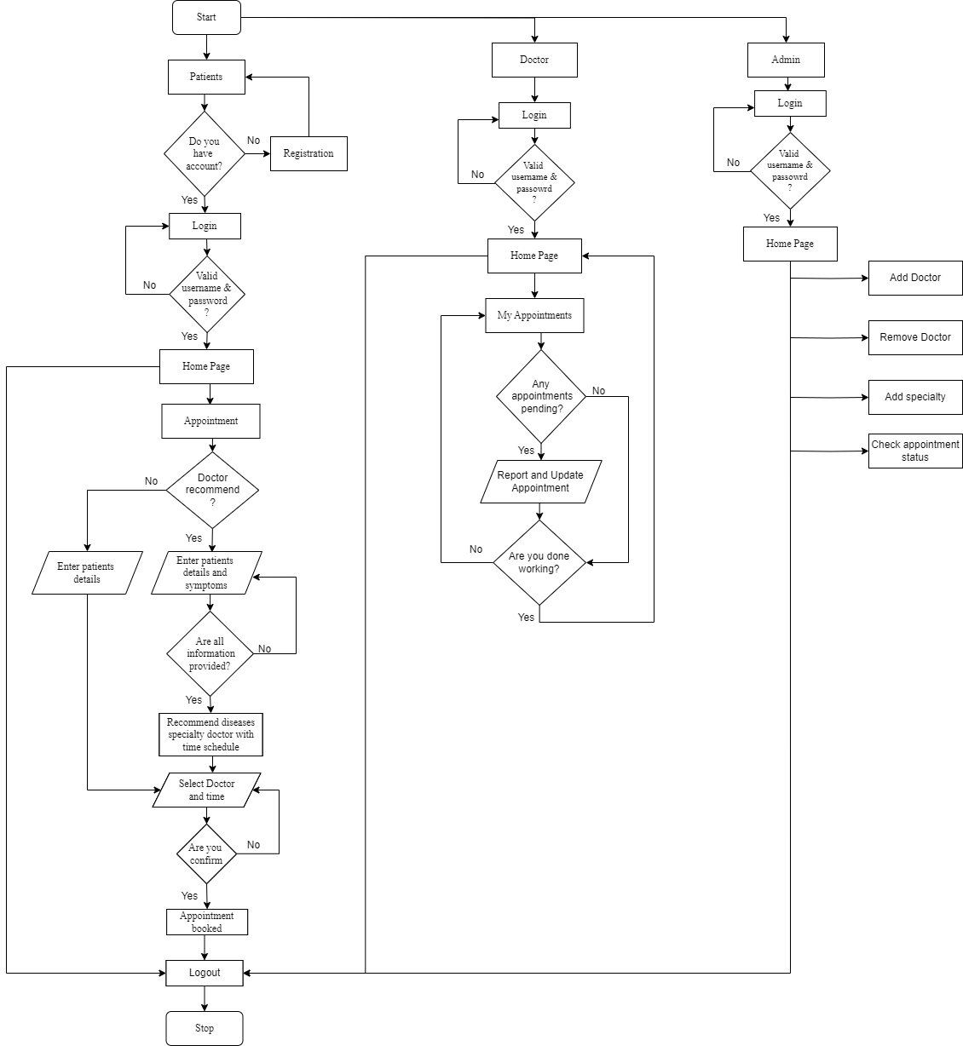
11. FLOWCHART

Slide 15
12. GANTT CHART
 | 5th SEM |  |  |  |  | 6thSEM
Task | Jun | July | Aug | Sep | Oct | Nov | Dec | Jan | Feb | Mar
Documentation
Requirement Analysis
Design
Development
Testing
Implementation

Slide 16
13. TOOLS USED
PYTHON
JAVASCRIPT
REACT NATIVE
REACT JS
GIT
GITHUB
MYSQL

