Slide 1
Product Tracking and Customer Management System
By Mike Juarez-Sweeney, Jerry Moua and Mohammad Shariff

Slide 2
introduction

Slide 3
introduction
Existing small business has been selling their product on Amazon

Slide 4
introduction
Existing small business has been selling their product on Amazon
No customer database

Slide 5
introduction
Existing small business has been selling their product on Amazon
No customer database
Tracking stock and products sold

Slide 6
Vision and scope

Slide 7
Vision and scope
Move customer traffic to company website

Slide 8
Vision and scope
Move customer traffic to company website
Detailed product information

Slide 9
Vision and scope
Move customer traffic to company website
Detailed product information
In depth customer service and help

Slide 10
Vision and scope
Move customer traffic to company website
Detailed product information
In depth customer service and help
Direct customer contact

Slide 11
Vision and scope
Move customer traffic to company website
Detailed product information
In depth customer service and help
Direct customer contact
Better inventory tracking

Slide 12
Vision and scope
Move customer traffic to company website
Detailed product information
In depth customer service and help
Direct customer contact
Better inventory tracking
Lower costs

Slide 13
Business value

Slide 14
Business value
Inventory tracking will help reduce wasted product

Slide 15
Business value
Inventory tracking will help reduce wasted product
Expanding customer database

Slide 16
Business value
Inventory tracking will help reduce wasted product
Expanding customer database
Promotions

Slide 17
Business value
Inventory tracking will help reduce wasted product
Expanding customer database
Promotions
Changes to existing product

Slide 18
Business value
Inventory tracking will help reduce wasted product
Expanding customer database
Promotions
Changes to existing product
New Products

Slide 19
Business value
Inventory tracking will help reduce wasted product
Expanding customer database
Promotions
Changes to existing product
New Products
More control over changes to products/pricing

Slide 20
Feasibility study

Slide 21
Feasibility study
A website is key to longevity

Slide 22
Feasibility study
A website is key to longevity
Generate more revenue

Slide 23
Feasibility study
A website is key to longevity
Generate more revenue
More control over market presence

Slide 24
Development Methodology

Slide 25
Development Methodology
Agile

Slide 26
Development Methodology
Agile
Changes can be addressed as they come

Slide 27
Development Methodology
Agile
Changes can be addressed as they come
Consistent communication with client

Slide 28
Development Methodology
Agile
Changes can be addressed as they come
Consistent communication with client
Keep the project on schedule

Slide 29
Development Methodology
Agile
Changes can be addressed as they come
Consistent communication with client
Keep the project on schedule
Delivering the software correctly the first time

Slide 30
System functionality

Slide 31
System functionality
Two human actors who use the system

Slide 32
System functionality
Two human actors who use the system
Administrator

Slide 33
System functionality
Two human actors who use the system
Administrator
Customer

Slide 34
System functionality
Two human actors who use the system
Administrator
Customer
A third “non-human” actor

Slide 35
System functionality
Two human actors who use the system
Administrator
Customer
A third “non-human” actor
Bank/payment processor

Slide 36
System functionality
Administrator

Slide 37
System functionality
Administrator
Login/Logout

Slide 38
System functionality
Administrator
Login/Logout
View products

Slide 39
System functionality
Administrator
Login/Logout
View products
Edit/add products

Slide 40
System functionality
Administrator
Login/Logout
View products
Edit/add products
Receive payments

Slide 41
System functionality
Customer

Slide 42
System functionality
Customer
Login/Logout

Slide 43
System functionality
Customer
Login/Logout
View products

Slide 44
System functionality
Customer
Login/Logout
View products
Add products to purchase list

Slide 45
System functionality
Customer
Login/Logout
View products
Add products to purchase list
Make payments

Slide 46
System functionality
Bank/Payment processor

Slide 47
System functionality
Bank/Payment processor
Receive/Process payments

Slide 48
System functionality
Bank/Payment processor
Receive/Process payments
Deposit payments to company account

Slide 49
Initial use case

Slide 50
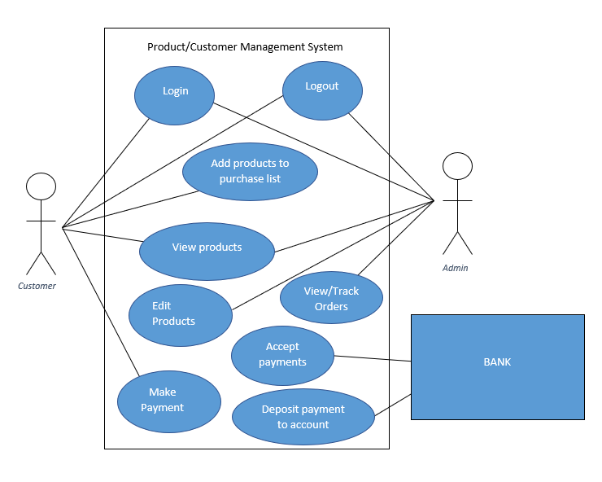
Initial use case
Fig. 1: Initial use case

Slide 51
Hardware requirements

Slide 52
Hardware requirements
Minimal hardware initially

Slide 53
Hardware requirements
Minimal hardware initially
Pay to host through cloud computing service

Slide 54
Hardware requirements
Minimal hardware initially
Pay to host through cloud computing service
Potential onsite server if growth allows for it

Slide 55
Software requirements

Slide 56
Software requirements
Software used to create and implement application

Slide 57
Software requirements
Software used to create and implement application
HTML

Slide 58
Software requirements
Software used to create and implement application
HTML
JavaScript

Slide 59
Software requirements
Software used to create and implement application
HTML
JavaScript
CSS

Slide 60
Software requirements
Software used to create and implement application
HTML
JavaScript
CSS
SQL

Slide 61
Software requirements
Software used to create and implement application
HTML
JavaScript
CSS
SQL
PHP

Slide 62
Questions?

