Slide 1


GoCode
We learn by doing, by falling down, and by picking ourselves back up
HTTP://GOCODENOW.COM

Slide 2
Performance and Algorithms
What is an algorithm?
Why do you need to know this for web?
How do we assess performance/speed?
Examples:
a) Bubble Sort
b) Binary Search

Slide 3
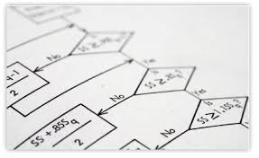
Algorithms
An algorithm is a set of steps to accomplish some goal.
There are usually different solutions! Some are faster than others.

Slide 4
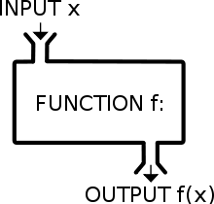

Slide 5
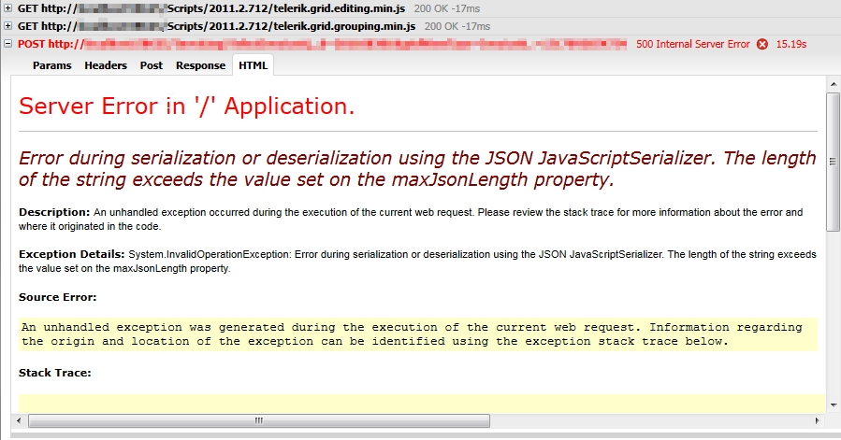
Web Development
Processing a large piece of data

Slide 6
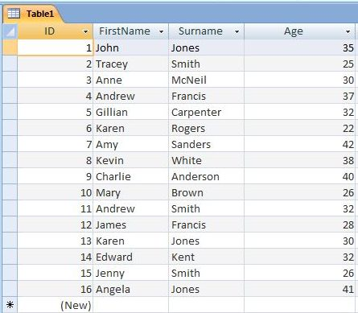
Web Development
2) Searching a large database/table

Slide 7

How we analyze algorithms
Big O notation describes the limiting behavior of a function when the argument tends towards infinity

Slide 8
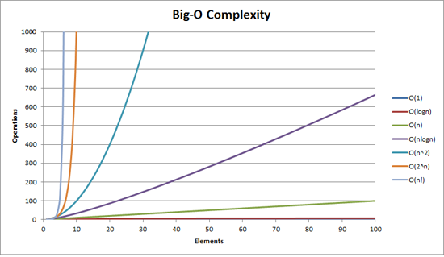
O(n^2) and above gets bad really quickly!

Slide 9
Iterating through array = [1,2,3,4]
Nested for loop – O(n^2)
for x in array:
for y in array:
print y
One loop - O(n)
for x in array:
print x

Slide 10
Examples
Searching an array:
a) Linear Search
b) Binary Search
c) Many others!
Sorting an array:
a) Bubble Sort
b) Merge Sort
c) Many others!

Slide 11
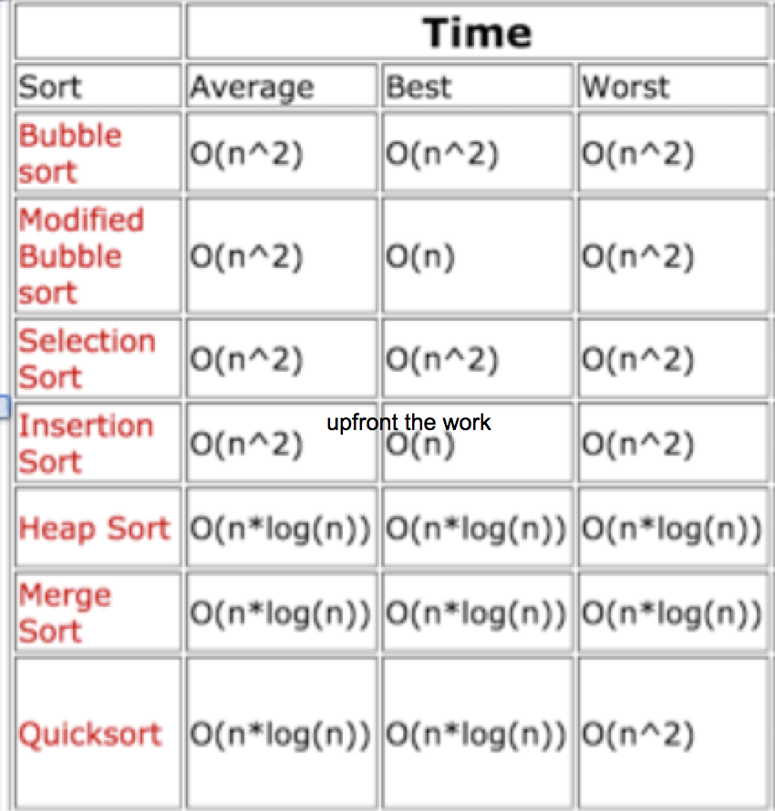

Slide 12
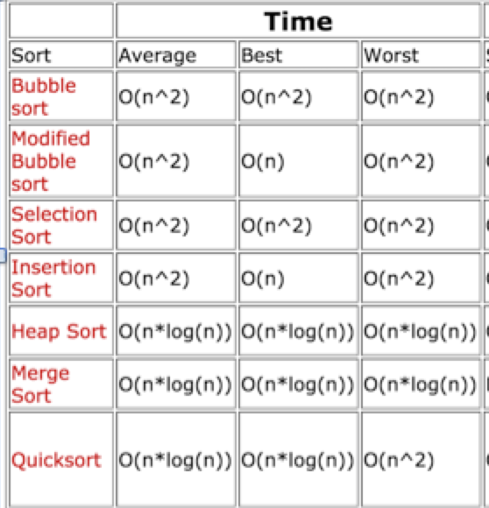

Slide 13
Examples
Searching an array:
a) Linear Search
b) Binary Search
c) Many others!
Sorting an array:
a) Bubble Sort
b) Merge Sort
c) Many others!

Slide 14
Linear Search
Lets say we have an array
>>> a = ['b','a','c','e','d']
>>> a.index('c')
2
>>> def linear_search(value,list):
... for i,v in enumerate(list):
... if value == v:
... return i
... return None
...
>>> linear_search('c',a)
2
GoCode
We learn by doing, by falling down, and by picking ourselves back up

Slide 15
Linear Search Case
Best case: O(1) - the item is first
Average: O(n/2) – halfway through
Worst case: O(n) – last in list
>>> b = range(0,50000000)
>>> linear_search(50000000-1,b)

Slide 16
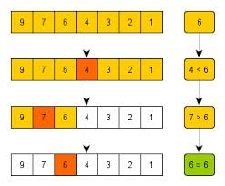
Binary Search Algorithm (Divide and Conquer)

Slide 17
Binary Search Algorithm (Divide and Conquer)
a = [1,2,3,4,5,6,7,8]
value = 3
Sort array
Look at the midpoint
Does it match the value
lower, dive into the lower half
higher, dive into the upper half, repeat

Slide 18
Binary Search Algorithm Analysis
Keep dividing until item found, or the start-end matches.
With this algorithm, best case is O(log N)
O(log N) performs better than O(N)

Slide 19
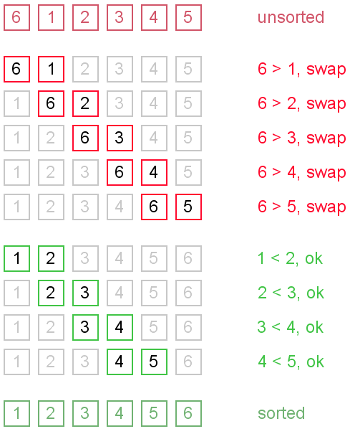
Bubble Sort

Slide 20
Bubble Sort
for passes in len(array)-1
for i in len(array) - 1
if array[i] > array[i+1]
swap(array[i],array[i+1]
Nested for loop – O(n^2) - worst and average

Slide 21
Key Points
Algorithms are steps to accomplish a goal
Two main concerns in web: database, data processing
Search/Sort built into most languages
Big-O used to describe performance
e.g. O(n) is linear, O(n^2) is bad!
5) Algos have best, worst, average cases

