Slide 1


GoCode
We learn by doing, by falling down, and by picking ourselves back up
HTTP://GOCODENOW.COM

Slide 2
Recursion
What is it?
Five Common Problems
How to Approach

Slide 3
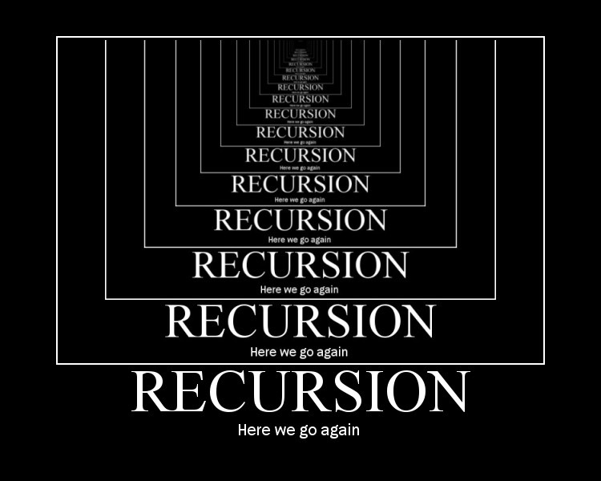
Recursion

Slide 4
Five classes of recursion
Linear Recursive (Factorial)
Functions with one recursive call (most common)
2. Binary Recursive (Fibonacci)
Functions with two recursive calls
3. Tail Recursive (Greatest Common Denom.)
Returns recursive call
4. Mutual Recursive (Is Odd/Is Even)
Functions calling each other
5. Exponential Recursive (All permutations)
If there were n elements, there would be O(a^n) calls

Slide 5
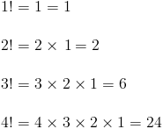
Factorial Iterative Approach
GoCode
We learn by doing, by falling down, and by picking ourselves back up
def iterative_factorial(n):
result = 1
for i in range(2,n+1):
result *= i
return result

Slide 6
Factorial Recursive Approach (Linear)
def factorial(n):
if n == 1:
return 1
else:
return n * factorial(n-1)

Slide 7
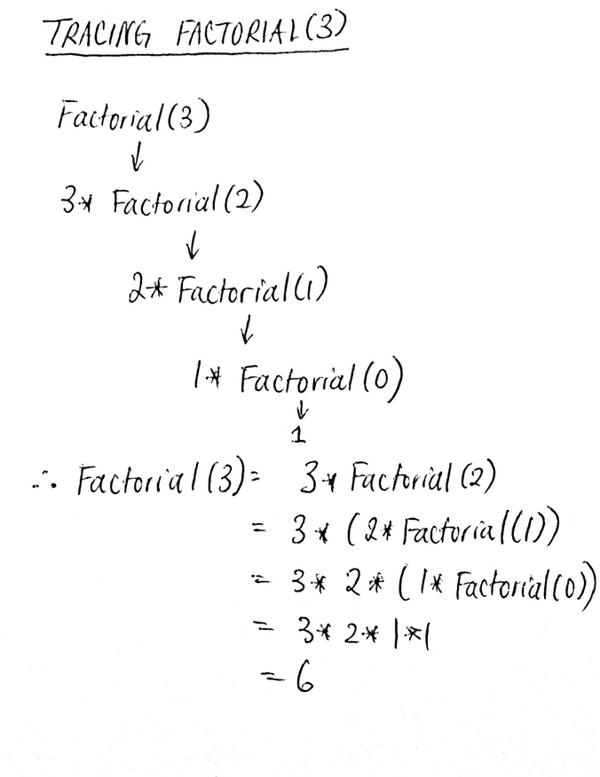
def factorial(n):
if n == 1:
return 1
else:
return n * factorial(n-1)

Slide 8
Fibonacci Recursive Approach (Binary)
def fibonacci(x):
if x == 0 or x ==1:
return 1
else:
return fibonacci(x-1) + fibonacci(x-2)
print fibonacci(10)
Recursion is slower than Iterative approach!

Slide 9
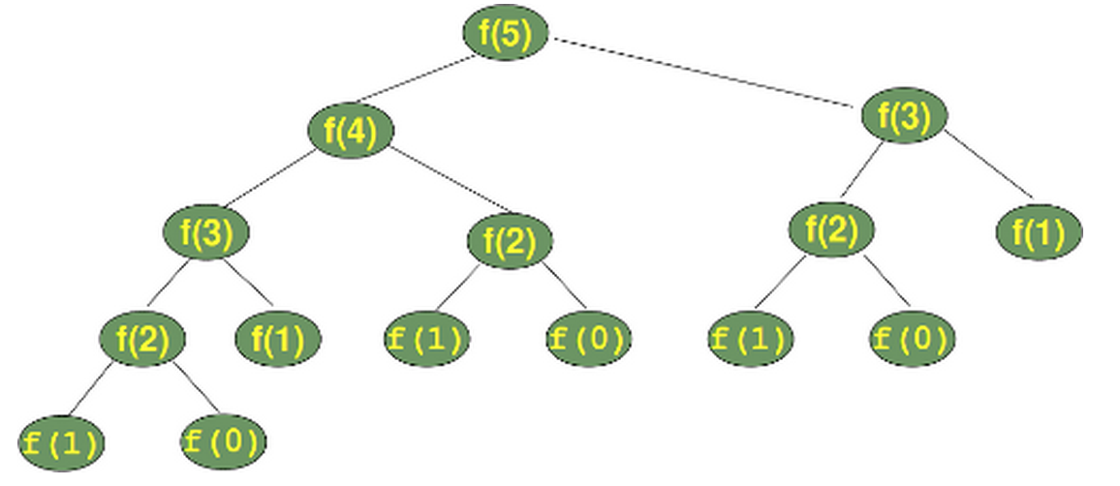

Slide 10
Greatest Common Denom (Tail)
def gcd(a, b):
if (0 == a % b):
return b
return gcd(b, a%b)
1) Returns the function itself (no additions or other operations)
2) Can be further optimized for memory management
3) In functional programming languages replaces loops

Slide 11
Odd or Even (Mutual)
def is_even(x):
if x == 0:
return True
else:
return is_odd(x - 1)
def is_odd(x):
if x == 0:
return False
else:
return is_even(x - 1)

Slide 12
How to Approach
Always start with thinking about base case (1)
Then start thinking about the repeated case (n) – what am I trying to repeat?
Then plan it out….

Slide 13
Tips for beginners
Draw diagrams (linear or tree)
Learn by example and pattern matching
Spot repeatable patterns that you can recurse into
You can use for/while loops to wrap recursion

Slide 14
By the way
Recursion is not always efficient
Recursion can be elegant and easy to read but harder to come up with solution
Python has a limit (~1000 recursive calls, which can be changed)

